Slide 1
OSINT .

Slide 2
Open Source INTelligence

Slide 3
PROBLEM STATEMENT :
CONNECTING ONLINE PRESENCE FOR OSINT AND INVESTIGATION
TECHNOLOGY STACK:
PYTHON 3.6
SELENIUM
BEAUTIFUL SOUP & REQUESTS
DLIB AND FACE_RECOGNITION
OPENCV
HTML, CSS & FLASK
TWITTER API
AZURE, WATSON API
BROWSER EXPLOITATION FRAMEWORK XSS
METASPLOIT

Slide 4
Goals...
PERSONAL DETAILS
CLOSE CONNECTIONS
TARGET PROFILING
UNCANNY RESOURCES

Slide 5
Personal Details
GENDER
DATE OF BIRTH
EMPLOYMENT STATUS
MARITAL STATUS
FAMILY DETAILS
EDUCATIONAL BACKGROUND
CLOSE FRIENDS
FACEBOOK

Slide 6
OUR APPROACH
FACEBOOK SEARCH ---> INPUT NAME
IMAGE SEARCH ---> LIST OF PEOPLE WITH SAME NAME ---> TARGET
OR
FACEBOOK SEARCH ---> EMAIL

Slide 7
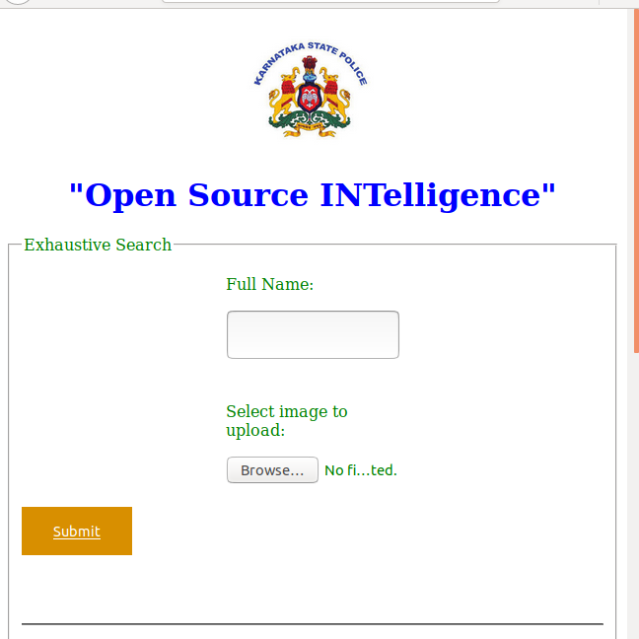
OUR APPROACH
FACEBOOK SEARCH ---> INPUT NAME
IMAGE SEARCH ---> LIST OF PEOPLE WITH SAME NAME ---> TARGET

Slide 8
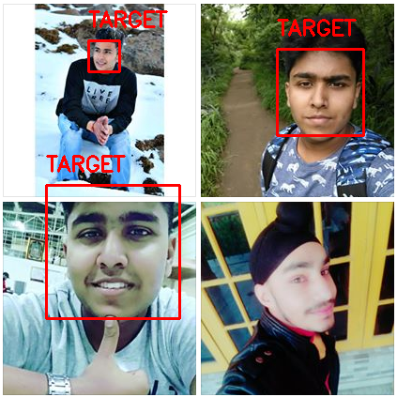
OUR APPROACH
FACEBOOK SEARCH ---> INPUT NAME
IMAGE SEARCH ---> LIST OF PEOPLE WITH SAME NAME ---> TARGET

Slide 9
Close Connections
TOP 10 RECURRING CONNECTIONS
Twitter
Instagram
Facebook

Slide 10
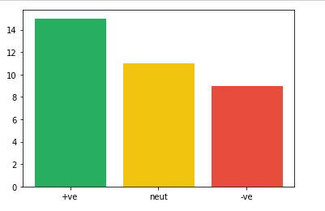
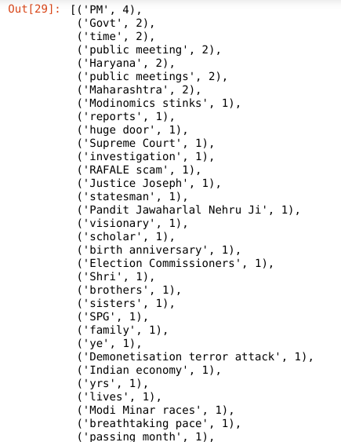
Target Profiling
TWEETS
NATURAL LANGUAGE PROCESSING
AZURE SENTIMENT ANALYSIS

Slide 11
Target Profiling Results
TWEETS
NATURAL LANGUAGE PROCESSING

Slide 12
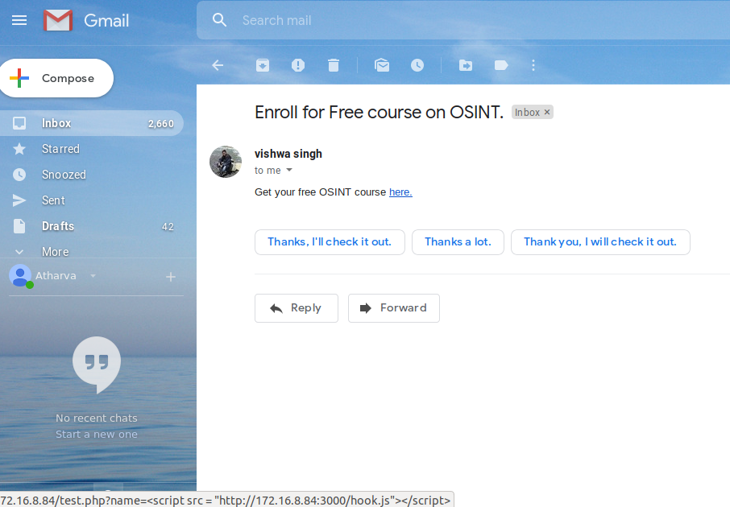
NS-OSINT
Social Engineering ---> Browser Hijacking

Slide 13
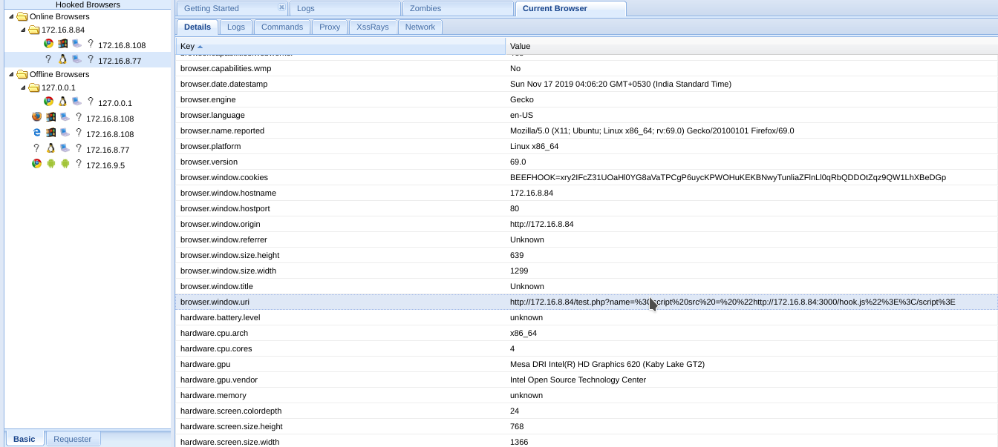
NS-OSINT
Social Engineering ---> Browser Hijacking

Slide 14
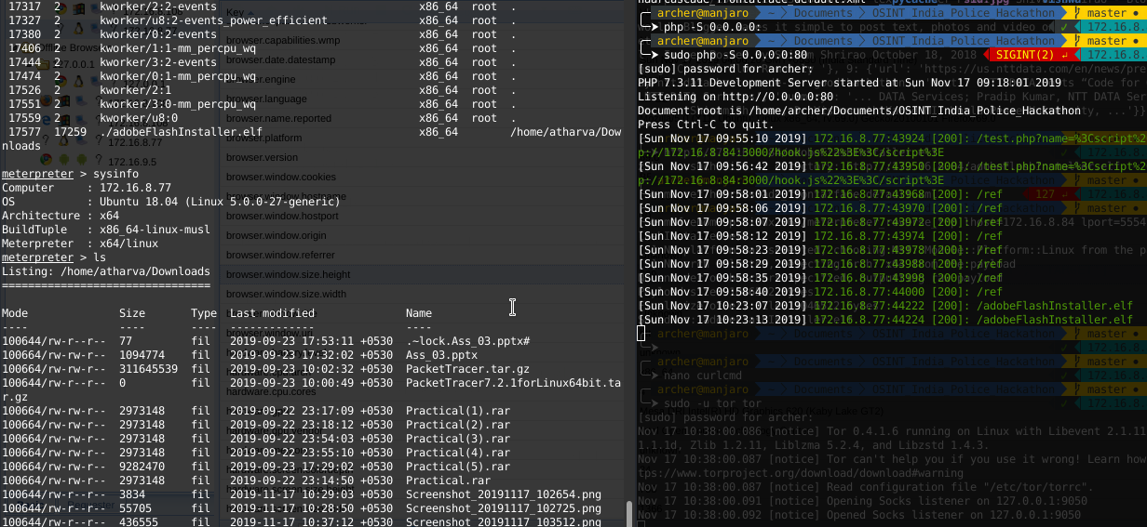
NS-OSINT
Social Engineering ---> Malware

