Slide 1
SGSim Install

Slide 2
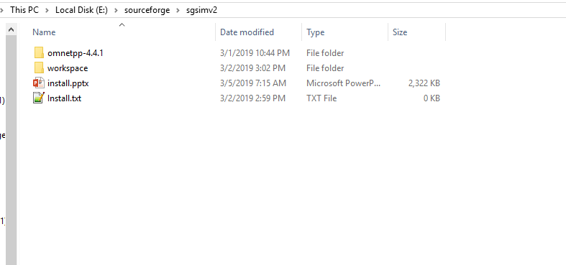
Extract the files

Slide 3
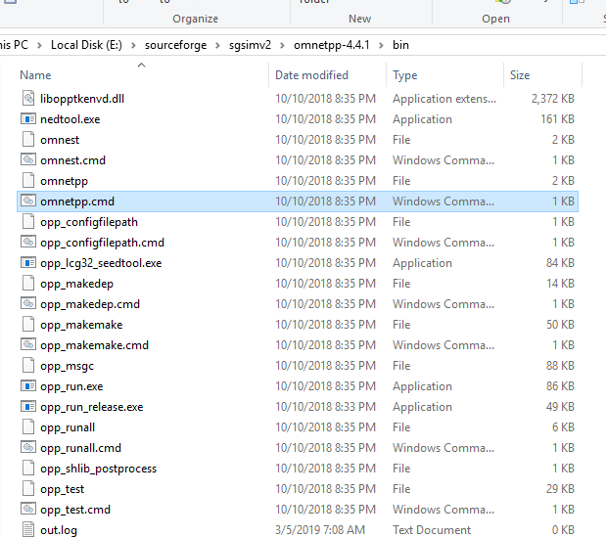
Run omnetpp
Run omnetpp.cmd
If it doesn’t work you have to recompile ometpp

Slide 4
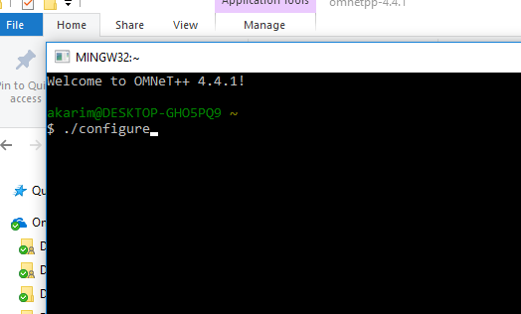
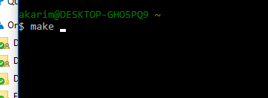
If you can’t run omnetpp
If it doesn’t work you have to recompile ometpp
Run mingwenv.cmd
.then run
./configure
And then
make

Slide 5
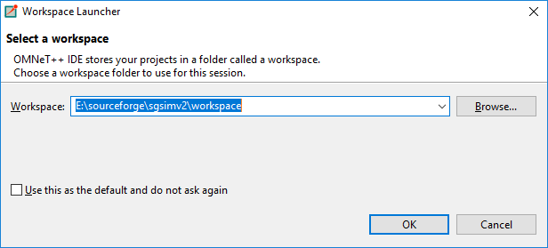
Run omnetpp and select the workspace folder where you have extracted the files

Slide 6
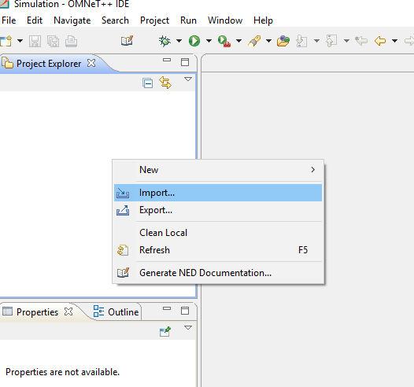
Import the projects

Slide 7
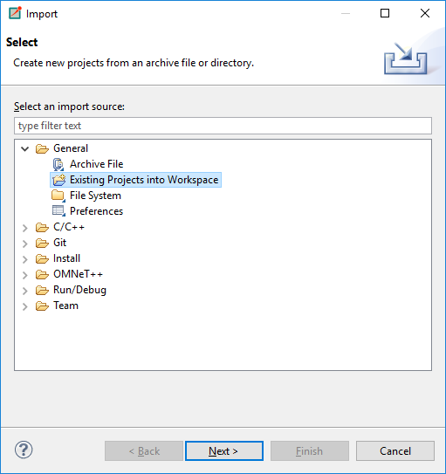
Select existing projects into workspace

Slide 8
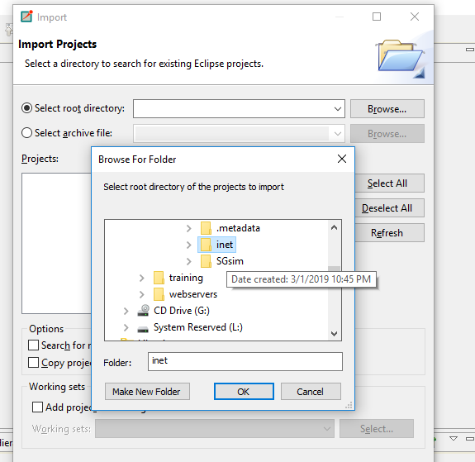
Select inet from the workspace
Go to browse and select the inet project

Slide 9
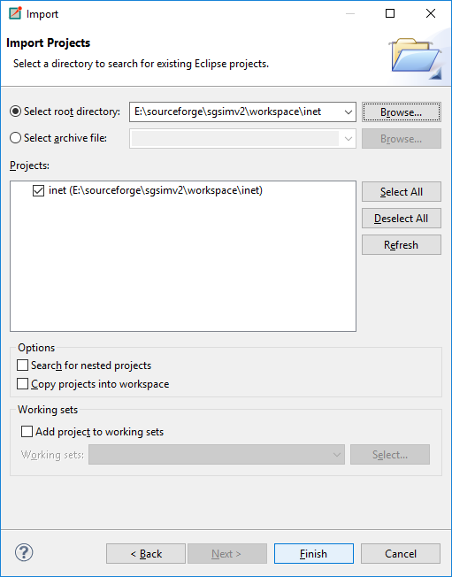

Slide 10
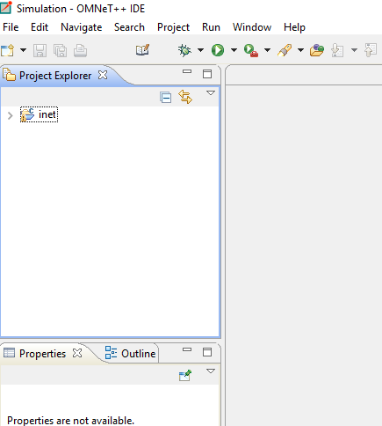
Click finish

Slide 11
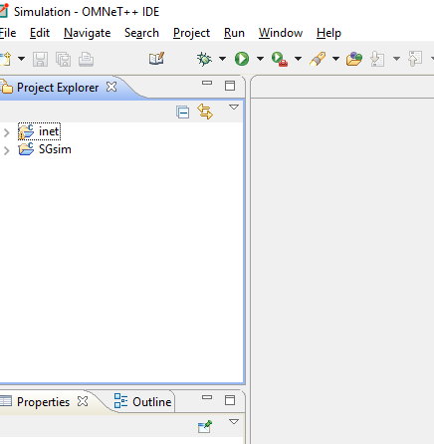
Similarly, import SGsim

Slide 12
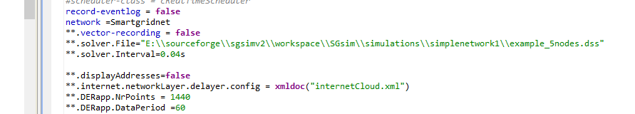
Important: Make sure the path of the dss file is correct
**.solver.File="E:\\sourceforge\\sgsimv2\\workspace\\SGsim\\simulations\\simplenetwork1\\example_5nodes.dss"

Slide 13
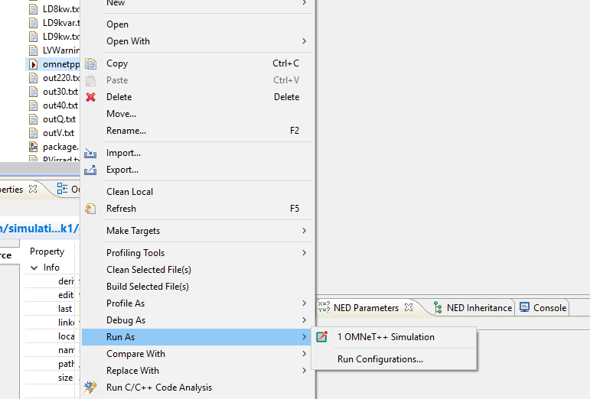
Run the sgsim
Select the omnetpp.ini file
Right click and then run as omnet++ simulation

Slide 14
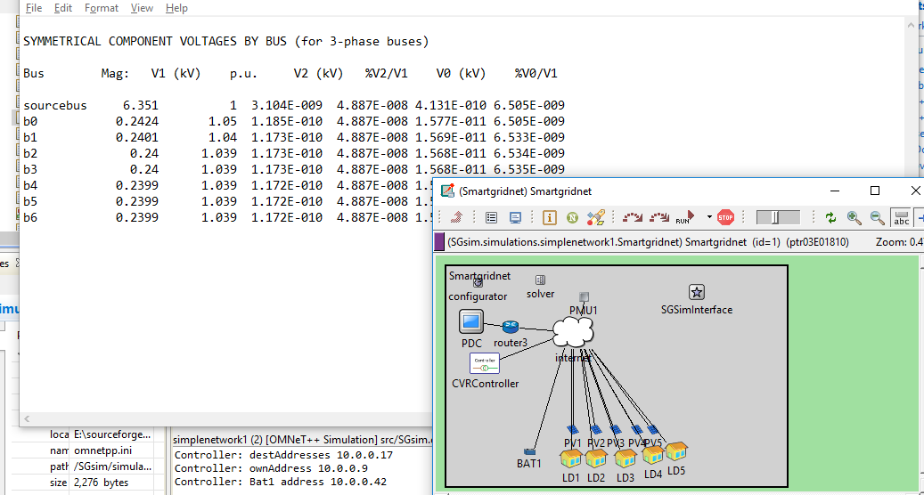
You should see something like

Slide 15
Important
If there is a problem in running the code you have to recomiple the code
First clean the projects
Then compile

Slide 16
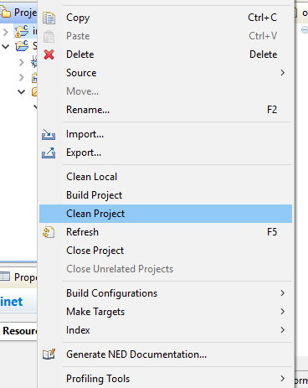
To clean the project
Select the inet
Right click
The select clean project
Select sgsim
Then select clean project

Slide 17
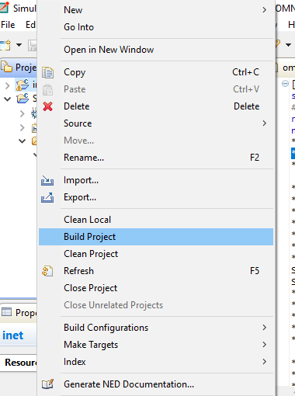
To build the projects
Select the inet
Right click
The select build project
Select sgsim
Then select build project

Slide 18
Then you can run it as before

