Slide 1



XCore: Support for Developing Program Analysis Tools
Alexandru Ștefănică
Petru-Florin Mihancea

Slide 2
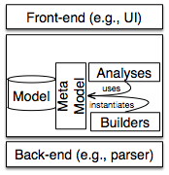
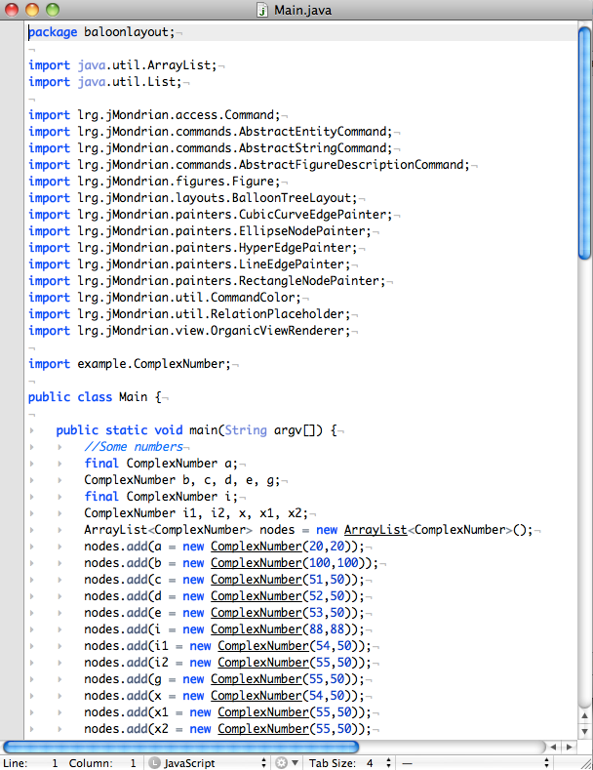
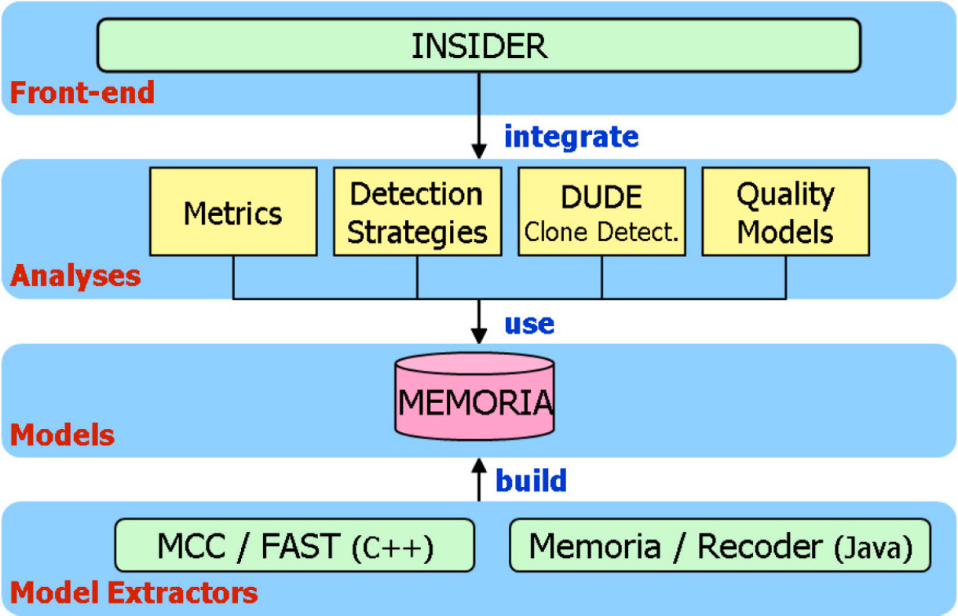
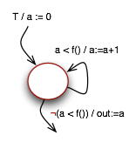




A generic tool architecture
Analysis tools
generic architecture
TEDi
iPlasma / Mcc
jModex
Randoop

Slide 3
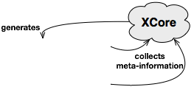

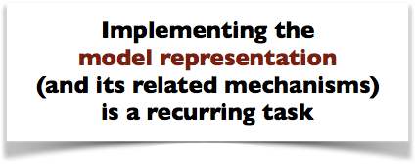
Why XCore?

Slide 4
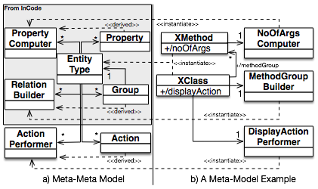















Describing the model
Based on Ganea et. al.
Continuous Quality Assessment with inCode, 2017

Slide 5


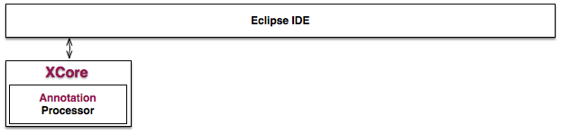

XCore - Eclipse plugin
The Eclipse Project of the Tool
/ **
* Documentation
*/
@PropertyComputer
class NoOfArgs implements IPropertyComputer<Integer,XMethod>
{
public Integer compute() {…}
}
//Generated by XCore
interface XMethod {
/**
* Documentation
*/
public Integer noOfArgs();
}
class XMethodImpl implements XMethod {
…
}
build
time
generates

Slide 6
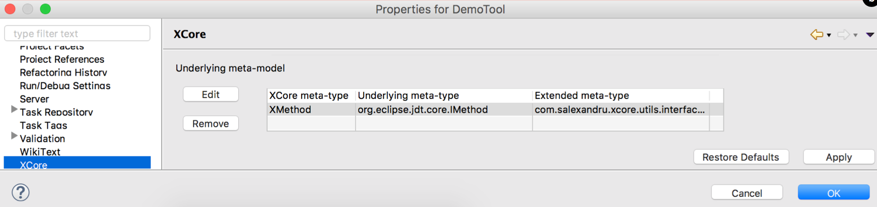



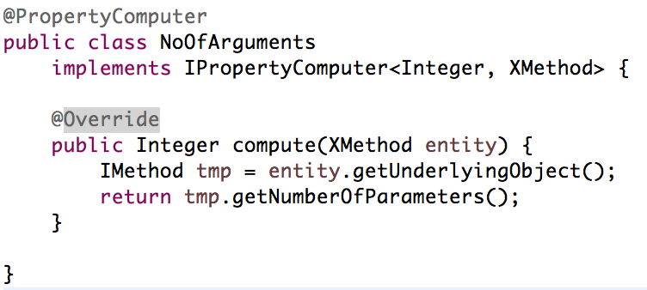
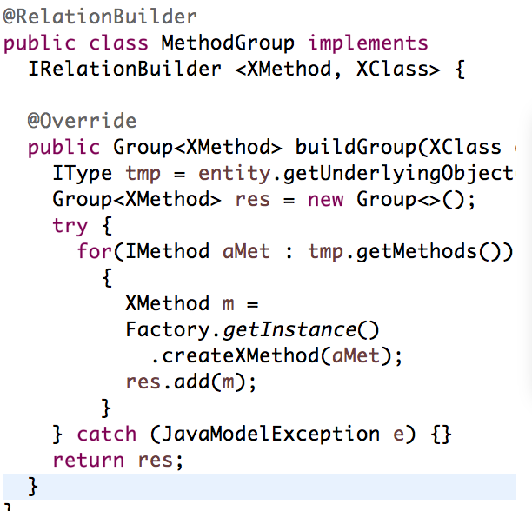

Additional features
reuse
available
set

Slide 7

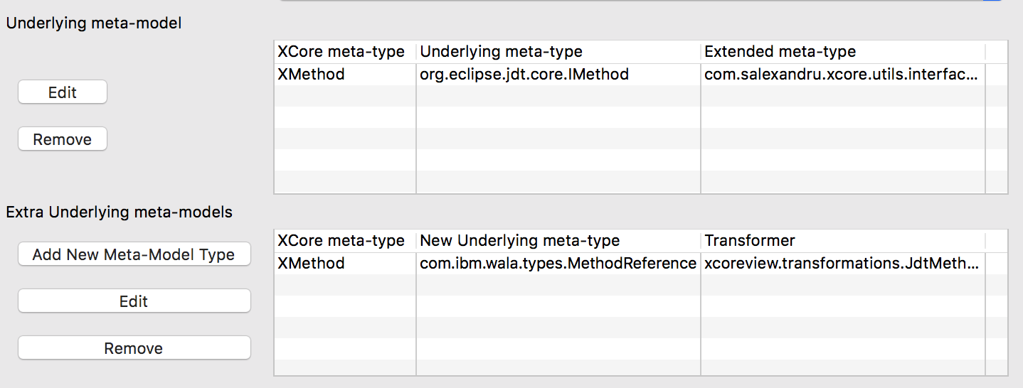



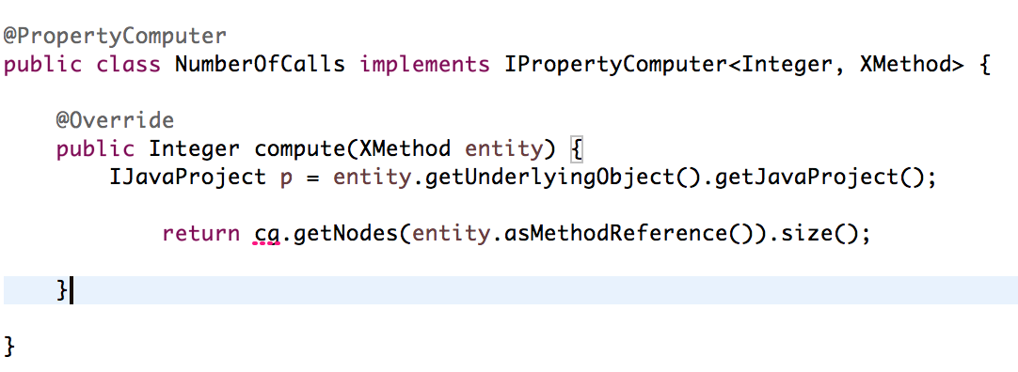


Additional features
original binding
Extra-binding

Slide 8
Pros & Cons
Generate the meta-model source code
Reuse an XCore-based tool
specialise the meta-model of another tool
Easy to extend
just add annotated classes
Problems with incremental compilation
all annotated classes are needed

Slide 9
Future Work
“Merge Tool Into …“ feature
combine two XCore-based tools
Associate to multiple back-ends
combine different tools

Slide 10

XCore: Support for Developing Program Analysis Tools
Alexandru Ștefănică
Petru-Florin Mihancea

