Slide 1
Overview
Hw1 - Q5
clear recent data
Initialization
plotting m(t)
Quantiziation for N = 8
plotting mq(t) for N = 8
Quantiziation for N = 16
plotting q(t)
SQNR

Slide 2
Hw1 - Q5

Slide 3
Teacher : Dr.Emadi Author: [SeyedAli] - [SeyedHosseini] E-mail: [alishosseini79@aut.ac.ir]
%Student-Number : [9723042]
% University: Amirkabir University of Technology

Slide 4
clear recent data

Slide 5
clc;
close all;
clear ;

Slide 6
Initialization

Slide 7
fs = 200 ; %sampling frequency
Ts = 1/fs ; %step resolution
t = 0 : Ts : 10 - Ts ; %time
A = 2 ; %Amp
fc = 10 ; %carrier frequency
m = A*sin(2*pi*fc.*t); %Original signal

Slide 8
plotting m(t)

Slide 9
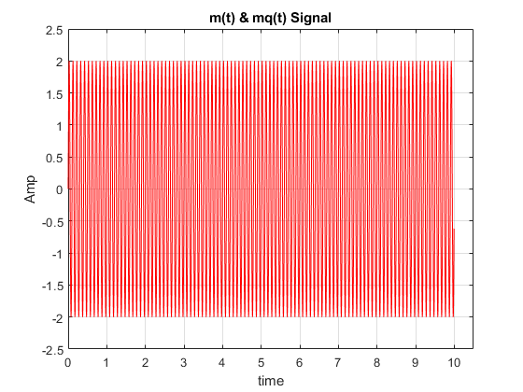
clc;
figure(1)
plot(t,m,'r')
hold on;
ylabel("Amp")
xlabel("time")
title("m(t) & mq(t) Signal")
grid on;
axis([0 10.5 -2.5 2.5])

Slide 10
Quantiziation for N = 8

Slide 11
clc;
N = [8 , 16]; %Quantize Levels
v = log2(N(1)) ;
%Quantize a signal to "v" bits.
maxsig = max(m); %signal max
interval = 2*maxsig/(N(1)-1); %interval length for 8 levels resolution
u = maxsig + interval; %Upper bound of codebook
partition = [-maxsig : interval : maxsig]; %Distinct endpoints of different ranges, specified as a row vector
codebook = [-maxsig : interval : u]; %Quantization value for each partition
[index , mq1] = quantiz(m,partition,codebook); % Quantized Signal

Slide 12
plotting mq(t) for N = 8

Slide 13
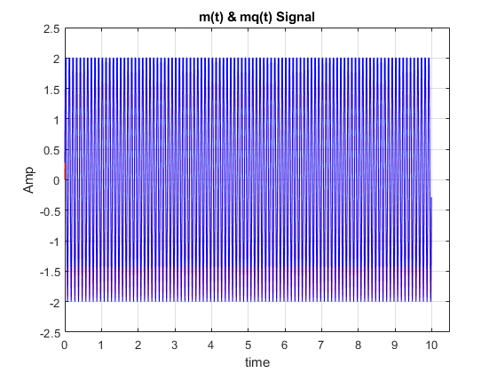
figure(1)
plot(t,mq1,'b')
grid on;
axis([0 10.5 -2.5 2.5])

Slide 14
Quantiziation for N = 16

Slide 15
clc;
N = [8 , 16]; %Quantize Levels
v2 = log2(N(2)) ;
%Quantize a signal to "v" bits.
maxsig = max(m); %signal max
interval = 2*maxsig/(N(2)-1); %interval length for 8 levels resolution
u = maxsig + interval; %Upper bound of codebook
partition = [-maxsig : interval : maxsig]; %Distinct endpoints of different ranges, specified as a row vector
codebook = [-maxsig : interval : u]; %Quantization value for each partition
[index , mq2] = quantiz(m,partition,codebook); % Quantized Signal

Slide 16
plotting q(t)

Slide 17
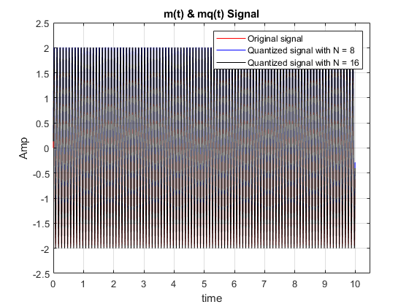
figure(1)
plot(t,mq2,'k')
legend('Original signal','Quantized signal with N = 8','Quantized signal with N = 16')
grid on;
axis([0 10.5 -2.5 2.5])

Slide 18
SQNR

Slide 19
clc;
L = numel(m) ; %length of signal
Pm = sum(m.^2)/L ; %average power
% display(Pm)
distor1 = m - mq1 ; %distortion vector 1
distor2 = m - mq2 ; %distortion vector 2
Pq1 = sum(distor1.^2)/L ; %average power of Distortion 1
Pq2 = sum(distor2.^2)/L ; %average power of Distortion 1
Sqnr1 = Pm / Pq1 ; %SQNR of First Quantiztation
Sqnr2 = Pm / Pq2 ; %SQNR of Second Quantiztation
Sqnr1 = pow2db(Sqnr1) ;
Sqnr2 = pow2db(Sqnr2) ;
fprintf("SQNR of first Quantization is %f db and Second Time is %f db.",Sqnr1,Sqnr2)
fprintf("\n So More levels,Better SQNR")
SQNR of first Quantization is 13.818131 db and Second Time is 19.973333 db.
So More levels,Better SQNR

