Slide 1
Project number 1 Scott Anderwald

Slide 2
Introduction
Three stocks were picked to determine the viability of investment.
The stocks are petroleum industry specific.
They include:
Exxon (XOM)
Anadarko (APC)
WPX Energy (WPX)
why these stocks?

Slide 3
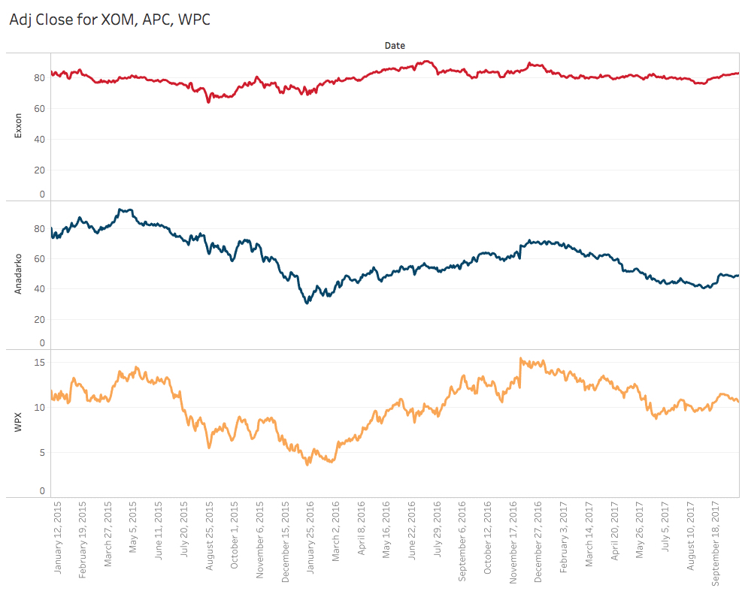
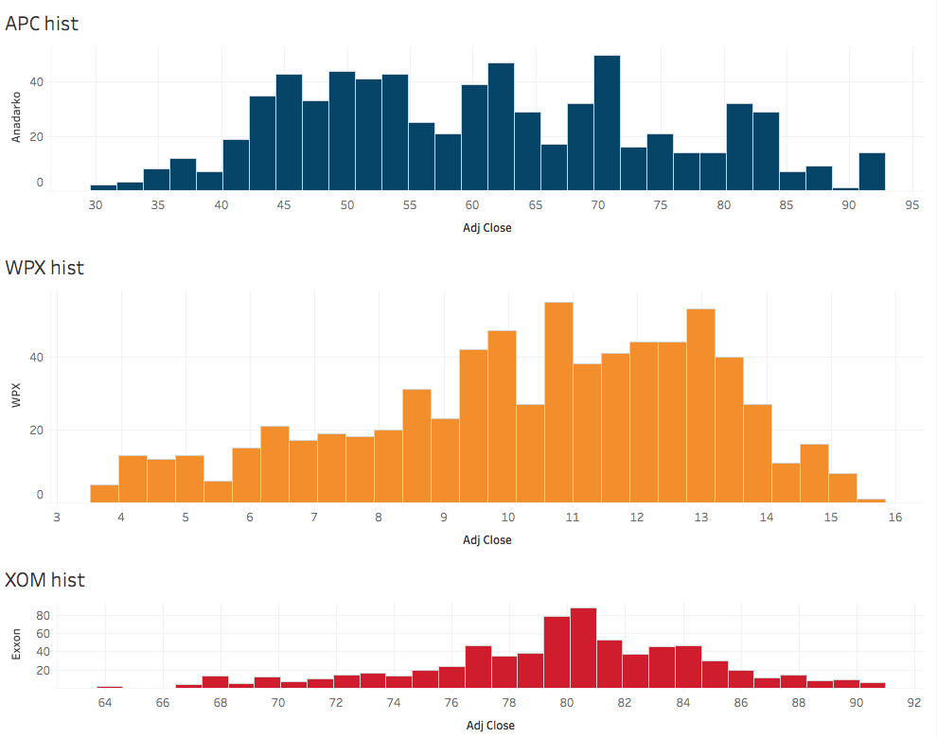
Exploratory data analysis
Data was obtained from yahoo finance either with a direct download or url request.

Slide 4
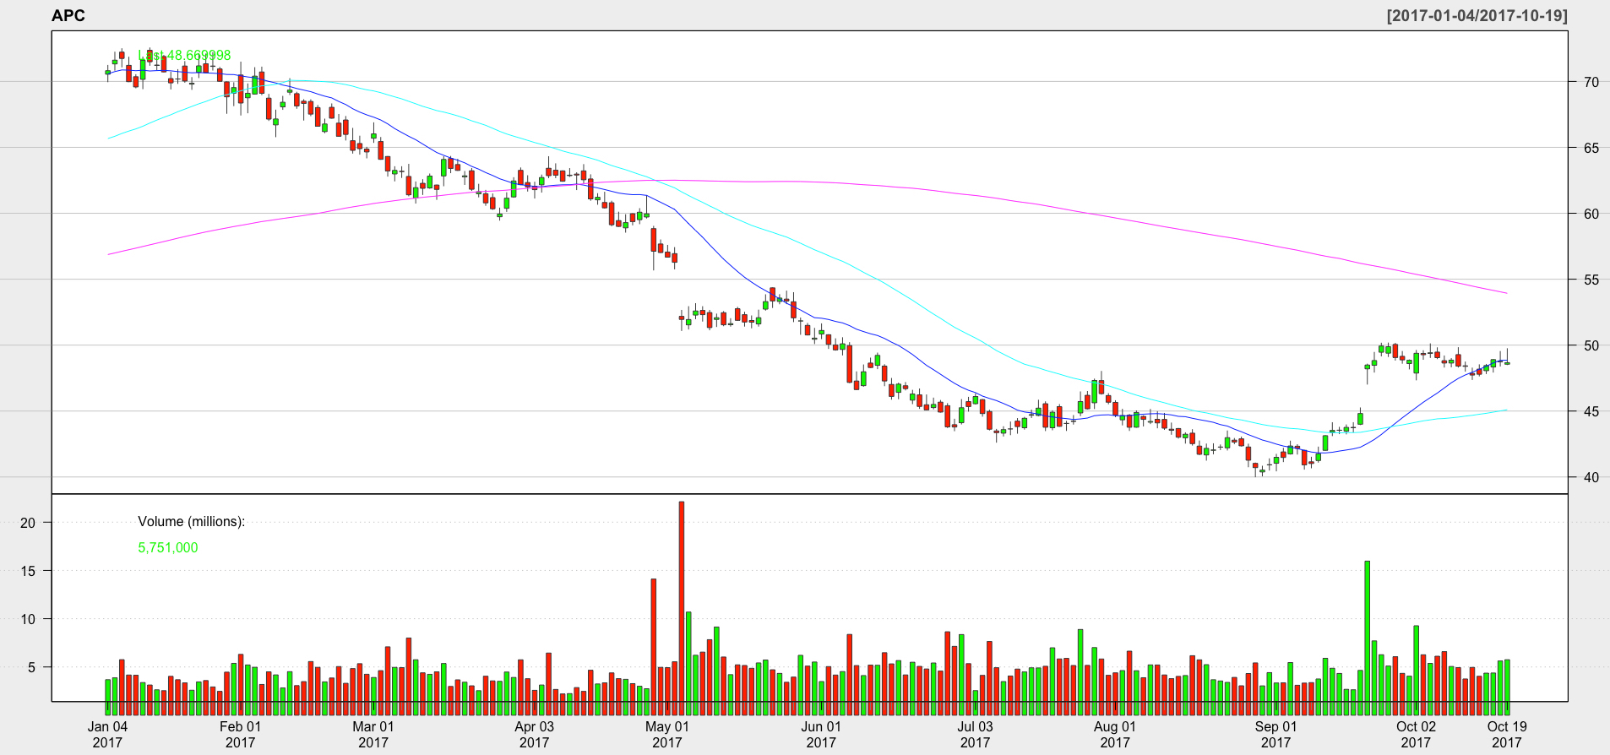
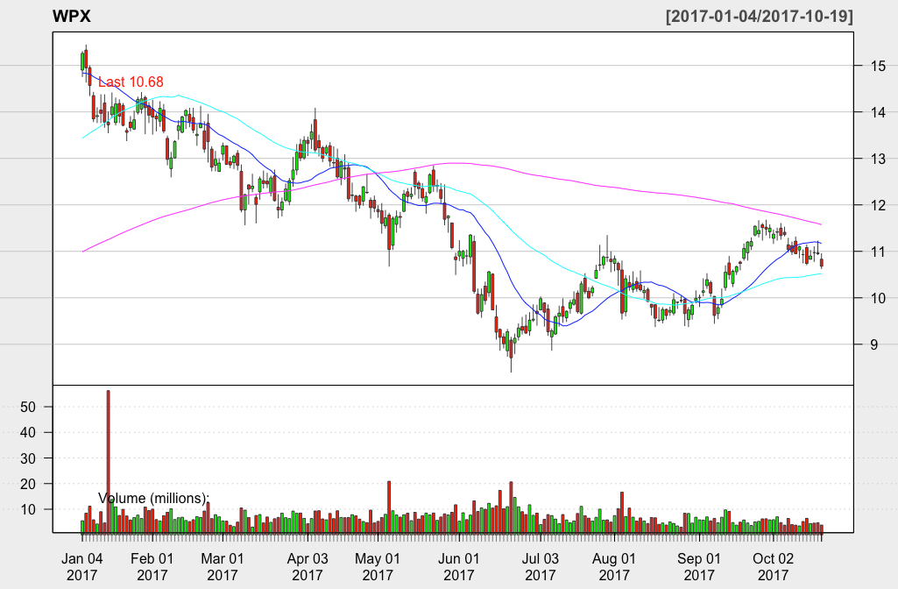
Analysis with the quantmod package
Both seem to be in a possible downtrend

Slide 5
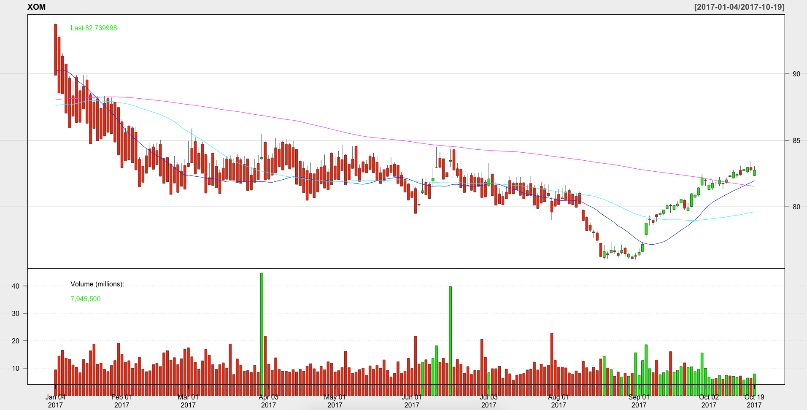
Cont. of quantmod analysis
Exxon unlike APC and WPX might be in a uptrend

Slide 6
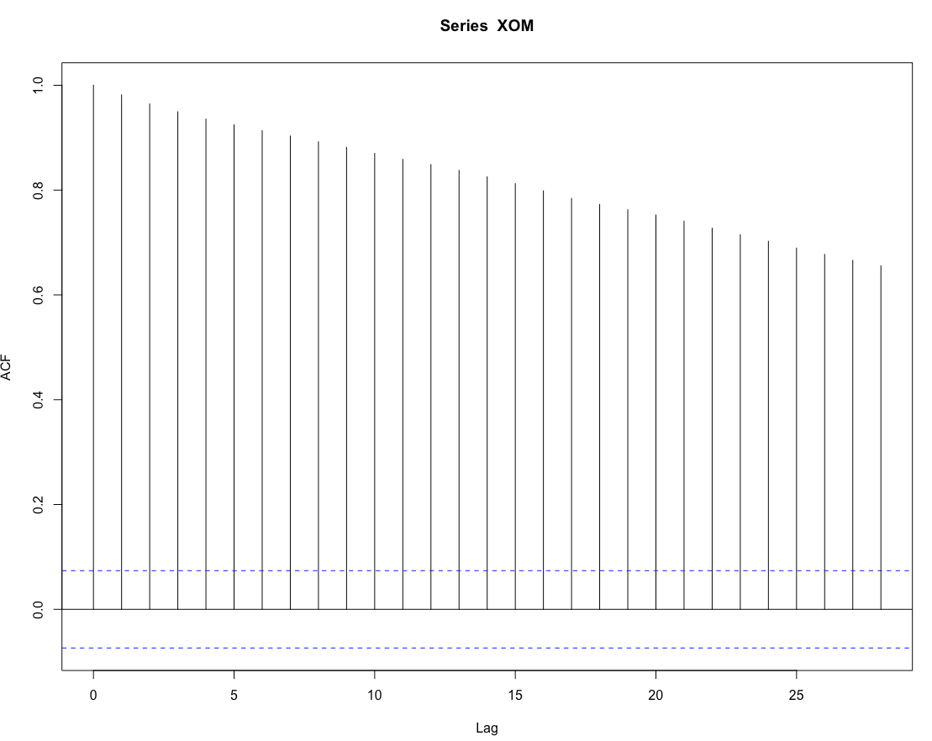
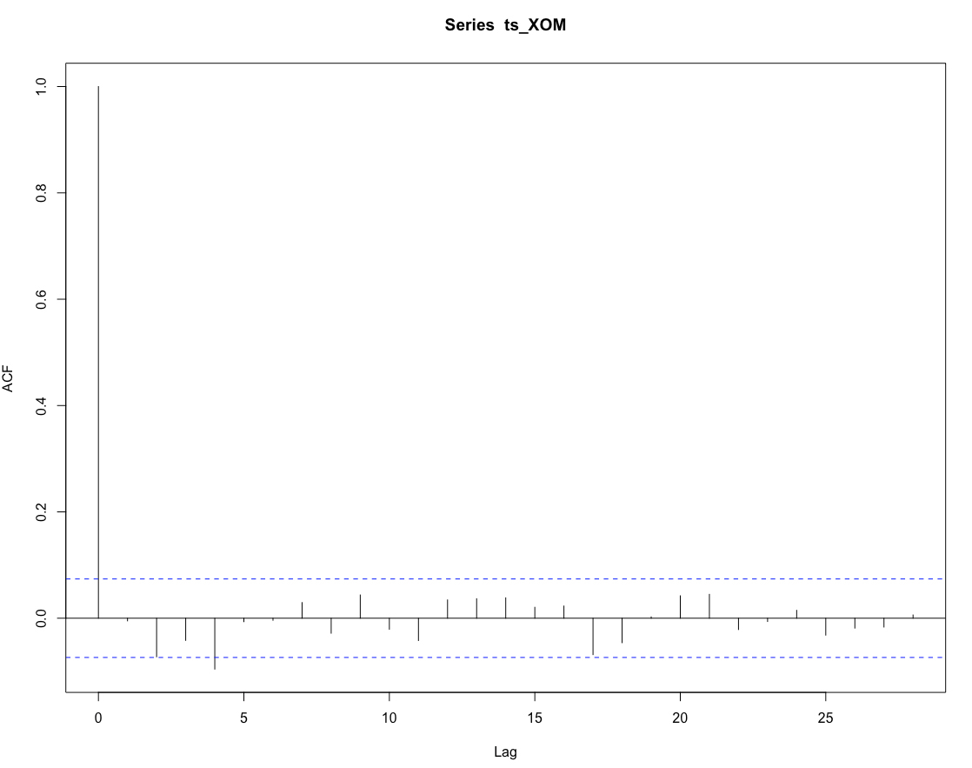
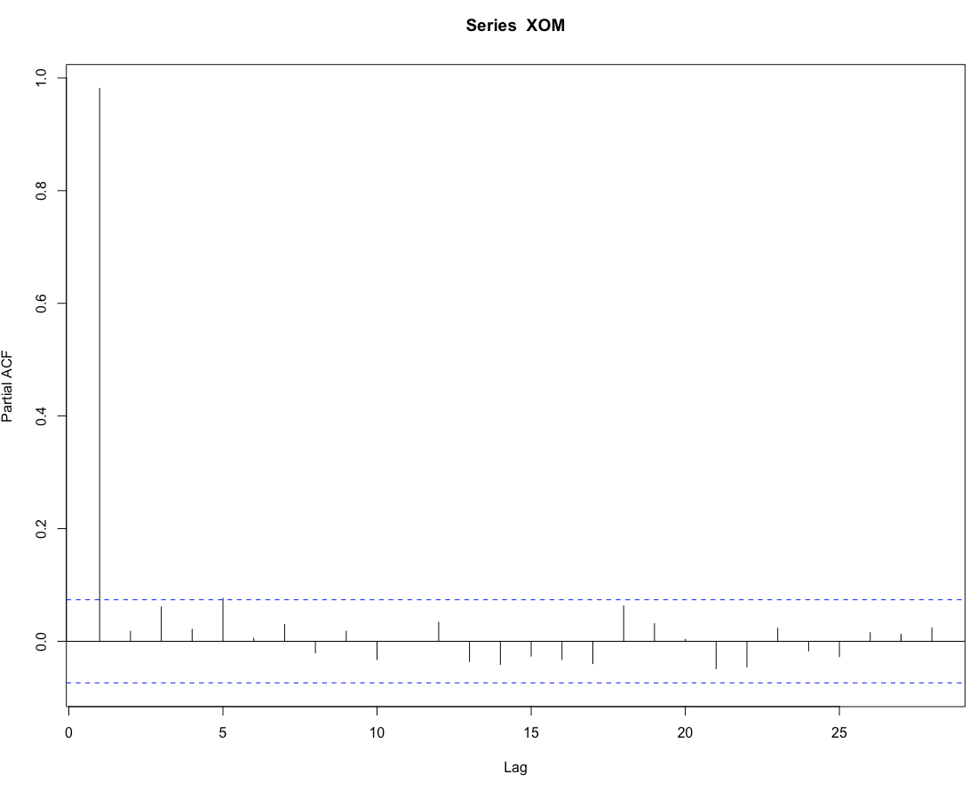
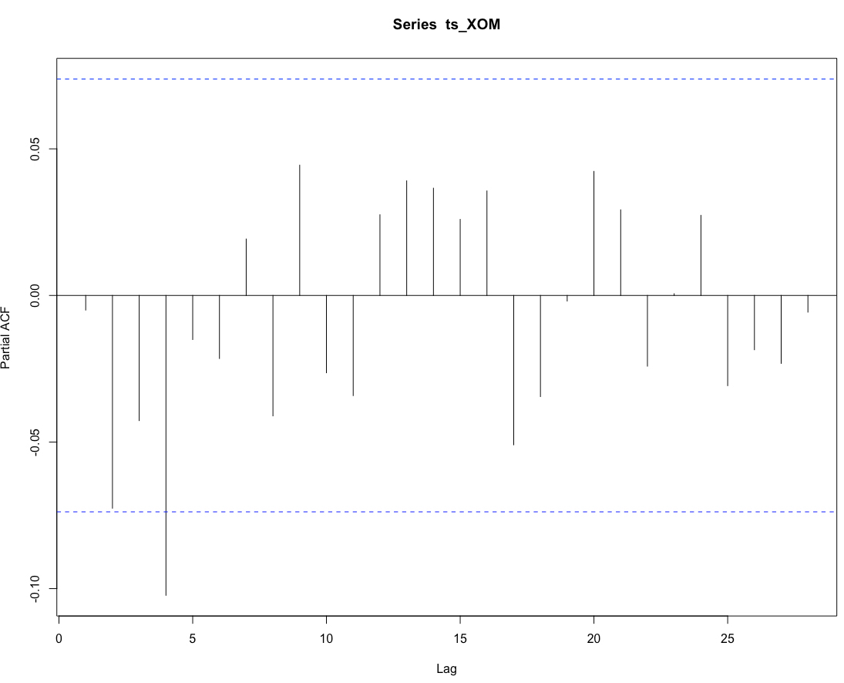
Prior to differencing
Post differencing

Slide 7
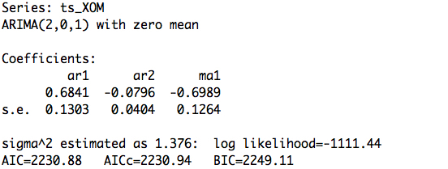
Arima analysis
For this portion I selected Exxon.
Seem to be in a uptrend
Ran auto.arima

Slide 8
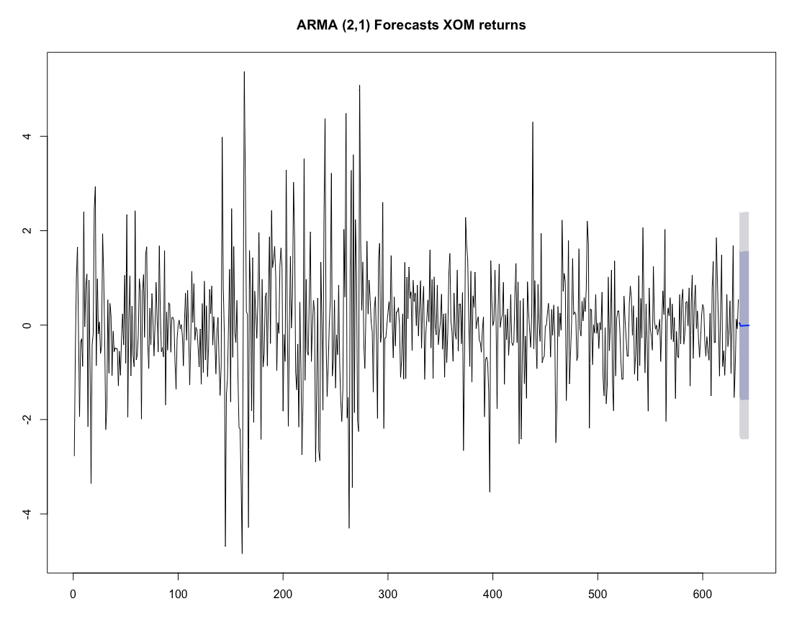
Arima forecast
Split the data into a 90/10
Had RMSE of 0.56
Tried the 80/20 and the rmse was lower

Slide 9
Conclusion
The moving average of 20 and 50 for the exxon stock appears to be in a uptrend with the 200 day trend on the downside
Looking at the arima forecast it appears to be flat with a rmse of 0.56

Slide 10
Thanks

