Slide 1
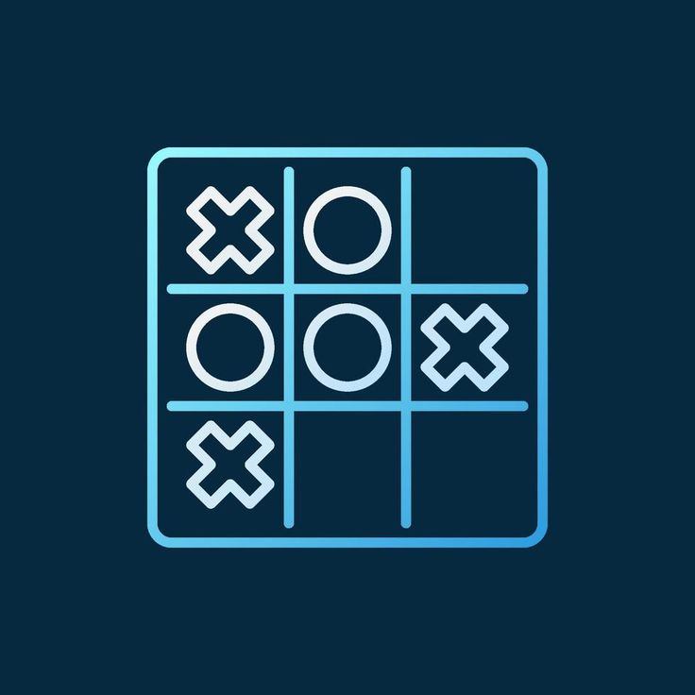
Using Java Programming Language |  | And Swing GUI
 | Tic Tac Toe Game
Satpute Arshita |  | September 30, 2023

Slide 2

Agenda
Introduction
Working
Uses
Advantages & Disadvantages
Future Scope
Conclusion

Slide 3

Introduction
Tic Tac Toe is a classic game that involves two players taking turns marking spaces on a 3x3 grid. The goal is to have three of their symbols in a row horizontally, vertically, or diagonally.
This project aims to implement a Tic Tac Toe game in Java using the Swing framework for a graphical user interface (GUI). The GUI enhances the user experience, making it visually appealing and interactive.

Slide 4

WORKING
Architecture
The game is built using Java programming language with a Swing-based GUI.
The main components include:
Game Board: Represented by a 3x3 grid.
Players: Two players take turns to place their symbol (X or O).
Logic: Checks for winning conditions, and ties, and updates the board accordingly.
GUI: Utilizes Swing components like JFrame, JPanel, and JButton for the graphical interface.

Slide 5

User-Interaction
WORKING
Players take turns clicking on an empty cell to place their symbol.
The game checks for a winner or a tie after each move.
A dialogue box announces the result, and the game can be reset for another round.

Slide 6

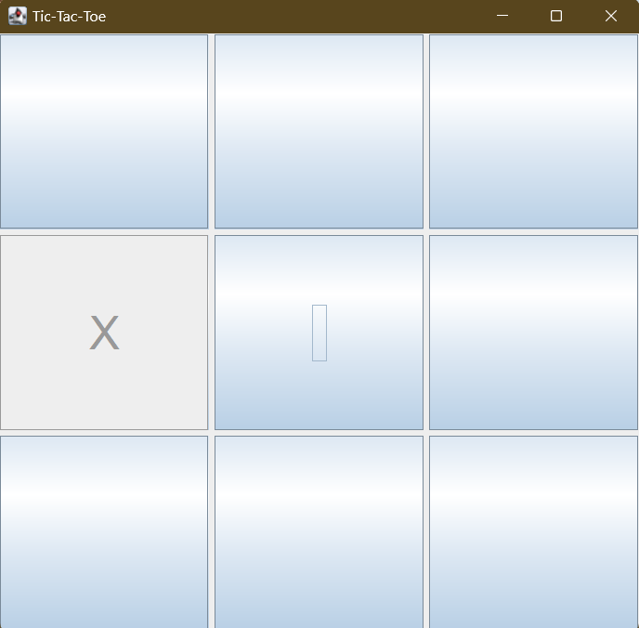
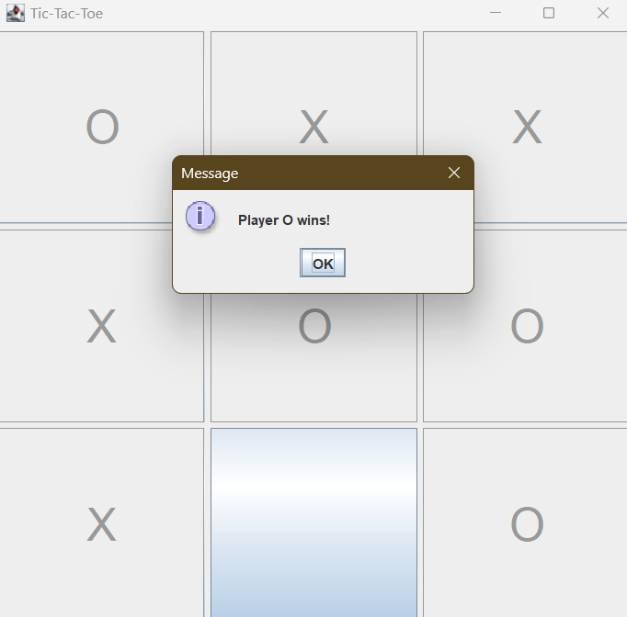
Real-Time Images

Slide 7


Uses
Educational Purpose:
Learn Java programming.
Understand GUI development using Swing.
Grasp the concept of game logic and user interaction.
Entertainment:
Provides a simple and fun gaming experience.
Suitable for quick breaks or leisure time.

Slide 8
Advantages | Easy to Learn: Simple rules make it accessible for all age groups. Quick Gameplay: Short rounds suitable for breaks or casual play. Educational Value: A practical project for learning Java and GUI development.
Disadvantages | Limited Complexity: Tic Tac Toe is a solved game, meaning that with perfect play, it always ends in a tie. Single Player Mode: The current implementation is designed for two human players.

Slide 9

Future Scope
Multiplayer Support: Extend the game to support online multiplayer, allowing users to play against each other remotely.
AI Implementation: Integrate an AI opponent using algorithms like Minimax to provide a challenge for players.
Additional Features: Include customizable themes and symbols. Implement a scoreboard to track player statistics.
Enhanced UI/UX: Improve the graphical elements and user interface for a more polished look. Add features like animations and sound effects to enhance the gaming experience.

Slide 10
Conclusion
The Tic Tac Toe project in Java with Swing offers an excellent opportunity to learn and practice Java programming and GUI development.
It provides a foundation for more complex game development projects and can be expanded with additional features and enhancements.
The project strikes a balance between simplicity and educational value, making it a valuable resource for both beginners and intermediate developers.

Slide 11
THANK
YOU
Satpute Arshita
satputearshita@gmail.com

