Slide 1







Survey Results for Current Technology Usage and Future Trend
Sherae Ashwood
12/27/2021

Slide 2



OUTLINE
Executive Summary
Introduction
Methodology
Results
Visualization – Charts
Dashboard
Discussion
Findings & Implications
Conclusion
Appendix

Slide 3

EXECUTIVE SUMMARY
Top Current Languages include Java, HTML, SQL, Bash/Shell/Power Shell, as opposed to Top Future Languages include Java, HTML, Python, SQL
Top Current Databases include MySQL, Microsoft SQL Server, PostgreSQL as opposed to Top Future Databases which include PostgreSQL, MongoDB, Redis, MySQL
Top Current Platforms include Linux, Windows, AWS, Docker as opposed to Top Future Platforms include Linux, Docker, AWS, Windows
Top Current WebFrames include jQuery, Angular, ASP.NET versus Top Future WebFrames include React.js, Vue.js, Angular
Respondents by:
Gender – approx. 94% men, 6% women
Top Countries – USA 38M, Canada 5M, Australia 3M
Age – Most respondents were 24 – 30 years old
Education Level – Men & Women Bachelors 71M, Men & Women Masters 33M

Slide 4

INTRODUCTION
The following report is about the current and next year’s technology trend in regards to the most popular Programming Languages, Database, WebFrame, and Platforms. The survey was taken by persons from several countries so that we were able to get unbiased results. I believe this report may be used by anyone who is interested in technology trends, and would like to know how to make themselves more competitive in the workplace.

Slide 5

METHODOLOGY
A survey was taken of the current and future trends regarding technology. The survey’s respondents included persons of all gender, educational level, from different countries, that were of working age.

Slide 6
RESULTS
The data was organized according to the current trends, such as, what are the most popular Programming Languages, DataBases, WebFrames, and Platforms that are used. Then the results of the survey is also grouped by what technology trends people would like to learn about for the following year. Finally, the data is illustrated to show the demographics of how the information was obtained to show that it was unbiased.

Slide 7
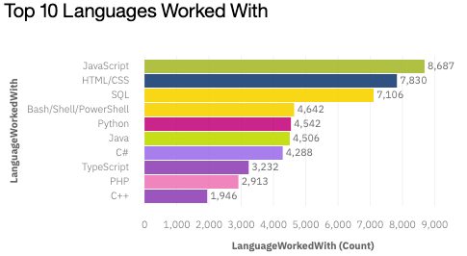
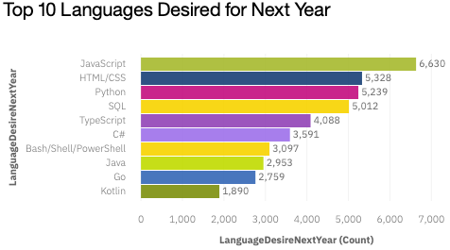
PROGRAMMING LANGUAGE TRENDS
Current Year
Next Year

Slide 8
PROGRAMMING LANGUAGE TRENDS - FINDINGS & IMPLICATIONS
Findings
The top 5 languages currently are:
JavaScript
HTML
SQL
Bash/Shell/PowerShell
Python
Implications
More persons should be inclined to learn the following languages for next year:
JavaScript
HTML/CSS
Python
SQL
TypeScript

Slide 9
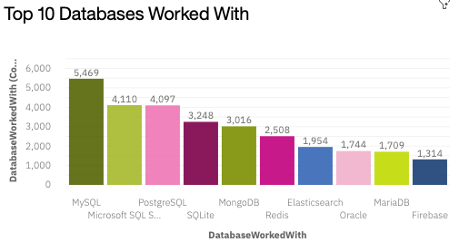
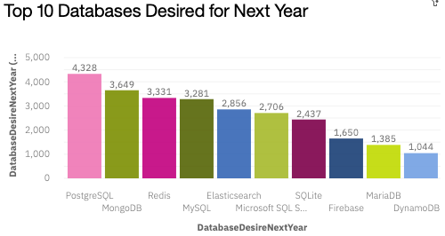
DATABASE TRENDS
Current Year
Next Year

Slide 10
DATABASE TRENDS - FINDINGS & IMPLICATIONS
Findings
The top 5 Databases currently are:
MySQL
Microsoft SQL Server
PostgreSQL
SQLite
MongoDB
Implications
More persons are interested in the following Databases for next year:
PostgreSQL
MongoDB
Redis
MySQL
Elasticsearch

Slide 11

DASHBOARD
Click here for Dashboard with Survey Results

Slide 12
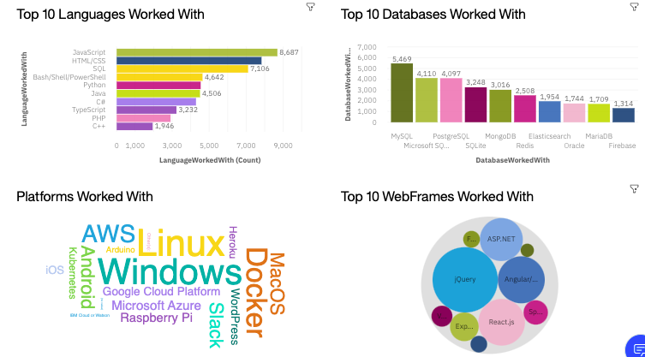
DASHBOARD TAB 1 – Current Tech Usage

Slide 13
DASHBOARD TAB 2 – Next Year Tech Trend

Slide 14
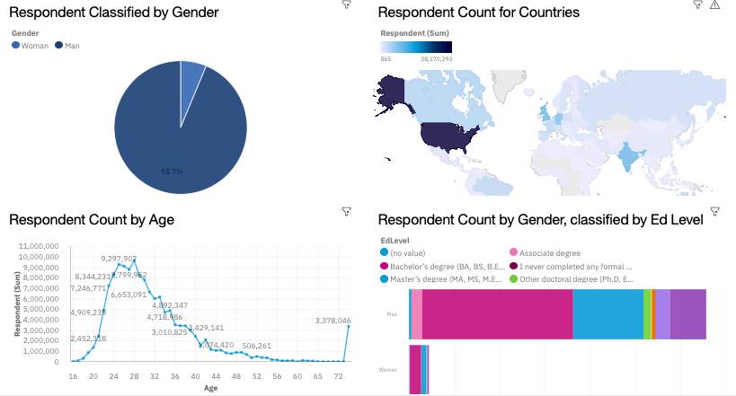
DASHBOARD TAB 3 - Demographics

Slide 15
DISCUSSION
To be more competitive, persons would need to learn JavaScript, HTML, SQL and Python since it is among the top 5 current/desired languages.
Also, persons should be familiar with MySQL, PostgreSQL, and MongoDB databases to be more competitive in the workplace.

Slide 16
OVERALL FINDINGS & IMPLICATIONS
Findings
JavaScript is the most popular language and MySQL is among the most popular databases.
Implications
JavaScript is the most popular language for the following year, but SQL would be very helpful as most of the databases are based on SQL.

Slide 17

CONCLUSION
It would be beneficial for more persons to learn JavaScript, HTML, SQL and Python for the following year as they were among the most popular languages. They should also familiarize themselves with MySQL, MongoDB, and PostgreSQL databases.

Slide 18

APPENDIX
No additional graphs/charts.

Slide 19
GITHUB JOB POSTINGS
In Module 1 you have collected the job postings data using GitHub API in a file named “github-job-postings.xlsx”. Present that data using a bar chart here. Order the bar chart in the descending order of number of job postings.

Slide 20
POPULAR LANGUAGES
In Module 1 you have collected the job postings data using web scraping in a file named “popular-languages.csv”. Present that data using a bar chart here. Order the bar chart in the descending order of salary.

