Slide 1

PMP Preparation Training
Scope Management
Chapter 5

Slide 2
Scope Management
Initiation
Planning
Executing
Controlling
5.2
Scope
Planning
5.4
Scope
Verification
5.5
Scope
Change
Control
5.1
Initiation
5.3
Scope
Definition

Slide 3
Scope Management
Processes used to identify all the work
required to successfully complete the project
Initiation
Scope Planning
Scope Definition
Scope Verification
Scope Change Control

Slide 4
Scope
Product scope – The features and functions that are to be included in a product or service
Project scope – The work that must be done in order to deliver a product with the specified features and functions
Successful completion of product scope is measured against the requirements; project scope is measured against the plan

Slide 5
Initiation
Scope Initiation
Formal authorization that the project exists
Recognition the project should continue into the next phase

Slide 6
Initiation
Scope Initiation
Tools
Project selection methods
Expert judgement
Outputs
Project charter
PM assigned
Constraints
Assumptions
Inputs
Product description
Strategic plan
Selection criteria
Historical information

Slide 7
Inputs
Scope Initiation
Product description – Documents characteristics of the product or service and its relationship to a business need
Strategic plan – Describes the organization’s mission, vision, and goals for the future, which the project supports
Project selection criteria – Defined in terms of the product and covers the full range of management concerns
Historical information – Results of previous project decisions and performance

Slide 8
Tools & Techniques
Scope Initiation
Project selection methods (Decision models)
  Benefit-measurement methods – Comparative approaches; scoring models; benefit-contribution and economic models
  Constrained optimization methods – Mathematical models using linear, dynamic, integer, and multi-objective programming algorithms
Expert judgment – Experts with specialized knowledge or training assess the inputs to this process

Slide 9
Outputs
Scope Initiation
Project charter
Project manager selected
Constraints – Factors that limit the project management team’s options regarding scope, staffing, and schedule
Assumptions – Factors that, for planning purposes, will be considered to be true, real, or certain

Slide 10
Project Charter
Scope Initiation
Formally recognizes the existence of a project
Refers to the business need the project is addressing
Describes the product to be delivered
Gives the project manager the authority to apply resources to the project

Slide 11
Scope Planning
A written statement that includes:
  Project justification, the major deliverables, and the project objectives
  Criteria used to determine if the project or phase has been successfully completed

Slide 12
Scope Planning
Tools
Product analysis
Benefit/cost analysis
Alternatives identification
Expert judgment
Outputs
Scope statement
Supporting detail
Scope management plan
Inputs
Product description
Project charter
Constraints
Assumptions

Slide 13
Inputs
Scope Planning
Product description – Contains the characteristics of the product or service in which the project will result
Project charter – Formally recognizes the existence of a project
Constraints – Factors that limit the project management team’s options regarding scope, staffing, and schedule
Assumptions – Factors that, for planning purposes, will be considered to be true, real, or certain

Slide 14
Tools & Techniques
Scope Planning
Product analysis – Techniques to develop a better understanding of the product (e.g., systems engineering, value engineering, function analysis, quality function deployment)
Benefit/cost analysis – Estimating the tangible and intangible costs (or outlays) and the benefits (or returns) of various project alternatives
Alternative identification – Techniques used to generate different approaches to the project (e.g., brainstorming and lateral thinking)
Expert judgment

Slide 15
Outputs
Scope Planning
Scope statement – Written statement of project. It contains:
  Project objectives
  Project justification
  Project deliverables
Supporting detail – Supporting documentation containing identified requirements, plans, assumptions, and constraints
Notes:
A scope management plan includes:
How changes will be integrated into the project
An assessment of the stability of the project scope
A clear description of how scope changes will be identified and classified

Slide 16
Scope Management Plan
Scope Planning
Guidelines for how scope is to be managed and how scope changes are to be integrated into the project
It includes:
  An assessment of the stability of the project scope
  A clear description of how scope changes will be identified and classified

Slide 17
Scope Definition
Subdividing major project deliverables into manageable components, in order to improve the accuracy of cost, time, and resources estimates
Provides a baseline and assigns responsibility
A scope baseline is the original plan, plus or minus approved changes
Notes:
Scope definition is necessary to:
Improve the accuracy of cost, time, and resource estimates
Define a baseline for progress measurement and control
Facilitate clear responsibility assignments
Poor scope definition can result in:
Higher project costs
Rework
Low workforce morale and productivity
Schedule delays

Slide 18
Scope Definition
Scope Definition
Tools
WBS templates
Decomposition
Inputs
Scope statement
Constraints
Assumptions
Other planning inputs
Historical information
Outputs
Work breakdown
structure

Slide 19
Inputs
Scope Definition
Scope statement
Constraints
Assumptions
Other planning outputs – Outputs of the processes in other knowledge areas should be reviewed for possible impact on project scope definition
Historical information – About previous projects

Slide 20
Tools & Techniques
Scope Definition
WBS templates – Use a WBS from a previous project or a standard template to develop a WBS for this project
Decomposition – Subdividing major project deliverables into smaller, more manageable components until deliverables are defined in sufficient detail for supporting future project activities
  Identify major elements of the project
  For each element, decide if adequate cost and duration estimates can be developed at this level of detail
  Identify constituent elements (e.g., tangible, verifiable results)
  Verify the correctness of the decomposition – is it necessary and is it sufficient for completion of the item decomposed

Slide 21





WBS Definition
Scope Definition
Deliverable oriented grouping of project elements that organizes and defines the total scope of the project
  Hardware
  Services
  Data

Slide 22
WBS
Scope Definition
Code of accounts – Uniquely identifies each element of the WBS
Work packages – A deliverable at the lowest level of the WBS
WBS dictionary – Includes work-package descriptions

Slide 23
Typical WBS
Scope Definition
Information
System
1.
Project
Systems
Hardware
Software
Facilities
Training
Management
Engineering
Acquisition
Development
Modifications
Development
1.1
1.2
1.3
1.4
1.5
1.6
Project
Product
CPU
Operating
Facility
Training
Planning
Design
Acquisition
System
Plans
Plans
1.1.1
1.2.1
1.3.1
1.4.1
1.5.1
1.6.1
Project
Systems
Auxiliary
Database
Facility
Training
Control
Integration
Equipment
1.4.2
Modification
Courses
1.1.2
1.2.2
1.3.2
1.5.2
1.6.2
Project
Test &
Printer
Application
Facility
Data
Evaluation
Acquisition
Development
Installation
1.1.3
1.2.3
1.3.3
1.4.3
1.5.3

Slide 24
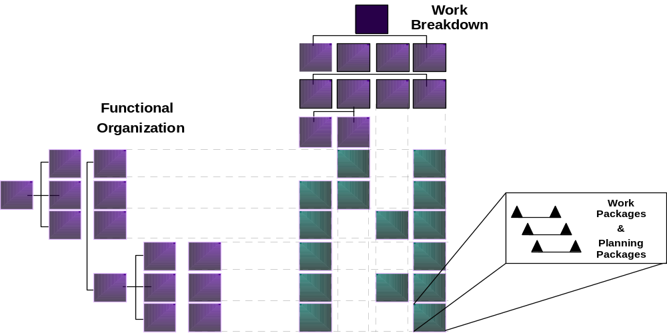
Responsibility Assignment Matrix
Scope Definition

Slide 25
Outputs
Scope Definition
Work breakdown structure

Slide 26
Scope Verification
Process of formalizing stakeholders’ acceptance of the project scope
Reviewing work products and results
Primarily concerned with acceptance of the work results

Slide 27
Scope Verification
Scope Verification
Tools
Inspections
Outputs
Formal acceptance
Inputs
Product documentation
Work results

Slide 28
Inputs
Scope Verification
Work results – Information concerning which deliverables have been fully or partially completed
Product documentation – Documents describing the project’s products (e.g., plans, specifications, technical documentation, drawings)

Slide 29
Tools & Techniques
Scope Verification
Inspection – Includes activities, such as measuring, examining, and testing, undertaken to determine whether results conform to requirements
Also referred to as reviews, product reviews, audits, and walk-throughs

Slide 30
Outputs
Scope Verification
Formal acceptance – Documentation of the the client or sponsor’s acceptance of the product

Slide 31
Scope Change Control
A process for controlling changes to project scope by:
  Influencing factors which create scope changes, in order to ensure the changes are beneficial
  Determining that a scope change has occurred
  Managing the changes when they occur
The system includes the paperwork, tracking systems, and approval levels necessary for authorizing changes

Slide 32
Change Control Process
Scope Change Control
Steps for changing official project documents
Change Control Board (CCB) – Responsible for approving or rejecting change requests
Procedures for handling those changes that may be approved without prior review
The scope change control process is a subsidiary process of the overall project control process

Slide 33
Scope Change Control
Scope Change Control
Tools
Scope change control system
Performance measurement
Additional planning
Outputs
Scope changes
Corrective action
Lessons Learned
Inputs
WBS
Performance reports
Change requests
Scope management plan

Slide 34
Inputs
Scope Change Control
WBS
Performance reports – Provide information on scope performance, such as: which interim products have been completed and which have not
Change requests
Scope management plan

Slide 35
Tools & Techniques
Scope Change Control
Scope change control system – Defines procedures for changing project scope
Performance measurement – Techniques for assessing the magnitude of any variation and determining the cause of the variance and whether the cause requires corrective action
Additional planning – Scope changes may require changes to the WBS or analysis of alternative approaches

Slide 36
Outputs
Scope Change Control
Scope changes – Any modification to the agreed upon project scope, as defined by the approved WBS
Corrective action – Any action taken to bring future project performance back in-line with the project plan
Lessons learned – Documentation of the reasons behind the corrective action and other types of information; to be included in the historical database for this project and for other projects of the performing organization

Slide 37

Summary
Review Questions

