Slide 1

PMP Preparation Training
Cost Management
Chapter7

Slide 2
Project Cost Management
Processes required to ensure the project
is completed
within the approved budget
Resource Planning
Cost Estimating
Cost Budgeting
Cost Control
Notes:
Life-cycle costing involves looking at the effect on the project cost of project decisions.
Project cost management should include the consideration that different stakeholders measure costs in different ways.
When project costs are used as part of a reward and recognition system, controllable and uncontrollable costs should be estimated and budgeted separately, to ensure that rewards reflect actual performance.

Slide 3
Cost Management
Planning
Controlling
7.1
Resource
Planning
7.2
Cost
Estimating
7.3
Cost
Budgeting
7.4
Cost
Control

Slide 4
Resource Planning
Determining physical resources needed (i.e., material, equipment, and people) and number of resources required to perform the project activities

Slide 5
Resource Planning
Tools & Techniques
Expert judgment
Alternatives identification
Inputs
Scope statement
WBS
Resource pool description
Organizational policies
Historical information
Outputs
Resource requirements

Slide 6
Inputs
Resource Planning
Work breakdown structure (WBS) – Identifies the project elements that require resources
Historical information – Used to identify the types of resources that were required for similar work on previous projects
Scope statement – Contains project justification and the project objectives, which need to be considered
Resource pool description – Description of resources available, if necessary, to work on a project
Organizational policies – Of the performing organization, regarding staffing and the rental and purchase of supplies and equipment

Slide 7
Tools & Techniques
Resource Planning
Expert judgment – Expertise, provided by any group or individual, used to assess the inputs to this process
  Other units within organization
  Consultants
  Professional and technical associations
  Industry groups
Alternatives identification
Notes:
Describe alternatives identification.

Slide 8
Outputs
Resource Planning
Resource requirements – Description of the types (e.g., skill levels) and numbers of resources required by each element of the WBS

Slide 9
Cost Estimating
Process of developing an approximation (or estimate)
for the cost of the resources necessary to complete
the project activities
Difference between cost estimating and pricing:
  Cost estimating: Assessing how much it will cost the organization to provide the product or service
  Pricing: Assessing how much the organization will charge for the product or service
Cost estimating also includes identifying and considering cost alternatives

Slide 10
Cost Estimating
Tools & Techniques
Analogous estimating
Parametric modeling
Bottom-up estimating
Computerized tools
Inputs
WBS
Resource requirements
Resource rates
Activity duration estimates
Historical information
Chart of accounts
Outputs
Cost estimates
Supporting detail
Cost management plan

Slide 11
Inputs
Cost Estimating
WBS – Used to organize the cost estimates and to ensure that the cost of all identified work has been estimated
Resource requirements
Resource rates – Unit rates for each resource
Activity duration estimates – Affects cost estimates if project budget includes an allowance for the cost of financing (i.e., interest)
Chart of accounts – Coding structure used by the organization to report financial information. Cost estimates must be assigned to the correct accounting category.
Notes:
Describe resource requirements.
Describe activity duration estimates

Slide 12
Inputs (cont.)
Cost Estimating
Historical information – Information on the cost of resources
  Project files – Records of previous project results that are detailed enough to aid in developing cost estimates
  Commercial cost-estimating databases – Historical information available commercially
  Project team knowledge

Slide 13
Tools & Techniques
Cost Estimating
Analogous estimating (Expert judgment) – Used to estimate total project costs if there is a limited amount of detailed information
Parametric modeling – Using project characteristics (or parameters) in a mathematical model to predict costs (e.g., price per square foot)
Bottom-up estimating – Estimating the cost of individual work items and then rolling up the costs to arrive at a project total
Computerized tools – PM software and spreadsheets

Slide 14
Outputs
Cost Estimating
Cost estimates – Quantitative assessments of the cost of resources (e.g., units of currency or staff hours)
Types of estimates
  Order of magnitude (-25% / +75%)
  Budget estimate (-10% / +25%)
  Definitive estimate (-5% / +10%)
Supporting detail
  Description of estimated scope of work
  Documentation of the basis for the estimate
  Documentation of any assumptions made
  Range of possible results

Slide 15
Outputs (cont.)
Cost Estimating
Cost management plan
  Describes how cost variances will be managed
  Part of the overall project plan

Slide 16
Cost Budgeting
Allocating the value of the overall cost estimate to individual work items, in order to establish a cost baseline to use in measuring project performance

Slide 17
Cost Budgeting
Tools & Techniques
Cost-estimating
tools and techniques
Inputs
Cost estimates
WBS
Project schedule
Outputs
Cost baseline

Slide 18
Inputs
Cost Budgeting
Cost estimates
WBS – Identifies the project elements to which the costs will be allocated
Project schedule – Used to assign costs to project elements for the time period when costs will be incurred

Slide 19
Tools & Techniques
Cost Budgeting
Cost estimating tools and techniques
  Analogous estimating
  Parametric modeling
  Bottom-up estimating
  Computerized tools

Slide 20
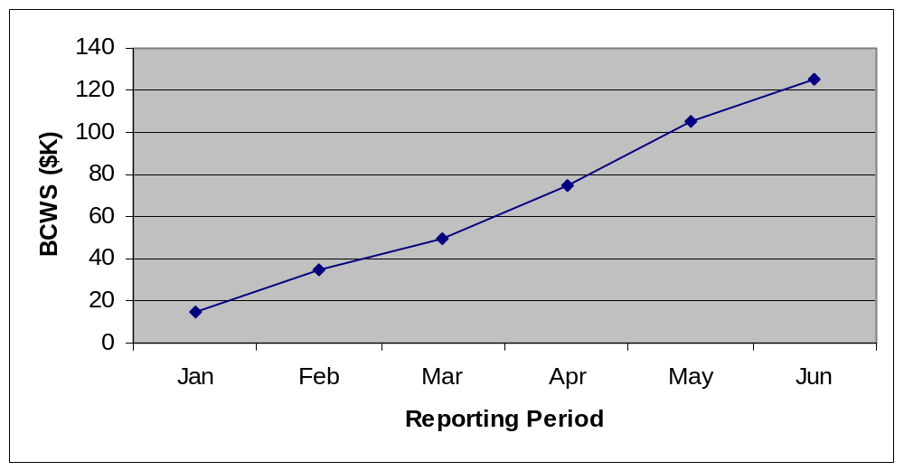
Outputs
Cost Budgeting
Cost baseline – Time phased budget that will be used to measure and monitor the cost performance of the project

Slide 21
Cost Control
Controlling changes to the project budget
  Monitoring cost performance to detect variances from the plan
  Ensuring that all appropriate changes are recorded
  Preventing incorrect, inappropriate, or unauthorized changes
  Informing the appropriate stakeholders of authorized changes
  Analyzing positive and negative variances and how they affect the other control processes

Slide 22
Cost Control
Tools & Techniques
Cost change control system
Performance measurement
Additional planning
Computerized tools
Inputs
Cost baseline
Performance reports
Change requests
Cost management plan
Outputs
Revised cost estimates
Budget updates
Corrective action
Estimate at completion
Lessons learned

Slide 23
Inputs
Cost Control
Cost baseline
Performance reports – Information on cost performance
Change requests – Oral or written requests to change the budget
Cost management plan

Slide 24
Tools & Techniques
Cost Control
Cost change control system – Procedures used for making changes to the cost baseline
  Paperwork
  Tracking system
  Approval levels
Performance measurement – Assessment of the magnitude of any variation, the cause of the variance, and the corrective action needed

Slide 25
Tools & Techniques (cont.)
Cost Control
Additional planning – Changes may require new or revised cost estimates or an analysis of alternative approaches
Computerized tools – Used for tracking the value of planned costs compared to actual costs and for predicting the effects of cost changes

Slide 26
Outputs
Cost Control
Revised cost estimates
Budget updates
Corrective action
Estimate at completion
Lessons learned

Slide 27
Earned Value (EV)
Cost Control
A method of measuring project performance by comparing the amount of work planned with that actually accomplished, in order to determine if cost and schedule performance are as planned

Slide 28
EV Terms
Cost Control
Data Element
Term
Acronym
Scheduled Work
Budgeted Cost of Work Scheduled
BCWS
Earned Value
Budgeted Cost of Work Performed
BCWP
Actuals
Actual Cost of Work Performed
ACWP
Authorized Work
Budget at Completion
BAC
Forecasted Cost
Estimate at Completion
EAC
Work Variance
Schedule Variance
SV
Cost Variance
Cost Variance
CV
Completion Variance
Variance at Completion
VAC

Slide 29
Establishing Control Accounts
Cost Control
Control account – Level of the WBS at which a budget is assigned and a control account manager (CAM) is given responsibility for delivering the item
Create control accounts at the level that senior management wants to track cost and schedule
Use the responsibility assignment matrix (RAM) as a tool

Slide 30
Responsibility Assignment Matrix
Cost Control
RAM – The integration of the WBS and the OBS of a project
Proper creation of the RAM results from locating the intersection of the OBS unit that is assigned responsibility for the work and the specific WBS element that defines the work to be performed

Slide 31
Control Account Example
Cost Control
CA #1
WBS Element:
OBS Element:
CAM:
Budget:
Schedule:
1.1 Frame
Frame Shop
Mr. I. M. Smart
$ 125,000
Jan - Jun 00

Slide 32
Control Account Managers
Cost Control
  Receive work authorization
  Develop work and planning packages
  Assign a budget and schedule for each work and planning package
  Build a baseline by summing the budgeted cost of work scheduled (BCWS) for each reporting period

Slide 33
Control Account Elements
Cost Control
Work Packages
Detailed, short-span
tasks or material items;
Required to accomplish
the CA objectives;
Typically for the near term
Planning Packages
Future work that has not been planned in detail as work packages; Always scheduled to occur in the future
Task 1
Work Packages
Task 2
Task 3
Planning Packages
Task 4
Task 5

Slide 34
Performance Measurement Baseline (PMB)
Cost Control
The plan against which actual performance can be compared
Based on budgets assigned to scheduled segments of work
Build PMB by summing the BCWS for all control accounts, by reporting period
Budget at completion (BAC) – Equal to the cumulative BCWS for the total project

Slide 35
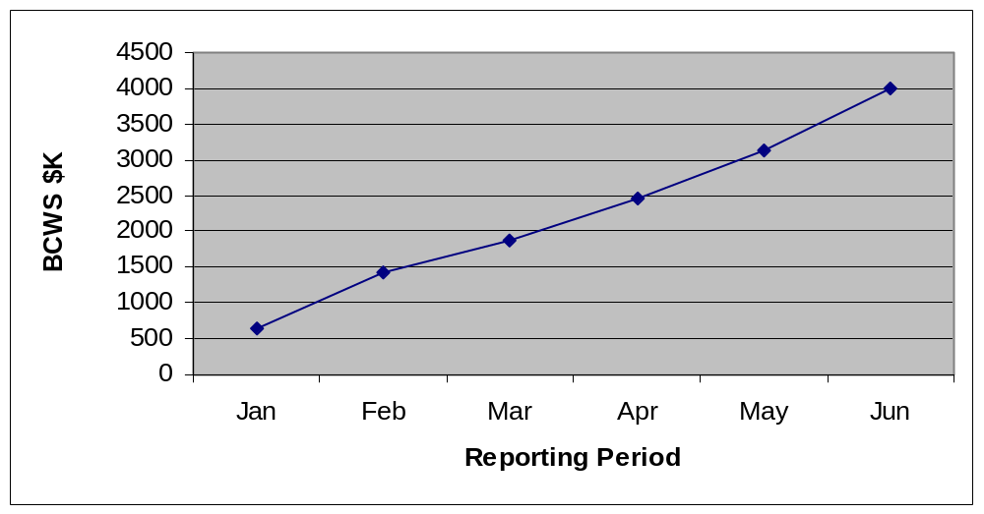
Performance Measurement Baseline (PMB)
Cost Control
Time-Phased Budget
BAC

Slide 36
Budgeted Cost of Work Scheduled (BCWS)
Cost Control
Work schedule to be accomplished
Performance Measurement Baseline
80000
BAC
70000
BCWS
60000
JANUARY
0
50000
CURRENT
FEBRUARY
2500
BCWS
MARCH
8000
40000
30000
APRIL
13000
20000
MAY
42000
JUNE
62000
10000
JULY
70700
0
JANUARY
FEBRUARY
MARCH
APRIL
MAY
JUNE
JULY

Slide 37
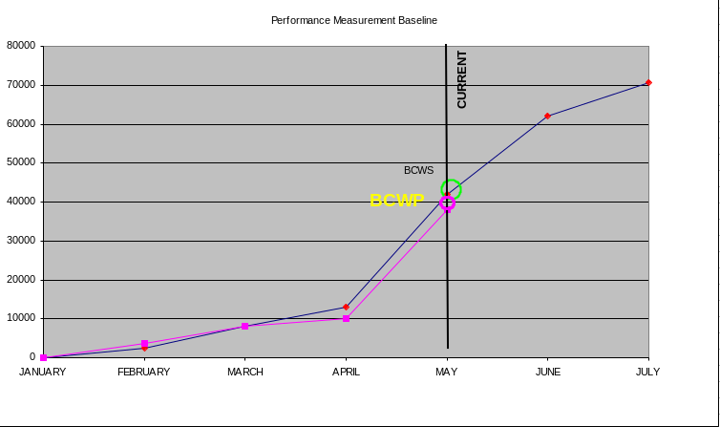
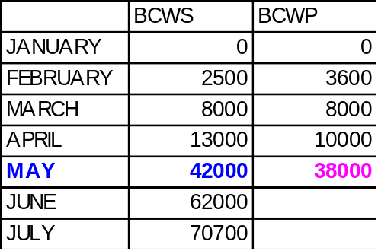
Budgeted Cost of Work Performed (BCWP)
Cost Control
Budgeted value of completed or in-process work

Slide 38
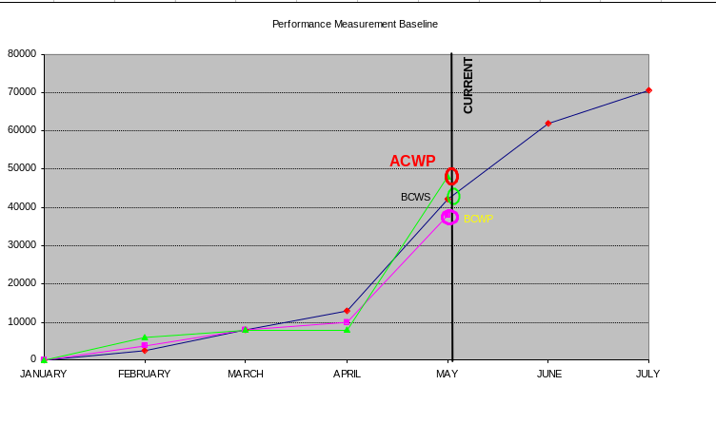
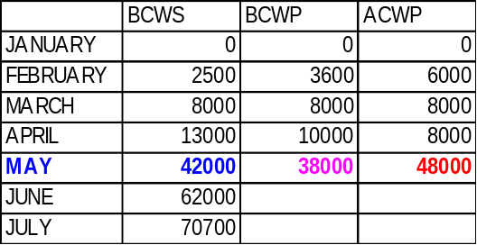
Actual Cost of Work Performed (ACWP)
Cost Control
Actual value of completed or in-process work

Slide 39
Schedule Variance
Cost Control
Comparing the BCWP, the amount originally budgeted for the work that has been completed or is in-process, to the BCWS, the amount budgeted for the work that was planned to have been accomplished
SV = BCWP – BCWS
A negative result means less work has been performed than was planned

Slide 40
SV Example
Cost Control
BCWS = $42,000
BCWP = $38,000
ACWP = $48,000
SV = BCWP – BCWS
= $38,000 – $42,000 = ⁻ $4,000
SV% = SV / BCWS
⁼ ⁻ $4000 / $42,000 = ⁻ 0.095
    = ⁻ 9.5%

Slide 41
Cost Variance
Cost Control
  Comparing the amount originally budgeted for the work completed or in-process, the BCWP, to the actual costs of that work, the ACWP
  CV = BCWP – ACWP
  A negative CV means more dollars were spent to accomplish the work than was planned

Slide 42
Cost Variance Example
Cost Control
BCWS = $42,000
BCWP = $38,000
ACWP = $48,000
CV = BCWP - ACWP
= $38,000 – $48,000 = ⁻ $10,000
CV% = CV / BCWP
= ⁻ $10,000 / $38,000
= ⁻ 26%

Slide 43
Performance Indices
Cost Control
Dfn: Cost- and schedule-performance efficiency calculations; expressed in $
  Cost Performance Index (CPI)
    CPI = BCWP/ACWP
  Schedule Performance Index (SPI)
    SPI = BCWP/BCWS

Slide 44
CPI Example
Cost Control
BCWS = $42,000
BCWP = $38,000
ACWP = $48,000
CPI = BCWP / ACWP
= $38,000 / $48,000 = 0.79
$0.79 worth of work was actually done for each $1.00 spent

Slide 45
SPI Example
Cost Control
BCWS = $42,000
BCWP = $38,000
ACWP = $48,000
SPI = BCWP / BCWS
= $38,000 / $42,000 = 0.90
$0.90 worth of work has been done for each $1.00 worth of work that was planned to be done

Slide 46
Estimate at Completion (EAC)
Cost Control
Dfn: The management’s assessment of the cost of the project at completion
  After variance analysis, the estimated cost at completion is determined

Slide 47
EAC Example
Cost Control
One methodology:
  EAC = BAC / CPI
  BAC = $80,000
  CPI = 0.79
  EAC = $80,000 / 0.79 = $101,265

Slide 48
Variance at Completion
Cost Control
BAC = $80,000
EAC = $101,265
VAC = BAC – EAC
    = $80,000 – $101,265
    = $21,265
Based on past performance, project will exceed planned budget by $21,265

Slide 49
To Complete Performance Index (TCPI)
Cost Control
Work Remaining / Cost Remaining
TCPI = (BAC – BCWP) / (EAC – ACWP)
  = ($ 80,000 – $ 38,000) / ($ 101,265 – $ 48,000)
  = $ 42,000 / $ 53,265
  = 1.4

Slide 50
Earned Value Examples
Cost Control
BCWS BCWP ACWP
$1 $1 $1 On schedule On cost
$2 $2 $1 On schedule Under cost
$1 $1 $2 On schedule Over cost
$1 $2 $2 Ahead of schedule On cost
$1 $2 $3 Ahead of schedule Over cost
$1 $2 $1 Ahead of schedule Under cost
$3 $2 $1 Behind schedule Under cost
$2 $1 $3 Behind schedule Over cost
$2 $1 $1 Behind schedule On cost

Slide 51
Example
Cost Control
BCWS BCWP ACWP EAC BAC
100 125 75 600 560
125 100 100 850 800
75 75 75 700 560
100 75 100 570 600

Slide 52
Sample Cost Problem
Cost Control
BAC = $ 40k
BCWP = $ 20k
BCWS = $ 28k
ACWP = $ 26k
Calculate
% of Work Scheduled
% of Budget Spent
% of Work Accomplished
Cost Variance
Schedule Variance

Slide 53
Sample Solution
Cost Control
Calculate
% of Work Scheduled BCWS / BAC = $ 28K / $ 40K = 70 %
% of Budget Spent ACWP / BAC = $ 26K / $ 40K = 65 %
% of Work Accomplished BCWP / BAC = $ 20K / $ 40K = 50 %
Cost Variance BCWP – ACWP = $ 20K – $ 26K = ⁻ $ 6K
Schedule Variance BCWP – BCWS = $ 20K – $ 28K = ⁻ $ 8K

Slide 54

Summary
Review Questions

Slide 55

Case 1
This is the ideal situation, where everything goes according to plan.
BCWS = $ 1,860
BCWP = $ 1,860
ACWP = $ 1,860

Slide 56
Case 2
In this Case, without Earned Value measurements, it appears we’re in good shape. Expenditures are less than planned.
BCWS = $ 1,900
ACWP = $ 1,700
Spending Variance = ⁻ $ 200

Slide 57
Case 2
But with EV measurements, we see...$400 worth of work is behind schedule in being completed; i.e., we are 21 percent behind where we planned to be.
BCWS = $ 1,900
BCWP = $ 1,500
ACWP = $ 1,700
SV = BCWP – BCWS = ⁻ $ 400
SV % = SV / BCWS x 100 = ⁻ 21 %

Slide 58
Case 2
In addition, we can see...
“Actuals” exceed “Value Earned” (BCWP), i.e., $1,500 worth of work was accomplished but it cost $1,700 to do so. We have a $200 cost overrun (i.e., 13% over budget) .
BCWS = $ 1,900
BCWP = $ 1,500
ACWP = $ 1,700
CV = BCWP – ACWP = ⁻ $ 200
CV % = CV / BCWP x 100 = ⁻ 13 %

Slide 59
Case 2
This means only 79 cents worth of work was done for each $1.00 worth of work planned to be done.
And, only 88 cents worth of work was actually done for each $1.00 spent
BCWS = $ 1,900
BCWP = $ 1,500
ACWP = $ 1,700
SPI = BCWP / BCWS = $ 0.79
CPI = BCWP / ACWP = $ 0.88

Slide 60
Case 2
This is the worst kind of scenario, where all performance indicators are negative.
BCWS = $ 1,900
BCWP = $ 1,500
ACWP = $ 1,700
SV = ⁻ $ 400; SPI = 0.79
CV = ⁻ $ 200; CPI = 0.88

Slide 61
Case 3
In this case there is bad news and good news.
BCWS = $ 2,600
BCWP = $ 2,400
ACWP = $ 2,200

Slide 62
Case 3
The bad news is that our work efficiency is a bit low; we’re getting only 92 cents of work done on the dollar. As a result, we are behind schedule.
BCWS = $ 2,600
BCWP = $ 2,400
ACWP = $ 2,200
SPI = 0.92
SV = ⁻ $ 200; SV % = ⁻ 8 %

Slide 63
Case 3
The good news is that we’re under-running our budget. We’re getting $1.09 worth of work done for each $1.00 we’re spending.
BCWS = $ 2,600
BCWP = $ 2,400
ACWP = $ 2,200
CV = ⁺ $ 200; CV % = ⁺ 8 %
CPI = 1.09

Slide 64
Case 4
BCWS = $ 1,700
BCWP = $ 1,500
ACWP = $ 1,500
In this case, the work is not being accomplished on schedule...
SV = ⁻ $ 200; SV % = ⁻ 12 %
SPI = 0.88

Slide 65
Case 4
BCWS = $ 1,700
BCWP = $ 1,500
ACWP = $ 1,500
...but the cost of the work accomplished is just as we budgeted.
CV = $ 0.00
CPI = 1.00

Slide 66
Case 5
BCWS = $ 1,400
BCWP = $ 1,600
ACWP = $ 1,400
A positive scenario; right? But is it because we are out-performing our learning-curve standards or because we planned too pessimistically?

Slide 67
Case 5
BCWS = $ 1,400
BCWP = $ 1,600
ACWP = $ 1,400
Here in this case, we are getting work done at 114 percent efficiency...
SPI = 1.14
CPI = 1.14

Slide 68
Case 5
BCWS = $ 1,400
BCWP = $ 1,600
ACWP = $ 1,400
...work is ahead of schedule by 14 percent and under-running cost by 12.5%.
SV = ⁺ $ 200; SV % = ⁺ 14 %
CV = ⁺ $ 200; CV % = ⁺ 12.5 %

Slide 69
Case 6
BCWS = $ 2,000
BCWP = $ 2,200
ACWP = $ 2,400
In Case 6, work is being done efficiently, but a cost overrun is occurring.
SPI = 1.10
CV = ⁻ $ 200; CV % = ⁻ 9 %

Slide 70
Case 7
BCWS = $ 2,200
BCWP = $ 2,400
ACWP = $ 2,400
In Case 7, work is being done efficiently, and costs are right on target.
SPI = 1.09
CV = $ 0.00

Slide 71
Case 8
BCWS = $ 2,000
BCWP = $ 2,000
ACWP = $ 2,200
See if you can analyze this one!!
SV = BCWP – BCWS
SV % = SV / BCWS
CV = BCWP – ACWP
CV % = CV / BCWP
SPI = BCWP / BCWS
CPI = BCWP / ACWP

Slide 72
Case 8
BCWS = $ 2,000
BCWP = $ 2,000
ACWP = $ 2,200
We’re on schedule. But in order to be on schedule, its costing us $1.00 to do each 91-cents worth of work. There’s a $200 overrun as a result.
SV = $ 0.00
CV = ⁻ $ 200; CPI = 0.91

Slide 73
Case 9
BCWS = $ 1,700
BCWP = $ 1,500
ACWP = $ 1,900
OK, see how you do with this one!!!
SV = BCWP – BCWS
SV % = SV / BCWS
CV = BCWP – ACWP
CV % = CV / BCWP
SPI = BCWP / BCWS
CPI = BCWP / ACWP

Slide 74
Case 9
BCWS = $ 1,700
BCWP = $ 1,500
ACWP = $ 1,900
Negative scenario:
12% behind schedule and over-running cost by 27%
SV = ⁻ $ 200; SV % = ⁻ 12 %
CV = ⁻ $ 400; CV% = ⁻ 27 %

Slide 75
Case 10
BCWS = $ 1,000
BCWP = $ 0.00
ACWP = $ 800
Let’s try one more!!!
SV = BCWP – BCWS
SV % = SV / BCWS
CV = BCWP – ACWP
CV % = CV / BCWP
SPI = BCWP / BCWS
CPI = BCWP / ACWP

Slide 76
Case 10
BCWS = $ 1,000
BCWP = $ 0.00
ACWP = $ 800
A tough one!!!
Of $1,000 worth of scheduled work, no measurable milestone has yet been accomplished. However, $800 has been spent just getting started.
SV = ⁻ $ 1,000; SV % = ⁻ 100 %
CV = ⁻ $ 800; CV % = N/A

Slide 77
Case 11
BCWS = $ 0.00
BCWP = $ 700
ACWP = $ 900
See how you do on this final one!!!
SV = BCWP – BCWS
SV % = SV / BCWS
CV = BCWP – ACWP
CV % = CV / BCWP
SPI = BCWP / BCWS
CPI = BCWP / ACWP

Slide 78
Case 11
BCWS = $ 0.00
BCWP = $ 700
ACWP = $ 900
Work was begun before it was scheduled to start. But while $700 worth of work was completed ahead of schedule, it cost $900 to do it. (A 29% overrun.)
SV = ⁺ $ 700; SV % = N/A
CV = ⁻ $ 200; CV % = ⁻ 29 %

