Slide 1
U.S. Energy & The Role of
Rocky Mountain Natural Gas:
Clean Domestic Energy For a Growing America(2005)

Slide 2
Basic Energy Facts
There is no economy, be it new, old or even futuristic, that would exist without reliable, accessible and affordable energy

Slide 3
Basic Energy Facts
There is no economy, be it new, old or even futuristic, that would exist without reliable, accessible and affordable energy
Over the past 25 years U.S. demand for energy has increased by 35% while our supply has only increased by 17%

Slide 4
Basic Energy Facts
There is no economy, be it new, old or even futuristic, that would exist without reliable, accessible and affordable energy
Over the past 25 years U.S. demand for energy has increased by 35% while our supply has only increased by 17%
We import 14% of the gas and 53% of the oil we use

Slide 5
Basic Energy Facts
Polls demonstrate that the American public:
1. Takes energy for granted
Source: COGA Flowline, Vol. 17, #3

Slide 6
Basic Energy Facts
Polls demonstrate that the American public:
1. Takes energy for granted
2. Neither understands nor appreciates how cheap our energy is in constant dollars or in comparison to other consumer nations
Source: COGA Flowline, Vol. 17, #3

Slide 7
Basic Energy Facts
Polls demonstrate that the American public:
1. Takes energy for granted
2. Neither understands nor appreciates how cheap our energy is in constant dollars or in comparison to other consumer nations
3. Seems to believe the mistaken notion that energy production necessarily entails unacceptable environmental impact
Source: COGA Flowline, Vol. 17, #3

Slide 8
Basic Energy Facts
In Colorado about 2,000 drilling permits are issued annually compared to about 50,000 housing permits
Source: COGA Flowline, Vol. 17, #3

Slide 9
OIL

Slide 10
Total U.S. Energy Consumption by
Primary Energy Source 2001
Other - 3.9%
Hydro - 2.5%
Nuclear - 8.4%
Coal
23.1%
Petroleum
39.4%
Natural Gas
22.8%
Source: EIA

Slide 11

World Petroleum Demand
76.0 MMbod
25.9%
Source: EIA

Slide 12
Basic Energy Facts
In the last 5 years the world consumed 27 billion barrels/year, but the industry discovered only 3 billion barrels/year
Therefore: used 135 billion barrels of oil while discovering 15 billion barrels of oil
Source: USGS

Slide 13
World Top Oil Producing Countries in 2001
U.S. 9.0 MMbo/d
Russia 8.8 MMbo/d
Saudi Arabia 8.0 MMbo/d
North Sea (UK, Norway, Denmark) 6.3 MMbo/d
Iran 3.7 MMbo/d
Mexico 3.6 MMbo/d
China 3.3 MMbo/d
Venezuela 2.9 MMbo/d
Canada 2.8 MMbo/d
Iraq 2.4 MMbo/d
Source: EIA

Slide 14

U.S. Petroleum Products Production vs. U.S. Petroleum Demand
Demand +24%
Production -25%
Source: EIA

Slide 15
U.S. Crude Oil Production
& Crude Oil Imports
25
Oil Production
20
15
10
Quadrillion Btu
Oil Imports
5
0
Source: EIA
1973
1976
1979
1982
1985
1988
1991
1994
1997
2000
2001

Slide 16
Top Suppliers of Crude Oil to U.S. in 2001
Saudi Arabia 1,611 Mbo/d
Mexico 1,394 Mbo/d
Canada 1,356 Mbo/d
Venezuela 1,291 Mbo/d
Nigeria 842 Mbo/d
Iraq 795 Mbo/d
Source: EIA

Slide 17
NATURAL GAS

Slide 18
Total U.S. Energy Consumption by
Primary Energy Source 2001
Other - 3.9%
Hydro - 2.5%
Nuclear - 8.4%
Coal
23.1%
Petroleum
39.4%
Natural
Gas
22.8%
Source: EIA

Slide 19
U.S. Natural Gas Consumption in 2001
22.0 Tcf
Chemicals and Materials
3%
Other
9%
Residential
22%
Electric Utilities
26%
Commercial
15%
Industrial
26%
Source: Groppe, Long & Littell

Slide 20
U.S. Natural Gas Consumption vs. Dry Production
70
60
50
40
Bcfd
30
20
10
Source: EIA
0
1973
1977
1981
1985
1989
1993
1997
2001
Consumption
Production

Slide 21
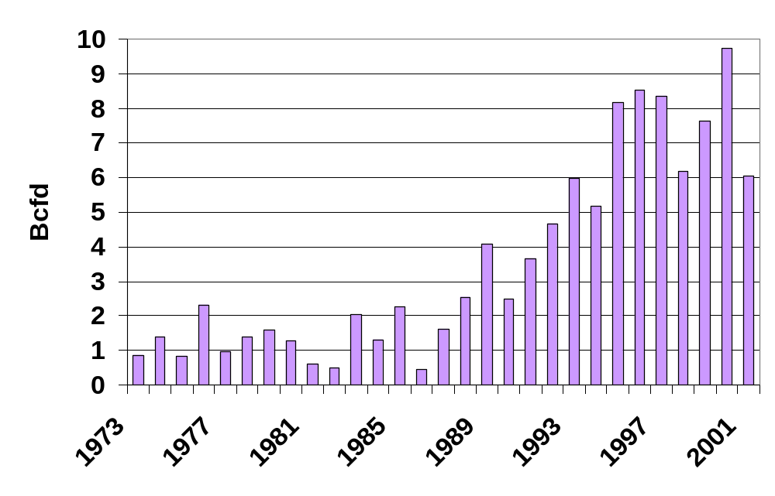
U.S. Shortfall in Production vs. Consumption
In 2001 U.S. consumption was
6 Bcfd greater than U.S. production!
Source: EIA

Slide 22
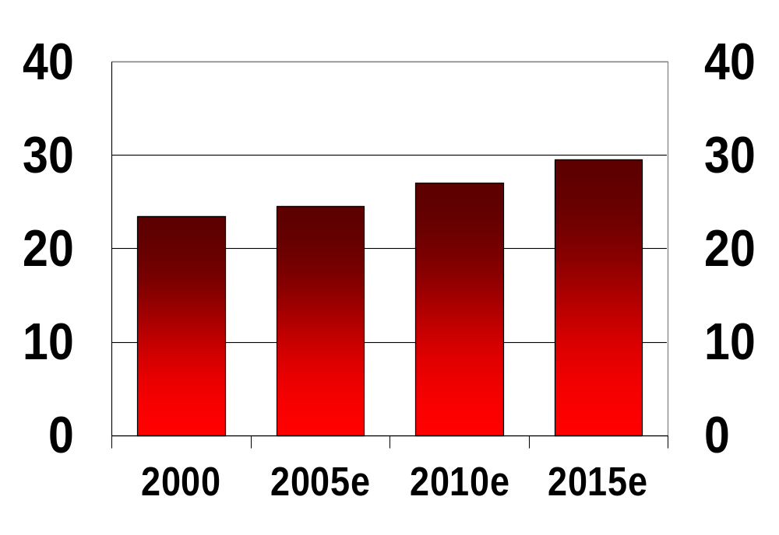
Projected Natural Gas Demand
Tcf per year
Source: EIA

Slide 23
U.S. manufacturing is based on affordable and reliable supplies of natural gas.
At these prices, it is unlikely the U.S. will attract new manufacturing capital.
Today’s gas prices are forcing manufacturers to consider production overseas.
Source: Industrial Energy Consumers of America

Slide 24
ELECTRICITY

Slide 25
Electricity – Basic Energy Facts
U.S. highway fuel market totals 11-12 MMbopd making it the single largest petroleum market in the world
However the energy content creating Kilowatts in the U.S. is almost twice as large as the highway fuel market!

Slide 26
Basic Energy Facts
In 2001 nearly 42% of the energy consumed in the U.S. was used to generate electricity.
Source: Groppe, Long & Littell

Slide 27
U.S. Electricity Supply by Source in 2001
Other Gaseous Fuels - 0.5%
Geothermal, Solar, Wind - 2.1%
Petroleum - 3.4%
Hydro - 5.8%
Natural Gas
16.5%
Coal
Nuclear
51.5%
20.3%
Source: EIA

Slide 28
From end of WWII to start of 2000 residential and commercial electrical use increased 51 out of 53 years
Yet no significant new power plants were built between 1990 and 2000

Slide 29
Basic Energy Facts
In 2000, PC’s and electronics consumed 13% of our nation’s energy supply. By 2020, these uses are expected to consume 25% of the nation’s energy supply.
40% of the country’s electricity is used to power air conditioners.

Slide 30
U.S. Electricity Net Generation
4
1.6% CAGR
Billion Kilowatt Hours
3
2
1
Source: Groppe, Long & Littell
0
1975
1980
1985
1990
1995
2000
2001

Slide 31
U.S. Electricity Supply by Source in 2001
Other Gaseous Fuels - 0.5%
Geothermal, Solar, Wind - 2.1%
Petroleum - 3.4%
Hydro – 5.8%
Natural Gas
16.5%
Coal
Nuclear
51.5%
20.3%
Source: EIA

Slide 32
U.S. Hydroelectric Power Production
25
20
15
10
Quadrillion Btu
5
0
1973
1976
1979
1982
1985
1988
1991
1994
1997
2000
2001
Source: EIA

Slide 33
Basic Energy Facts
Over the past 25 years U.S. demand for energy has increased by 35% while our supply has only increased by 17%

Slide 34
Basic Energy Facts
Over the past 25 years U.S. demand for energy has increased by 35% while our supply has only increased by 17%
Oil, gas and hydro production are flat to down – so what has increased energy supply?

Slide 35
U.S. Electricity Supply by Source in 2001
Other Gaseous Fuels - 0.5%
Geothermal, Solar, Wind - 2.1%
Petroleum - 3.4%
Hydro - 5.8%
Natural Gas
16.5%
Nuclear
Coal
51.5%
20.3%
Source: EIA

Slide 36
U.S. Nuclear Electric Power Production
25
20
15
10
Quadrillion Btu
Three Mile
Island
5
0
Source: EIA
1973
1976
1979
1982
1985
1988
1991
1994
1997
2000
2001

Slide 37
U.S. Electricity Supply by Source in 2001
Other Gaseous Fuels - 0.5%
Geothermal, Solar, Wind - 2.1%
Petroleum - 3.4%
Hydro - 5.8%
Natural Gas
16.5%
Coal
Nuclear
51.5%
20.3%
Source: EIA

Slide 38
U.S. Electric Power Production from Coal
25
20
Coal
15
10
Quadrillion Btu
5
0
Source: EIA
1973
1976
1979
1982
1985
1988
1991
1994
1997
2000
2001

Slide 39
Electricity – Basic Energy Facts
Can’t store electricity like you can oil and gas – so excess capacity is essential!
The nation is now adding gas fired power plants at an unprecedented rate

Slide 40
Why Gas Fired Power Plants?
Easier to permit
More cost efficient
Take years less to construct
Distributed location
Clean (50% of coal and oil power plant emissions)

Slide 41
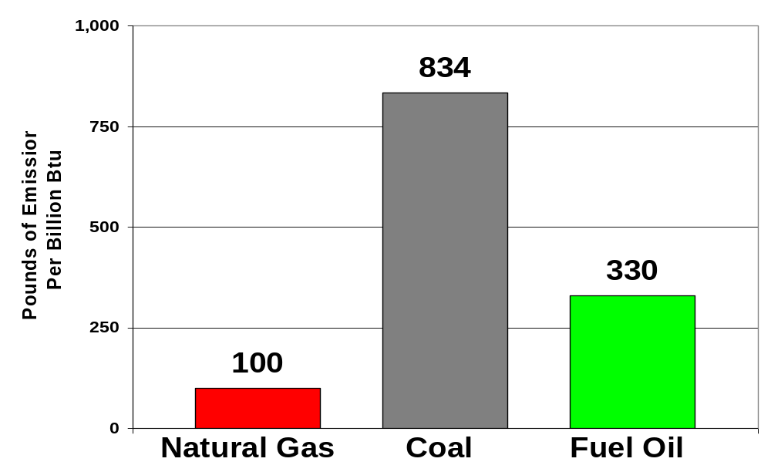
Air Pollution Emissions of Nitrogen Oxides (NOx)
Source: EPA & AGA

Slide 42
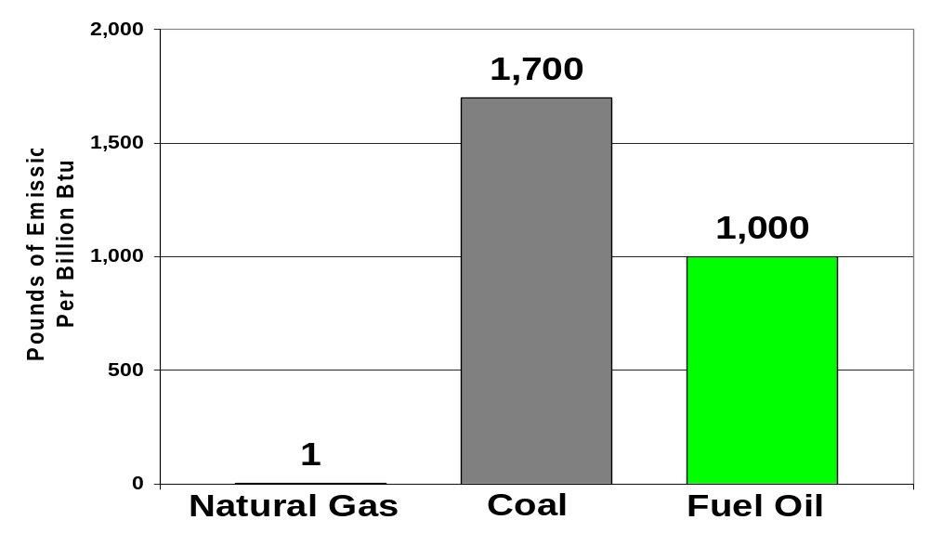
Air Pollution Emissions of Sulpher Dioxide (SOx)
Source: EPA & AGA

Slide 43
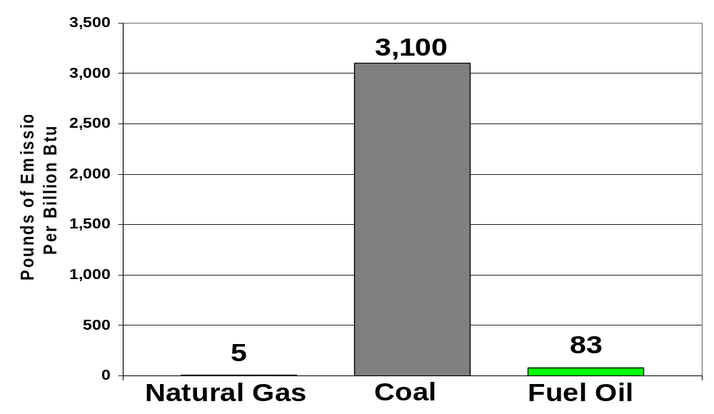
Air Pollution Emissions of Particulate Matter
Source: EPA & AGA

Slide 44
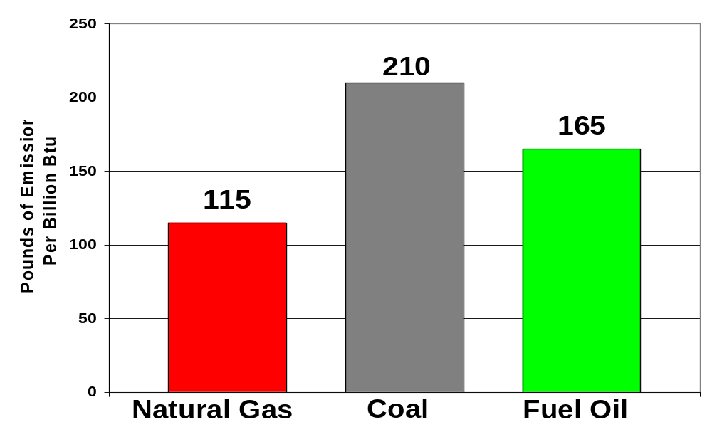
Air Pollution Emissions of Carbon Dioxide (CO2)
Source: EPA & AGA

Slide 45
Why the Rockies?
Estimated Proven and Potential Gas Reserves in the U.S. (1,135 Tcf)
Rockies
41%
Mid-Continent
36%
Gulf Coast
23%
Rockies represent the single largest untapped
onshore natural gas basin in the U.S.
Source:
National Petroleum Council

Slide 46
Basin Center Gas (BCG)
Source: AAPG Memoir 67, p. 286.

Slide 47
Rocky Mountain BCG
Huge and largely untapped “unconventional” natural gas resource
Abnormally pressured gas accumulations below normally pressured water system
Compartmentalized non-continuous gas columns

Slide 48
Rocky Mountain BCG
Usually low perm reservoirs but high perm areas do exist (sweetspots)
Complex poorly understood system which represents tremendous opportunity

Slide 49
Rocky Mountain BCG
These accumulations have defied exploitation by conventional techniques
A deep basin high potential “frontier” exists in mature province

Slide 50
Coal Bed Methane
Unconventional resource
1.4 TCFG produced annually >7% of U.S. gas production
Over 90% of CBM production came from Rockies in 2000

Slide 51
Coal Bed Methane
39.7 TCFG most likely recoverable from Rocky Mountain region
CBM potential of entire Rockies being reevaluated after success in Powder River, Uinta, Raton & Piceance Basins

Slide 52
Three of the four largest (?) U.S. onshore gas discoveries in last 25 years are in the Rockies
Producing
San Juan Basin CBM (1986) 2,000 MMcfd
Powder River Basin CBM (1991) 930 MMcfd
Barnett Shale (1981) 700 MMcfd
Jonah – BCG (1995) 650 MMcfd

Slide 53
U.S. Gas Supply: Why the Rockies?
U.S. Daily Gas Production 1972 - 1999
40
1972
-24%
-24%
1999
30
Bcfd
20
-36%
-36%
518%
Source: 2000 Potential Gas Committee Report
518%
10
-21%
700%
0
Gulf
Coast
Mid-
Continent
Rockies
Pacific
N.
Central

Slide 54
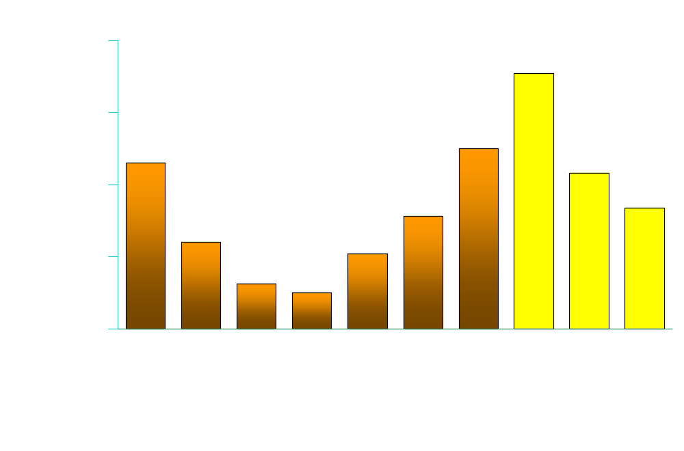
Discount to NYMEX
F=’03 (Actual Jan-Feb, Futures Mar-Dec), ’04 & ’05 Futures 2-7-03
CIG Basis
1.77
1.25
1.15
1.08
$ / MMbtu
0.78
0.84
0.60
0.52
0.31
0.25

Slide 55
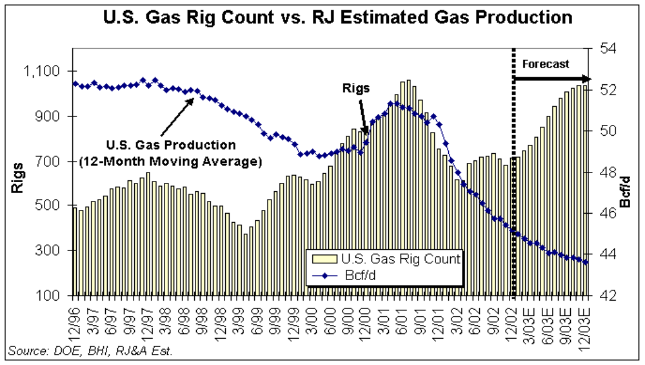

Slide 56
What is holding us back from growing our gas production?
Volatile prices
Excessive regulations
Inefficient permitting procedures
Lack of land and lease accessibility

Slide 57
Barriers to Meeting the Nation’s Demand for Natural Gas
U.S. Lower-48 Natural Gas Reserves Subject to Access Restrictions
21
Tcf
137
Tcf
31
Tcf
24
Tcf
Source: National Petroleum Council

Slide 58
What is holding us back from
growing our gas production?
Lack of infrastructure
Lack of impactful new technology (“silver bullets”)
Lack of prospects?

Slide 59
Most of our gas supply and drilling activity in last 10 years has come from extremely successful exploitation efforts
The problem is that this is a finite game

Slide 60
History of U.S. Exploration Activity
20,000
1981
17,500
Oil
Gas
Dry
15,000
1972
7,551
1986
7,156
# of Wells Completed
10,000
2000
2,076
5,000
0
1972
1974
1976
1978
1980
1982
1984
1986
1988
1990
1992
1994
1996
1998
2000
Source: API

Slide 61
Why are exploration efforts so anemic?
  Price uncertainty
  “Tired” mature basins
  Lack of creative new ideas
  – where have all the prospectors gone?

Slide 62
Why are exploration efforts so anemic?
  Quarterly financial “street” expectations
  Perception that domestic projects can’t compete with global opportunities

Slide 63
Why are exploration efforts so anemic?
  Lack of consistent corporate commitment or fortitude

Slide 64
We must explore
for the good of our country
and the survival of our industry

Slide 65

WANTED:
A New Supply of
“Silver Bullets”

Slide 66
Needed: New “Silver Bullets”
IP / EUR Logs!
  Pipe set “dry holes” are tremendous waste of capital
Cost Effective (Cheap) Onshore 3D Seismic Acquisition!
  Need “offshore-like” coverage in all of our basins

Slide 67
Needed: New “Silver Bullets”
BOP’s That Can Drill With Air to Greater Than 5,000#
Efficient air drilling in horizontal
laterals
“Canada-Like” Regulations Such That ALL Data Becomes Public Allowing Much More Efficient Data Farming
More Subsurface Hole with Less Surface Impact

Slide 68
Independents drill 85% of domestic oil and natural gas wells and produce approximately 75% of domestic natural gas
– This is not BIG OIL! –
Source: Independent Petroleum Association of America

Slide 69
Independents Are the Nation’s “Energy Farmers”
Price “takers,” not price “makers.”
Produce something that everyone needs.
Heavily dependent on the weather.

Slide 70
Where are the majors?
Majors need to step up and play a significant role in our nation’s gas supply growth efforts

Slide 71
Conclusions:
The ability to produce clean burning domestic natural gas in adequate supply is critical to our nation’s economy and
self-sufficiency
Source: COCA Flowline, Vol. 17, #3

Slide 72
Basic Energy Fact
The general public is clueless!
Get informed
and tell others of the crucial role the natural gas industry plays in America’s future

Slide 73
Project Manager
Jim Lightner, Tom Brown
February 13, 2005

