Slide 1
Title: A Smart Platform for Book Discovery and Personalized Recommendations with Semantic Search
Submitted By
Gobindo ray - CS 2102076
Anando Talukder - CS 2203103
Sagor Ahmed - CS 2203105
Istiak Ahmed – CS 2203107
Submitted To
Rakib Hossen
(Lecturer)
Department of Computer Science and Engineering
(NITER)

Slide 2
TABLE OF CONTENTS
1. Introduction
2. Problem Statements
3. Objectives
4. Related works
5.Proposed Methodology
6. Future Works
9. Conclusion
10. References

Slide 3
INTRODUCTION
Smart Platform: A smart platform refers to a system that uses advanced technologies like artificial intelligence (AI), automated, and highly adaptable solutions.
Semantic Search: Semantic search focuses on understanding the query's meaning and context instead of just matching keywords.

Slide 4
Problem Statements

Slide 5
OBJECTIVES
● To offer book requesting, uploading, and sharing system.
● To develop a platform that uses semantic search for understanding user queries and intent.
● To offer personalized book recommendations based on user preferences and ratings.
● To enable users to discover books they might not have otherwise encountered.

Slide 6
Related Work
● Existing platforms like Goodreads, Amazon's book and Library Thing offer basic recommendation system. However they are :
● Primarily depends on user rating and popularity trends.
● Lack semantic search capabilities to process natural language queries effectively and did not focus on university related books category.

Slide 7
Methodology

Slide 8
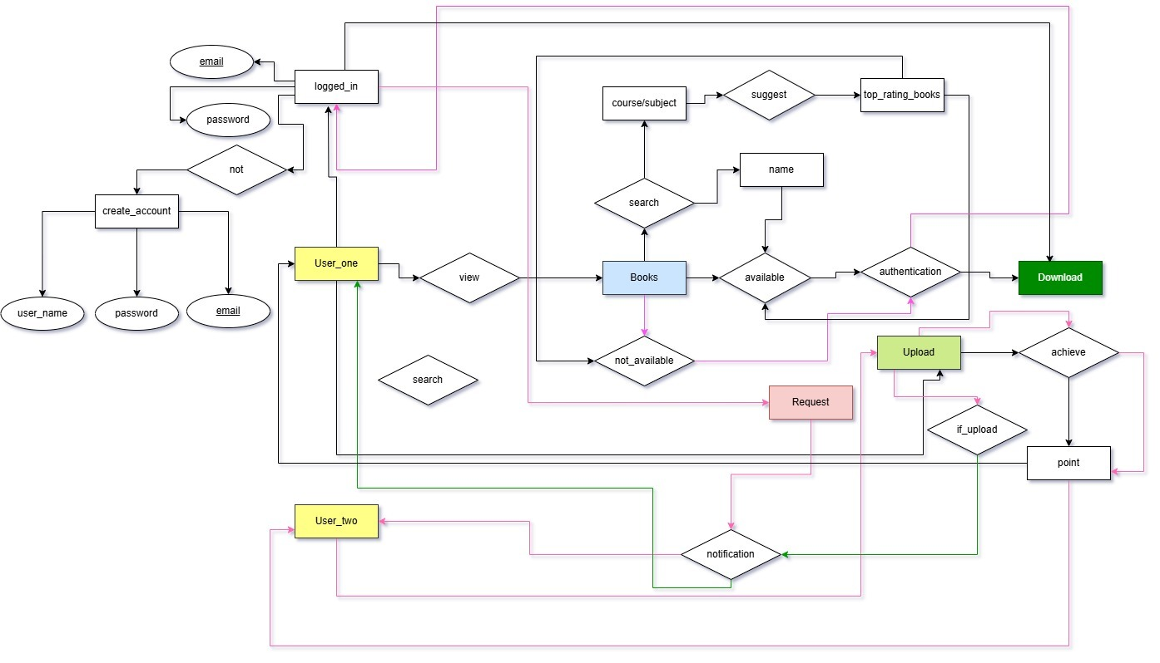
E-R Model Design

Slide 9
Future Works
● Add interactive tutorials, video lectures, and live Q&A sessions with professors.
● Al-Powered Recommendations: Implement Al to analyse student performance and suggest books, notes, or additional resources tailored to their needs.

Slide 10
CONCLUSION
ICT and E-learning offers opportunity to schools
Helping to break the education barrier.
Need a lot of improvement.
Need to create awareness for online education

Slide 11

References

Slide 12


