Slide 1
Power Factor Improvement
Reducing Electricity Bill of a Garments Factory
Presented by: Group 1 (ID: 1806131-1806136)

Slide 2
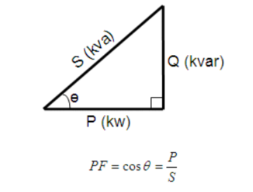
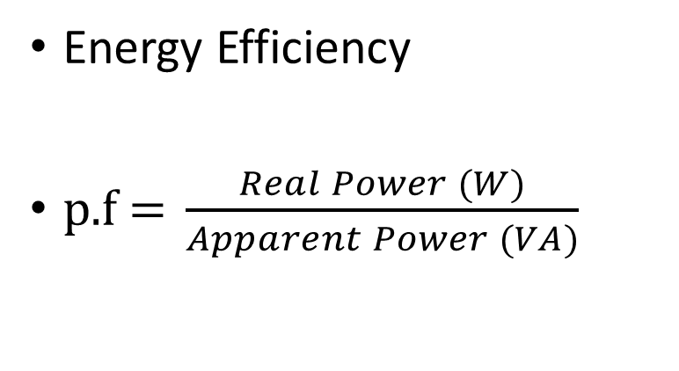
What is Power Factor?
Energy Efficiency
$\text{p}\text{.}\text{f}\text{ = }\frac{Real Power (W)}{Apparent Power (VA)}$

Slide 3
Why is it important?
Higher Current
Higher Apparent
Power
Low pf
Inefficiency
Penalty
Notes:
Why is it important? When the power factor decreases, the amount of current drawn by the inductive loads increases. As a result, for the same amount of real power, the consumed apparent power also increases. Consequently, the power system becomes more inefficient.

Slide 4
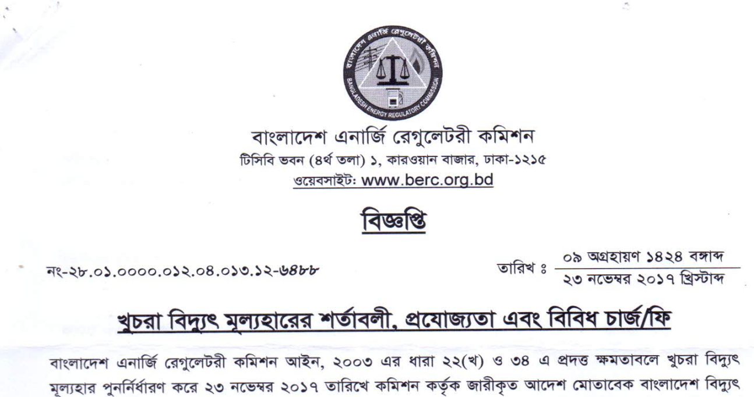
Why is it important?

Slide 5
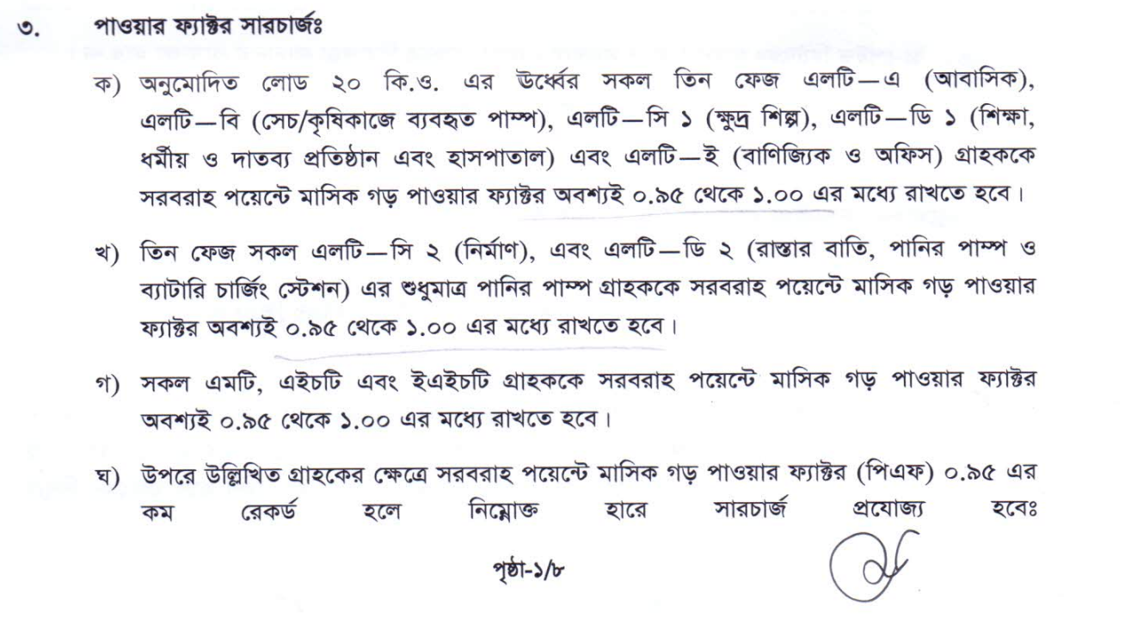
Why is it important?

Slide 6
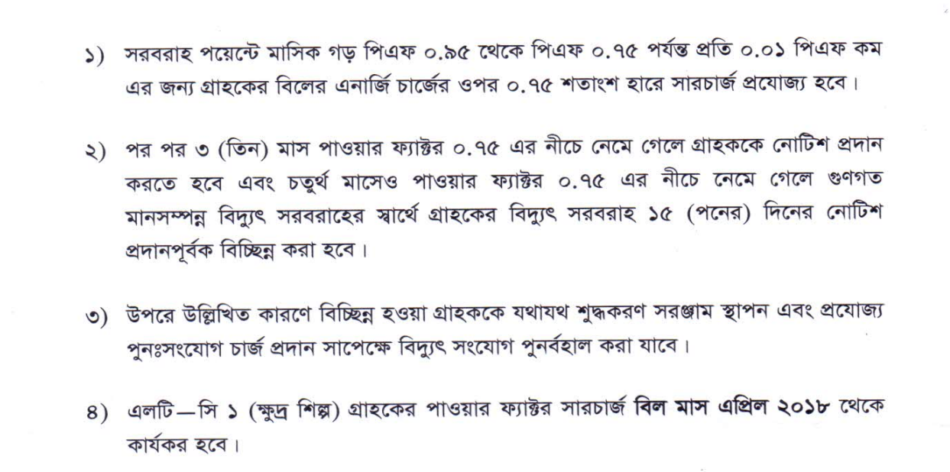
Why is it important?

Slide 7
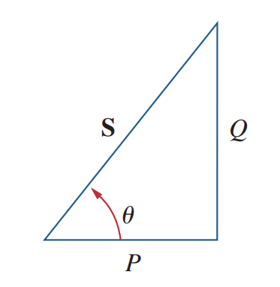
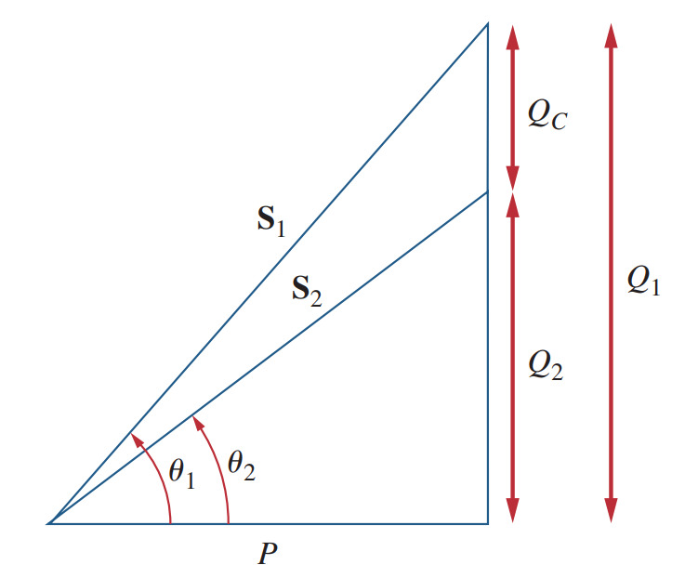


How to improve p.f.?
Add
Capacitance
$$θ_{2}<θ_{1}$$
$$⇒ {pf}_{2}>{pf}_{1}$$

Slide 8
Project Objectives
Model a small Garments Factory in Simulink
Observe the total load and power factor
Find the peak load and lowest power factor
Calculate the required capacitance for achieving 0.96 power factor
Observing the effect of capacitance on the model
Calculating the costs and savings

Slide 9
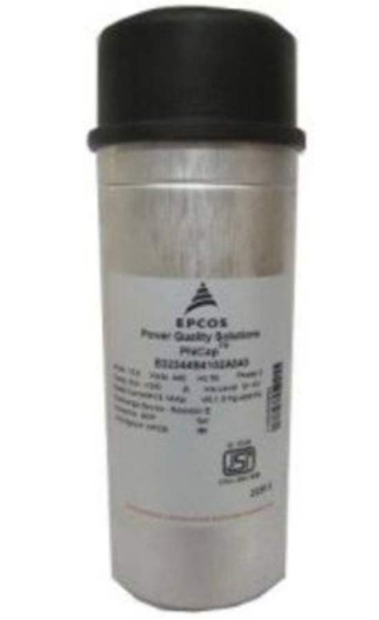
Used Capacitor Bank
Manufacturer: Epcos
Power Rating: 20 kVAR
Voltage Rating: 440 V
Current Rating: 32.8 A inrush
Frequency Rating: 50 Hz
Capacitance: 3 x 137.5 mF
Phase: 3
Mounting Position: Indoor
Casing: Extruded Round Aluminum Can with Stud
Dielectric: Polypropylene Film (Metallized)
Dimensions: 90 mm Depth x 345 mm Height
Material: Aluminum
Type: Standard Duty
Degree of Protection: IP00
Source: daraz.com.bd

Slide 10
Results

Slide 11
Results

Slide 12
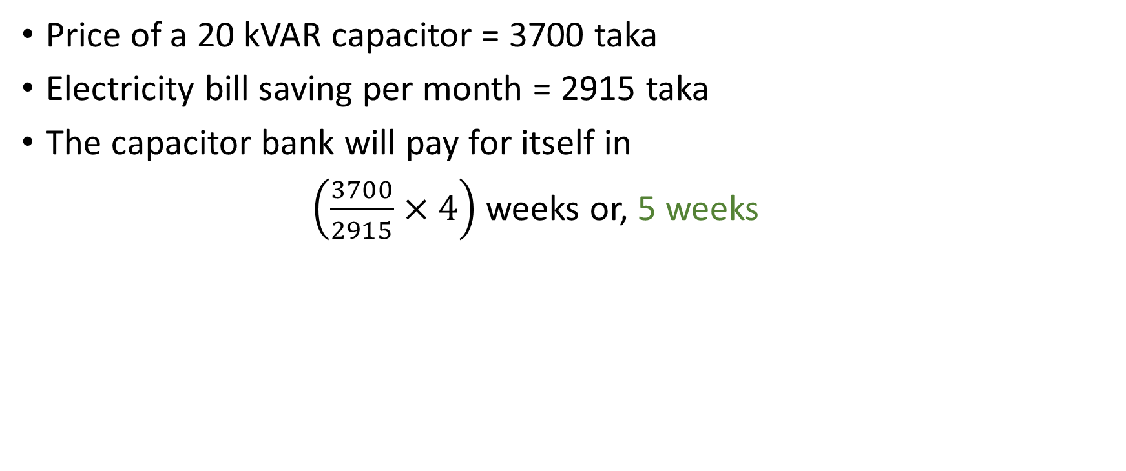
Costs and Savings
Price of a 20 kVAR capacitor = 3700 taka
Electricity bill saving per month = 2915 taka
The capacitor bank will pay for itself in
$\left(\frac{3700}{2915}×4\right)$weeks or, 5 weeks

Slide 13
Conclusion
Capacitor banks are economically feasible
Timely connecting and removing from system
Proper control mechanism should be applied
Power system monitoring for extending lifetime

Slide 14
Prospects of Improvement
Better modeling of operating hours
Better modelling of transformer regulation
Better modelling of single phase loads
Improving the circuit breaker control of capacitor bank

Slide 15
Thank you

