Slide 1
HTML & CSS

Slide 2
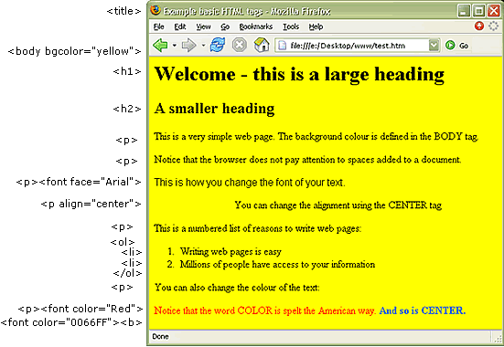
Notes:
Image from: http://sccweb.scea.wa.edu.au/C3_IT/Cert%20III%20IT%20ICA30105%20Alternate%20materials/ICAB4135A_Create_Simple_Markup_Doc/lo/1755/graphics/1755_act5_f07.gif
HTML is the basis for all web pages that you visit.

Slide 3
HTML overview, part 1
HTML
Stands for HyperText Markup Language
Describes the structure of web pages
An HTML page is a text document with the .html extension
Document Object Model (DOM)
common to HTML, XHTML, XML documents
"The W3C Document Object Model (DOM) is a platform and language-neutral interface that allows programs and scripts to dynamically access and update the content, structure, and style of a document."
In other words: “The HTML DOM is a standard for how to get, change, add, or delete HTML elements.”
Notes:
Definition from https://www.w3schools.com/js/js_htmldom.asp
Analogy: HTML is a wooden marionette puppet. The DOM is like the strings; they define how you can manipulate the puppet.

Slide 4
HTML overview, part 2
An HTML document is composed of a tree of elements
Specific-purpose elements: <table>, <form>, <img>, <h1>
General-purpose elements: <div>, <span>
An element usually has an opening and closing tag
For example, <foo> opens the tag, </foo> closes the tag (but some tags are self-closing!) Take a guess…
Tags act as containers
Tags can be nested
Attributes provide descriptive information about elements
<p lang=”en”>Paragraph in English</p>
Proper indentation is important to keep the code readable!
Notes:
Proper indentation meaning you indent every time you define a new element within a tag. No hard rules, but you’ll see people generally following certain formatting patterns.

Slide 5
Good indentation vs no indentation
<html>
<head>
<title>My First HTML!</title>
</head>
<body>
<div>
Here’s my first HTML
</div>
</body>
</html>
<html>
<head>
<title>My First HTML!</title>
</head>
<body>
<div>
Here’s my first HTML
</div>
</body>
</html>
...or worse…
<html><head><title>My First HTML!</title></head><body><div>Here’s my first HTML</div></body></html>

Slide 6
Basic HTML Elements
Every HTML page will have at least these tags:
<html> defines the whole document
<head> defines metadata for the document
<title> defines the title of the document (technically optional, but good practice to always have)
<body> defines the document body

Slide 7
HTML Text
Headings: <h1>, <h2>, … <h6>
Paragraphs: <p>
Other
<strong> and <em> emphasis (preferred over <b> bold and <i> italic)
<sup> superscript, <sub> subscript
<br/> line break, <hr/> horizontal rule
<blockquote>, <abbr> abbreviation/acronym, <cite>, <dfn> definition
<address> author contact, <ins> insert, <del> delete, <s> strikethrough
Whitespace: &nbsp;
Notes:
While lecturing, create a demo HTML page and show how each of these tags format text.

Slide 8
HTML Lists
Ordered Lists
<ol>
<li> list item </li>
</ol>
Unordered Lists
<ul>
<li> list item </li>
</ul>
Lists can be nested

Slide 9
HTML Links
Link between pages on the same website (relative URL)
<a href=”test.html”>This page is in the same folder</a>
<a href=”music/listings.html”>This page is in a different folder</a>
<a href=”../index.html”>This page is up one folder</a>
Link to a page on another website (absolute URL)
<a href=”http://www.linkedin.com”>LinkedIn</a>
Link to a part of a web page (usually referred to as an anchor)
<a href=”#section2”>Section 2 on same page</a>
<a href=”random.html#section2”>Section 2 on random page</a>
Email link
<a href=”mailto:steph@test.com”>Email Steph</a>
A link can open in a new browser window
<a href=”page.html” target=”_blank”>Open me!</a>

Slide 10
HTML Images
Image formats: JPEG, GIF, PNG
Size is measured in pixels
Good practice to have a folder that organizes the images on your site
<img src=”images/frog.jpg” alt=”a green frog on a lilypad” title=”Frog” width=”50” height=”40”>
Images can be animated, transparent, have captions… and more!
<figure> <img src=”images/pigs.jpg” /> <figcaption>Piglets</figcaption></figure>
Notes:
The img tag is an example of a self-closing tag!
The alt attribute is very important and is required. Can anyone guess what the “alt” attribute does?

Slide 11
HTML Tables
Used for displaying tabular data
<table>, <tr> row, <td> cell
<th> row or column heading
rowspan, colspan attributes
<thead>, <tbody>, and <tfoot> will not affect the layout of the table by default. However, you can use CSS to style these elements.

Slide 12
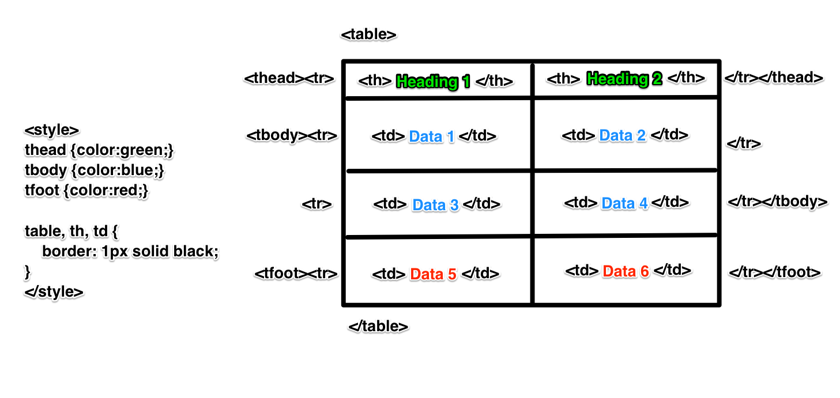

Slide 13
Other HTML Markup
Here are some more HTML features:
Doctype: tells the browser that this is an HTML document and which version of HTML it is
Comments are formatted like so: <!-- comment -->
Id attribute: <p id=”my-paragraph”>...</p>
Class attribute: class <p class=”important”></p>
Block elements <h1>, <p>, <ul>, <li>
Inline elements <a>, <b>, <i>, <em>, <img>
Grouping in a block: <div>
Grouping inline: <span>
<iframe>
<meta> tags: description, keywords, robots, author, pragma, expires
...Don’t bother trying to memorize everything!
Notes:
Id uniquely identifies an element
Class identifies all elements marked with the same class

Slide 14
Enough HTML... Let’s learn CSS!
But first, any questions?

Slide 15
Cascading Style Sheets (CSS)
Associates style rules with HTML elements, and dictates how they’re displayed
Can be defined in an HTML document inside a <style> tag inside the <head>:
<head>
<style> <!-- CSS goes inside this tag -->
#my-div { <!–- define styling for the element with id “my_div” --> color: blue; <!-- make the text color blue -->
}
</style>
</head>
Or it can be defined in-line with the HTML:
<div style=”background-color: red;”></div>
Or it can even be pulled into an HTML document from a file externally:
<link href=”css/styles.css” type=”text/css” rel=”stylesheet” />
Notes:
Generally a bad idea to write CSS inline; generally people will write them in separate files to keep it organized.
Color codes correspond to best > worst practices.

Slide 16
CSS Selectors
In order to use CSS to style elements, you have to be able to select which elements you want your styling to apply to (styling definitions go inside the {}):
Universal selector: * {}
Tag/element selector: h1, h2, h3 {}
Class selector: .note {}, p.note {}
ID selector: #intro {}
Child selector: li>a {}
Targets only the anchor elements which are children of list elements, but not other anchor elements on the page
Descendent selector: p a {}
Targets only the anchor elements which are inside a paragraph element, even if there are other elements nested between them
Notes:
Don’t use the universal selector
CSS styling definitions go inside those {}
Child vs. descendent: child is nested only one layer deep. Descendant can be nested many layers deep.
There are many other ways in CSS to traverse elements in relation to each other--child and descendant selectors are not the only ways. There are also sibling selectors, among others.
You can also select by attribute. Attribute selectors allow you to apply styles to all elements that have a certain attribute value.

Slide 17
Example!
<html>
<head>
<style>
div p.foo { color: red; }
</style>
</head>
<body>
<div id=”first-div”>
<div id=”nested-div”>
<p class=”foo”>Hello!</p>
</div>
</div>
<p class=”foo”>How are you?</p>
<div id=”second-div”>
<p id=”foo”>Goodbye!</p>
</div>
</body>
</html>
Notes:
Focus on classes vs id’s for next slide

Slide 18
ID vs. class
In the previous slide, you’ve seen IDs and classes defined for HTML elements. This is so we can use CSS selectors to apply styling to particular elements. What’s the difference between the IDs and classes?
ID: there should only be one of any given ID
IDs are used for uniquely identifying elements
Classes: can be used across multiple elements
Classes should reused to group elements
Ideally, styles should be reusable across elements
Best practice is to use classes for styling

Slide 19
CSS Specificity
If there are two or more rules that apply to the same element, which takes precedence? This is how CSS decides:
The last rule (Cascade)
The most specific rule
You can also add !important to override

Slide 20
CSS Cascading
It’s called “cascading” style sheets because the style rules cascade down!
If you specify a rule like font-family to <body>, it will apply to most child elements
Most properties are inherited by child elements
A few properties are not inherited by child elements, like background-color and border
Use inherit to force properties to inherit values from parent

Slide 21
CSS Color
Three ways to specify color:
RGB values: rgb(102, 205, 170)
Hex codes: #66cdaa
Color names: MediumAquaMarine (Not supported in all browsers)
Hue, Saturation, Lightness
Opacity (alpha)
hsla(0, 100%, 100%, 0.5)
rgba(0, 0, 0, 0.5)

Slide 22
CSS Text
font-family (serif, sans-serif, monospace)
font-size
@font-face {font-family: ‘Times’; src: url(‘fonts/times.eot’);}
font-weight (normal, bold, ...)
font-style (normal, italic, oblique)
text-transform (uppercase,lowercase, capitalize)
text-decoration (none, underline, overline line-through)
line-height
letter-spacing, word-spacing
text-align (left, right, center, justify), vertical-align (top, middle, bottom, etc)
text-indent
text-shadow
:first-letter, :first-line
Notes:
Notice some same font and some say text

Slide 23
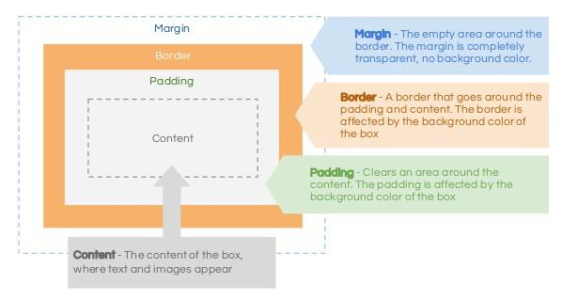
CSS Box Model
Notes:
Image from https://image.slidesharecdn.com/css-boxmodel-130811120108-phpapp02/95/css-box-model-2-638.jpg?cb=1376222562

Slide 24
CSS Boxes
width, height, min-width, max-width, min-height, max-height
overflow (auto, hidden, scroll)
border, margin, padding
border-width, border-style, border-color
display (inline, block, inline-block, none) - turns inline element into block-level element
visibility (hidden, visible) - hide boxes from users
border-image
box-shadow
border-radius
Notes:
Not there a few properties that need to have other properties to properly work.

Slide 25
CSS Lists, Tables
Lists styles
list-style-type (none, disc, circle, square, upper-roman, lower-alpha)
list-style-image
list-style-position
list-style
Table properties
width, padding
border, border-collapse
text-align
vertical-align
background-color

Slide 26
CSS Layout
Positioning elements
Document flow
Relative positioning
Absolute positioning
Overlapping/layering elements
z-index
Floating elements
float
Can be used to create multi-column layouts
Fixed-width layouts vs liquid layouts (percentages)

Slide 27
CSS Layout
Positioning elements
Document flow
Relative positioning
Absolute positioning
Overlapping/layering elements
z-index
Floating elements
float
Can be used to create multi-column layouts
Fixed-width layouts vs liquid layouts (percentages)

Slide 28
That’s it for CSS!
Any questions?

Slide 29
Reference
http://www.htmlandcssbook.com/code-samples/
http://www.w3schools.com/html/
http://www.w3schools.com/css/
http://onwebdev.blogspot.com/2011/01/css-understanding-document-flow.html

Slide 30
IDE ???

Slide 31
IDE - VS Code
Key benefits
Easy view of site folder structure
Git GUI ( Easy git)
Built-in terminal
IntelliSense code completion
Recommended plugins
Git Lens
HTML Snippets
Trailing spaces
Auto close tag
code.visualstudio.com/download

Slide 32
IDE – Sublime text
Key benefits
Simple & lightweight
Built-in terminal (Not as detailed)
Super fast
Syntax highlighting is suburb
Recommended plugins
Git gutter
HTML Snippets
SideBar Enhancements
Download using self-service

Slide 33
IDE – ATOM
I don’t know anything about atom, feeling rebellious go ahead an try no one will look at you funny.
https://atom.io/

