Slide 1
JavaScript
Interacting with HTML

Slide 2
Old websites…
Static text
Links
Simple images
Adding JavaScript is what allows for user interaction on the page to create rich, dynamic web applications!
Amazon.com circa 1995 →

Slide 3
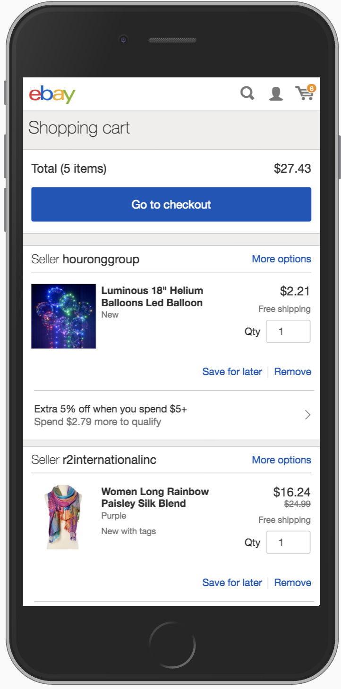
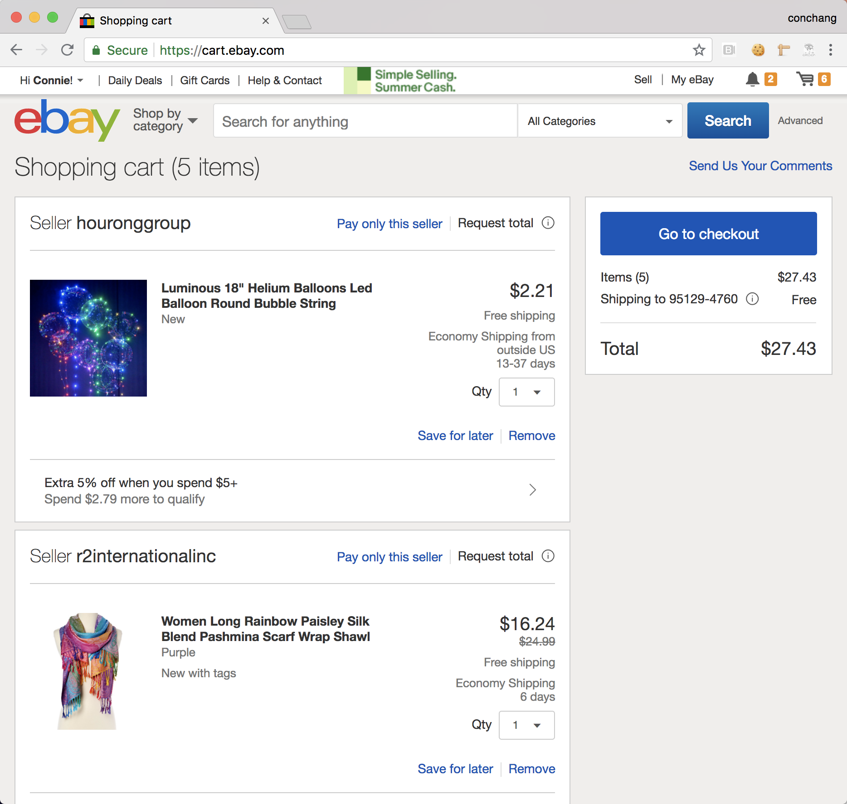
Modern website example:
eBay Shopping Cart 2018
https://cart.ebay.com
- Single Page App (SPA)
- AJAX interactions
- Loading indicators
- Stylized text/links
- Lazy loaded images
- Desktop/Mobile Web
← Desktop Web
Mobile Web →

Slide 4
Goals for the lesson:
Include a JavaScript file in your HTML file
Listen for DOM content ready
Change text in HTML, using JavaScript
Listen for user input
Update HTML on user input

Slide 5
JavaScript can be used to
modify HTML elements
modify HTML attributes
modify CSS styles
remove existing HTML elements and attributes
create new HTML elements and attributes
react to existing HTML events
create new HTML events
...and more!

Slide 6
Including JavaScript
Just like with CSS, your JavaScript code can either live directly in the HTML
<script>
function foo() {
...
}
</script>
Or in a separate file included by the HTML
<script type="text/javascript" src="click.js"></script>
Keeping your JavaScript separate is the preferred practice!

Slide 7
Including JavaScript – let’s do it!
Let’s create a bare bones HTML file that includes some JavaScript:
(bonus – create those files using the terminal commands we learned last week! mkdir, vi, etc)
index.html
<html>
<head>
<script type="text/javascript" src="click.js"></script>
</head>
<body>
</body>
</html>
click.js
alert('Connie thinks you are awesome!');

Slide 8
Goals for the lesson:
Include a JavaScript file in your HTML file
Listen for DOM content ready
Change text in HTML, using JavaScript
Listen for user input
Update HTML on user input

Slide 9
Key terms
The Document Object Model (DOM) is the Object representation of everything in your web page.
A DOM node is any individual element within your web page, that makes up the DOM.
Any item in your web page can be accessed by using the document object.
<html> <body> <p id='demo'></p> <script> document.getElementById('demo').innerHTML = 'Hi!';
</script> </body> </html>

Slide 10
Key terms
A property is a value that you can get or set on a DOM node (like changing the content of an HTML element)
innerHTML is a property
A method is a function you can do on an Object such as document (like add or deleting an HTML element)
getElementById() is a method
<html> <body> <p id='demo'></p> <script> document.getElementById('demo').innerHTML = 'Hi!';
</script> </body> </html>

Slide 11
Working with HTML elements
You can select HTML elements from the DOM using selectors
by id const x = document.getElementById('intro');
by tag name const x = document.getElementsByTagName('p');
by class name const x = document.getElementsByClassName('intro');
by CSS selectors const x = document.querySelectorAll('p.intro');
by Object collection const x = document.forms['form-1’];
...and more!

Slide 12
Working with HTML elements
You can do many things with methods available on the document object, for example:
- Write directly to the HTML output stream
document.write(Date());
- Change the content of an HTML element
document.getElementById('p1').innerHTML = 'New text!’;
- Change the value of an attribute
document.getElementById('my-image').src = 'landscape.jpg';

Slide 13
Working with HTML elements
- Change the style of an HTML element
document.getElementById('p2').style.color = 'blue’;
- Create a new HTML element
const para = document.createElement('p'); // Create a <p> element
const t = document.createTextNode(‘This is a paragraph.'); // Create a text node
para.appendChild(t); // Append the text to <p>

Slide 14
But wait!
An HTML document loads in order from top to bottom*. File includes are usually in the document head, so the JavaScript will run before the HTML is ready, causing selectors in the JavaScript to try to grab elements that don’t exist yet. To prevent this, you can pass all your code as a function to an event listener listening for the DOM to be loaded: document.addEventListener('DOMContentLoaded', function(event) {
// Your JavaScript code
});
There are better practices to address this issue that we’ll be covering later on.
*unless specified as asynchronous

Slide 15
Working with HTML elements – let’s do it!
Let’s use JavaScript to manipulate some HTML in the files we created earlier.
First, we’ll need to add a div and add an ID we can use to manipulate its contents:
index.html
<html>
<head>
<script type="text/javascript" src="click.js"></script>
</head>
<body>
<div id="div1">Unchanged text</div>
</body>
</html>
Then, we need to listen for DOM ready and then add some JavaScript to call the HTML above!
click.js
document.addEventListener('DOMContentLoaded', function(event) {
const div1 = document.getElementById('div1');
div1.innerHTML = 'New text!'; });
Notes:
https://i.ytimg.com/vi/icqDxNab3Do/maxresdefault.jpg

Slide 16
Goals for the lesson:
Include a JavaScript file in your HTML file
Listen for DOM content ready
Change text in HTML, using JavaScript
Listen for user input
Update HTML on user input

Slide 17
That’s it for JavaScript with HTML
Any questions?

Slide 18
Question: Now we know how to use JavaScript to manipulate the webpage, but how do we get JavaScript to dynamically respond to user interactions?
Answer: Events and event listeners!

Slide 19
Event listeners
Attaches an event handler to an element without overwriting existing event handlers. (An event handler is code that is executed in response to an event.)
You can attach many event handlers to one element.
You can attach many event handlers of the same type to one element, i.e. two "click" events.
You can remove a specific event handler using removeEventListener.
Notes:
Allows for multiple different actions on an event--not limited to one

Slide 20
Events
Events can be:
click
mouseover
keydown
keyup
...and more!
How to assign events to DOM Elements?
<script>
// Gets the element with id “div1”
const div1 = document.getElementById('div1');
// Do something when div1 is clicked
div1.addEventListener('click', function() {
...
});
</script>

Slide 21
Event listeners – let’s do it!
We want a <div> that initially says “Unclicked” and changes to “Clicked!” when a user clicks on it:
index.html
<html>
<head>
<script type="text/javascript" src="click.js"></script>
</head>
<body>
<div id="div1">Unclicked</div>
</body>
</html>
Then, use `addEventListener` to listen for a user event!
click.js
document.addEventListener('DOMContentLoaded', function(event) {
const div1 = document.getElementById('div1');
div1.addEventListener('click', function() {
div1.innerHTML = 'Clicked!';
}); });

Slide 22
Event listeners pt. 2 – let’s do it!
Now, we want the div to show the number of times that it has been clicked.
index.html
<html>
<head>
<script type="text/javascript" src="click.js"></script>
</head>
<body>
<div id="div1">Unclicked</div>
</body>
</html>
click.js
document.addEventListener('DOMContentLoaded', function(event) {
let clicks = 0;
const div1 = document.getElementById('div1');
div1.addEventListener('click', function() {
clicks++;
div1.innerHTML = 'Clicked ' + clicks + ' times!';
}); });

Slide 23
Goals for the lesson:
Include a JavaScript file in your HTML file
Listen for DOM content ready
Change text in HTML, using JavaScript
Listen for user input
Update HTML on user input

Slide 24
That’s it for event listeners
Any questions?

Slide 25
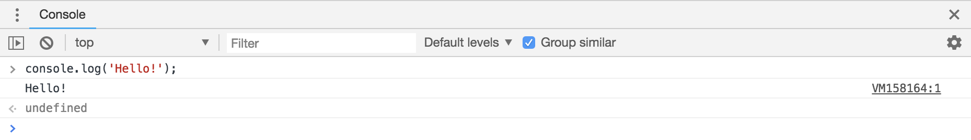
JavaScript tools
Many browsers come with a JavaScript console under Developer Tools
Allows you to see logged output from JavaScript
Allows you to execute JavaScript commands to interact with the web page

Slide 26
JavaScript debugging
Printing to debug is only efficient for simple problems.
For more complex issues, you can use debugger; as a breakpoint in your code. You can also set breakpoints from the browser via the developer console.
Breakpoint: pauses execution of code at the specified point
Once paused at a breakpoint, you can use debugging tools provided in the console to step through your code statement by statement. You can also inspect the value of variables at each point to track what is going on in your code!

Slide 27
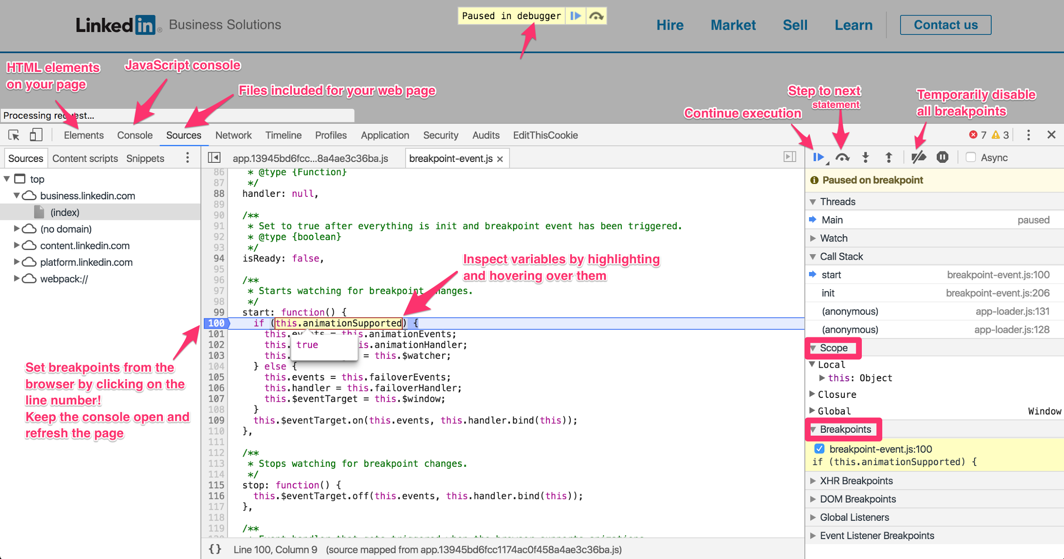

Slide 28
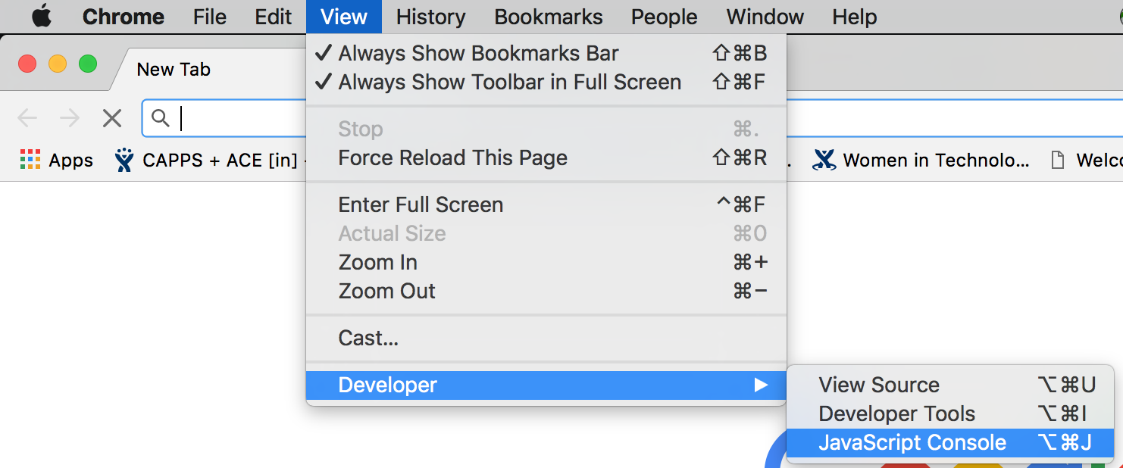
Try it yourself!
Open up a browser and find its console.
Test out some JavaScript you just learned to see output in the console. Practice setting breakpoints, stepping through code, and inspecting variables.
Bonus: use the console to execute JavaScript to manipulate the webpage!

Slide 29
That’s it for the console
Any questions?

Slide 30
References
https://www.w3schools.com/js/js_debugging.asp
http://blog.teamtreehouse.com/mastering-developer-tools-console
http://idratherbewriting.com/events-and-listeners-javascript/
https://www.w3schools.com/js/js_htmldom_eventlistener.asp

