Slide 1
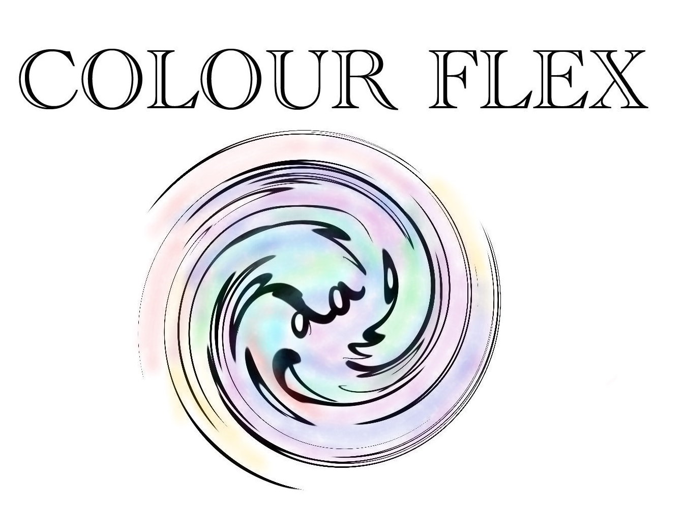
Arguably the most powerful colour scheme maker available anywhere in the world at this current moment in time

Slide 2
MOTIVE
If you actually even care, you might not know that wearing red trousers and a green jumper is perhaps not the most aesthetically appealing
so we have a solution →

Slide 3
SOLUTION
if you have one item of clothing you like, the app will suggest the colours of the remaining items of clothing (following the concept of “colour blocking” in fashion)

Slide 4
WHAT/HOW
A webapp using html/javascript where a user can import a picture of their item of clothing.
A query is made to a colour recognising API that returns an array of RGB values which are then fed to another API that returns the best user made colour palettes that include the colours from the photo.
Once the colours are loaded, one can click the colours to get a link to highest rated items of clothing (in t shirts, trousers, shoes, shirts etc) SO YOU CAN BUY THEM STRAIGHT AWAY*
*obviously these are affiliate links so we can get the $$$$$$$$$$$$$$$

