Slide 1

Is GDP Affected By Temperature & Precipitation

Slide 2

Data Acquisition

Slide 3
Methods Used

Slide 4
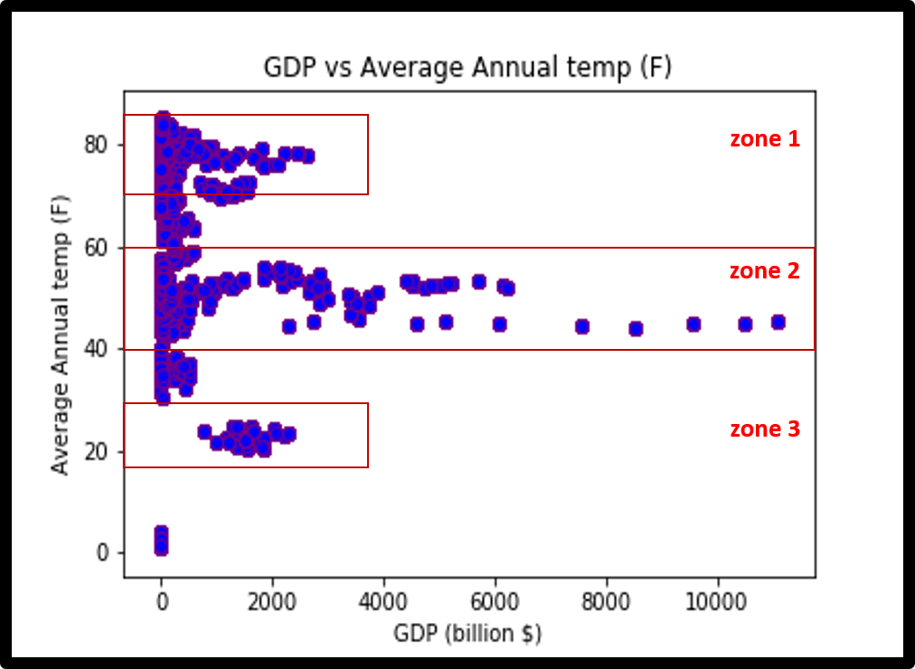
Annual Average Temperature & Precipitation vs GDP
Identified Zones of interest based on the wide range of GDP values for a range of temperatures

Slide 5
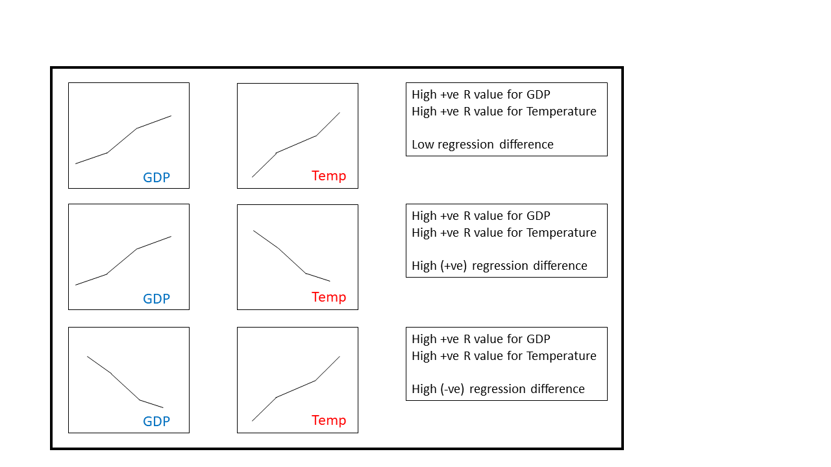
Regression Correlation Technique
Strong positive regression correlation = Low regression difference
Strong inverse regression correlation = High regression difference

Slide 6
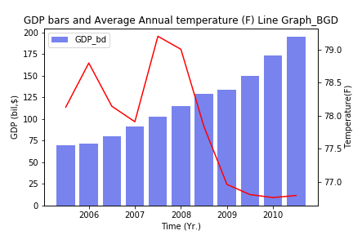
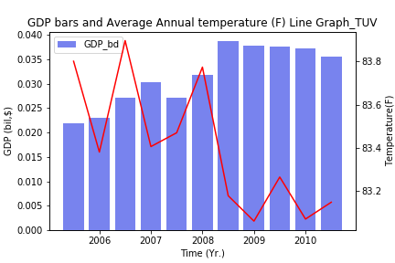
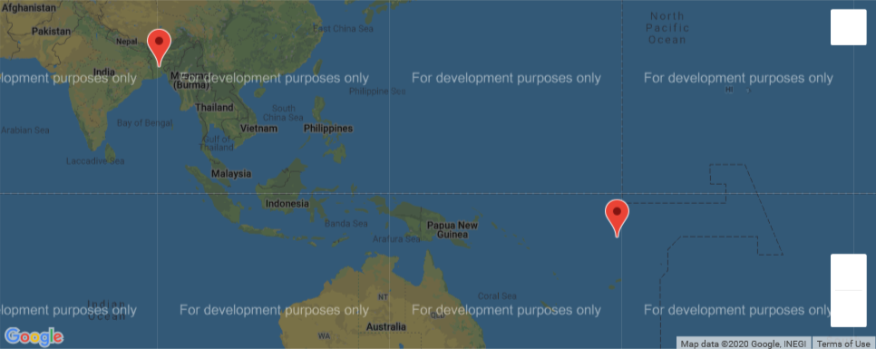
Inversely correlated relationship

Slide 7
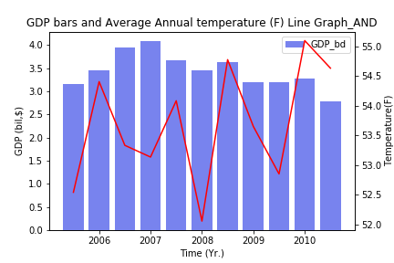
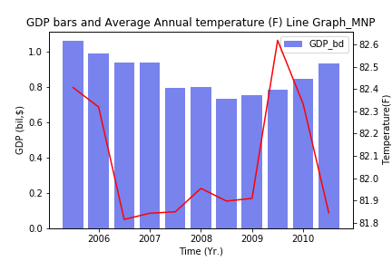
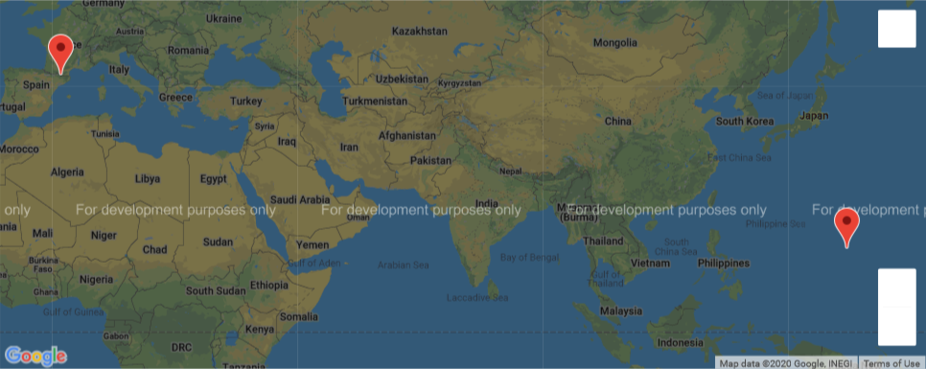
Inversely correlated relationship

Slide 8
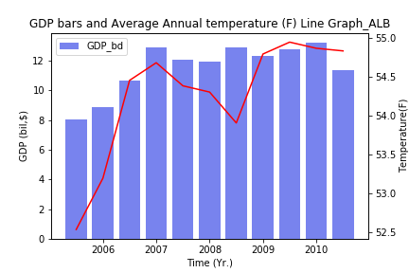
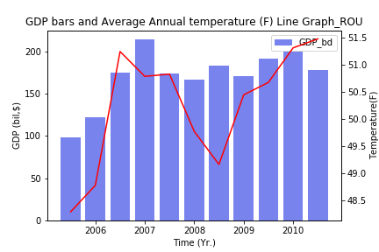
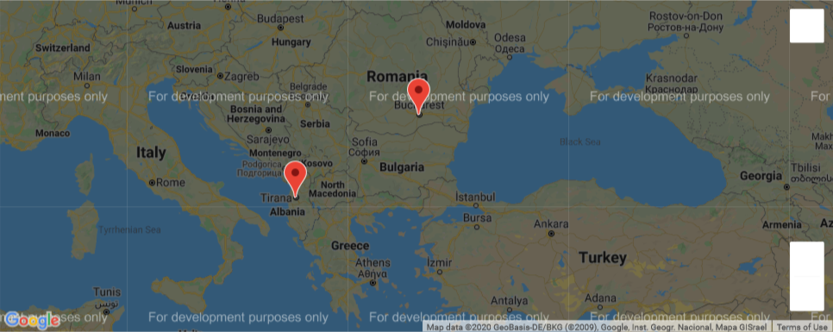
Positively correlated relationship

