Slide 1

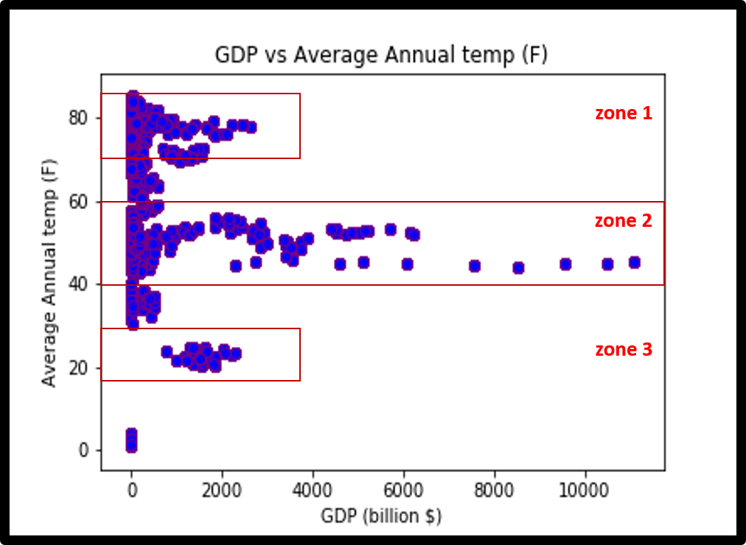
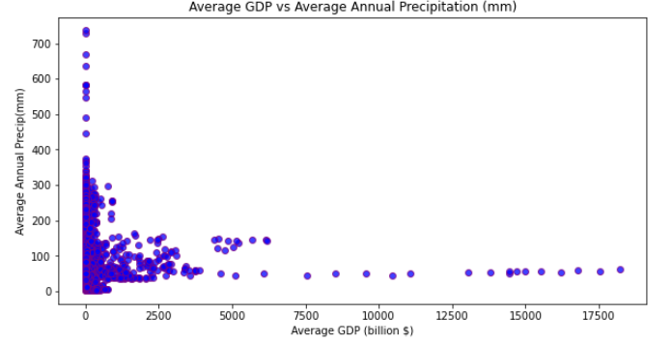
Annual Average Temperature & Precipitation vs GDP
Identified Zones of interest based on the wide range of GDP values for a range of temperatures
zone of interest

Slide 2
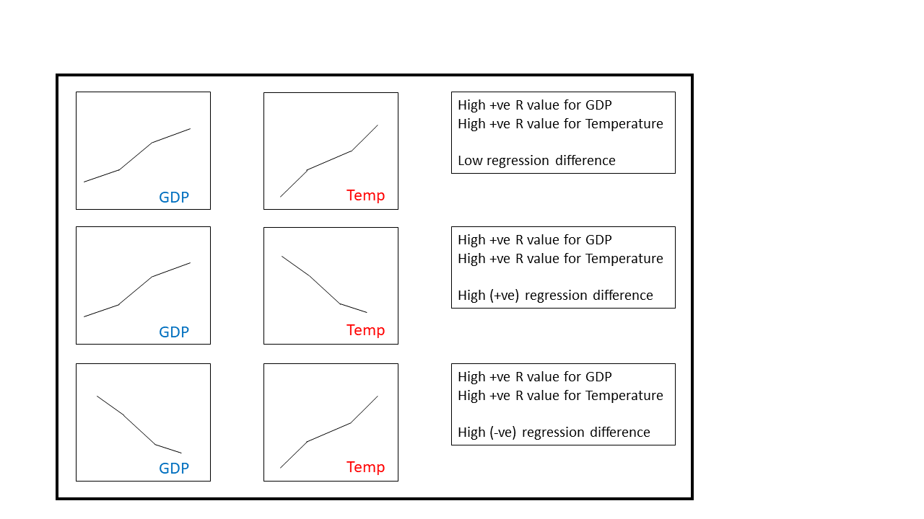
Regression Correlation Technique
Strong positive regression correlation = Low regression difference
Strong inverse regression correlation = High regression difference

Slide 3
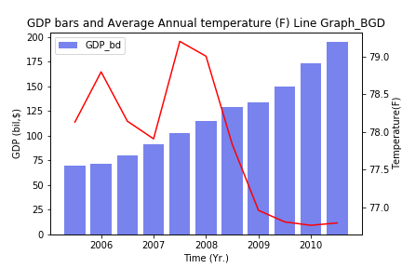
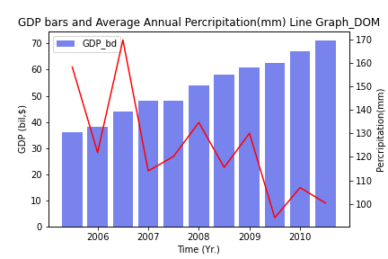
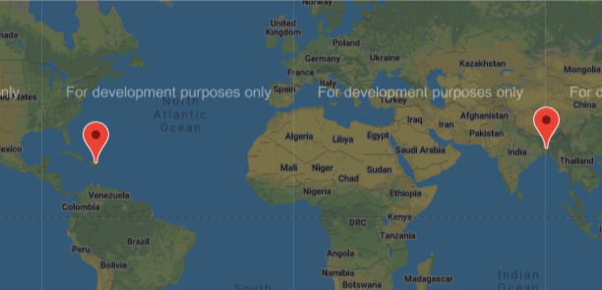
Inversely correlated relationship
Temperature r-value: -0.7
GDP r-value: 0.98
Temperature r-value: -0.71
GDP r-value: 0.99

Slide 4
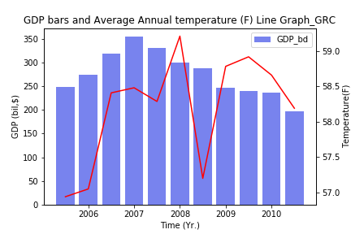
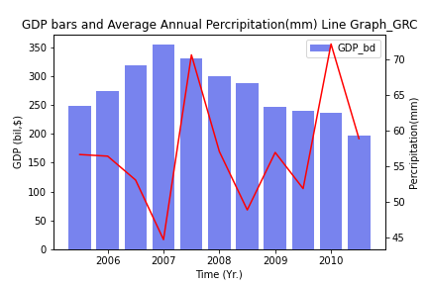

Inversely correlated relationship
Temperature r-value: 0.52
GDP r-value: -0.57
Temperature r-value: 0.29
GDP r-value: -0.57

Slide 5
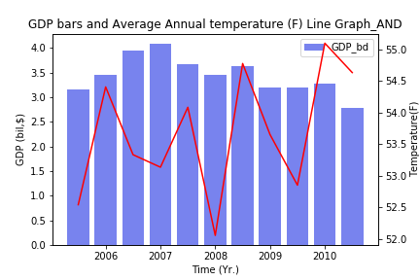
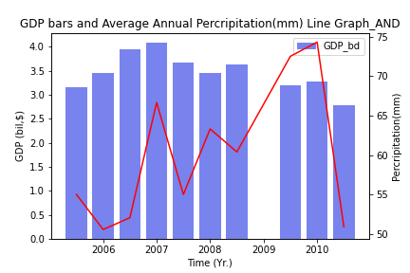

Inversely correlated relationship
Temperature r-value: 0.41
GDP r-value: -0.53
Temperature r-value: -0.51
GDP r-value: -0.53

Slide 6
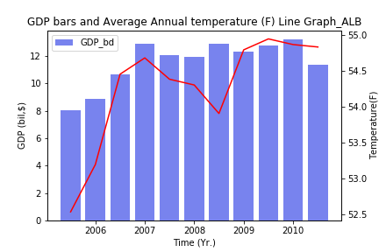
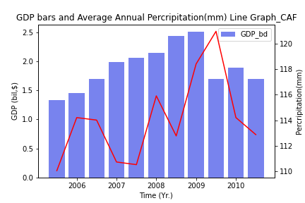

Positively correlated relationship
Temperature r-value: 0.76
GDP r-value: 0.71
Temperature r-value: -0.47
GDP r-value: 0.40

