Slide 1
Gotta Catch Em All
Group 6: Kimberly Flores, Joceline Flores, Kiran Mundae, Sadie Boudreau

Slide 2

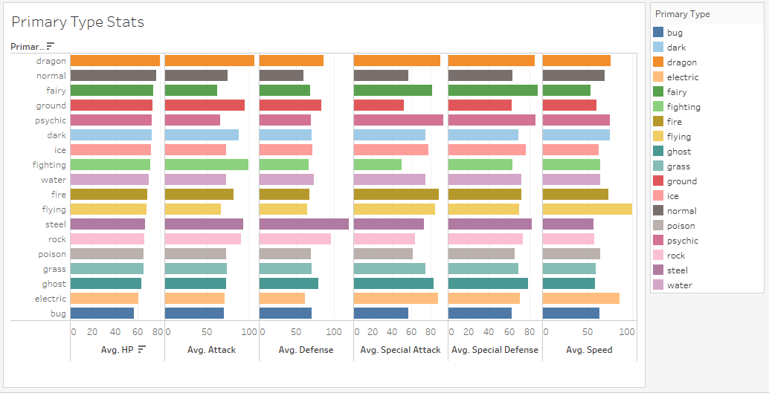
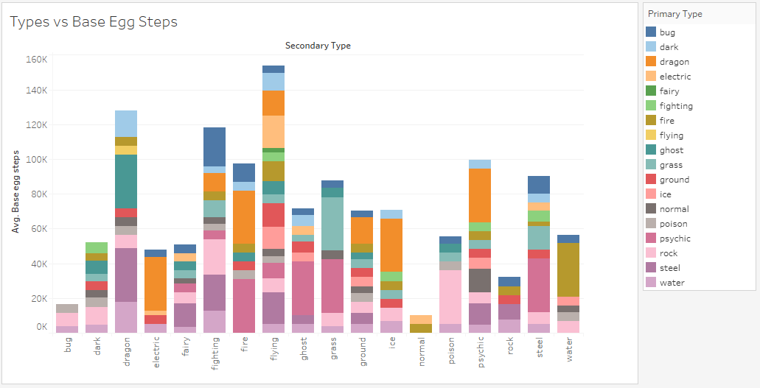
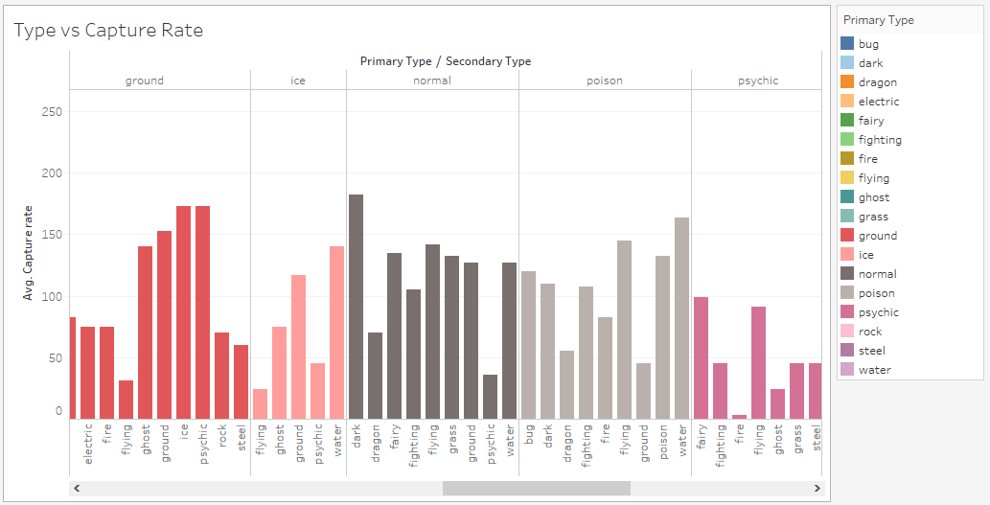
\
Is your significant other really interested in Pokémon.. And you aren’t..
Well, we’ve got the solution to all your Pokémon-Problems
Step 1: Watch Ryan Reynolds movie 2+ times
Step 2: Check out our website for individual Pokémon facts
Step 3: DO NOT watch Pokémon For Dummies YouTube video
Step 4: Check out the interesting facts in our Tableau Story

Slide 3
Data Sources

Slide 4
Data Sources
Image Data Set:
https://www.kaggle.com/thedagger/pokemon-generation-one
Pokemon Stats:
https://www.kaggle.com/rounakbanik/pokemon

Slide 5
Building The Model

Slide 6
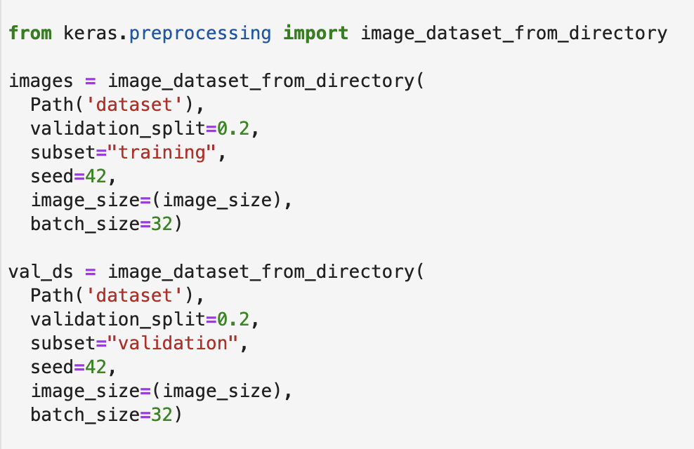
Building the Convolutional Model
Image Data Set was uploaded from Kaggle using Keras to import the dataset
Keras was used because it automatically determined the categories for our dataset
80% of the image dataset was used for Training
Remaining 20% of image dataset was used for Testing

Slide 7
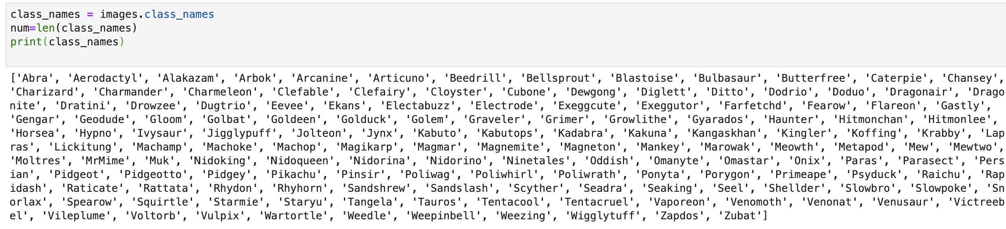
Building the Convolutional Model
149 different Pokémon were analyzed

Slide 8
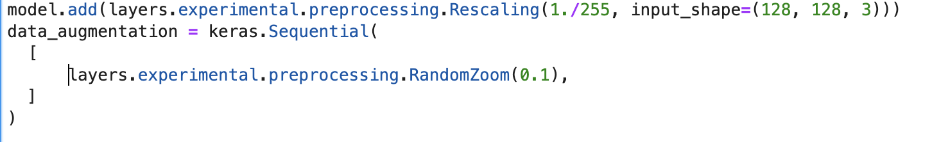
Building the Convolutional Model
Images were scaled for model consistency
Data augmentation was used to randomly zoom into the images for optimal training

Slide 9
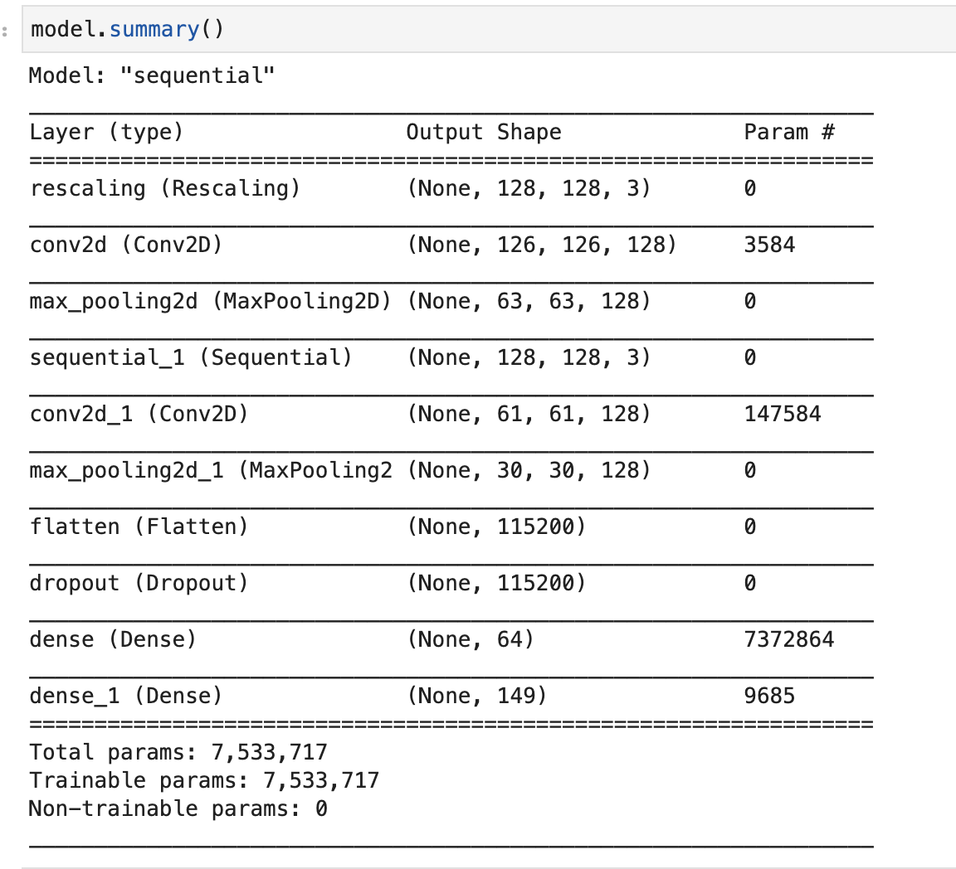
\
Building the Convolutional Model
9 different layers were built into our convolutional model, 1 being the dropout layer to reduce overfitting
Model was compiled using Sparse Categorical Crossentropy
Model was trained until accuracy was >70%

Slide 10
Let’s Check Out The Website

Slide 11
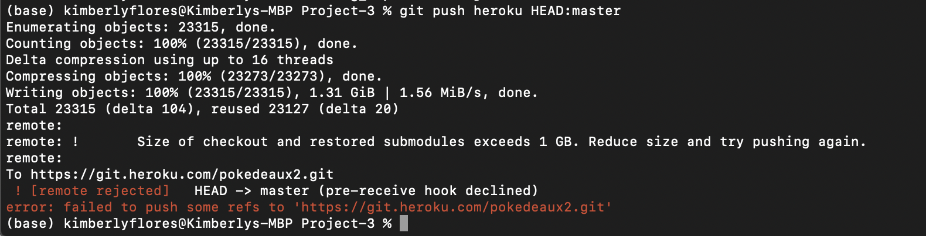
\
Lessons Learned
Attempted to build a CNN to analyze Where’s Waldo images
Attempted to build a CNN to analyze mushrooms
We were able to use H5 rather than Pickle to load our model because we were using TensorFlow (i.e., images)
Attempted to deploy to Heroku, but the model alone was too large
https://pokedeaux2.herokuapp.com/

Slide 12
Questions?

