Slide 1
Spark Streaming SQL Introduction
Hao Cheng
Software Engineer@ Big Data Technologies

Slide 2
Outlines
Why Streaming SQL?
Recall Spark Streaming & Spark SQL
How Spark Streaming SQL works?
Demo Project
Spark Streaming DataFrames

Slide 3
Why do we need Streaming SQL
Low level programming schemes cost longer developing cycles and cost.
SQL is a standard high level (declarative) language widely used for many years.

Slide 4

DStreams (Discretized Streams)
Data Streams
Batches
RDD
Results
val ssc = new StreamingContext(conf, Seconds(2))
val lines = KafkaUtils.createStream(…) .map(_._2)
val words = lines.flatMap(_.split(" "))
val wordCounts = words.map(x => (x, 1)).reduceByKey(_ + _)
wordCounts.print()
ssc.start()
ssc.awaitTermination()

Slide 5
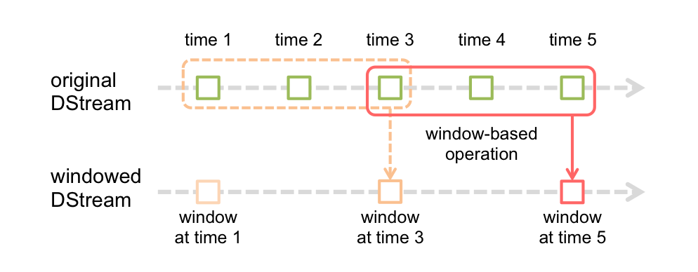
DStreams (Discretized Streams)
val wc = pairs.reduceByKeyAndWindow(_ + _, Seconds(30), Seconds(20))

Slide 6
Spark SQL Optimization/execution Pipeline
AST
Unresolved Logical Plan
Resolved Logical Plan
Optimized Logical Plan
Physical Plan
DataFrame
Catalog
Cost Model
Select Physical Plan
RDD

Slide 7
Spark SQL Spark Plan & RDD
mapPartitions(writeFile _)
SparkPlan
SaveIntoFile(“/path/to/file”)
map
Project(a.value, b.value, a.key)
zipPartitions()
SortMergeJoin (a.key=b.key)
ShuffledRDD
ShuffledRDD
Parquet Table Scan(b)
Filter(a.key>1)
sc.parallelize(.)
ORC Table Scan(a)
filter()
sc.parallelize(.)

Slide 8
Spark Streaming SQL ??
Reuse the existing code? Benefit from the existing functionalities? (Of Spark SQL & Streaming)
Define the “Window” on a Spark SQL relation?
Define the Streaming Data Source for Spark SQL

Slide 9
The Key Classes
case class WindowedPhysicalPlan(
windowDuration: Duration,
slideDuration: Option[Duration],
child: SparkPlan)
extends SparkPlan with StreamPlan {
override def execute(): RDD[Row] = {...}
}
Planning Stage
class SchemaDStream(
val streamSqlContext: StreamSQLContext,
val queryExecution: SQLContext#QueryExecution)
extends DStream[Row](streamSqlContext.streamingContext) {
override def compute(validTime: Time): Option[RDD[Row]] = {...}
}
Submit Stage

Slide 10
Spark Streaming SQL
SchemaDStream
mapPartitions(writeFile _)
SparkPlan
SaveIntoFile(“/path/to/file”)
map
Project(a.value, b.value, a.key)
zipPartitions()
SortMergeJoin (a.key=b.key)
ShuffledRDD
ShuffledRDD
WindowedPhysicalPlan
Parquet Table Scan(b)
Filter(a.key>1)
sc.parallelize(.)
ORC Table Scan(a)
filter()
sc.parallelize(.)

Slide 11
Create a Streaming Data Source
CREATE TEMPORARY TABLE t_kafka (
word string
) USING org.apache.spark.sql.streaming.sources.KafkaSource
OPTIONS(
zkQuorum "localhost:2181",
groupId "test",
topics "aa:1",
messageToRow "org.apache.spark.sql.streaming.examples.MessageDelimiter“)

Slide 12
Define Window Over SQL Relation
SELECT t.word, COUNT(t.word)
FROM (SELECT * FROM test) OVER (WINDOW '9' SECONDS, SLIDE '3' SECONDS) AS t
GROUP BY t.word

Slide 13
Spark Streaming V.S. Streaming SQL
Spark Streaming
Streaming SQL
val weblog= KafkaUtils.createStream(…)
.map(_._2)
.flapMap(_.split(“|”)).map(_._2, _)
val category=
sc.textFile(…).flatMap(_.split(“|”))
val result
= weblog.transform(r => r.join(category))
.map(_._2._2, 1L))
.reduceByKey(_ + _)
result.print
CREATE TEMPORARY TABLE weblog ( sourcep_ip STRING, cookie_id INT, item_id INT …) USING ‘xxx.KafkaDataSource’ OPTIONS (..)
CREATE EXTERNAL TABLE category (item_id INT, category STRING) STORED AS TEXTFILE LOCATION “..”;
SELECT category, COUNT(*) FROM weblog JOIN category ON category.item_id = weblog.item_id GROUP BY category.category;
Notes:
More convenient for users:
Who NOT familiar with scala/java programming
Adhoc Query

Slide 14
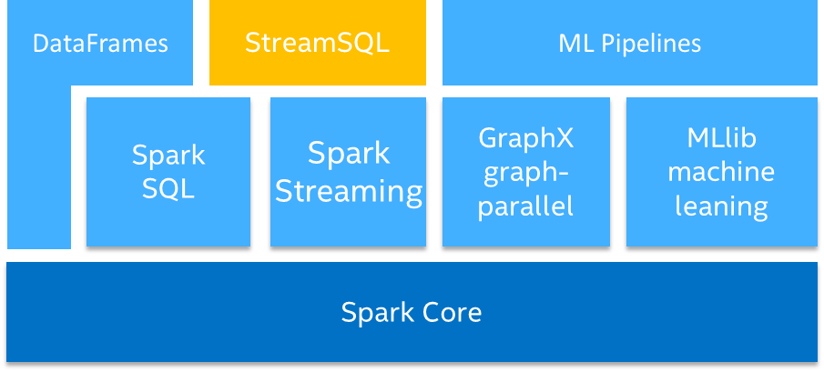
More Characteristics
Auto benefit from both Spark SQL / Streaming improvements.
100% compatible with Spark SQL queries, metastore.
Operations among static data relation and streaming data relation.
~2300 LOC
Streaming SQL

Slide 15





E2E Video analytics for Internet of Things
Algorithms & Learning Frameworks
Face Recognition
Face Detection
…
VA SDK
VA SDK
Real-time, Streaming Analysis (Spark Streaming)
Based Analytics Platform
Data Platform (“Plumbing”)
User Interface
Smart
Camera
Alert & Query Interface
Compute (Spark)
Video/Metadata over RTSP
Frame/Metadata over MQTT
Load Balance & Data Input (Kafka)
Web Service / App
Gateway
Metadata
Transport Broker
Storage (HDFS, HBase)
Edge Preprocessing
Backend / Cloud Analytics
Enabled two use cases
Real-time face detections in video surveillance
Large-scale face recognition in history video stream
Notes:
Video Analytics is becoming increasingly relevant in Security
User Interface: Both Real Time alert / History Search / Custom Adhoc Query

Slide 16
Spark Streaming SQL
https://github.com/Intel-bigdata/spark-streamingsql
Notes:
1. Spark 1.4.1 1.3.0 supported almost 1 year before
2. Discussed with DB for couple of times already.

Slide 17
Spark Streaming DataFrames
https://issues.apache.org/jira/browse/SPARK-8360
abstract class SparkPlan {
def children: Seq[SparkPlan]
def execute(): RDD[InternalRow] = {
child.execute().mapPartitionsInternal { iter =>
val function = newPrepare(xxx, xxx)
iter.map { row =>... }
}
}
...
}
abstract class LocalNode {
def children: Seq[LocalNode]
def open(): Unit = { }
def next(): Boolean = { }
def fetch(): InternalRow = currentRow
def close(): Unit = { }
...
}
https://issues.apache.org/jira/browse/SPARK-9983

