Slide 1
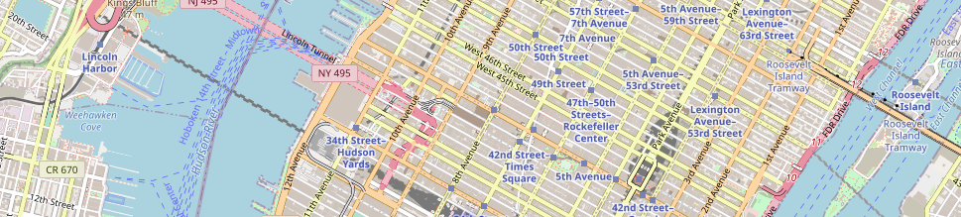
BATTLE OF THE NEIGHBOURHOODS
CAPSTONE FINAL PROJECT SUBMISSION
BY: SREYASHI BHATTACHARJEE

Slide 2
BEST PLACE TO SET UP A CAFE BUSINESS IN NEW YORK CITY?

Slide 3
Attract new customers
Not in a hub
Would not encourage too much of competition

Slide 4
WINNER??

Slide 5
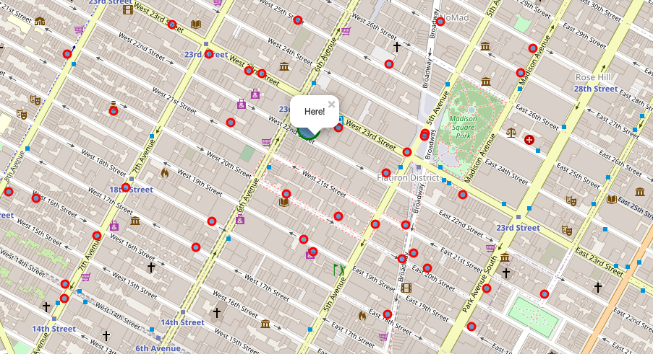

Slide 6
DETAILED REPORT
https://github.com/SBGitHub21/Coursera_Capstone/blob/master/Battle_of_Neighbourhoods_Final_Project_Report_Code.ipynb

Slide 7
THANK YOU

