Slide 1


SMART INDIA HACKATHON 2025
Data Dynamos
Problem Statement ID – SIH25068
Problem Statement Title-
Real time Groundwater resource
evaluation using DWLR data
Theme- Miscellaneous
PS Category- Software
Team ID- P142
Team Name: Data Dynamos
Problem Statement ID – SIH25068
Problem Statement Title-
Real time Groundwater resource
evaluation using DWLR data
Theme- Miscellaneous
PS Category- Software/Hardware: Software

Slide 2
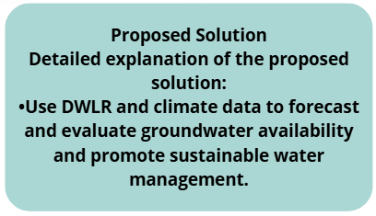
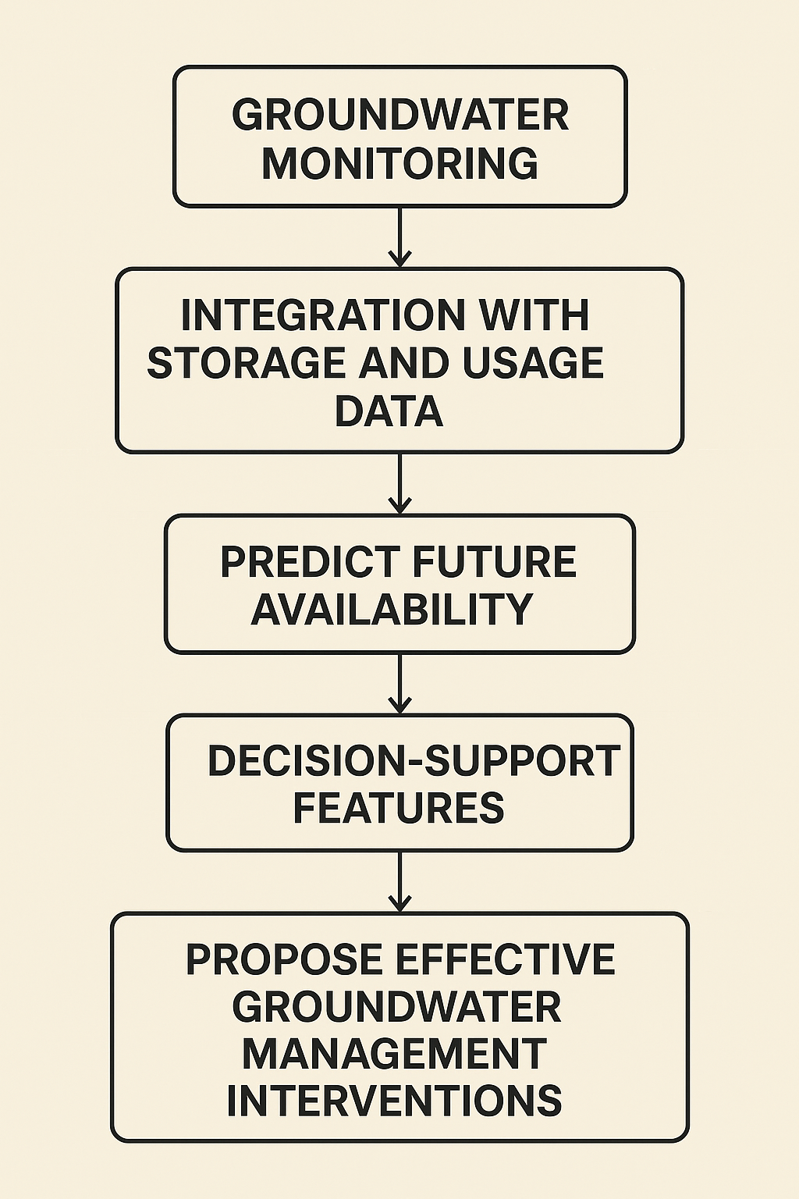
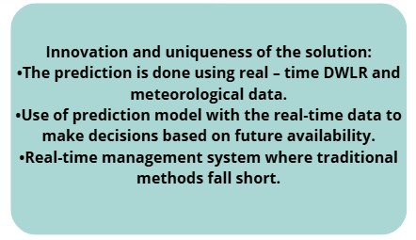
GROUNDWATER EVALUATION USING DWLR DATA
Data Dynamos
How to address the problem?

Slide 3
SMART INDIA HACKATHON 2025
TITLE PAGE
Problem Statement ID –
Problem Statement Title-
Theme-
PS Category- Software/Hardware
Team ID-
Team Name (Registered on portal)

Slide 4
TECHNICAL APPROACH
Data Dynamos
Technologies to be used: Flutter, Python, VPS or Cloud
Methodology and process for implementation:

Slide 5
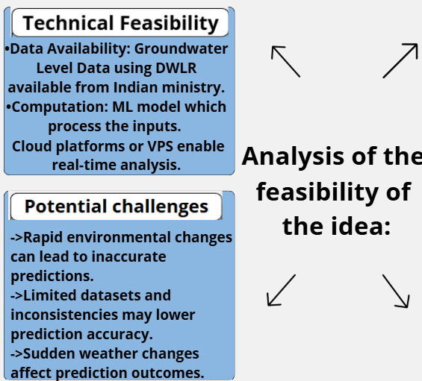
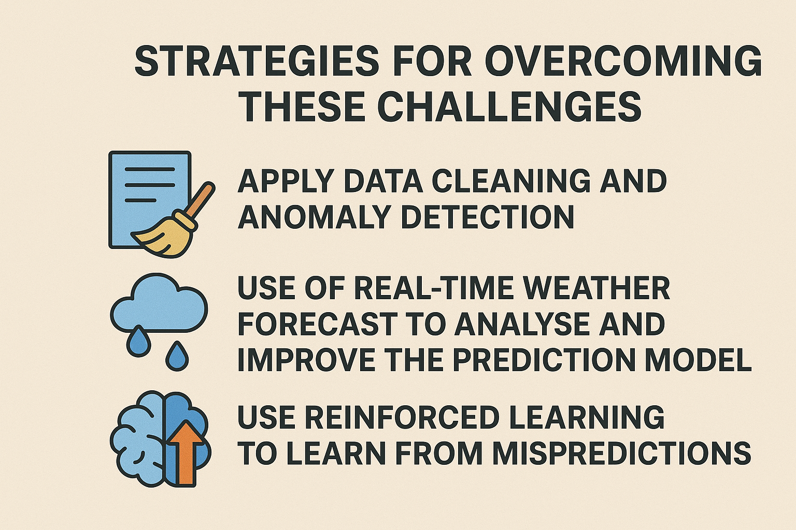
FEASIBILITY AND VIABILITY
Data Dynamos

Slide 6
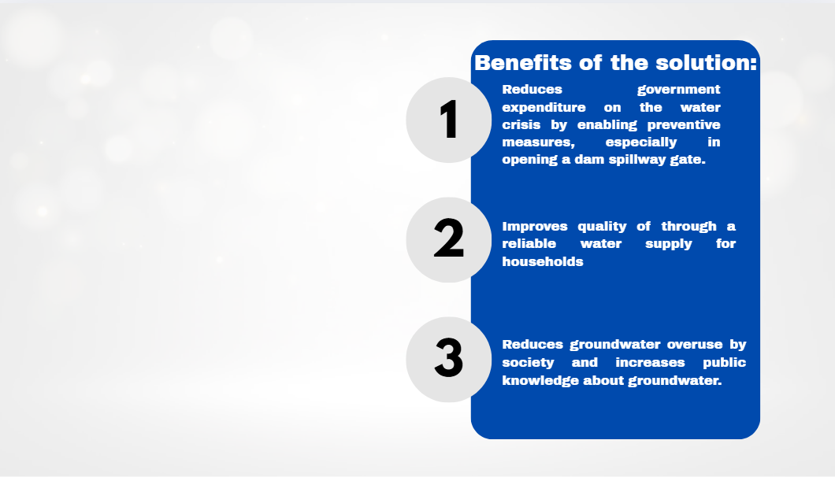
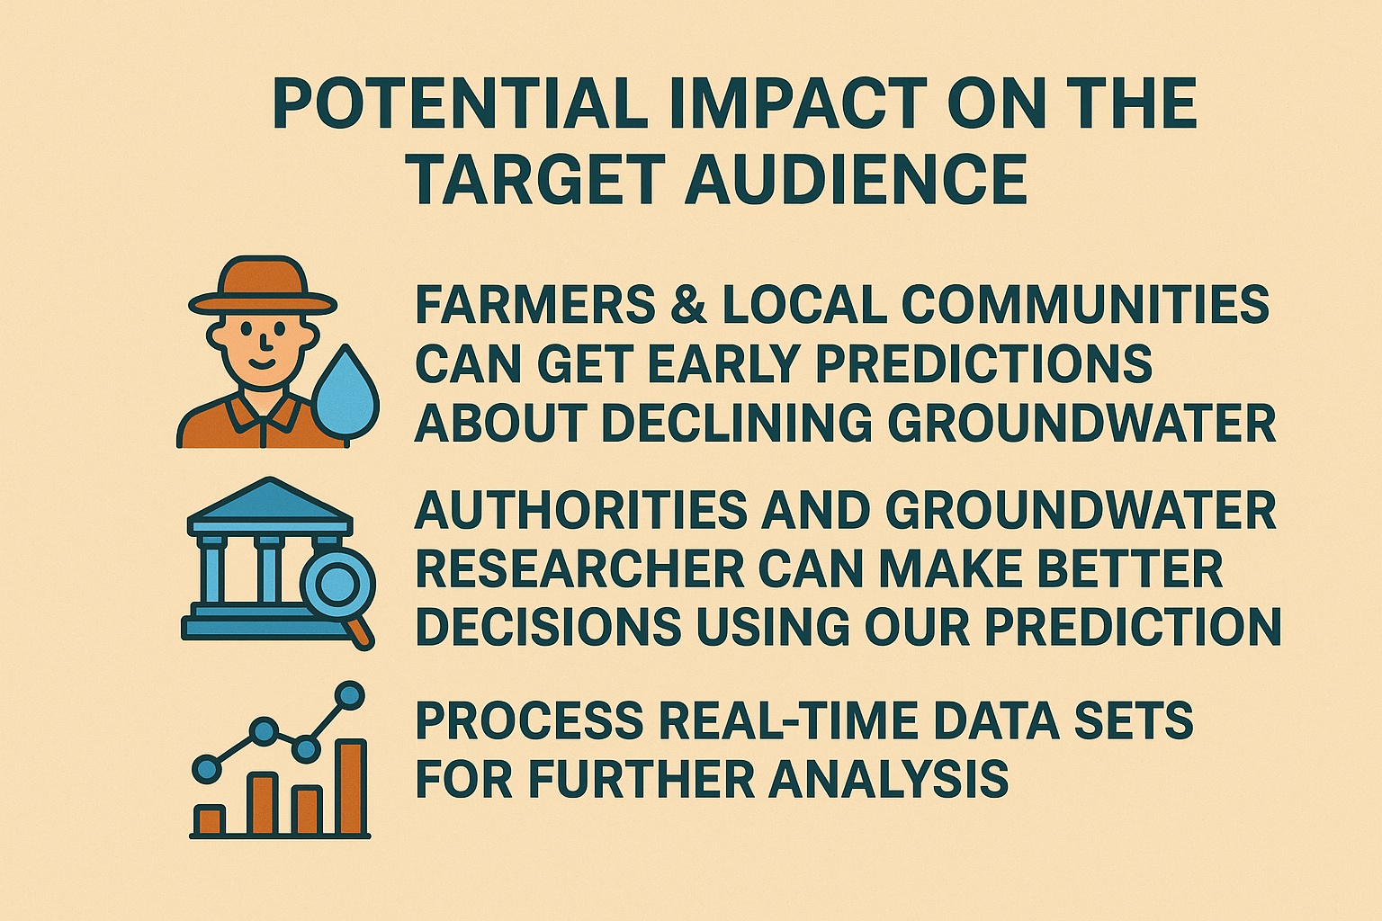
IMPACT AND BENEFITS
Data Dynamos

Slide 7
RESEARCH AND REFERENCES
Data Dynamos
One year data on water level, temperature, rainfall, pH, and dissolved oxygen:https://www.kaggle.com/datasets/alfredkondoro/digital-water-level recorder-dwlr-sensor-data?resource=download
Rainfall prediction with a machine learning algorithm: https://github.com/miketobz/ML-Rainfall-Prediction
Groundwater storage and depletion Trends in TamilNadu, India by P Chinnasamy and G Agoramoorthy: https://link.springer.com/article/10.1007/s11269-015-0932-z
Zhang, Qixiao, Peiyue Li, Xiaofei Ren, Jing Ning, Jiahui Li, Cuishan Liu, Yan Wang, and Guoqing Wang. "A new real-time groundwater level forecasting strategy: Coupling hybrid data-driven models with remote sensing data." Journal of Hydrology 625 (2023): 129962.
Zhu, Feilin, Ou Zhu, Mingyu Han, Weifeng Liu, Xuning Guo, Tiantian Hou, Lingqi Zhao, Chengjing Xu, and Ping-an Zhong. "A hybrid process-data driven framework for real-time hydrological forecasting with interpretable deep learning." Journal of Hydrology (2025): 134082.

