Slide 1

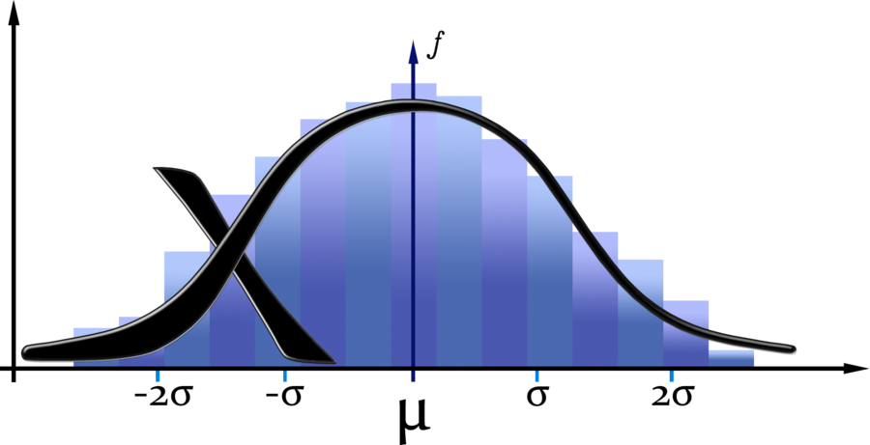



DATA-STATS
Sarika Rao Bommavaram - 12443437
Gouri Priya Vangavargu - 12437131
Sasidhar Malladi - 16175303
Sankalp Racharla - 16189434

Slide 2

Motivation
Many data sets these days are too large for a human to get any real meaning out of the content by reading through it manually.
Perfect example can be terabytes of website log files.
To solve this problem we have to get top level view on the data with some summarizations which can be used for analysis.

Slide 3
Summarization Patterns
Data is large and vast to handle, with more data coming into system every day.
Glean insights is not available from looking at a localized set of records alone.
To produce a top-level , summarized view of data these patterns are used.
Pattern which we are using in this use case is numerical summarizations.
Numerical Summarizations include minimum, maximum, average, median, and standard deviation.
Applicability:
You are dealing with numerical data or counting.
Data can be grouped by specific fields.

Slide 4
Numerical Summarization
The numerical summarizations pattern is a general pattern for calculating aggregate statistical values over a data collection.
Intent
Group records together by a key field and calculate a numerical aggregate per group to get a top-level view of the larger data set.
θ be a generic numerical summarization function we wish to execute over some list of values (v1, v2, v3, ..., vn) to find a value λ, i.e. λ = θ(v1, v2, v3, ..., vn). Examples of θ include a minimum, maximum, average, median, and standard deviation
Example
Group logins by the hour of the day and perform a count of the number of records in each group, group advertisements by types to determine how affective ads are for better targeting

Slide 5
Use Case Scenario
Statistics Is Fun:
John has a file that contains lots of numbers (all integer). They are unordered. He wants to generate some statistics around these numbers, namely COUNT, MEAN, Standard Deviation, MIN, MAX, and 25th, 50th, and 75th percentiles. The numbers are so large that it cannot be run on a single machine. Write a map-reduce program to generate above-mentioned statistics (no APACHE PIG, no HIVE).

Slide 6
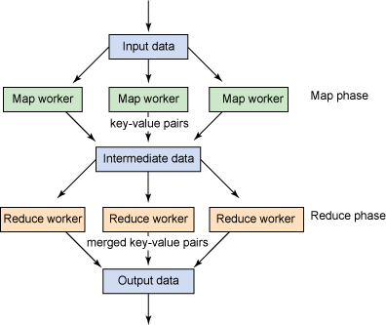
System Architecture

Slide 7
System Requiremts:
Software specifications | Tools
Operating System | Windows 8 64bit
Software platform | IBM BigInsights 1.2
NoSQL Data base | Hadoop
Visualization | IBM Big sheets
IDE | Eclipse

Slide 8
Implementation of Mean and Standard Deviation
Mean:
• Map Input (xi for i = 1 ..Nm)
• Map Output (Nm, Mean(x1..Nm))
• Reduce Input (Group(Map Output))
• Reduce Output (Mean(x1..N))
Standard Deviation:
• Map Input (xi for i = 1 ..Nm) & Mean(x1..N)
• Map Output (Sum(xi – Mean(x))2 for i = 1 ..Nm
• Reduce Input (Group (Map Output)) & N
• Reduce Output (Standard Deviation)

Slide 9
Implementation of Min, Max and Percentiles
Min:
The number with index 0 in the Array List
Max:
The Number with highest index in the Array list
Percentiles:
P=(R/100)*(N+1)
Where N= total number of numbers in the given input file
R= The percentile that we want to calculate
If p=I+D
Where I is Integer, D is Decimal Value that can be 0.25 or 0.50 etc.,
Percentile= (I th number-(I+1)number)*D + I th number;

Slide 10
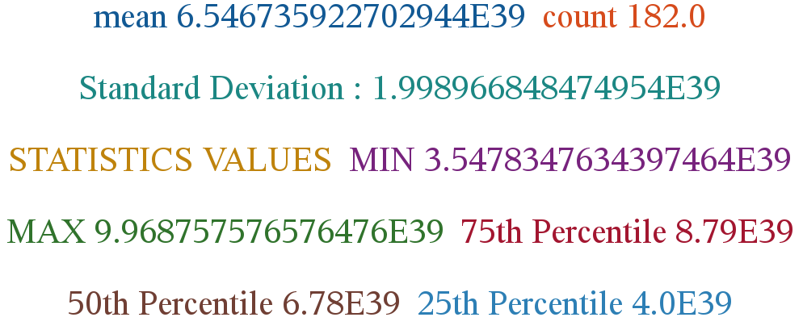
Results

Slide 11
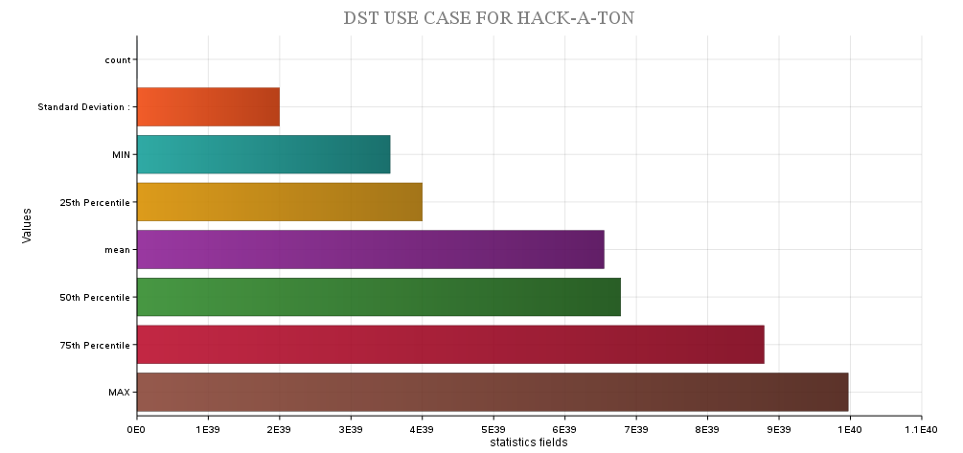
Results
Visualization using Big sheets

