Slide 1
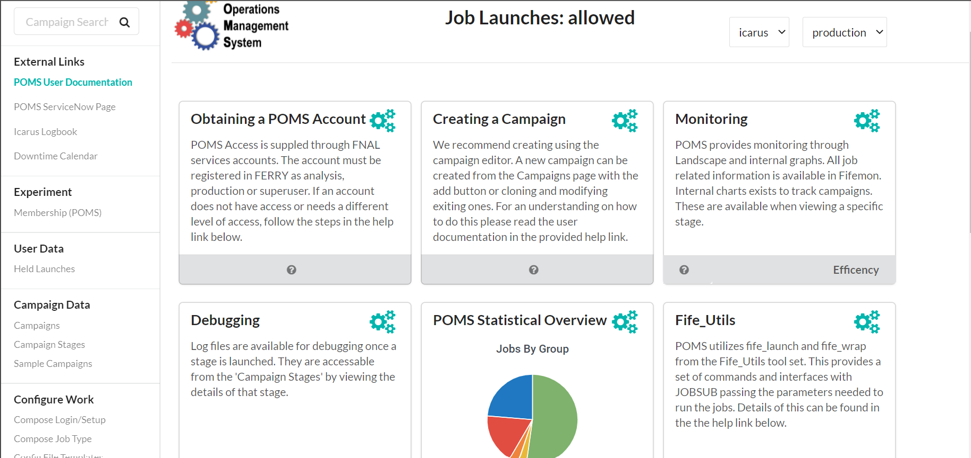
click

Slide 2
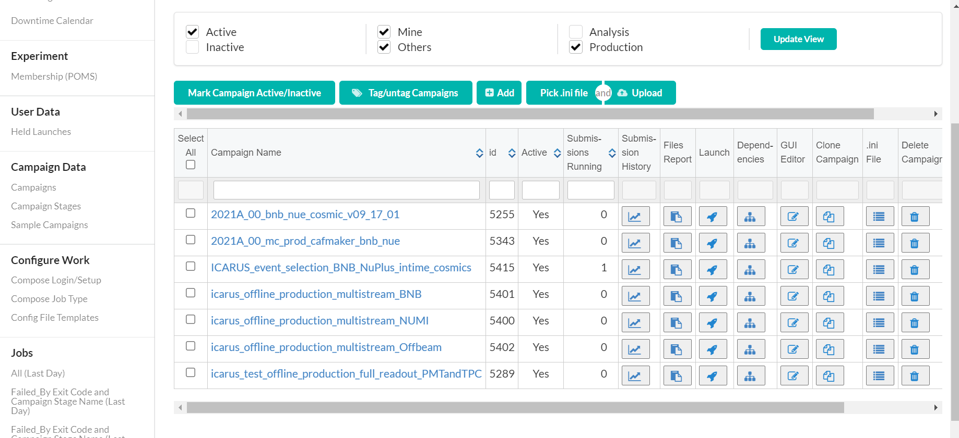
click

Slide 3
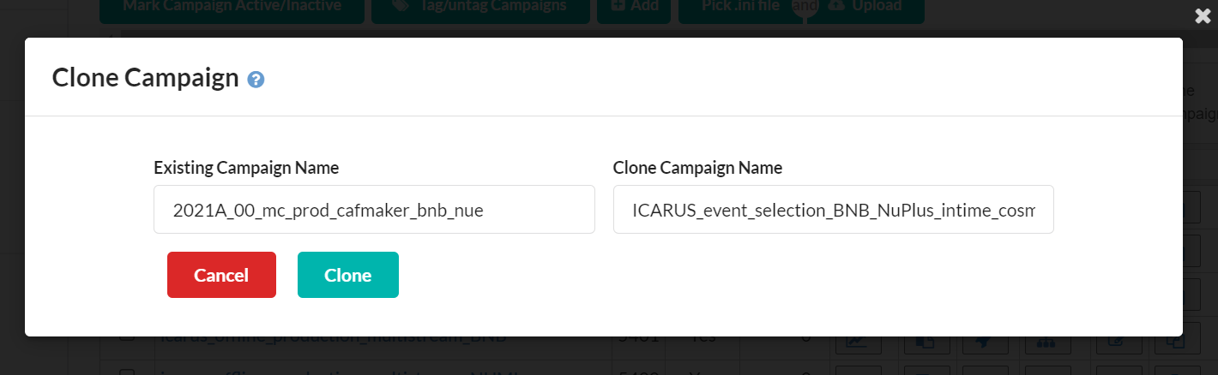
1
type
click
2

Slide 4
click

Slide 5
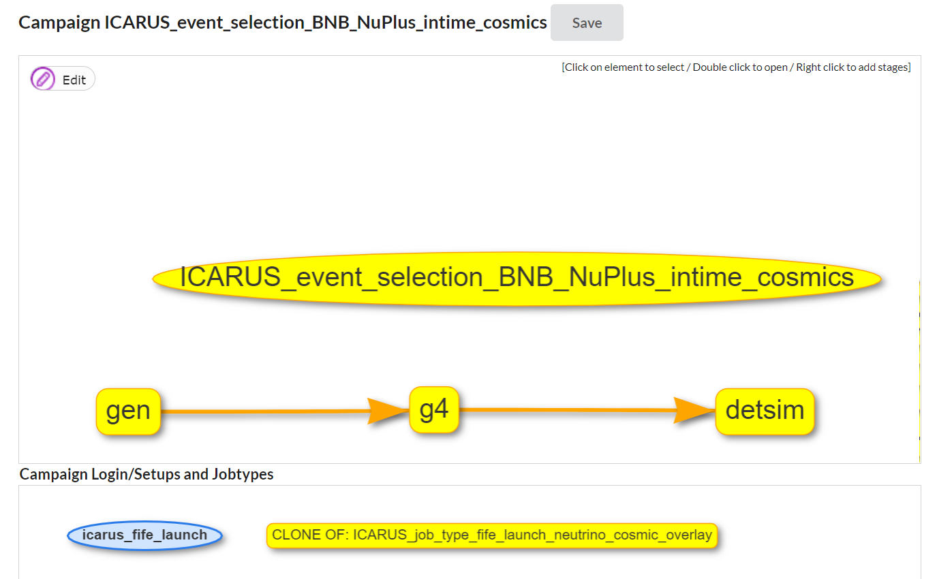
click

Slide 6
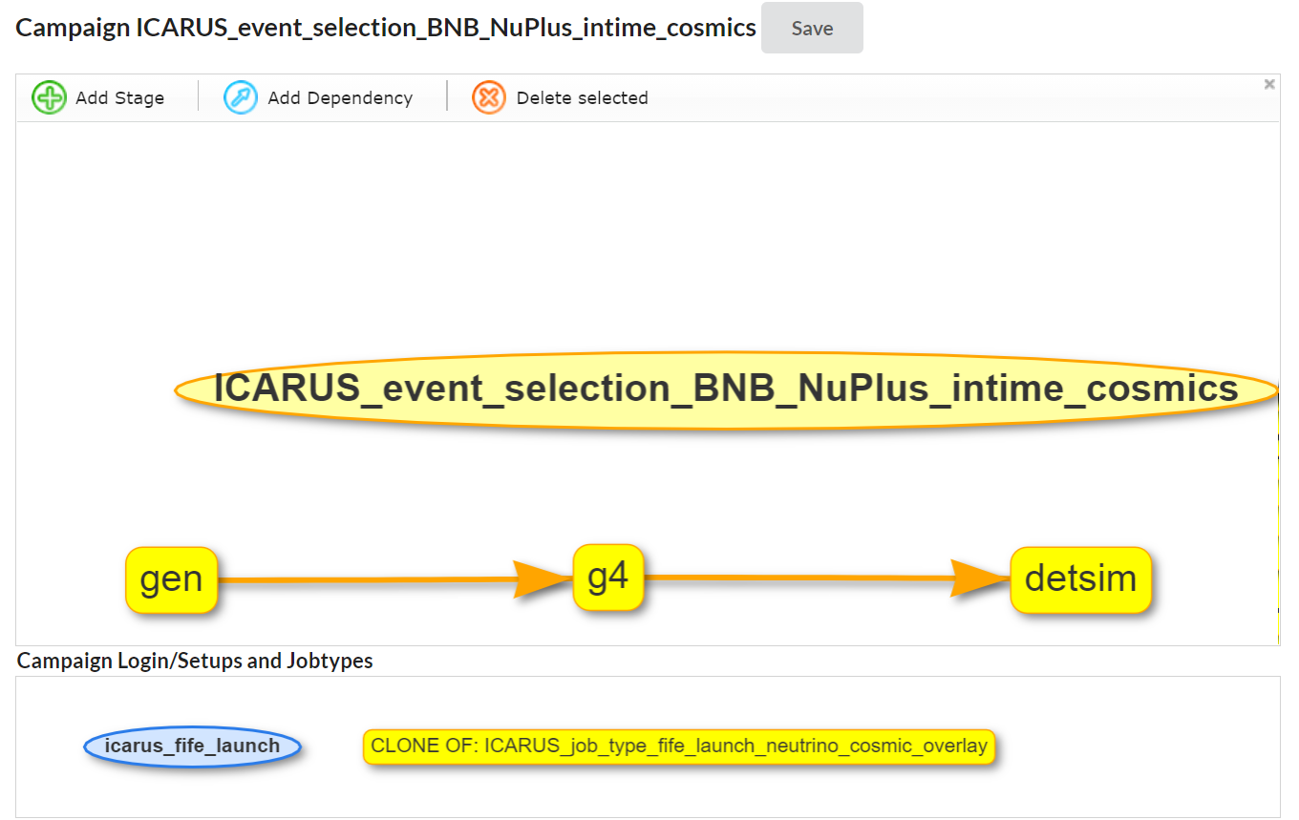

Slide 7
2-click

Slide 8
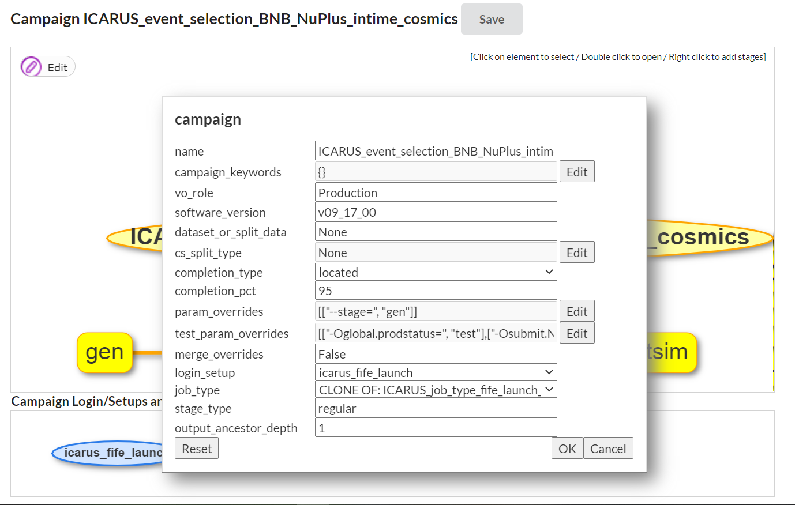
1
check
2
click

Slide 9
2-click

Slide 10
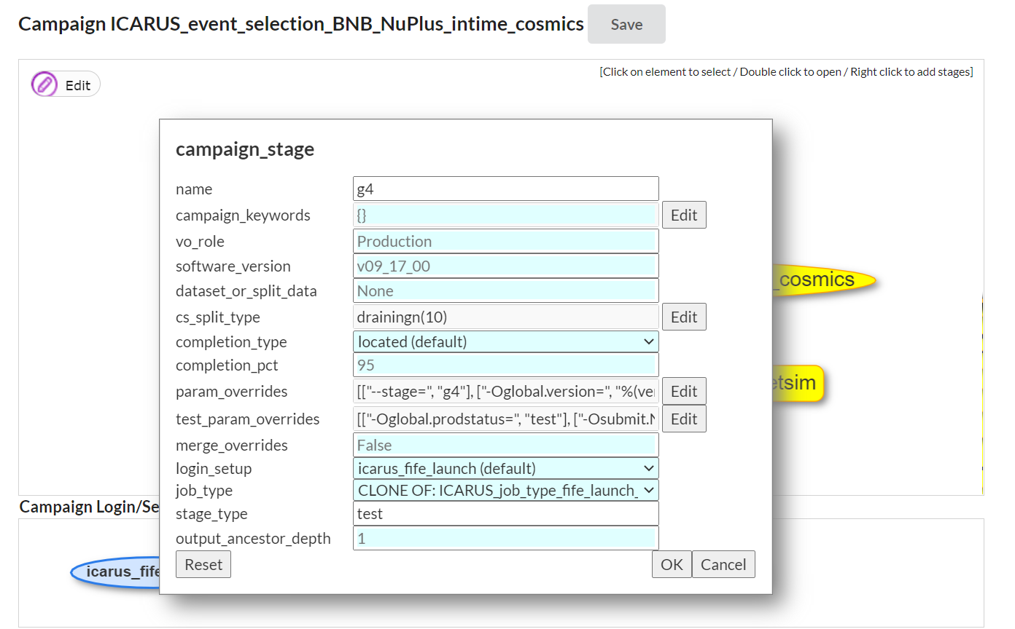
check
1
check
click
2

Slide 11
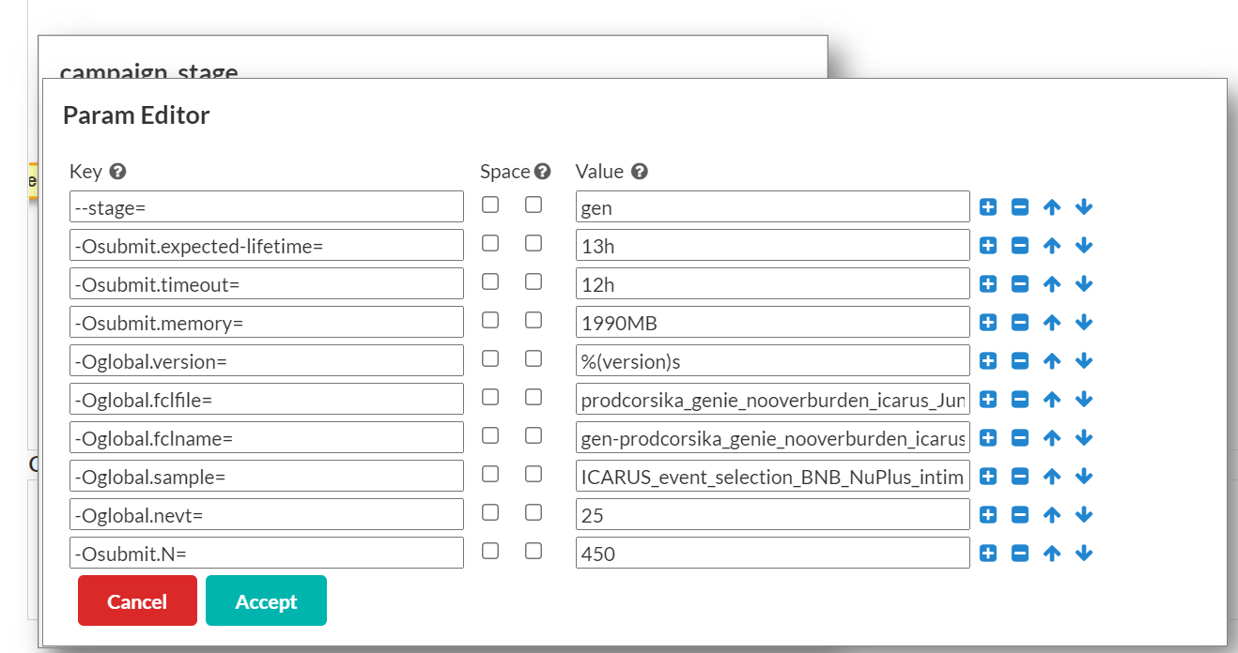
check
check
1
modify
check
2
click

Slide 12
click

Slide 13
click

Slide 14
click

Slide 15
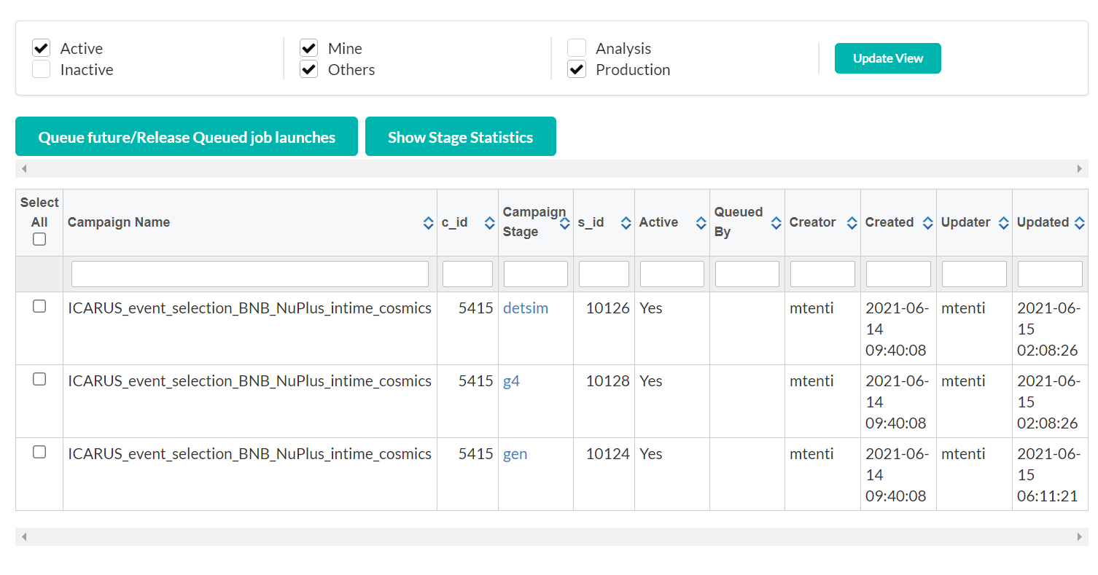
click

Slide 16
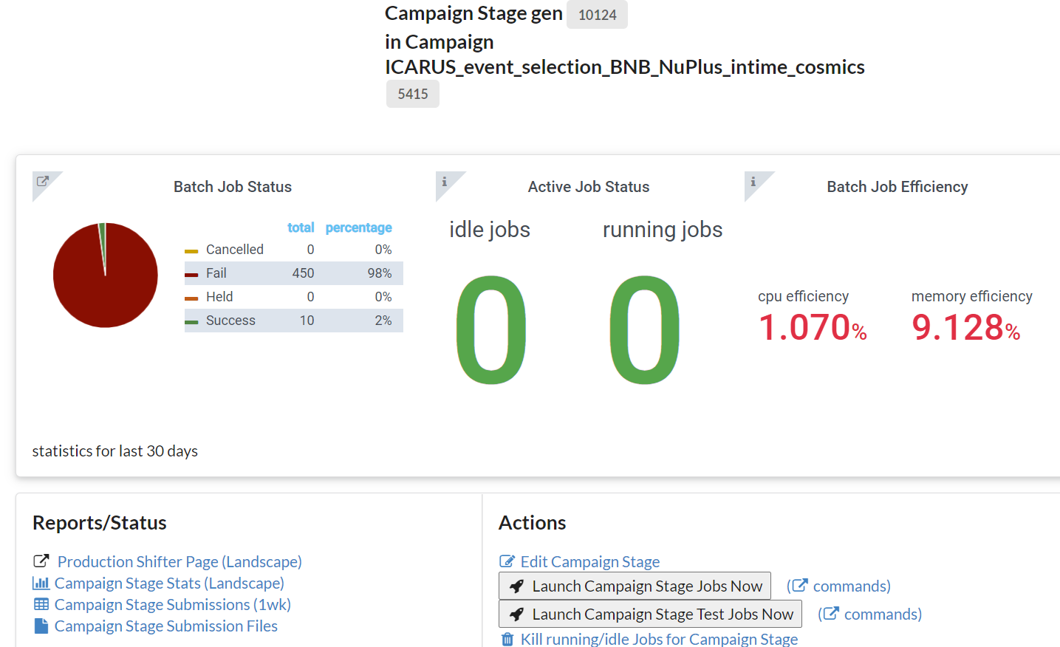
click

Slide 17
click

Slide 18
click

Slide 19
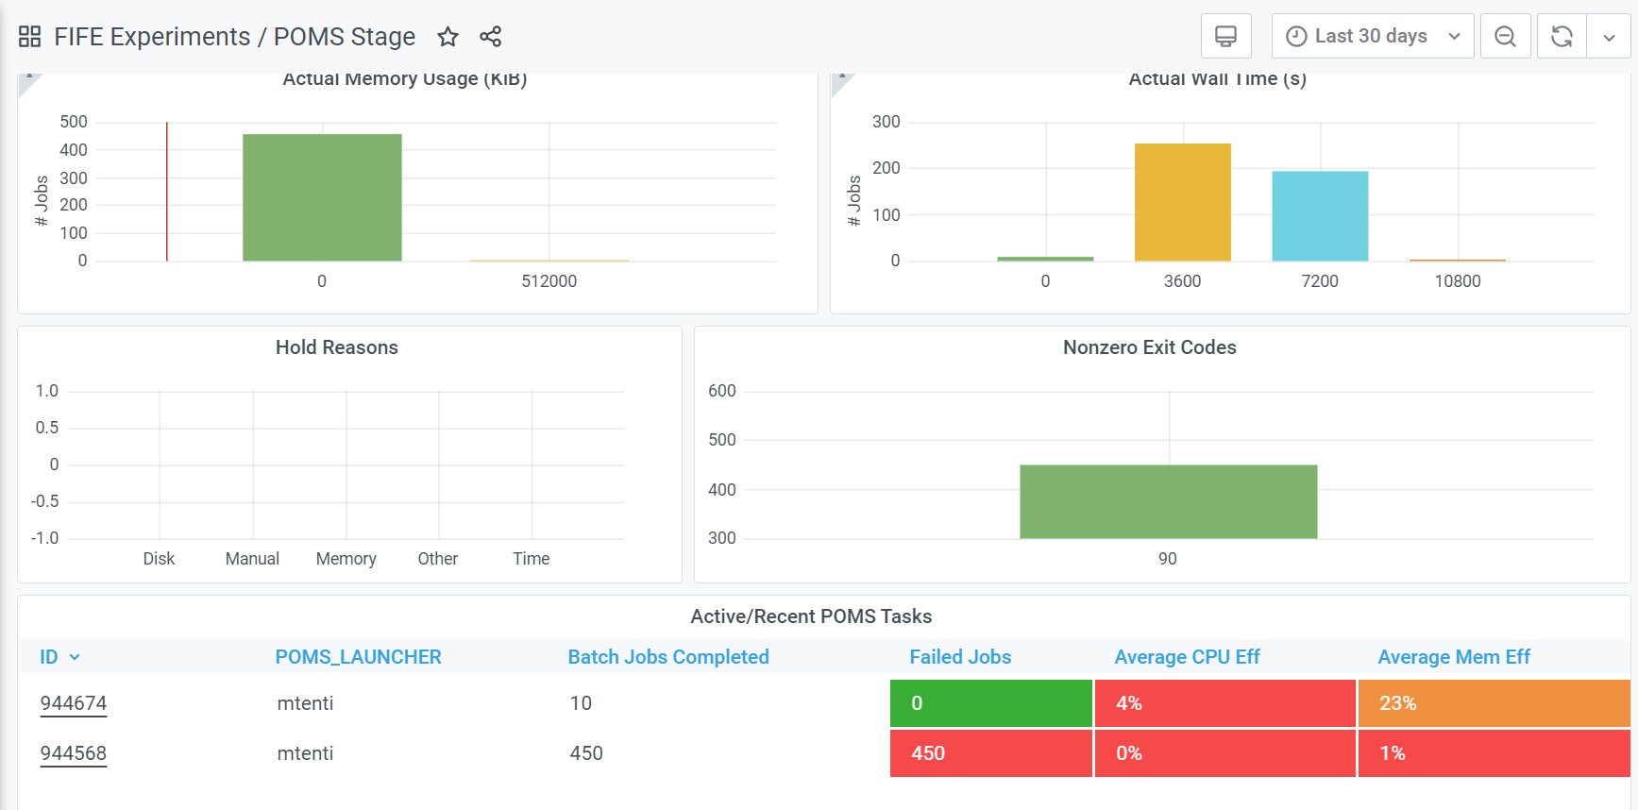
click

Slide 20
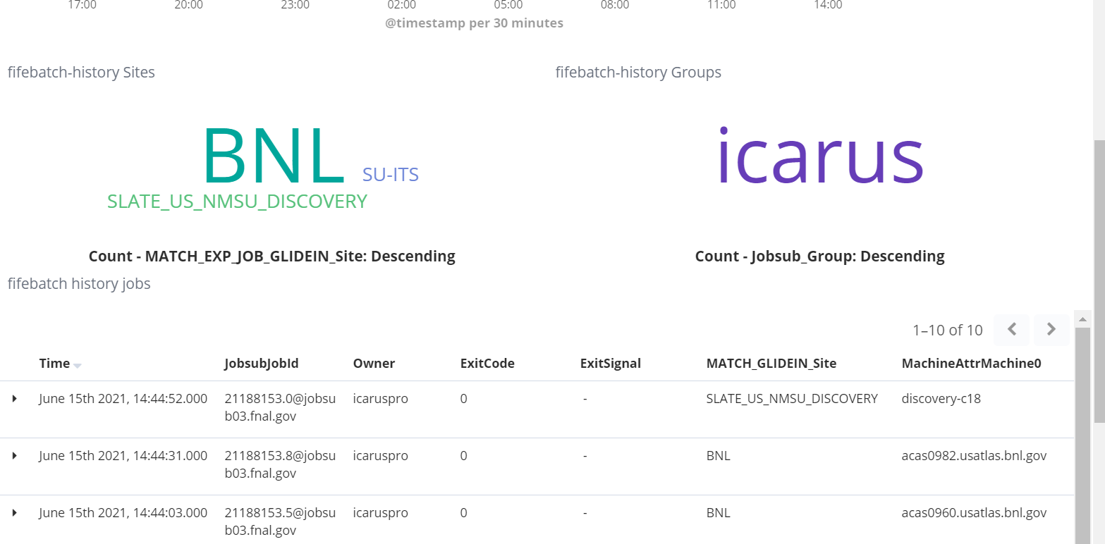
Here stderr and stdout

