Slide 1
Online Auction System
Project -II

Slide 2
Introduction
Online Auction System is a system developed for creating auctions for different product where seller posts and buyers bet their highest price.
It is a fully-fledged system which is aimed to keep track of all buyers, sellers, bids and authenticate them.

Slide 3
Problem Statement
In the normal conventional auction is that their people will have to leave their homes to auction.
People do not have enough time to sit for auctioning.
In online auction both buyer and seller’s uncertainty negatively affects the key success of the outcomes.

Slide 4
Objectives
Create an online forum where bidders auction for items posted by the seller.
To notify the bidders of new bids made in the bids that they participate in.
To computes the buyers, seller ratings using the feedback scores.

Slide 5
Algorithm
Item-Based Recommendations:
It looks for the items the user has viewed or auctioned, then finds other items similar to those items and recommends accordingly.
Steps:
Store user activity.
Compute similarity between user preferences and other items.
Show similar items to user.

Slide 6
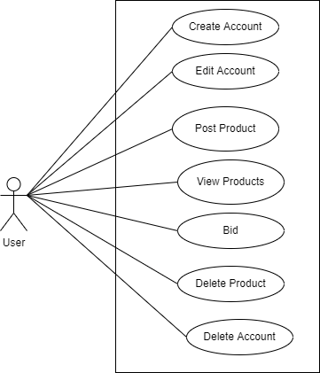
Case Diagram

Slide 7
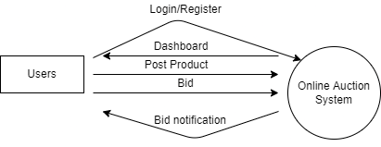
Context Diagram

Slide 8
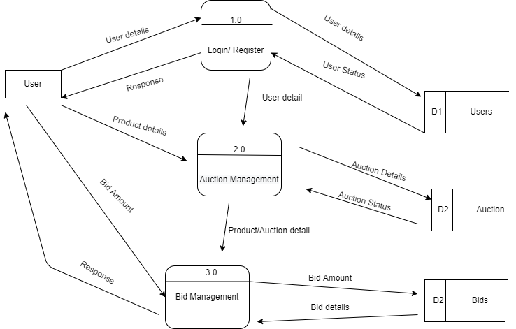
DFD

Slide 9
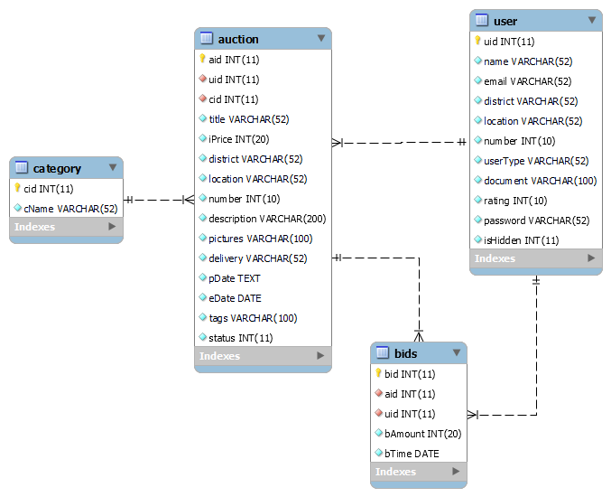
Schema Diagram

Slide 10
Thank You!

