Slide 1

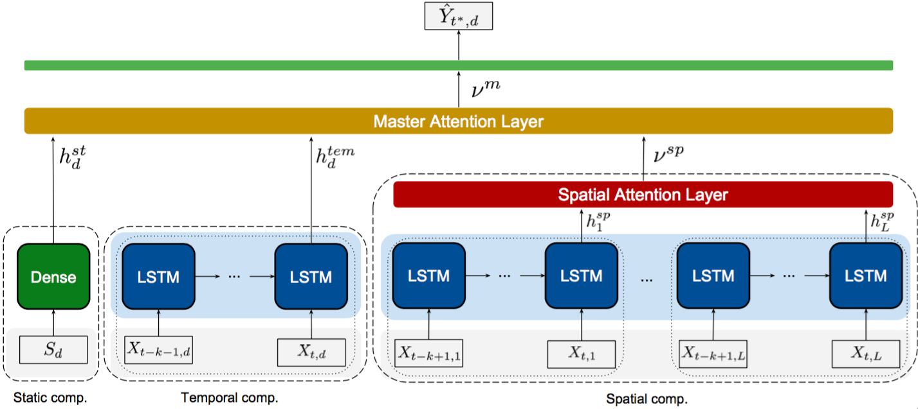
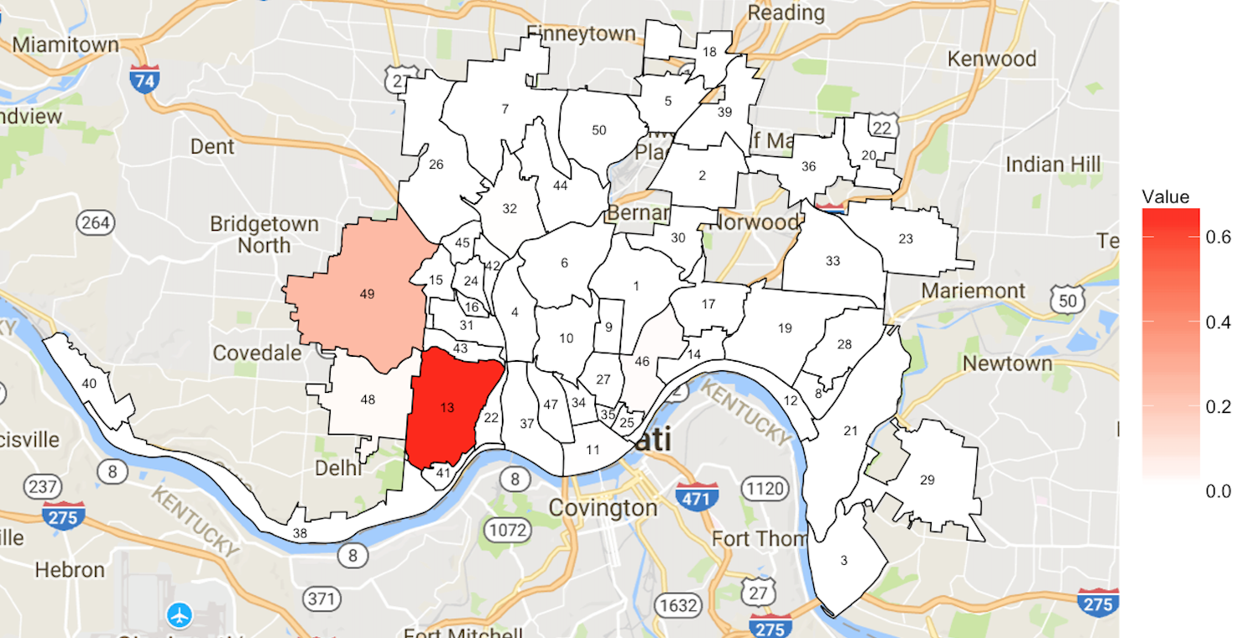
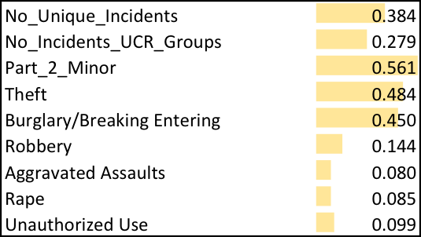


Forecasting Heroin Overdose Occurrences from Crime Incidents Ali Mert Ertugrul, Yu-Ru Lin, Christina Mair, Tugba Taskaya Temizel
Opioid overdose has increased at an alarming rate
To enhance the overdose surveillance
To identify the areas in need of prevention effort
We explore the forecasting capability of heroin overdose occurrences using real-time crime data.
Identification of significant static and dynamic features
Model spatiotemporal patterns of crime incidents to forecast future heroin overdose occurrences
Discovering the predictive hotspot neighborhoods

