Slide 1
Discovering bilateral and multilateral causal events in GDELT
Lei Jiang (Tapjoy Inc.)
Fan Mai (University of Virginia)
04-02-2014

Slide 2
Guideline
Introduction
Exploratory analysis on GDELT event (spatial) time series
Causal discovery: bilateral and multilateral events as causal links
Predictive analysis

Slide 3
Introduction
A snapshot of GDELT (Global Database of Events, Languages and Tone) data:
210 spatial time series of events between 15 countries (2000-2005)
Default assumption:
bilateral and multilateral events would be reported by each involved country, and/or other countries
The importance of events can be reflected by the frequency of news reports

Slide 4
Introduction-2
Time series of cross-country events could be correlated, which somehow reveals the relationship between countries
The relationship could be even more complex when considering more than two countries
It could eventually form a network --- with dynamics

Slide 5
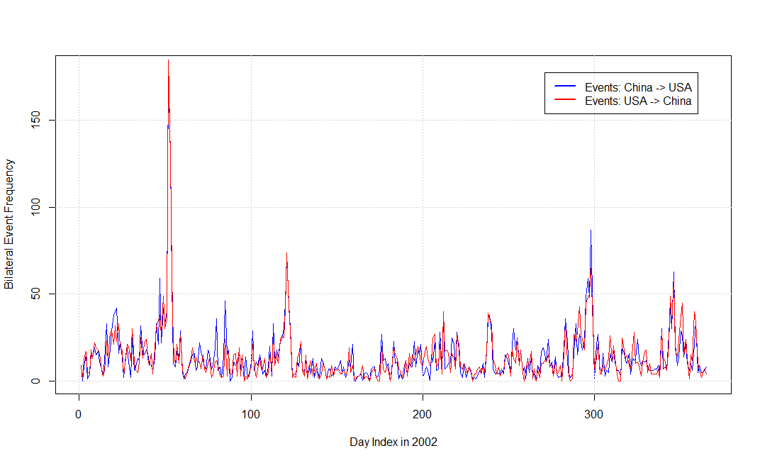
Exploratory analysis - 1

Slide 6
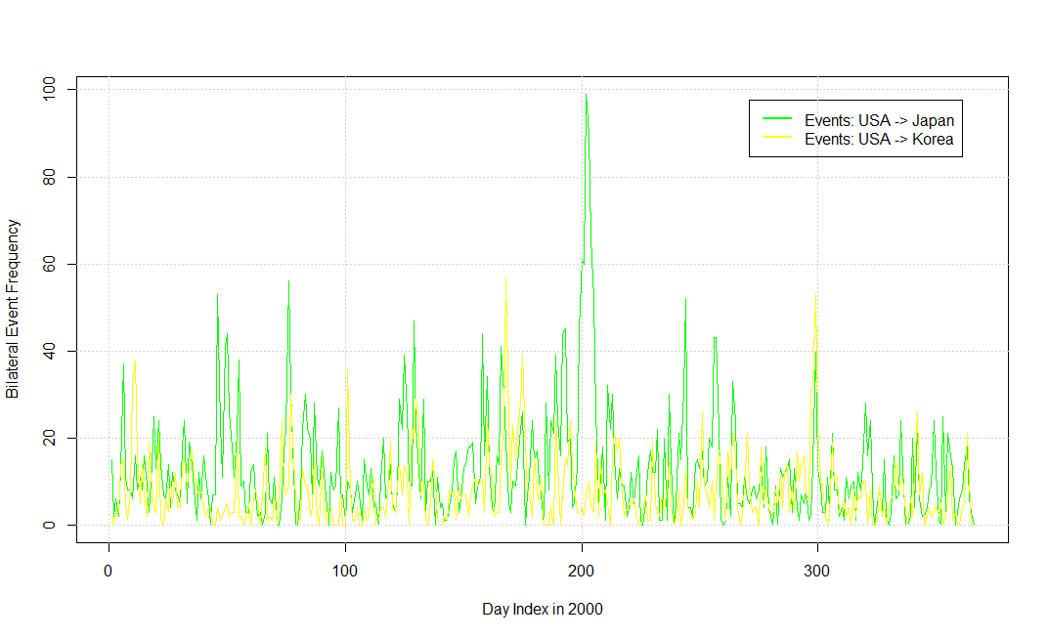
Exploratory analysis - 2

Slide 7
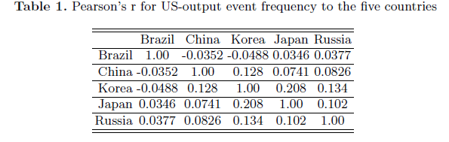
Exploratory analysis - 3
Correlation coefficient doesn’t seem to be a good indicator for linking multiple countries

Slide 8

Causal links - 0
Granger causality (Granger, 1969): examine whether a time series is useful for forecasting another one

Slide 9
Causal links - 1
Unidirectional relationship is revealed: assuming there is one single “initiator” in country-country relationship
By Granger testing with events series:
With p-value of 0.05, causal links are established
If p-value < 0.05 for both directions, link with smaller p-value is chosen
A causality-graph is thereby constructed

Slide 10
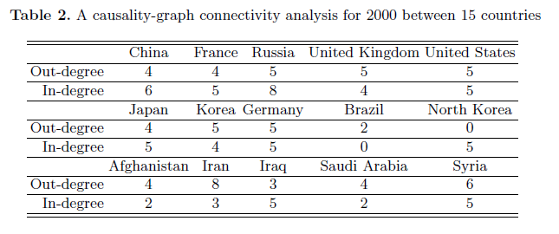
Causal links - 2

Slide 11
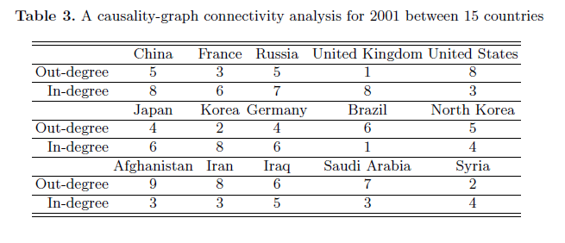
Causal links - 3

Slide 12
Causal links – 4 (Multilateral events)
Multivariate Granger test is not preferred:
Search space increases exponentially (curse of dimensionality)
Overfitting is possible to affect accuracy
Instead,
A heuristic framework is derived
Multilateral events are considered as optimization to bivariate links

Slide 13
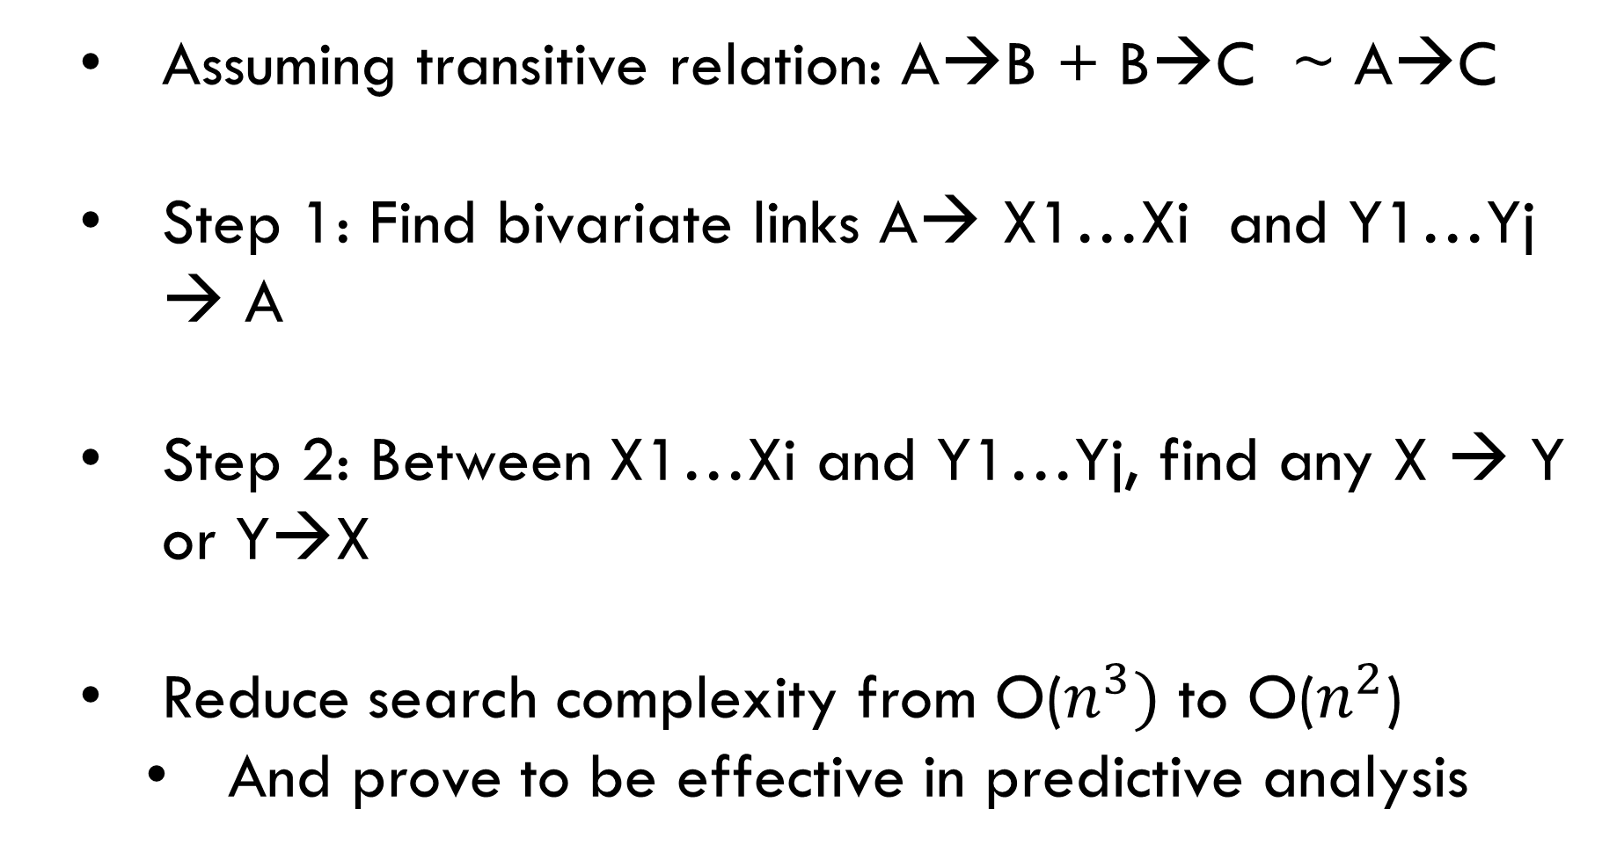
Causal links – 5 (Multilateral events)
Assuming transitive relation: A→B + B→C ~ A→C
Step 1: Find bivariate links A→ X1…Xi and Y1…Yj → A
Step 2: Between X1…Xi and Y1…Yj, find any X → Y or Y→X
Reduce search complexity from O($n^{3})$ to O($n^{2}$)
And prove to be effective in predictive analysis

Slide 14
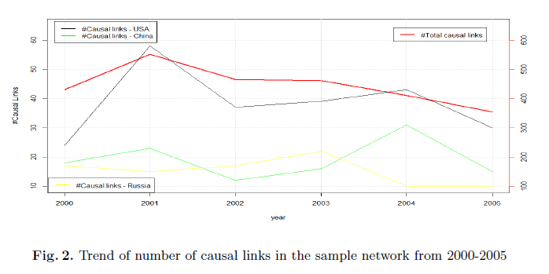
Causal links – 6 (3-party Causal links over time)

Slide 15
Causal links – 7 (3-party Causal links over time)
Insights:
Network assortativity increases when more causal links emerge in total
Influence/activeness can be reflected for an individual country
US/China follow global trending, Russia doesn’t

Slide 16
Predictive Analysis – 1
Problem definition
Find a third/fourth country that can help with predicting #bilateral events (regression task)
Additional data source as auxiliary time series
Use Sum of Squares (SSQ) as criteria

Slide 17
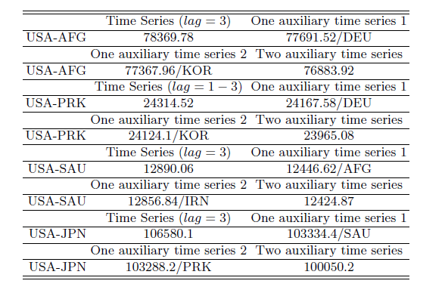
Predictive Analysis – 2

Slide 18
Conclusion and possible future work
Causal links are good indicator for revealing country-country relationship with a real-world metaphor
More information in GDELT can be used for building finer models: e.g. event type
Larger-scale analysis and visualization can lead to even more interesting results

Slide 19
Thank you ! Questions …

