Slide 1


Linear Algebra
Fall 2021
Introduction to NumPy
Provided by:
Mohammad Hashemi

Slide 2
Linear Algebra
Outline
Fall 2021
Motivations for learning LA
An introduction to NumPy

Slide 3
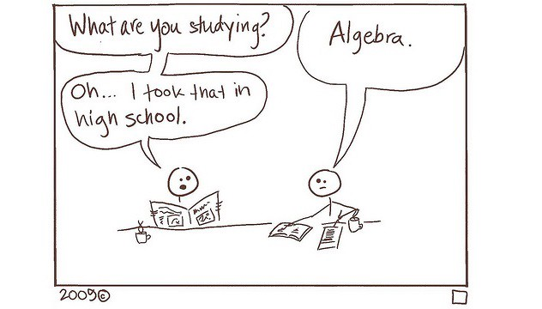
Linear Algebra
Motivation
Fall 2021
Why should I learn Linear Algebra?!

Slide 4
Linear Algebra
Motivation
Fall 2021
Fields of CE as graduate studies:
Computer Hardware
Computer Software
Artificial Intelligence

Slide 5
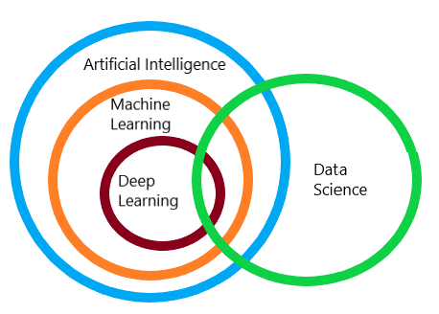
Linear Algebra
Motivation
Fall 2021
Fields of CE as graduate studies:
Computer Hardware
Computer Software
Artificial Intelligence

Slide 6
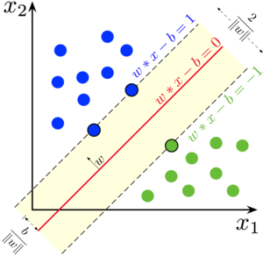
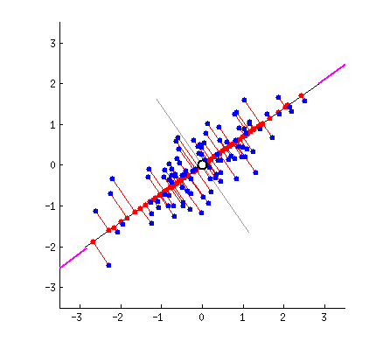
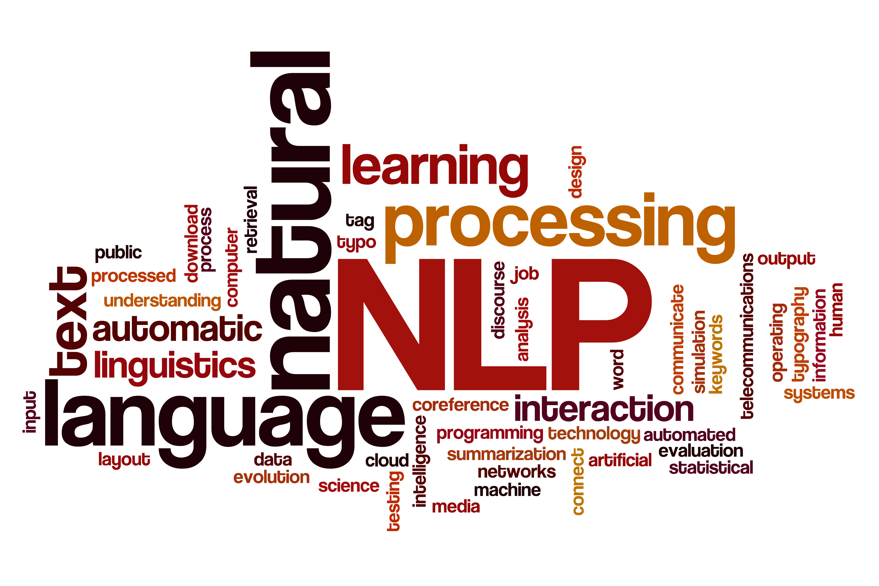

Linear Algebra
Motivation
Fall 2021
‘If Data Science was Batman, Linear Algebra would be Robin.’
Machine Learning
Dimensionality Reduction
Natural Language Processing
Computer Vision

Slide 7
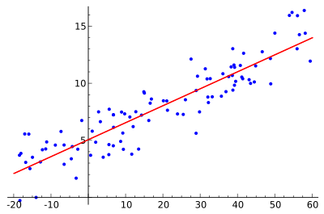
Linear Algebra
Motivation
Fall 2021
Linear Algebra in Machine Learning
1. Loss Functions
Start with some arbitrary function (i.e. A linear function).
Calculate how far-off the predicted output is from the actual output.
Use GD optimize your prediction function.
How?!
Linear Regression

Slide 8
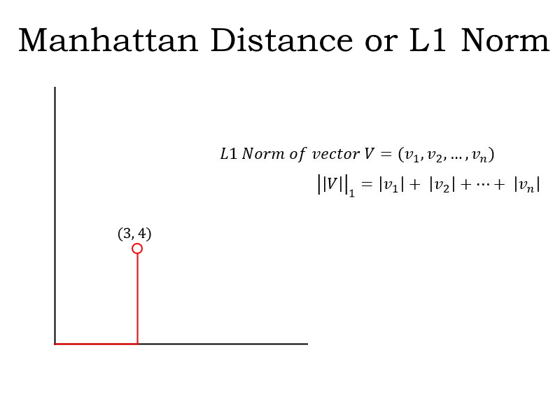
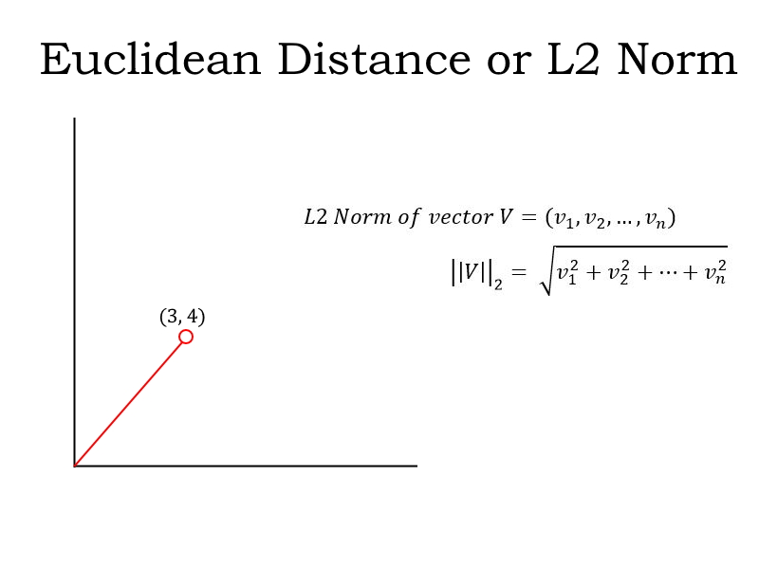
Linear Algebra
Motivation
Fall 2021
Linear Algebra in Machine Learning
1. Loss Functions

Slide 9
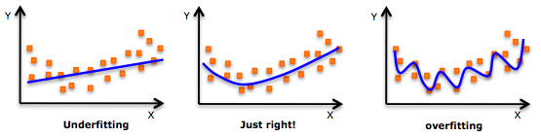
Linear Algebra
Motivation
Fall 2021
Linear Algebra in Machine Learning
2. Regularization
Regularization is a very important concept in data science. It’s a technique we use to prevent models from overfitting. Regularization is actually another application of the Norm.
L1 regularization used with Lasso Regression.
L2 regularization used with Ridge Regression.

Slide 10
Linear Algebra
Motivation
Fall 2021
Linear Algebra in Machine Learning
3. Support Vector Machines (SVM)
One of the most common classification algorithms that regularly produces impressive results. It is an application of the concept of Vector Spaces in Linear Algebra.

Slide 11
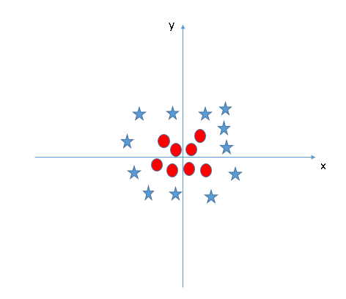
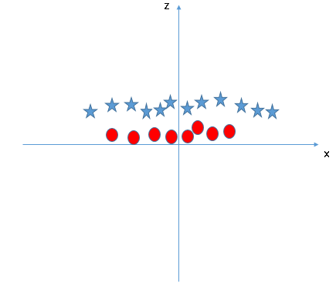

Linear Algebra
Motivation
Fall 2021
Kernel Transformations
$$z=x^{2}+y^{2}$$

Slide 12
Linear Algebra
Motivation
Fall 2021
Linear Algebra in Dimensionality Reduction
1. Principal Component Analysis (PCA)
PCA finds the directions of maximum variance and projects the data along them to reduce the dimensions.
Without going into the math, these directions are the eigenvectors of the covariance matrix of the data.

Slide 13
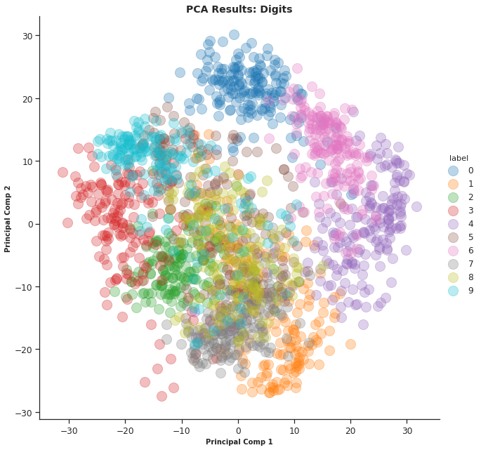
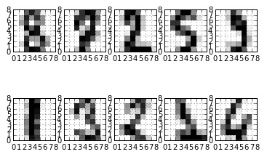
Linear Algebra
Motivation
Fall 2021
Digit Dataset

Slide 14
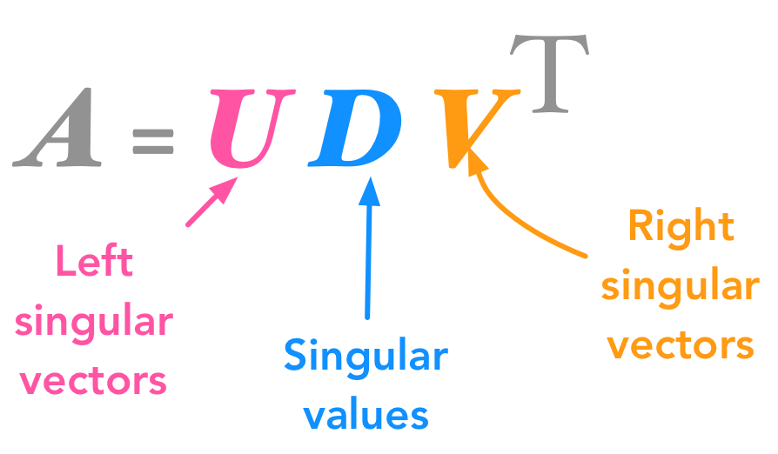
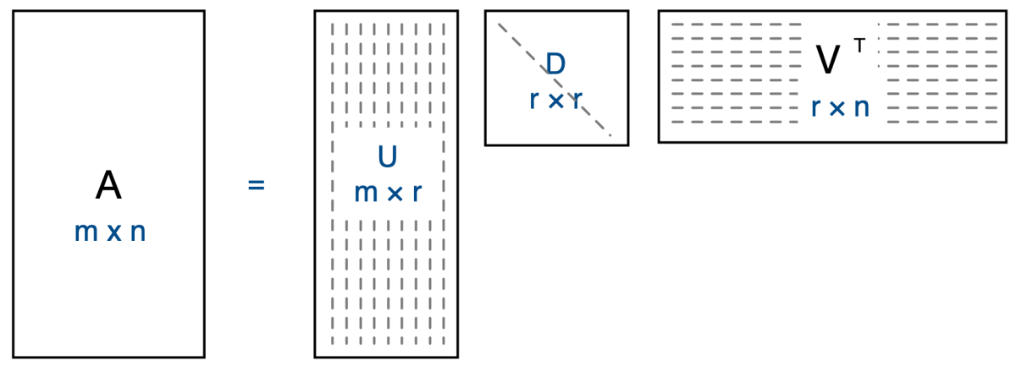
Linear Algebra
Motivation
Fall 2021
Linear Algebra in Dimensionality Reduction
2. Singular Value Decomposition (SVD)

Slide 15
Linear Algebra
Motivation
Fall 2021
Natural Language Processing
Natural Language Processing
Word Embeddings
Image Representation as Tensors
Latent Semantic Analysis (LSA)
Convolution & Image Processing
…
…
https://www.analyticsvidhya.com/blog/2019/07/10-applications-linear-algebra-data-science

Slide 16
An introduction to
Linear Algebra
TA session #1
Fall 2021

Slide 17
Linear Algebra
NumPy
Fall 2021
What is NumPy ?!
An open-source numerical Python library.
2. Contains a multi-dimensional array and matrix data structures.
3. Can be utilized to perform a number of mathematical operations on arrays. Therefore, the library contains a large number of mathematical, algebraic, and transformation functions.
4. It is a wrapper around library implemented in C.

Slide 18
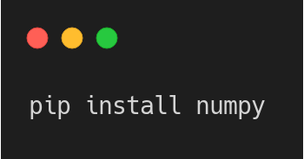
Linear Algebra
NumPy
Fall 2021
How to install NumPy?
If you already have Python, NumPy can be installed with:
If not, you might want to consider using Anaconda. It is the easiest way for getting started and has all the major packages pre-installed.

Slide 19
Linear Algebra
NumPy
Fall 2021
Let’s Do Some Code! 🧑🏻‍💻

Slide 20

Thanks.
Mohammad Hashemi
Hanieh Mahdavi
mohammad99hashemi@gmail.com
haniehmahdavi@yahoo.com
Narges Ghasemi
Peyman Alavi
ghasemi.narges2000@gmail.com
peymanalavy@gmail.com

