Slide 1

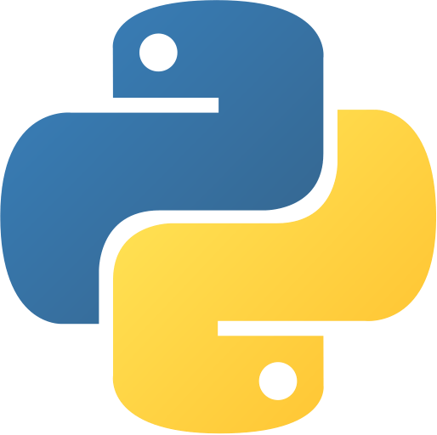

Linear Algebra
Fall 2021
Python Review
Provided by:
Mohammad Hashemi

Slide 2
Linear Algebra
Outline
Fall 2021
Python Introduction
Python Get Started

Slide 3

Linear Algebra
Python Introduction
Fall 2021
What is Python?
Python is a popular programming language. It was created by Guido van Rossum, and released in 1991.
It is used for:
Web development (server-side),
Software development,
System Scripting,
Mathematics and Data science.
Guido van Rossum is a Dutch programmer best known as the creator of the Python programming language.

Slide 4
Linear Algebra
Python Introduction
Fall 2021
Why Python?
Python works on different platforms (Windows, MacOS, Linux, etc.).
Python has a simple syntax similar to the English language.
Python has syntax that allows developers to write programs with fewer lines than some other programming languages.
Python can be treated in a procedural way, an object-oriented way or functional way.

Slide 5
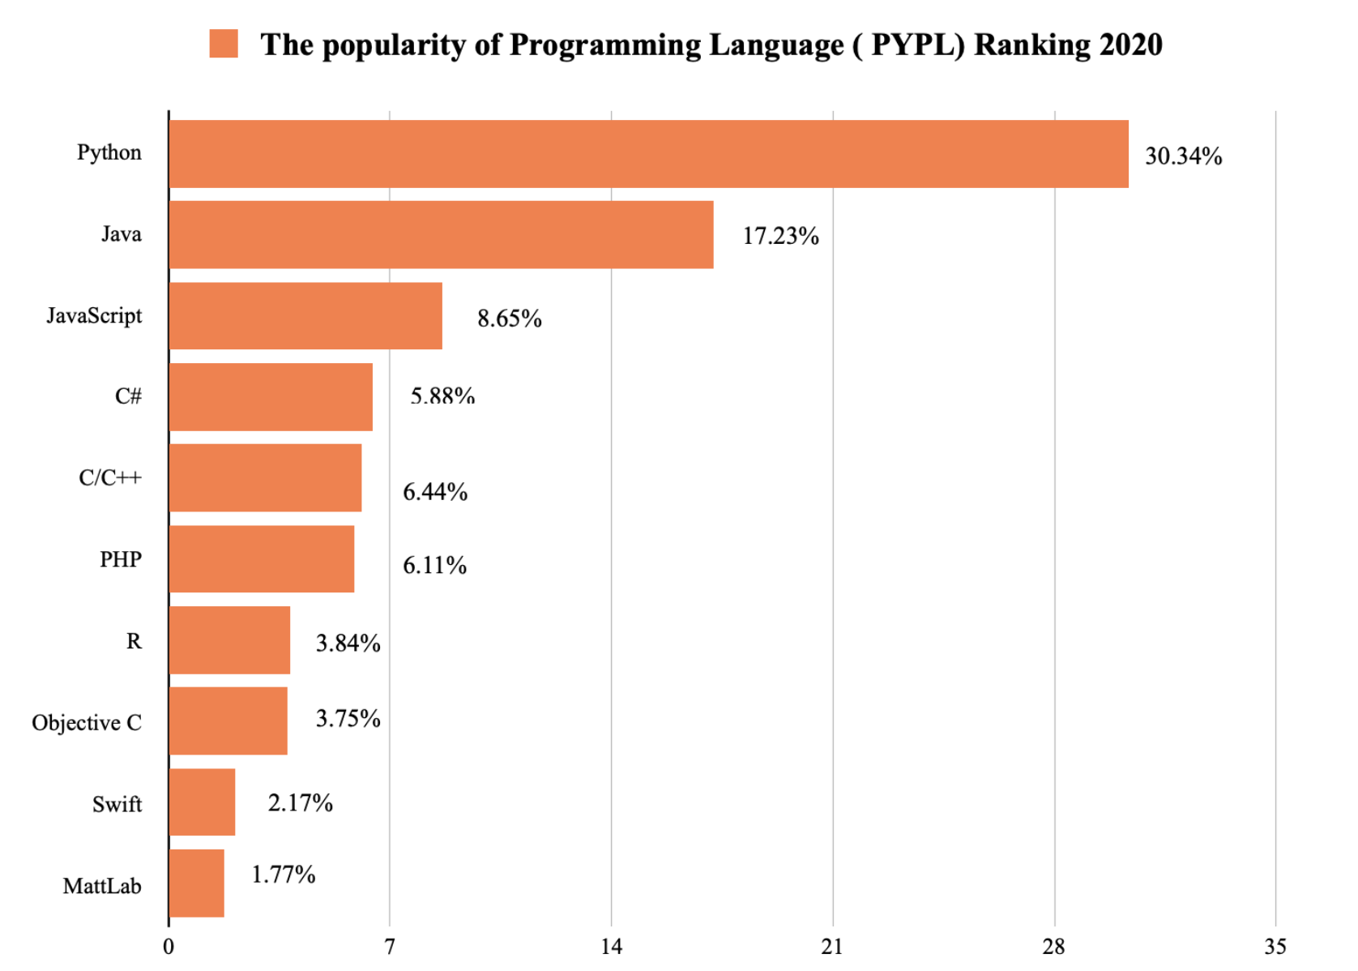
Linear Algebra
Python Introduction
Fall 2021
PYPL – The more a language tutorial is searched, the more popular the language is assumed to be. The raw data comes from Google Trends
https://darly.solutions/the-most-popular-programming-languages-in-2021/

Slide 6
Linear Algebra
Python Get Started
Fall 2021
Python Install:
Many PCs and Macs will have python already installed.
For installing newer versions of Python: https://www.python.org/downloads/.
To check if you have Python installed:
>> python --version

Slide 7

Thanks.
Mohammad Hashemi
Hanieh Mahdavi
mohammad99hashemi@gmail.com
haniehmahdavi@yahoo.com
Narges Ghasemi
Peyman Alavi
ghasemi.narges2000@gmail.com
peymanalavy@gmail.com

