Slide 1

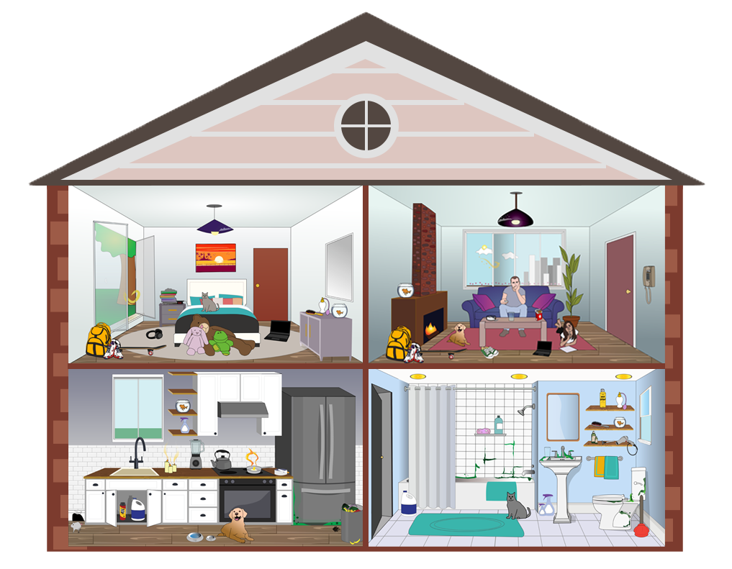

Asthma Trigger House Game
Learn about asthma triggers in a real life context with this online game.
Walk through a house, find the triggers that worsen asthma, and learn how to avoid or reduce their effects.
Play Now

