Slide 1
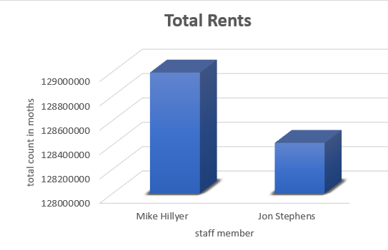
Movies rented out in certain months
A total rental made by the the store attendants(staff members in months

Slide 2
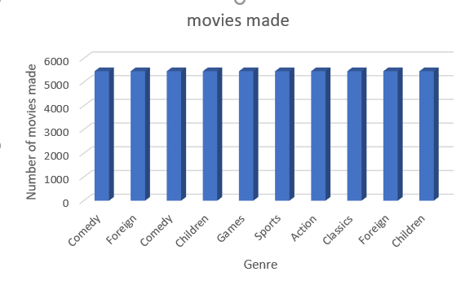
Total number of movies made by Actor
<visualization>
Here we have seen the total number of movies made by a particular actor and the corresponding genre or category

Slide 3
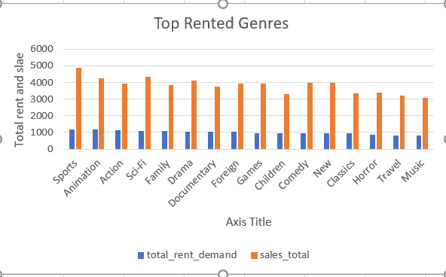
Highest Rented Genres
<visualization>
Here the graphs briefly describes the highest and least category of movies rented out and the monies made out from it

Slide 4
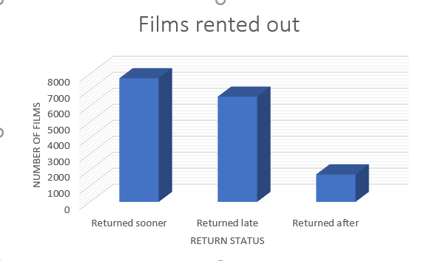
Return status
<visualization>
The total number of movies that were returned before their dates, on and after their due date.

