Slide 1
Data Foundation System
Project: Data Drive
Team: Red Flags

Slide 2
Team:
Divya
Karman
Soveet
This presentation entails the entire documentation of the work done, during the project ‘Data Drive’, it’s key features and the implementation of the individual features, that would be useful for future extensions, development of the application.

Slide 3
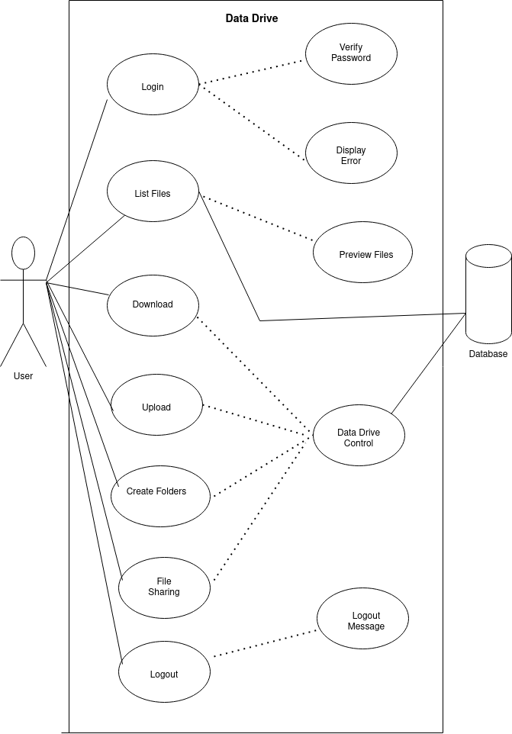

Slide 4
The architecture, could broadly be separated into 3 sections:
The Interface (frontend) The entire frontend, is built on react using modern coding practices, modular code, and good coding practices. The implemented features, have been built using individual components, which could be utilised elsewhere in the application. We use `MUI` design library, for styling the components and the application.
The Wrapper (backend) We build a wrapper around the minio-python-sdk, using flask, to support the CRUD, etc. operations on the frontend side. We use Flask, to create a basic REST API, service to the Interface. The interactions to the minio-db, are integrated using the python-sdk.
The Data Storage (minio-db). It emulates the S3 bucket storage, architecture for our application. Once, a user logs into the application, he is allocated, a bucket which entails the entire user’s data.

Slide 5
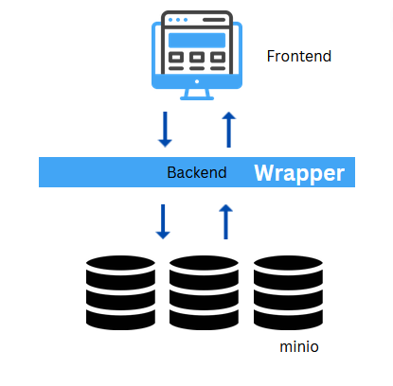

Slide 6
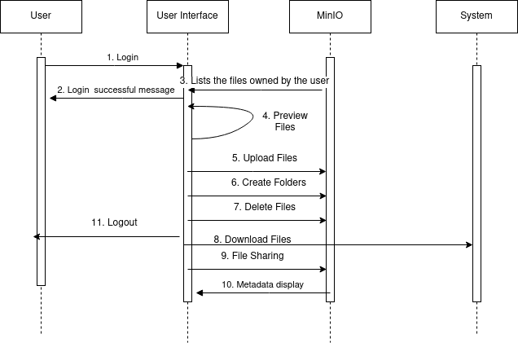

Slide 7
User Creation and Bucket Management
The application has a user creation and login page. When a user is created, a corresponding bucket and authorization token is generated from the minio server, which we use to manage access of a user to the buckets, and manages access of users to the buckets. The user authorisation, entails the user to access only the bucket and the content stored in the allocated bucket. An SQL server is used to store the information regarding user credentials, bucket name in which the files/folders related to the particular user are stored, the storage space used by the user and the storage limit for the user.

Slide 8
Dashboard Layout
The dashboard could be split into multiple components, stacked together:
The Top bar: Renders, the profile icon
Navigation Pane: The section to the left, renders the different sections and components of the data-drive, like shared etc. for ease of access of the files and folders, and their management by the user.
Content Pane: This section renders the files and contents from the user bucket. For the ease of feasibility, and usage, we have implemented 2 different views, for listing the folders and files within the current directory:

Slide 9
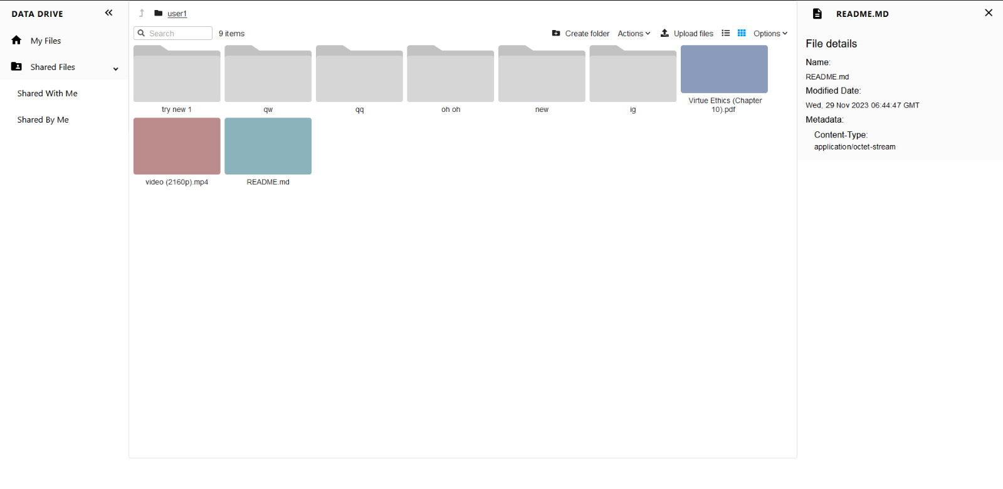

Slide 10
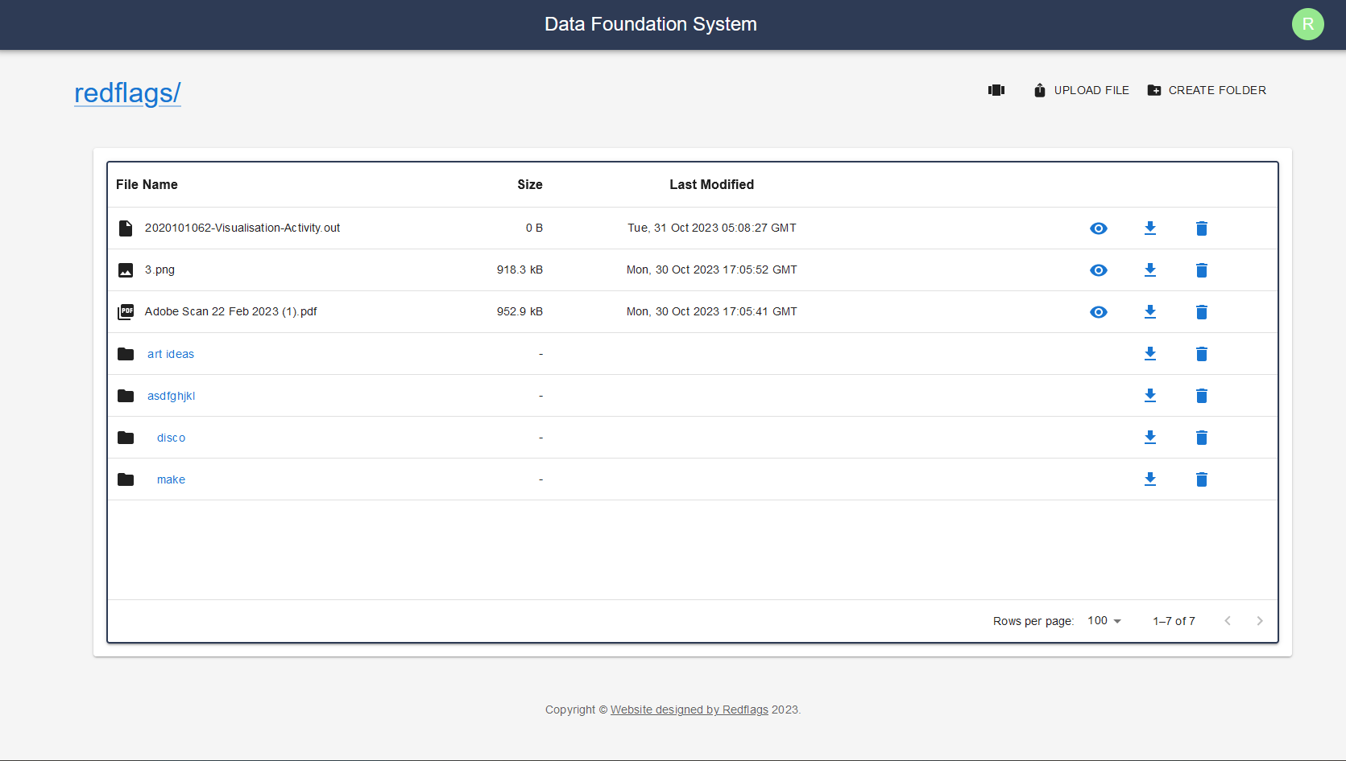
List View In this view, all the items are listed as a list, with their corresponding icons, file size, last Modified date etc. and a set of action buttons for preview, download and deletion of the selected file.

Slide 11
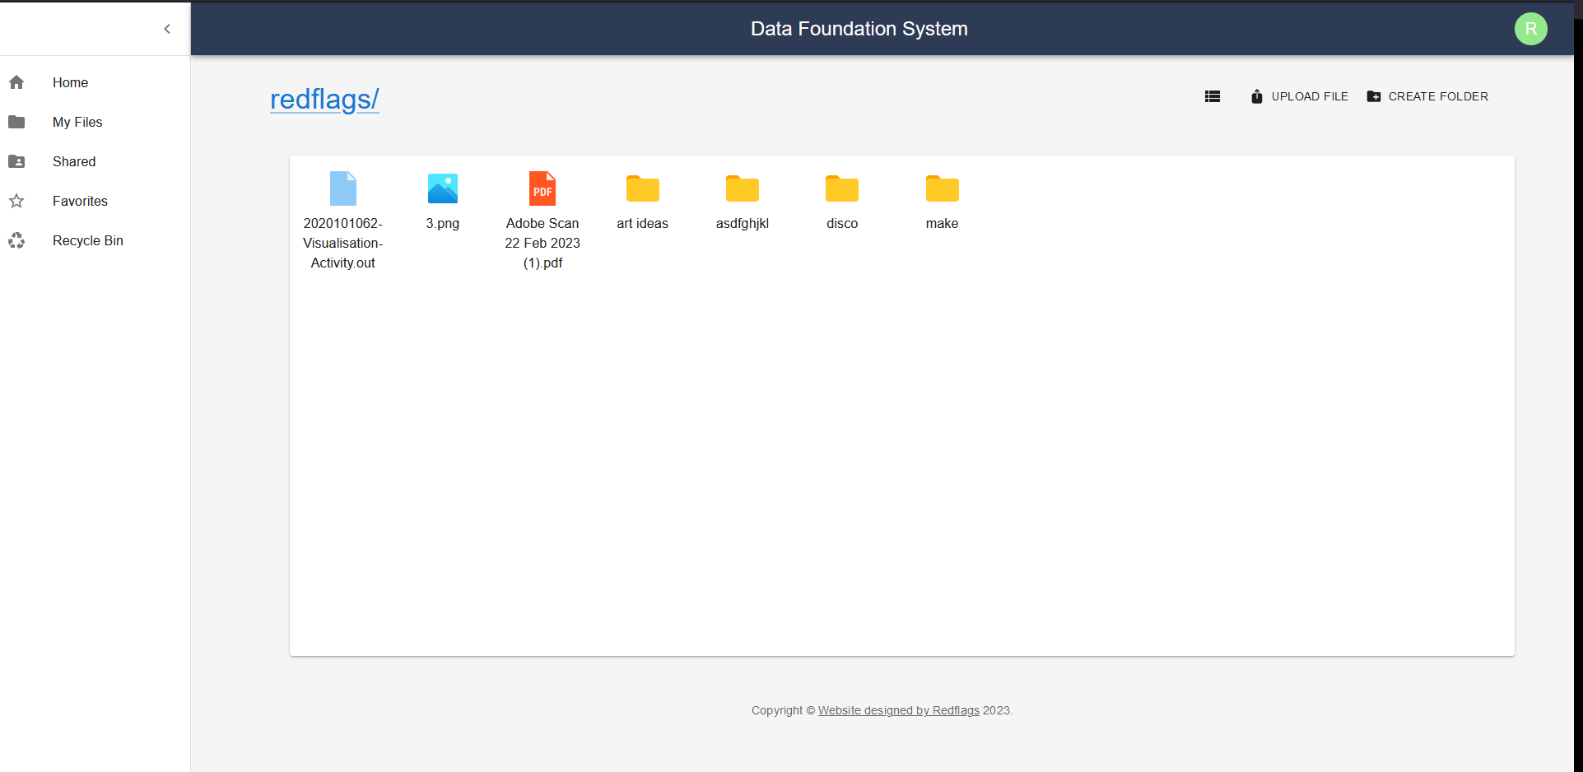
Grid View In this view, the items are listed, in a responsive grid style fashion, with corresponding file-icons for each of the file, and folder within the directory.

Slide 12
Folder System Navigation
We Implemented the folder, the main challenge over here, is that minio-sdk doesn’t provide the size, last modified meta data for folder systems, hence we plan to store and retrieve these details in our custom-meta data, and update/modify them, whenever the directory is updated. Whenever the folder is clicked, the content within that directory is rendered into the content-pane, and the current-directory gets updated. The user can navigate amongst the folder structure using, the hyperlink. The user can create/upload a folder from the react-dashboard onto the user, bucket.

Slide 13
File Interactions
The rendered file, component could provide below listed features:
Preview We have built a custom component, for rendering different types of data files - pdfs, images, audio and video in a good and presentable format using the react-pdf, etc. for rendering the pdf files. Using this feature, the user could preview the content without downloading the content.
Download The user could, download a copy of the folder/file from the hosted minio server into the local system
Upload The user can upload a file/folder into the current directory.
Delete
This operation deletes the folder/file from the minio server.
5. Share
We allowed sharing of files. Files owned by one user can be shared to other users with read/write permissions. Public sharing of sharing can also be done.

Slide 14
Display of Metadata
When a file is selected, the details of the file are displayed on the right side of the page. The File details include:
1. Name
The name of the file is displayed along with the appropriate extension
2. Modified Date:
The day, date, time at which the file was last modified is also stored.
3. Metadata:
The Content-Type of the file, which is the type of file is also stored in the metadata.

Slide 15
About the Codebase
To run:
/frontend
npm i
npm start
/backend
Activate venv
flask run –debug
Creating Folders and Folder Navigation

Slide 16
Further Plan
Integrate with DFS dev minio client, to further test the code.
Implement Favourites tab.
Work on the UI to make it more seamless and minimal.

Slide 17
Demo

