Slide 1
Bankruptcy Forecast
1
the Future of Taiwanese Company bankruptcies:
Prepared and Presented by:
Alejandro Gomez
Jessica Dean
Stacey Boyce
Brook forrester
Becca Stilley

Slide 2
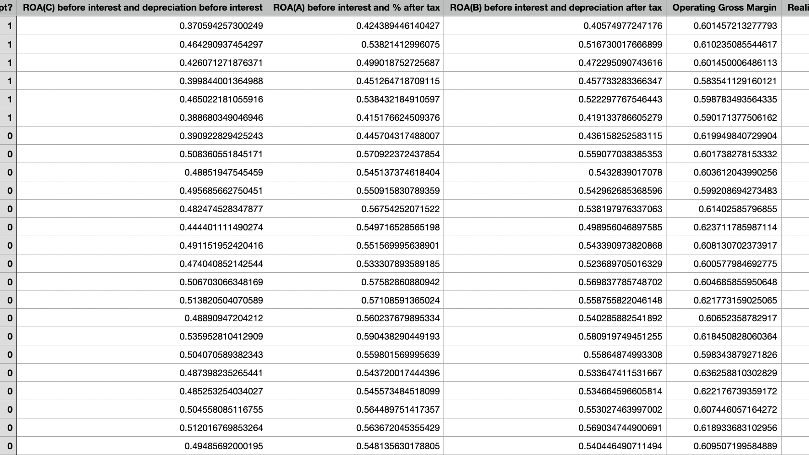
Original Dataset
Bankruptcy data from the Taiwan Economic Journal for the years 1999-2009, Stock exchange dataset

Slide 3
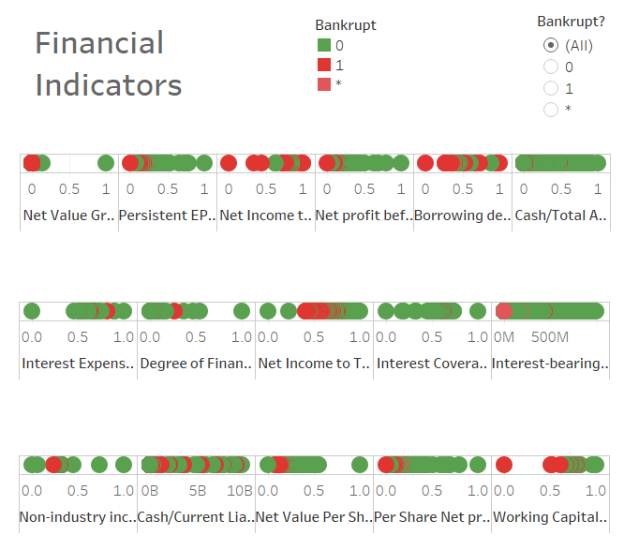
Background on the Dataset
The Taiwanese Stocks consist of about 2500 different companies including those that have gone bankrupt between 2009 and 2019
The original dataset had 96 financial indicators
Includes indicators for Bankrupt, In the Process of becoming bankrupt, and Not Bankrupt

Slide 4
What is Bankruptcy, and How does it Happen?
Bankruptcy is a legal process that involves a person or business that is unable to repay their outstanding debts.
All of the debtor's assets (property, gifts, land, etc.) are measured and evaluated; the assets may be used to repay a portion of outstanding debt.
Does not necessarily mean complete dissolution of company
Can be seen as a restart for a company to reestablish
Chapter 11- reorganization of assets/company debt

Slide 5
Data Cleaning
We asked ourselves can we predict using the data to determine if a company is likely to go bankrupt
Dataset was fairly clean and consistent to begin with, in terms of missing data
Our Process:
Used Sklearn in Jupyter Notebook to determine which indicators were relevant to us
Tested the model with the 41 relevant indicators that resulted, and we did not lose much integrity with our data (0.1%)

Slide 6

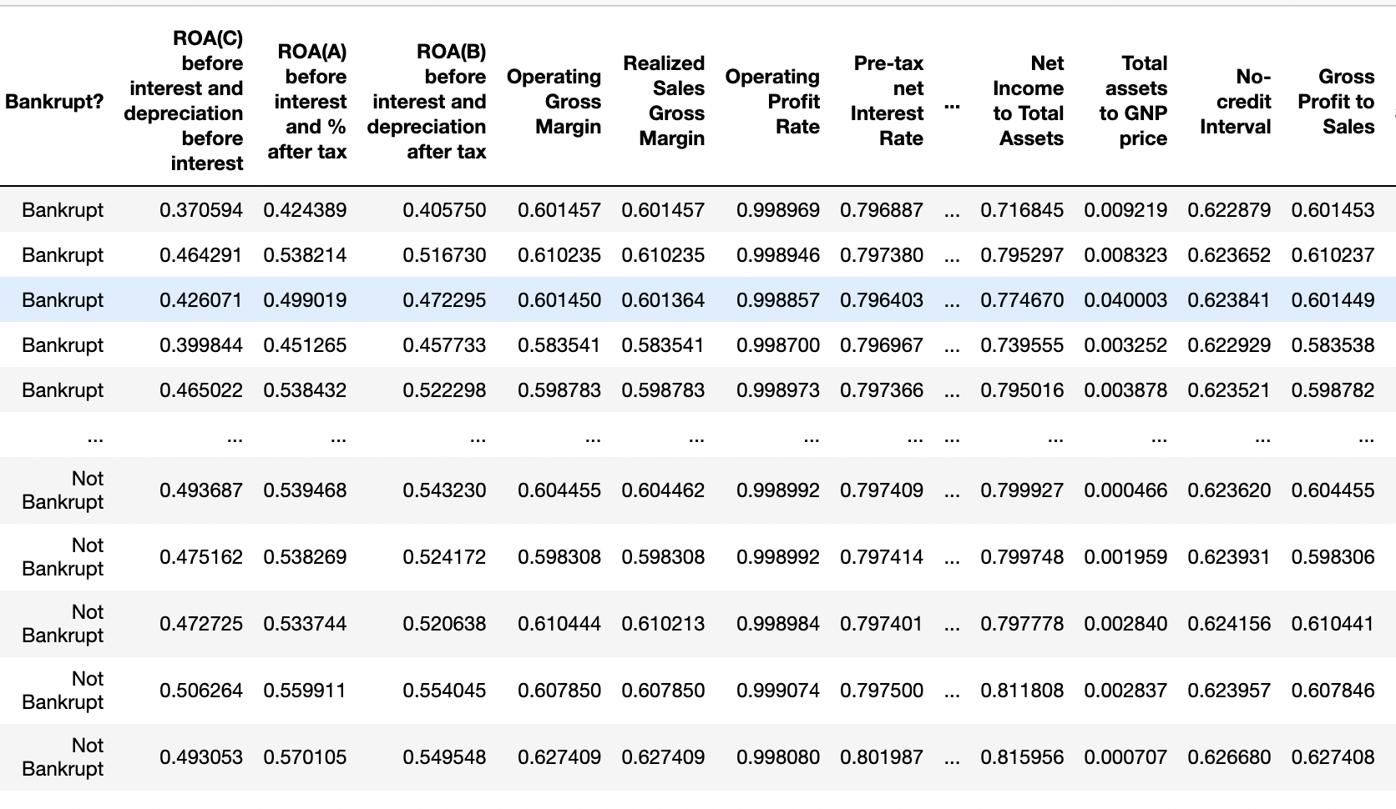
Our Cleaned Dataset

Slide 7
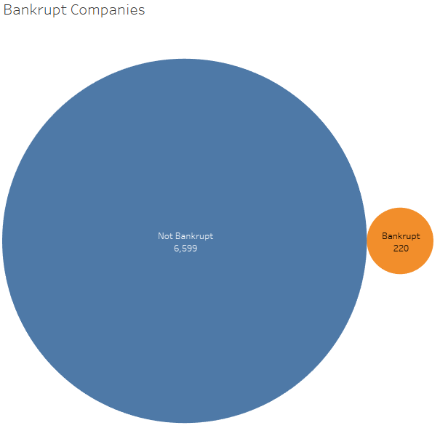
Bankrupt vs. Not Bankrupt 1999-2009
Over 10 years, only 3.33% of companies filed for Bankruptcy in Taiwan

Slide 8
Predictions and Trends

Slide 9
What We Learned

Slide 10
Looked at the data and found that it was fairly clean and consistent in terms of missing data
Had a bankrupt indicator, and a bunch of financial indicators
We asked ourselves can we predict usng the data to determine if a company is likely to go bankrupt
A slide defining bankruptcy
The original dataset had 96 financial indicators
We used sklearn to see what was relevant
Tested the model with 41 and we did not lose any integrity with our data (0.1%)
We put test data in and proved that it worked as suspected
Slide for graph
Slide for dashboard (alejandro) it is not easy to predict just looking at the data

Slide 11
More will be added once we develop our data

Slide 12
References
https://www.kaggle.com/fedesoriano/company-bankruptcy-prediction
https://public.tableau.com/app/profile/alejandro.gomez5182/viz/Bankrupcy/Dashboard1

