Slide 1
Data analysis using SCPREP and Scanpy
By Oliver Tastet and Stéphane Burwash

Slide 2
Our goal
Portray our dataset in different ways, including but not limited to:
Phate
UMAP
Subset clusters
Pseudotime (in progress)
Etc.
To give a global understanding of the dataset by studying it from multiple angles
Optional => To make the code as easy to understand as possible, in order to promote re-use

Slide 3
Steps
Preprocess (already done)
Create useful functions
Analyse data
Package solution
Present findings

Slide 4
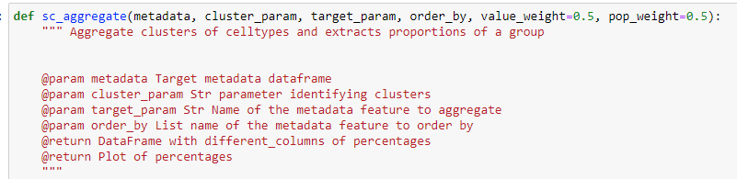
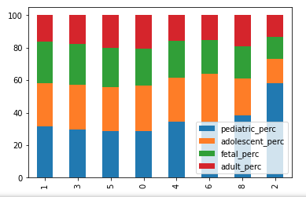
Useful functions
Sc_aggregate:
Created by Oliver in R and adapted to python by Stéphane

Slide 5
Useful functions
To_investigate:

Slide 6
Analyse data
Phate graph

Slide 7
Analyse data
UMAP

Slide 8
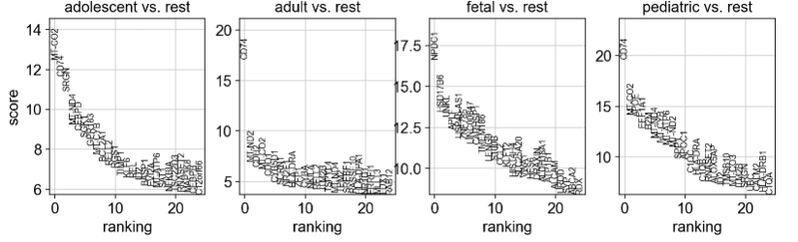
Analyse data
Gene ranking (Scanpy)

