Slide 1
Building Trust
ODSC AI · SNOWFLAKE MONTREAL · NOVEMBER 5, 2026
From AI pilot to production: knowing what to do next
Stéphane Burwash
Lead Forward Deployed Engineer, Infostrux
Notes:
Thank Augusto for the handoff: he showed what is underneath the agent; I’ll show what has to be true around it before it’s production-ready. Promise: by the end, you’ll know how to pick the next step instead of the loudest one.

Slide 2


Stéphane Burwash.
INTRODUCTION
Lead Forward Deployed Engineer at Infostrux.
WHERE I WORK
Snowflake Data Superhero.
Infostrux.
Leads the PyData Montreal chapter.
A Snowflake Elite Partner data consultancy. We build governed data platforms and put AI into production, starting from the value and working backwards. We invest in data governance because we believe it is the foundation this new AI age is built on.
Cooking, running and high-fantasy books #MalazanBookOfTheFallen.
Building Trust · 02
Notes:
Keep this under 30 seconds. The line that matters: we start from the value and work backwards, and governance is how we get there.

Slide 3
The ask - to “be more AI”.
THE PROBLEM
“We need to be more AI.”
“Self-serve analytics for everyone.”
WHICH LEADS TO TWO PROBLEMS
01
02
What does that mean, exactly?
How do I get there?
What is the actual need? What is the next logical outcome?
Which steps do I take, and in what order?
Building Trust · 03
Notes:
Open with the situation everyone in the room knows: your boss asks you to “be more AI”, or to give “self-serve analytics to everyone”. That mandate leads to two problems. One: what does it actually mean? What is the real need, and what is the next logical outcome we’re trying to reach? Two: once we’ve refined it into a concrete outcome and a set of problems, how do I know which steps to take, and in what order?

Slide 4
A mandate is not yet a need.
PROBLEM 01 · WHAT DOES THAT MEAN?
THE MANDATE
THE OUTCOME
“Be more AI.”
?
?
What is the tangible outcome?
What sits in between?
FIRST
Identify the tangible outcome behind this need: what would success actually look like?
Building Trust · 04
Notes:
Problem one, in a picture. All we have is the mandate. Before anything else, we need the tangible outcome behind it: what would success actually look like, in a way you could measure? Until that box is filled, everything in between is guesswork.

Slide 5
An outcome is not yet a plan.
PROBLEM 02 · HOW DO I GET THERE?
THE MANDATE
THE OUTCOME
“Be more AI.”
Tangible and measurable.
?
What activities are required to get there?
THEN
Which activities get us from the mandate to that outcome, and in what order?
Building Trust · 05
Notes:
Problem two. Say we’ve nailed the outcome: tangible and measurable. That still isn’t a plan. What activities are required to get from the mandate to that outcome, and in what order? And that’s where it gets noisy.

Slide 6
So many terms floating around
PROBLEM 02 · HOW DO I GET THERE?
Master data management
Lineage
Implement RBAC
Data contracts
Which one is next?
Implement Horizon Catalog
Business process modeling
LLMOps & evals
Data quality checks
Data classification
Semantic layer
Pick an AI use case
Building Trust · 06
Notes:
Problem two: once the need is refined into an outcome and a set of problems, how do you know which steps to take? This is the noise: every one of these is a real, good activity, and every vendor and blog says theirs comes first. One of them is a product name on purpose (Horizon Catalog) because that is how it usually arrives. The question nobody can answer: which one is next?

Slide 7
Agenda
THE PROBLEM
TODAY, WE WALK THROUGH
01
How can we clarify the gap between need and outcome?
THE ORIGINAL MANDATE
“Enable self-service analytics.”
02
What are the key activities required for rollout?
A large Canadian engineering firm. Business teams were close to building their own tools.
03
The outcomes, learnings and next steps
Building Trust · 07
Notes:
This is exactly what happened at our client, which we’ll call Client X: a large Canadian engineering firm whose mandate was “enable self-service analytics”, with business teams close to building their own tools. Today we walk through three things: how we went from that need to a tangible outcome and a series of problems; the key activities required to reach that outcome; and the outcomes, learnings and next steps.

Slide 8
From need to outcome
01
Refining a mandate into a tangible outcome and a series of problems.
Building Trust · 08
Notes:
Section 1: from the mandate to a tangible outcome and the problems standing in the way.

Slide 9
A mandate is not yet a need.
01 · FROM NEED TO OUTCOME
THE MANDATE
PROBLEMS
ACTIVITIES
THE OUTCOME
“Enable self-service analytics.”
What is actually in the way?
Which steps?
?
FIRST
Refine the mandate: what is the actual problem, and what is the next logical outcome?
Building Trust · 09
Notes:
We start with only the mandate: enable self-service analytics. Two things in between are unknown: the problems actually in the way, and the steps to take. So is the outcome. We’ll fill this picture in one block at a time.

Slide 10
Turn the mandate into tangible problems.
01 · FROM NEED TO OUTCOME
THE MANDATE
PROBLEMS
ACTIVITIES
THE OUTCOME
“Enable self-service analytics.”
AI answers aren’t trusted
Which steps?
?
No clear way to roll AI out
Data not modeled for the business
Every question queues on BI
THE PATTERN
Every problem should lead to an activity, and ultimately bring us closer to the outcome
Building Trust · 10
Notes:
The first block: the problems behind the mandate, in the words people actually used. They sorted into three buckets. Trust: they didn’t trust an AI to give the right answer, and two reports already gave two answers. Fear: they didn’t know how to roll AI out, or what it might expose. Technology: the data wasn’t modeled for how the business asks questions, and every question waited on the BI team.

Slide 11

How we defined success: one metric.
01 · FROM NEED TO OUTCOME
THE TANGIBLE OBJECTIVE
ONE METRIC
THE OUTCOME
Cut analyst time per ad-hoc question from about an hour to under a minute.
Enable self-serve analytics.
Productivity Gained
As measured in time saved by question asked
Building Trust · 11
Notes:
How did we know if it worked? We anchored the outcome, enable self-serve analytics, on one metric: productivity gained, measured in time saved per question asked. That metric turns into a tangible objective we could hold ourselves to: cut analyst time per ad-hoc question from about an hour to under a minute. One metric keeps both the investigation and the success criteria pointed at one problem.

Slide 12
Then name one tangible outcome.
01 · FROM NEED TO OUTCOME
THE MANDATE
PROBLEMS
ACTIVITIES
THE OUTCOME
“Enable self-service analytics.”
AI answers aren’t trusted
Which steps?
Cut analyst time per ad-hoc question from about an hour to under a minute.
No clear way to roll AI out
Data not modeled for the business
Every question queues on BI
“Which invoices are overdue for this client?”
“Which projects should we audit?”
“Our clients by market and sector.”
QUESTIONS LIKE
Building Trust · 12
Notes:
On the other side, we identified one tangible outcome: cut analyst time per ad-hoc question from about an hour to under a minute. Real questions like which invoices are overdue for a client, which projects to pick for an audit, or a client list by market and sector. Now we have both ends. What’s left in between is problem two: which steps?

Slide 13
Key activities
02
What it took to reach the outcome, and what it didn’t.
Building Trust · 13
Notes:
Section 2: the activities tied to those problems, given where they were starting from, and the ones we deliberately left out.

Slide 14
Specifying the problems
02 · KEY ACTIVITIES
THE MANDATE
PROBLEMS
ACTIVITIES
THE OUTCOME
“Enable self-service analytics.”
AI answers aren’t trusted
Which activities remove these problems?
Cut analyst time per ad-hoc question from about an hour to under a minute.
No clear way to roll AI out
Data not modeled for the business
Every question queues on BI
START HERE
Every activity we pick has to trace back to one of these problems.
Building Trust · 14
Notes:
We have the mandate and the outcome. Before picking any activity, we put the problems in the way front and centre: AI answers weren’t trusted, there was no clear way to roll AI out, the data wasn’t modeled for how the business asks, and every question queued on the BI team. Every activity we pick has to trace back to one of these.

Slide 15
Clarifying the activities
02 · KEY ACTIVITIES
THE MANDATE
PROBLEMS
ACTIVITIES (THE MVP)
THE OUTCOME
“Enable self-service analytics.”
AI answers aren’t trusted
A semantic layer on the existing warehouse
Cut analyst time per ad-hoc question from about an hour to under a minute.
No clear way to roll AI out
Golden questions, validated by the client
Data not modeled for the business
An agent, in Microsoft Teams
Every question queues on BI
LLMOps: evaluation and monitoring
THE GOAL
The minimum viable product that fits the outcome: get it started, then iterate on results.
Building Trust · 15
Notes:
Then the activities tied to those problems, given their current state. A semantic layer on the warehouse they already had, golden questions their own analyst validated, an agent in Microsoft Teams where people already work, and LLMOps for evaluation and monitoring. The goal was the minimum viable product that fit the requirements: get it started, then iterate on results.

Slide 16
Activities that are NOT required
02 · KEY ACTIVITIES
NOT FOR THIS OUTCOME
NOT FOR THIS OUTCOME
NOT FOR THIS OUTCOME
Ingesting more sources
A complex ABAC model
A data dictionary
The questions could be answered from what was already in the warehouse.
A small, known pilot group didn’t need attribute-based access control yet.
The semantic layer and golden questions carried the definitions for now.
Not wrong. Just not next.
Building Trust · 16
Notes:
Just as important as what we built is what we didn’t. We identified activities that were not relevant to this outcome: ingesting additional sources (the questions could be answered from what was already there), a more complex attribute-based access control model (a small, known pilot group didn’t need it yet), and a data dictionary (the semantic layer and golden questions carried the definitions for now). None of these are wrong. They’re just not next.

Slide 17
Trust is measured, not asserted.
02 · KEY ACTIVITIES
01 · GOLDEN QUESTIONS
02 · DETERMINISTIC EVALUATION
Every release is scored against questions the client’s own analyst approved.
Each version is scored before it ships. The first live run failed more than it passed.
03 · REAL QUESTIONS
04 · THUMBS-DOWN LOOP
Questions asked in production set the agenda for the next workshop.
Every thumbs-down is traced to a cause and fixed in production.
This is how AI builds trust fast: it makes testing cheap enough to run on every change.
Building Trust · 17
Notes:
This is the abstract’s promise: using AI to build trust quickly. Trust here isn’t a feeling; it’s a number on every release. Golden questions the client’s analyst approved, a deterministic runner that scores each version before it ships (the first live run failed more than it passed, and told us exactly why), real production questions feeding the next workshop, and every thumbs-down traced and fixed. 57 approved golden questions by now.

Slide 18

The LLMOps loop: every change is tested.
02 · KEY ACTIVITIES
Similarity vs. baseline acceptable?
STEP 1
STEP 2
STEP 3
STEP 4
Change proposed to a semantic view
Version-controlled commit
Golden questions run on the new version
LLM as a judge for in-depth evaluation
NO
Block the merge, flag for review
YES
Promote to production, then monitor agent and dashboard accuracy
AT CLIENT X
Drift detected? Back to step 1. Every run starts with a data health check; thumbs-downs feed new golden questions.
Building Trust · 18
Notes:
Here’s the LLMOps loop that makes that possible, the same CI/CD vocabulary you already trust. A change to a semantic view or its context is proposed and committed to version control. The golden questions run against the new version, and an LLM acts as a judge for in-depth evaluation. If similarity to the production baseline isn’t acceptable, the merge is blocked and flagged for review. If it is, it’s promoted to production and we monitor agent and dashboard accuracy. Drift detected? Back to step one. At Client X, every run started with a data health check, because data faults kept looking like AI bugs, and thumbs-down feedback turned into new golden questions.

Slide 19
Outcomes & learnings
03
What we shipped, what we learned, and what comes next.
Building Trust · 19
Notes:
Section 3: the outcomes, the next steps, and the learnings.

Slide 20
What we shipped.
03 · OUTCOMES & LEARNINGS
6 weeks
18 people
from kickoff to the first production answer
asking questions in production
341
57
questions asked so far
golden questions, each approved by the client
And the outcome: about an hour per ad-hoc question, down to a 32-second median.
Building Trust · 20
Notes:
The outcomes. Six weeks from kickoff to the first production answer. 18 people asking questions in production, 341 questions so far, and 57 golden questions the client approved, which is what makes every release defensible. And against the outcome we set: before, an ad-hoc question cost an analyst about an hour; now the median answer takes 32 seconds.

Slide 21

Next steps depend on where they go.
03 · OUTCOMES & LEARNINGS
IF THEY WANT…
THEY’LL NEED…
More users and personas
An attribute-based access control (ABAC) model
More areas of the business
New data sources, modeled for how that area asks
Answers the whole company relies on
Owners and governed definitions for every term
Same method each time: name the outcome, find the problems, pick only what it needs.
Building Trust · 21
Notes:
In terms of next steps, it all depends on where they want to go. If they want to roll out to more users and personas, they’ll likely need an attribute-based access control model. If they want to roll out to more areas of the business, they’ll need to add new data sources and model them for how that area asks questions. If they want answers the whole company relies on, they’ll need owners and governed definitions for every term. Same method every time: name the outcome, find the problems, and pick only the activities it needs.

Slide 22
AI Accelerates finding complex problems
03 · OUTCOMES & LEARNINGS
Ownership
Business process
Access control
“Understaffing” and “growth” stayed blocked for weeks, until someone owned the definition.
Fiscal periods, currency and regions each needed a workshop before answers were right.
“Which columns are sensitive, and who decides?” came up only once leadership got access.
None of these are AI problems. AI just made them impossible to ignore.
Building Trust · 22
Notes:
The biggest learning: it’s incredible how much AI exposes how well you understand your own business. Ownership: terms like understaffing and growth stayed blocked for weeks until someone owned the definition. Business process: fiscal periods, currency and region mapping each needed their own workshop before answers were right. Access control: which columns are sensitive, and who decides, only came up once leadership got access. None of these are AI problems; AI just made them impossible to ignore.

Slide 23
Thank you.
Questions, or reach out any time.
REACH OUT
FOLLOW
OUR WEBSITE
linkedin.com/in/stéphane-burwash
medium.com/@stefburwash
infostrux.com
Building Trust · 25
Notes:
Thank the room and ODSC, Snowflake and Augusto. Move to the feedback QR and leave it up during Q&A.

Slide 24
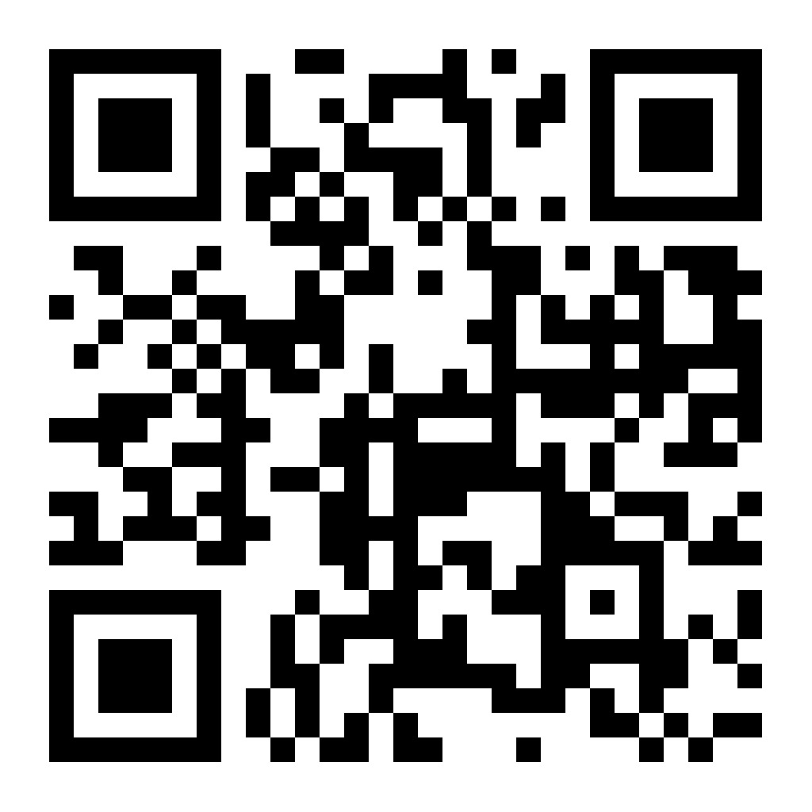
How did tonight land?
FEEDBACK
Scan to share feedback on this talk. It takes a minute, and it helps.
Building Trust · 26
Notes:
Leave this up during Q&A: this is when people actually scan. The form goes to Snowflake.

Slide 25
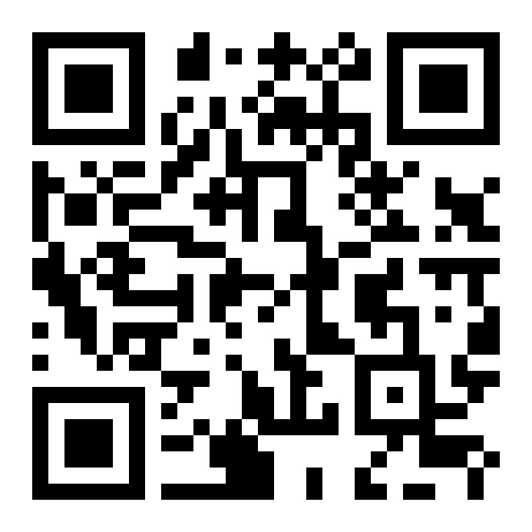
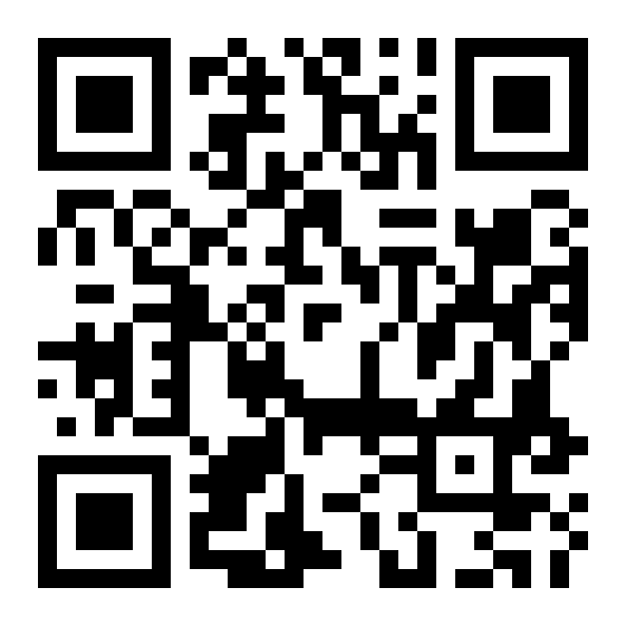
Stay Connected With the Community
COMMUNITY
Scan to keep the conversation going after tonight
Montreal User Group
Snowflake Discord
usergroups.snowflake.com/montreal
discord.gg/mwN4ffmbG
Building Trust · 27
Notes:
Plug the Montreal User Group and the Snowflake Discord. Then back to the feedback slide for Q&A if time allows.

