Slide 1
Increasing Overall-f1 score by removing features
Sebastien Church

Slide 2
Wine dataset (classification)
- 13 features
alcohol
malic_acid
ash
alcalinity_of_ash
magnesium
total_phenols
flavanoids
nonflavanoid_phenols
proanthocyanins
color_intensity
hue
od280/od315_of_diluted_wines
proline
- 3 classes
Class 1
Class 2
Class 3
- Estimator : SVC (linear)

Slide 3
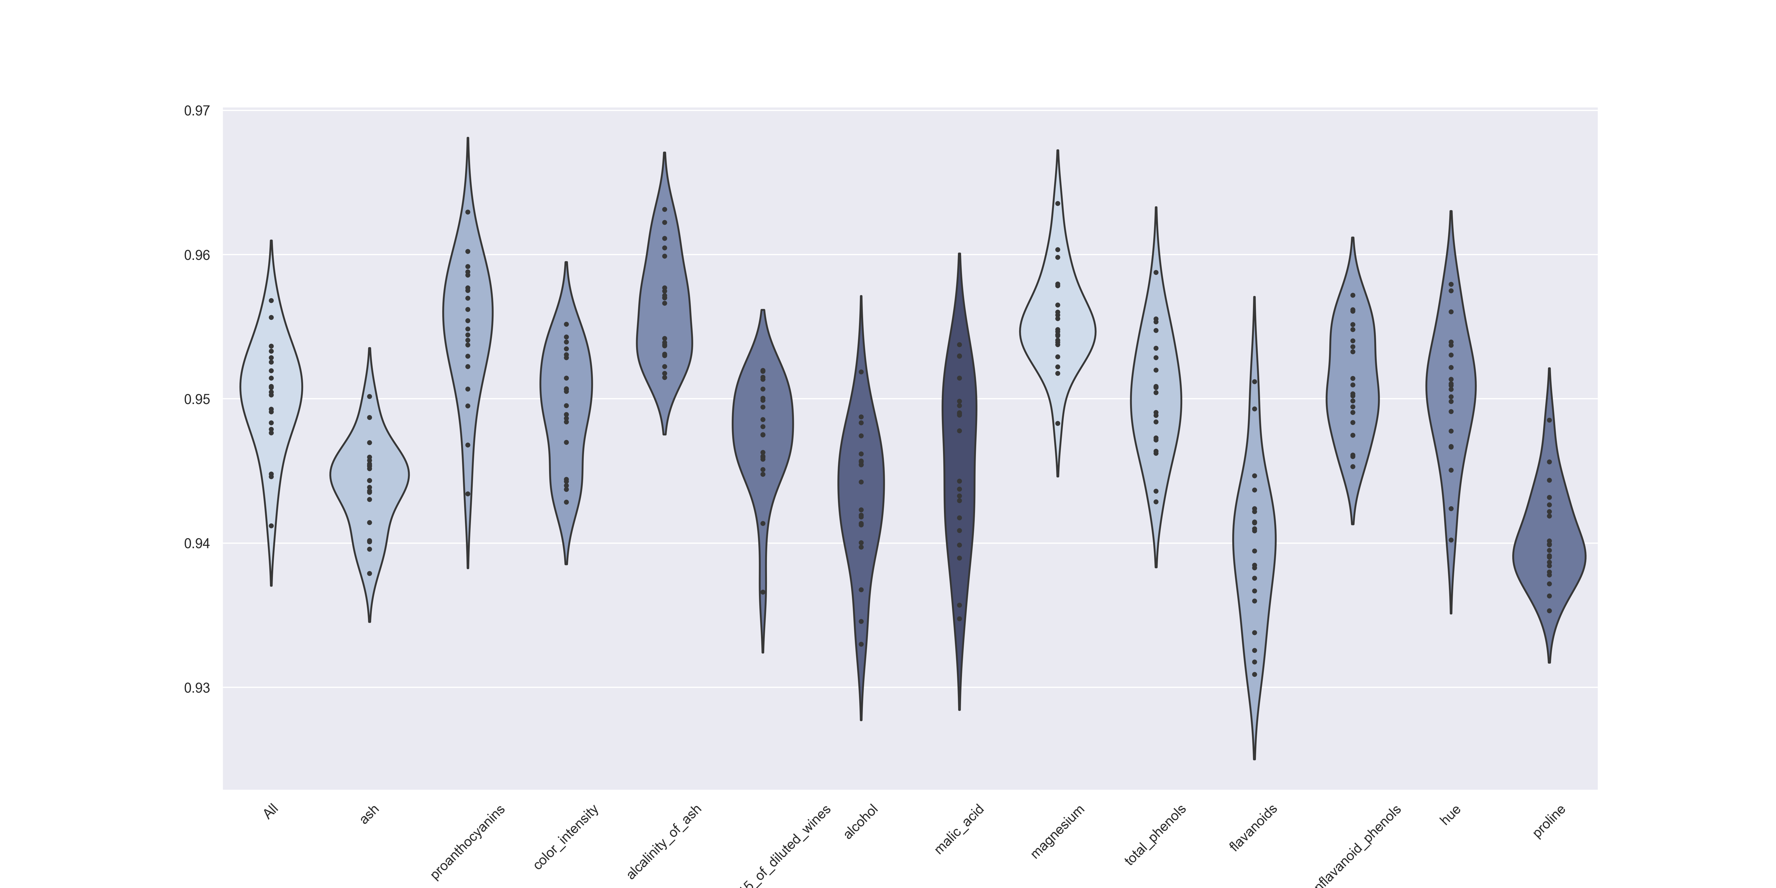
Single removal of features
Single removal of features
Please note the features that have an increase in the overall f1-score
Notably: proantocyanins, alcalinity_of_ash and magnesium

Slide 4
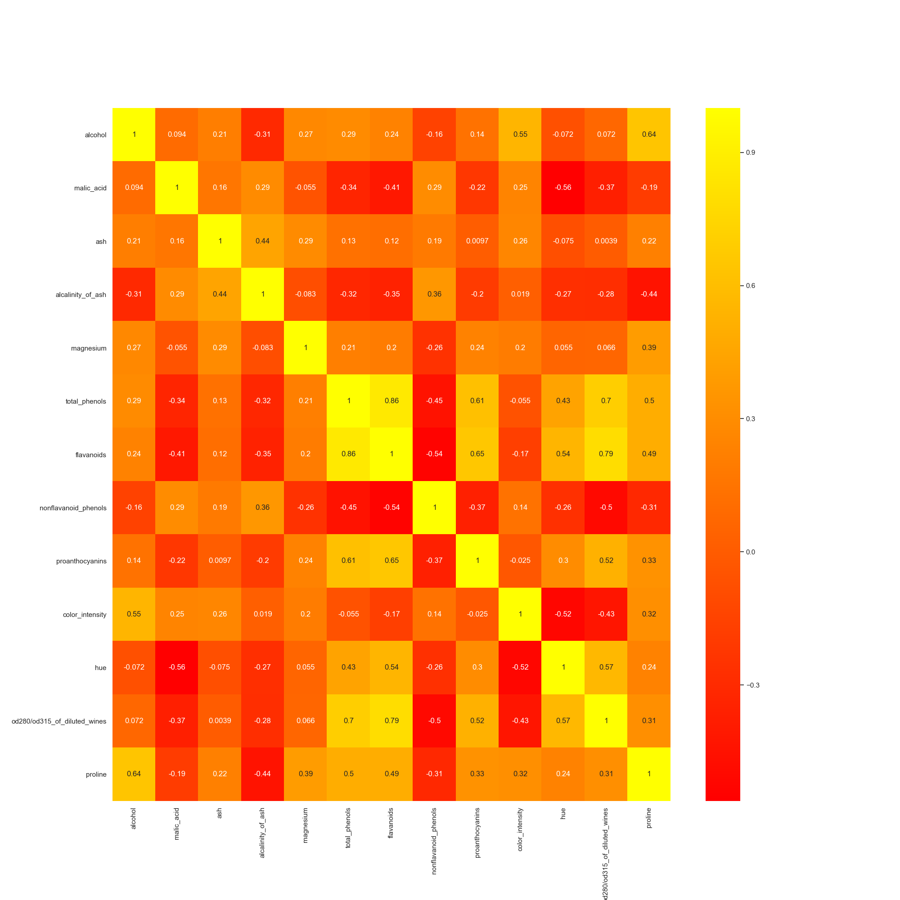
How to choose the right feature(s) to remove ?
By a using an approach of selecting the features based on the correlation values as we all have seen in the heat map
Selection based on a low value
In this case a correlation value of 0.05 was chosen
The selected features were found programmatically
In each case the mapped feature was selected and it’s count was increased
Finally the features were used with highest number of occurence first

Slide 5
Here is the list and their occurence
4 matches were found within the correlation range of -0.05 to 0.05
ash and proanthocyanins
ash and od280/od315_of_diluted_wines
alcalinity_of_ash and color_intensity
proanthocyanins and color_intensity
Occurence count for the 13 features
alcohol has count of 0
malic_acid has count of 0
ash has count of 2
alcalinity_of_ash has count of 1
magnesium has count of 0
total_phenols has count of 0
flavanoids has count of 0
nonflavanoid_phenols has count of 0
proanthocyanins has count of 2
color_intensity has count of 2
hue has count of 0
od280/od315_of_diluted_wines has count of 1
proline has count of 0

Slide 6
So the final array for incremental removal is as follows:
[(2, ‘ash’),
(2, ‘proanthocyanins'),
(2, ‘color_intensity'),
(1, 'alcalinity_of_ash'),
(1, ‘od280/od315_of_diluted_wines’),
(0, ‘alcohol'),
(0, ‘malic_acid'),
(0, ‘magnesium'),
(0, ‘total_phenols'),
(0, ‘flavanoids’),
(0, ‘nonflavanoid_phenols'),
(0, 'hue'),
(0, 'proline')]
You can see that the 5 first features are represented with their weight
Ash (2) Proanthocyanins (2)
color_intensity (2)
alcalinity_of_ash (1)
od315_of_diluted_wines (1)

Slide 7
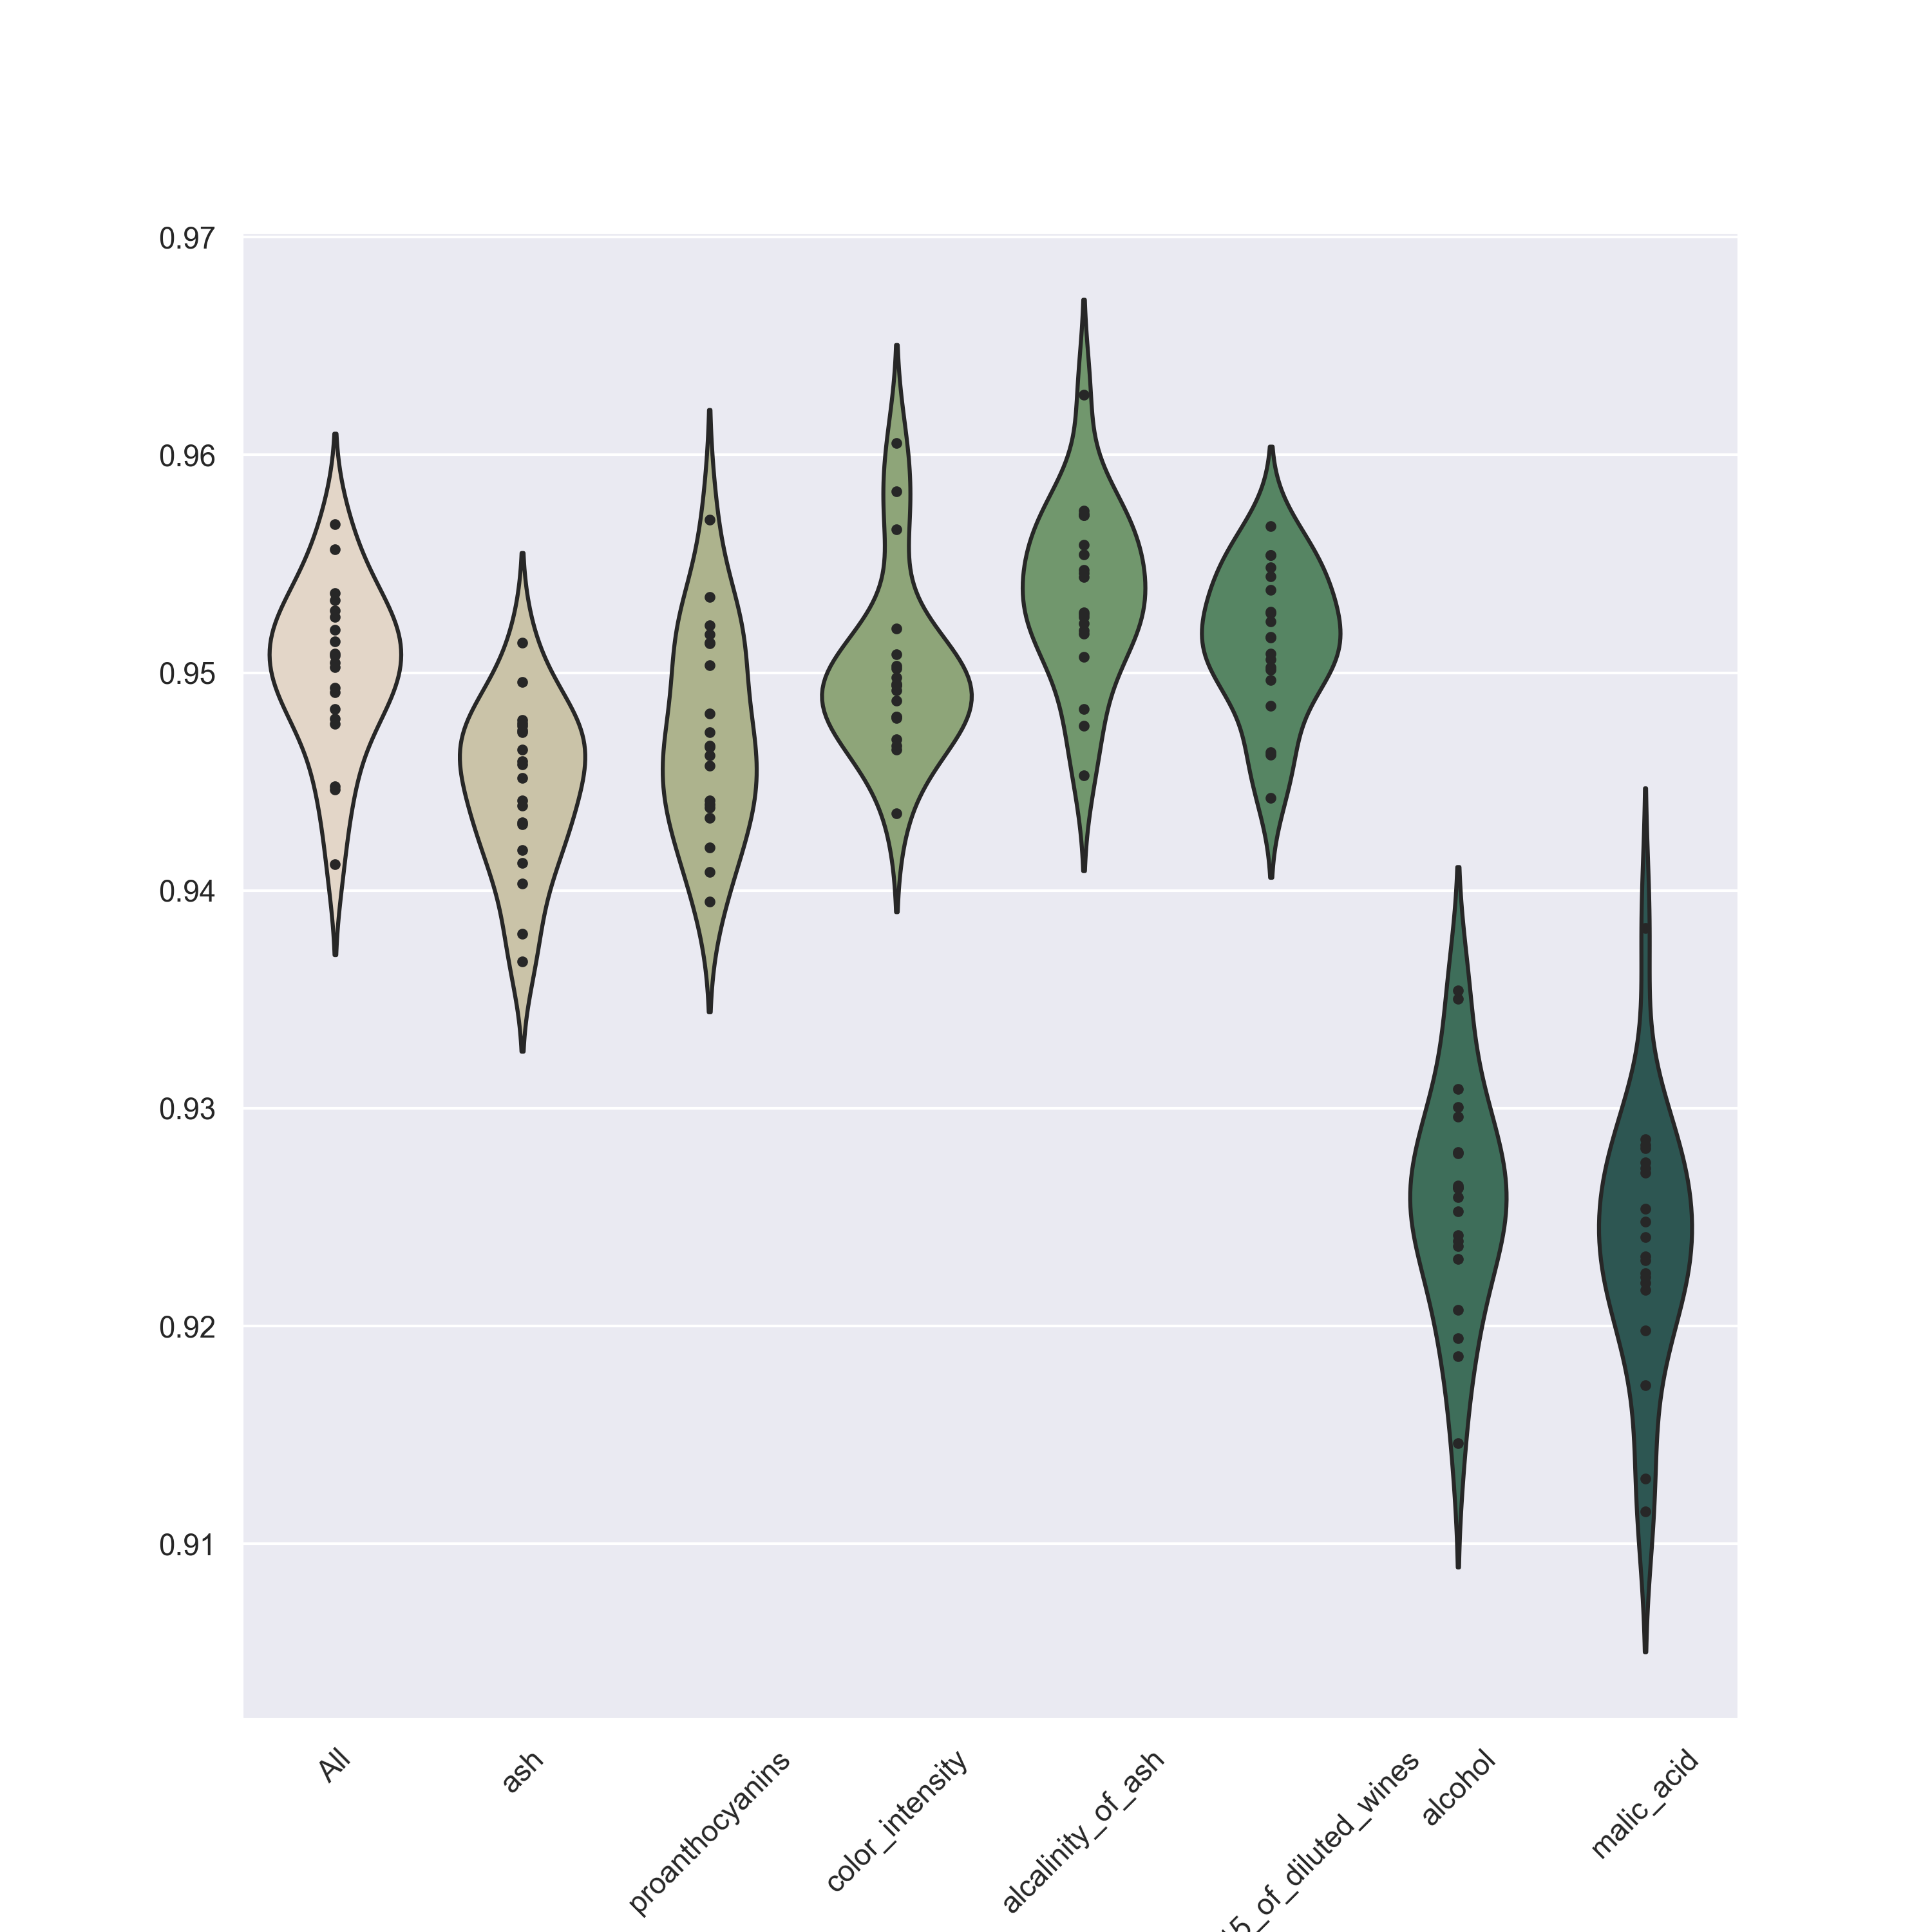
Incremental removal of features
There is almost no negative effect in overall f1-score when removing the selected features

Slide 8
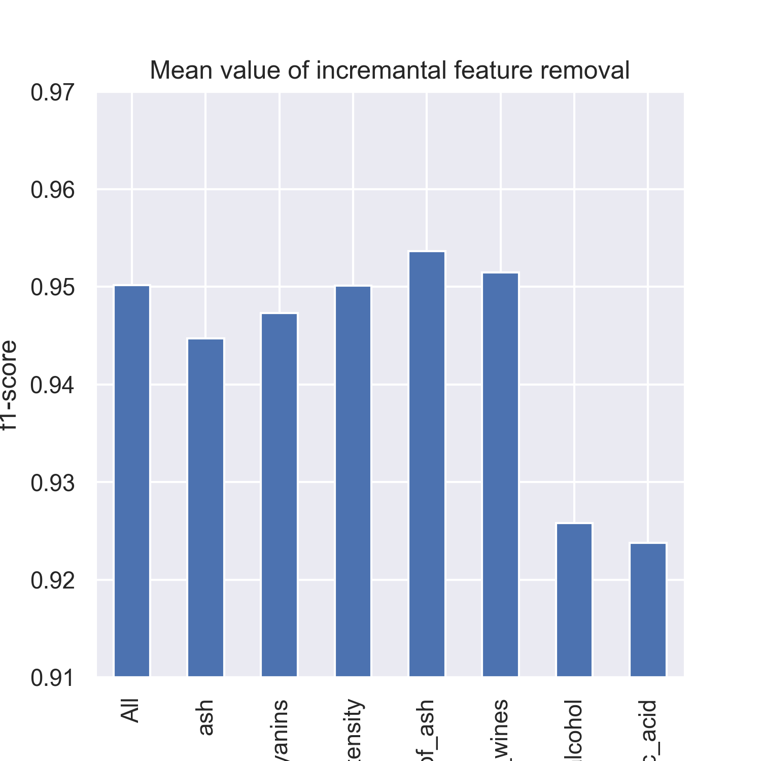
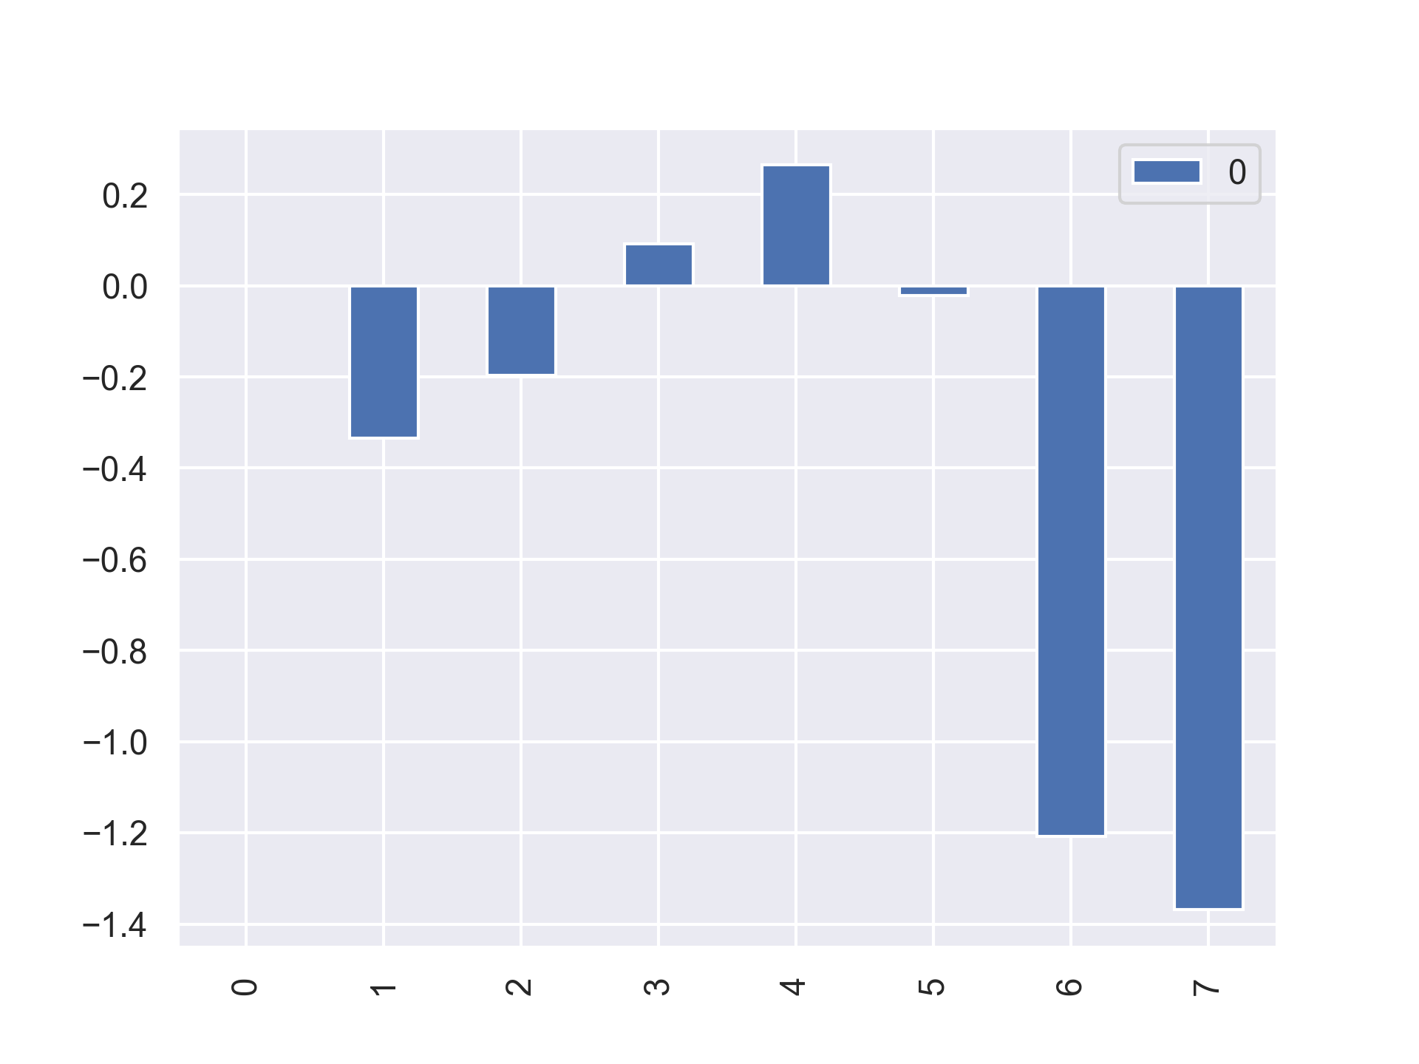
Mean values indicate better overall-f1 score when dropping the first 4 features
There is a 0.264862 percent increase in overall-f1 score after removal of the first 4 feature
This percent increase does improve the overall f1-score but not significantly
We can also see that the removal of low correlated features does not significantly affect the overall f1-score

Slide 9
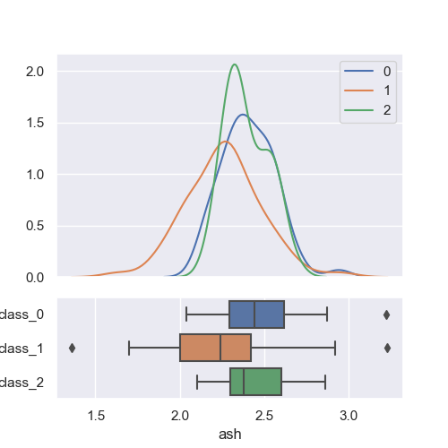
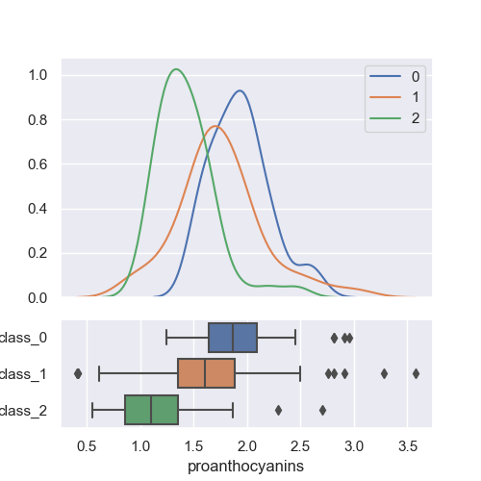
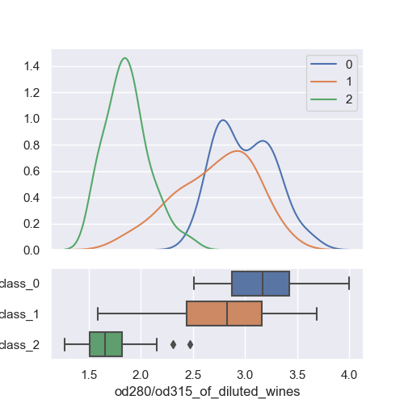
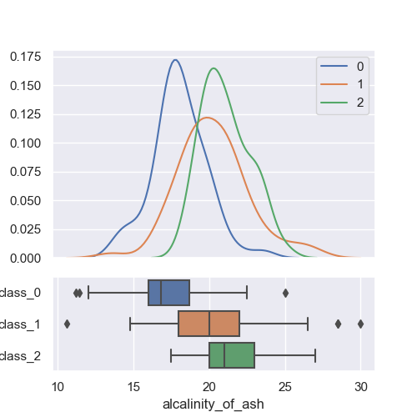
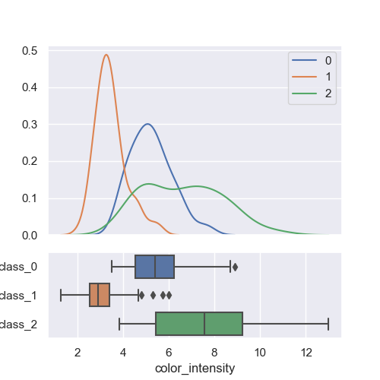
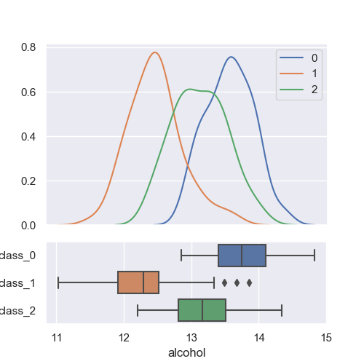
Other interesting graphs kdeplot to show class distribution per feature

Slide 10
Thank you

