Slide 1
Optimisation & Licensing Assessment
Name, Job Title
Date

Slide 2
Agenda
Executive summary
Business value
Financial summary
Licensing considerations
Support considerations
Business Value
Next steps
About Softcat
Questions/AOB
Softcat OLA
Notes:
These are the main points we’re going to run through during the presentation, some of it I might skip over if it’s not entirely relevant to the assessment but it’s in there because it might be useful for you in the PDF after.

Slide 3
Executive Summary

Slide 4

Executive Summary
<CUSTOMER>’s current estate consists of <SRV> servers of various types
<CUSTOMER> seeks to exit its current RackSpace Data Centre, while taking the opportunity to modernise into the Cloud
Softcat performed an Optimisation and Licensing Assessment to provide <CUSTOMER> a High-Level overview of how that migration journey might look.
Optimisation could save up to <b3at%> compared to on-demand License Included
EXECUTIVE SUMMARY
4
Notes:
Presentation focuses on overall estate that was assessed but you’ll see some variation in that number depending on what we’re talking about because of how the collector sees the data. It should all become clear but let me know if anything needs further explanation.
Savings % you see here may vary depending on final design and detail we find in scoping/readiness workshops

Slide 5
Overview
Current issues
Approx. <SRV> VMs and <STO> TB utilised storage
<SRV> VMs in scope for migration (<WIN> Windows, <LIN> Linux)
Including <SQL> SQL Server instances
All workloads currently hosted in Rackspace
Focused on migrating to AWS
Seeking cost comparisons
Committed to MAP funded migration with Softcat’s assistance
HIGH-LEVEL OVERVIEW
Notes:
Again, quick summary of the estate but a little more detail to show what the collector has picked up on.
Storage = 28.7TB overall, 22.3TB utilised

Slide 6
High-Level Analysis Summary
Scoping
Insights
Results
Next Steps
Collected Data
14 Days Data Collection
Results based on scope of <SRV> servers
1 zombie
0 removed from scope
90% of servers right-sized
Right-Sized & Optimized models
Up to <b3at%> Savings
From $<b3at> annualised spend on AWS
Migration Planning
Landing Zone deployment
Server replication and pilot migration
ANALYSIS SUMMARY
Notes:
This shows a quick summary of the analysis results.
20% of servers used less than 30% of the time means some right-sizing is possible which you’ll see in the upcoming slides where we can go into more detail.
(But it’s worth remembering that the numbers might change as we do more discovery. We’ll perform a TCO calculation at each stage so we should see more accuracy at each stage of the migration.)

Slide 7
Financial Summary

Slide 8
Annualised
Pricing
Comparison
This chart aims to demonstrate cost comparisons between AWS options and on-premise, when viewed as an annual cost.
Financial summary
8
Notes:
Quick comparison of a selection of savings plans we might look at in the future.
Bar chart shows the comparison well, more detail on other slides.

Slide 9
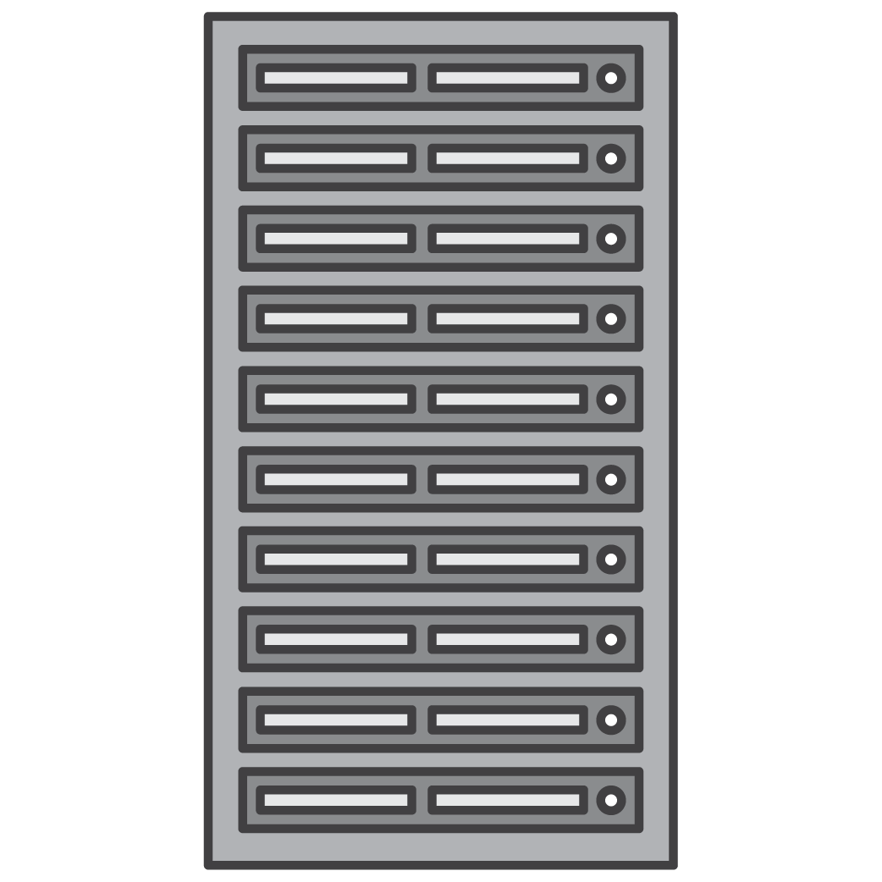
EC2 Instances: Shared Tenancy and Dedicated Hosts
Shared Tenancy
Dedicated Hosts
Customer A
Customer B
Customer C
Customer D
Customer E
Customer E
Customer A
Multi-tenant servers host instances for multiple customers
AWS determines which host instances run on
You pay per-instance
Single-tenant servers host instances dedicated to one AWS customer
Launch instances to same physical server through targeted placement
You pay per-host, per-hour
Notes:
Quick primer on the differences between shared and dedicated hosts in AWS which you’ll see referenced on the next slide.
Shared = standard cloud server environment
DH = you “purchase” the rack. More limiting in instance type, but can work well for licensing where needed.
You’ll see some recommendations for mixed tenancy, which is a combination of the two to provide the best of both worlds where needed.

Slide 10
Financial Summary - 3 YR NUSP - BYOL
Option | Compute | Storage | Network | Total
 | (annual) | (annual) | (annual) | (annual)
Shared Tenancy | $<stc> | $<sto> | $<net> | $91,000
Mixed Tenancy | $<mtc> | $<sto> | $<net> | $95,000
Modeling:
• Pricing Model: Reserved instances, 3 years, no upfront
• Region-London; Currency-USD
• Storage Assumptions:
• Storage Utilization = 100% of Provisioned Storage
• All Amazon EBS volumes are modeled to General Purpose SSD (gp3) with baseline performance of 3000 IOPS & 125 MBps throughput for SSD.
• Networking Assumptions = 10% of base compute Shared Tenancy 1 YR NUSP costs
• Licensing:
• Windows: License Included
• SQL: Bring Your Own License (BYOL)
BYOL Quantities
Product | Shared Tenancy | Mixed Tenancy
Win Server Datacenter Cores | n/a - Win License Included | 64
Win Server Standard Cores | n/a - Win License Included | 0
SQL Enterprise Cores | 0 | 0
SQL Standard Cores | 20 | 20
*Cores are listed as total cores, NOT core packs
Notes:
Comparative charts – used to indicate the approximate difference between shared and mixed as a rough guide
With SA to cover your SQL BYOL, you can go LI for Windows and reduce complexity and mgmt. overhead.
Avoiding DH also makes right-sizing much easier/possible. And in this case, lowers the cost!

Slide 11
Graviton for Linux Servers
Graviton processors are designed by AWS to deliver the best price performance for Cloud workloads running in EC2.
They are based in the ARM architecture and are supported by most Linux-based workloads. If compatible, they may deliver savings when compared to “traditional” EC2 Linux instances of..
<LIN> Linux Servers in scope
Non-Graviton cost: $4,000 | Graviton cost: $3,000
Total savings: $797
23%
Notes:
Because you have a handful of Linux servers, you might be interested in the Graviton instances.
They can lower costs a bit more where compatible.,
Here, assuming all Linux servers are eligible, saving is 23% in total for the 8 servers in scope.

Slide 12
Annualised comparison details –No Upfront
 |  | Option 1 | Option 2 | Option 3 | Option 4
 | Like-for-like unoptimized – no savings, on-demand | 3 YR NUSP | 1 YR NUSP | Right-sized shared tenancy, on-demand | Right-sized shared tenancy, on-demand, SQL LI
Compute | $145,000 | $<b3nc> | $<b1nc> | $<bodc> | $<blic>
Storage | $41,000 | $<b3ns> | $<b1ns> | $<bods> | $<blis>
Network | $4,000 | $<b3nn> | $<b1nn> | $<bodn> | $<blin>
Annual Total | $190,000 | $<b3nt> | $<b1nt> | $<bodt> | $<blit>
Annual Savings |  | <b3nt%> | <b1nt%> | <bodt%> | <blit%>
This design uses the Reserved No-Upfront 3-Year AWS price plan, License Mobility through SA, and attempts to Optimize Cost and Reduce the Number of Cores where possible.
This design uses the Reserved No-Upfront 1-Year AWS price plan, License Mobility through SA, and attempts to Optimize Cost and Reduce the Number of Cores where possible.
This design uses AWS's on-demand price plan, License Mobility through SA, and attempts to optimise cost and reduce the Number of Cores wherever possible.
This design uses AWS's on-demand price plan and adds SQL licensing costs to represent compute pricing if License Mobility and BYOL are not possible.
Notes:
A few similar tables in the next slides.
This one shows potential savings based directly on the outputs from the Cloudamize assessment.
It doesn’t differentiate between Prod and non-prod, so it tends to default to t instances.
(further notes on next slide)

Slide 13
Annualised comparison details –All Upfront
 |  | Option 1 | Option 2 | Option 3 | Option 4
 | Like-for-like unoptimized – no savings, on-demand | 3 YR AUSP | 1 YR AUSP | Right-sized shared tenancy, on-demand | Right-sized shared tenancy, on-demand, SQL LI
Compute | $145,000 | $<b3ac> | $<b1ac> | $<bodc> | $<blic>
Storage | $41,000 | $<b3as> | $<b1as> | $<bods> | $<blis>
Network | $4,000 | $<b3an> | $<b1an> | $<bodn> | $<blin>
Annual Total | $190,000 | $<b3at> | $<b1at> | $<bodt> | $<blit>
Annual Savings |  | <b3at%> | <b1at%> | <bodt%> | <blit%>
This design uses the Reserved No-Upfront 3-Year AWS price plan, License Mobility through SA, and attempts to Optimize Cost and Reduce the Number of Cores where possible.
This design uses the Reserved No-Upfront 1-Year AWS price plan, License Mobility through SA, and attempts to Optimize Cost and Reduce the Number of Cores where possible.
This design uses AWS's on-demand price plan, License Mobility through SA, and attempts to optimise cost and reduce the Number of Cores wherever possible.
This design uses AWS's on-demand price plan and adds SQL licensing costs to represent compute pricing if License Mobility and BYOL are not possible.
Notes:
A few similar tables in the next slides.
This one shows potential savings based directly on the outputs from the Cloudamize assessment.
It doesn’t differentiate between Prod and non-prod, so it tends to default to t instances.
(further notes on next slide)

Slide 14
Adjusted for Production - NUSP
 | Like-for-like unoptimized – no savings, on-demand | 3 YR NUSP | 1 YR NUSP | Right-sized shared tenancy, on-demand
Compute | $145,000 | $<b3nc> | $<b1nc> | $<bodc>
Storage | $41,000 | $<b3ns> | $<b1ns> | $<bods>
Network | $4,000 | $<b3nn> | $<b1nn> | $<bodn>
Annual Total | $190,000 | $<b3nt> | $<b1nt> | $<bodt>
 |  | <b3nt%> | <b1nt%> | <bodt%>
T instances are burstable, designed for low to moderate usage
Not suitable for high-performance workloads
Performance may be inconsistent depending on use-case
CPU credit system means performance may be throttled after periods of high usage when credits are exhausted
Network performance is also burstable so performance may be inconsistent
 | Like-for-like unoptimized – no savings, on-demand | 3 YR NUSP | 1 YR NUSP | Right-sized shared tenancy, on-demand
Compute | $145,000 | $<a3nc> | $<a1nc> | $<aodc>
Storage | $41,000 | $<a3ns> | $<a1ns> | $<aods>
Network | $4,000 | $<a3nn> | $<a1nn> | $<aodn>
Annual Total | $190,000 | $<a3nt> | $<a1nt> | $<aodt>
 |  | <a3nt%> | <a1nt%> | <aodt%>
T Family recommendations removed from production workloads
CPU/memory metrics matched with more appropriate instance types
Where no exact match, closest possible is used
Non-prod not adjusted
Storage/network not adjusted
Notes:
T instances are heavily used in automated data outputs but not recommended for production
Performance is inconsistent and will be throttled if credits are used up, affecting the performance of the server
Lower table replaces T family in production instances to show the difference.
Replaced with c6a and m6a, CPU/RAM kept same.
No match for anything with less than 4GB RAM so next one up was used (4GB).
Reality probably sits somewhere in between the 2 tables since rule is not set in stone, e.g. ADDC could be T instances.

Slide 15
Adjusted for production and right-sized - NUSP
 |  | Option 1 | Option 2 | Option 3
 | Like-for-like unoptimized – no savings, on-demand | 3 YR NUSP | 1 YR NUSP | Right-sized shared tenancy, on-demand
Compute | $145,000 | $<a3nc> | $<a1nc> | $<aodc>
Storage | $41,000 | $<a3ns> | $<a1ns> | $<aods>
Network | $4,000 | $<a3nn> | $<a1nn> | $<aodn>
Annual Total | $190,000 | $<a3nt> | $<a1nt> | $<aodt>
Annual Savings |  | <a3nt%> | <a1nt%> | <aodt%>
Adjustments:
Assumptions:
t3a.medium |  | c6a.large
t3a.large |  | m6a.large
t3a.small |  | c6a.large
t3a.xlarge |  | m6a.xlarge
Where predicted CPU utilisation is more than 30%, instance is right-sized according to adjustments listed.
Where less than 30%, t instance family is retained.
Notes:
This delves a bit deeper by attempting to adjust further based on server utilisation.
Instances chosen to match CPU and memory as closely as possible while still keeping costs as low as possible.
t3a.small doesn’t have an equivalent to match memory, so closest is used, hence c6a.large is repeated for different adjustments.
Assumed running 100% of the time.

Slide 16
Adjusted for Production - AUSP
 | Like-for-like unoptimized – no savings, on-demand | 3 YR AUSP | 1 YR AUSP | Right-sized shared tenancy, on-demand
Compute | $145,000 | $<b3ac> | $<b1ac> | $<bodc>
Storage | $41,000 | $<b3as> | $<b1as> | $<bods>
Network | $4,000 | $<b3an> | $<b1an> | $<bodn>
Annual Total | $190,000 | $<b3at> | $<b1at> | $<bodt>
 |  | <b3at%> | <b1at%> | <bodt%>
T instances are burstable, designed for low to moderate usage
Not suitable for high-performance workloads
Performance may be inconsistent depending on use-case
CPU credit system means performance may be throttled after periods of high usage when credits are exhausted
Network performance is also burstable so performance may be inconsistent
 | Like-for-like unoptimized – no savings, on-demand | 3 YR AUSP | 1 YR AUSP | Right-sized shared tenancy, on-demand
Compute | $145,000 | $<a3ac> | $<a1ac> | $<aodc>
Storage | $41,000 | $<a3as> | $<a1as> | $<aods>
Network | $4,000 | $<a3an> | $<a1an> | $<aodn>
Annual Total | $190,000 | $<a3at> | $<a1at> | $<aodt>
 |  | <a3at%> | <a1at%> | <aodt%>
T Family recommendations removed from production workloads
CPU/memory metrics matched with more appropriate instance types
Where no exact match, closest possible is used
Non-prod not adjusted
Storage/network not adjusted
Notes:
T instances are heavily used in automated data outputs but not recommended for production
Performance is inconsistent and will be throttled if credits are used up, affecting the performance of the server
Lower table replaces T family in production instances to show the difference.
Replaced with c6a and m6a, CPU/RAM kept same.
No match for anything with less than 4GB RAM so next one up was used (4GB).
Reality probably sits somewhere in between the 2 tables since rule is not set in stone, e.g. ADDC could be T instances.

Slide 17
Adjusted for production and right-sized - AUSP
 |  | Option 1 | Option 2 | Option 3
 | Like-for-like unoptimized – no savings, on-demand | 3 YR AUSP | 1 YR AUSP | Right-sized shared tenancy, on-demand
Compute | $145,000 | $<a3ac> | $<a1ac> | $<aodc>
Storage | $41,000 | $<a3as> | $<a1as> | $<aods>
Network | $4,000 | $<a3an> | $<a1an> | $<aodn>
Annual Total | $190,000 | $<a3at> | $<a1at> | $<aodt>
Annual Savings |  | <a3at%> | <a1at%> | <aodt%>
Adjustments:
Assumptions:
t3a.medium |  | c6a.large
t3a.large |  | m6a.large
t3a.small |  | c6a.large
t3a.xlarge |  | m6a.xlarge
Where predicted CPU utilisation is more than 30%, instance is right-sized according to adjustments listed.
Where less than 30%, t instance family is retained.
Notes:
This delves a bit deeper by attempting to adjust further based on server utilisation.
Instances chosen to match CPU and memory as closely as possible while still keeping costs as low as possible.
t3a.small doesn’t have an equivalent to match memory, so closest is used, hence c6a.large is repeated for different adjustments.
Assumed running 100% of the time.

Slide 18
Licensing considerations

Slide 19
MS Licensing on AWS - Key Questions
Can I reuse my existing MS Licenses on AWS? | Can I optimize my systems to get the most out of my existing licensing? | Can moving to AWS help me to reduce my MS licensing costs going forward? | Can AWS help me maintain license compliance?
Yes, certain Microsoft licenses can be reused in AWS, which brings down your monthly AWS spend by taking advantage of your existing license investments.¹ | Yes, when planning a migration, we want to ensure you’re choosing the ec2 instance that is the best fit for you needs, and that has the best overall cost for ec2 and Microsoft licensing. | Once migration is complete, AWS Cost Explorer provides recommendations for ongoing optimization of your VMs, to help keep your core count under control.² We can also explore modernization to AWS native solutions, such as fully managed SQL via Amazon RDS or AWS Aurora.³ | Yes, AWS License Manager tracks Windows and SQL licensing, and even tracks movement of VMs between hosts to help ensure you meet the 90 day license movement rules for non SA licenses. ⁴
1. Visit Microsoft Licensing on AWS and the FAQ for more information.
2. https://aws.amazon.com/aws cost management/aws cost explorer/
3. https://aws.amazon.com/blogs/modernizing with aws/three ways to run sql server on aws/
4. https://aws.amazon.com/license manager/
SOFTCAT PLC
Notes:
Lots of info on licensing in links, will share after meeting for full coverage, have condensed it…

Slide 20
BYOL Options for Windows Server and SQL Server
Summary
The table below lists the options for utilizing existing SQL Server and Windows Server licenses in AWS
Purchase date and Software Assurance benefits both impact how the licenses can be used.
Why it matters
Re-using your Windows Server and SQL Server licenses in AWS can result in significant savings, but specific rules must be followed.
Key takeaways
If an EA was signed before 01/10/2019 AND the product was on the original EA, then the ‘Before 01/10/2019’ rules apply. TrueUp quantities to these products still fall under the ‘Before 01/10/2019’ rule during the entire 3 years of the agreement.
SA can be renewed on these products after 01/10/2019 and since the original license was purchased prior to 01/10/2019 they still fall under the ‘Before 01/10/2019’ rule However…
If you deploy a version of the software that was released after 01/10/2019 then you need to follow the ‘After 01/10/2019’ rules.
SA benefits for SQL server includes passive-cluster members, among other features, so consider features that may be lost when dropping SA.
With an EA Subscription, at renewal you are forced onto the ‘After 01/10/2019’ rules (buyout option at agreement expiration lets them stay under the pre-01/10/2019 rules).
* Microsoft requires that you complete and send a License Mobility verification form which can be downloaded here. For more information, see License Mobility.
License purchased: | Before 01/10/2019 |  | After 01/10/2019
 | Shared Tenancy | Dedicated Host | Shared Tenancy | Dedicated Host
Windows
With SA | N | Y (Up to v2019) | N | N
No SA | N | Y (Up to v2019) | N | N
SQL
With SA | Y | Y | Y* | Y*
No SA | N | Y (Up to v2017) | N | N
Notes:
Key takeaways from licensing info. Important bit is with SA, you don’t need DH for SQL so recommended to go LI for Windows for an easier time.
Most important thing to remember is that DH is required for Windows but not for SQL.
As most of your servers are 2016, a good portion could be eligible. We’d need to calculate extra cost of DH vs. BYOL savings.

Slide 21
Support considerations

Slide 22
End of Support for Windows
Summary
The table represents the end of support for each relevant version, based on the Microsoft Lifecycle Extended End Date. Depending on specific requirements and terms per version, support may end before this.
At minimum, those already out of support or close to it should be refactored during migration if possible.
Version | Quantity | EOS Date
<= 2008 R2 | <win08qty> | 14/01/2020
2012 R2 | <win12qty> | 10/10/2023
2016 | <win16qty> | 12/01/2027
2019 | <win19qty> | 09/01/2029
2022 | <win22qty> | 13/10/2031
2025 | <win25qty> | 10/10/2034
COSTS SUMMARY
Notes:
About a year and a half left on windows 2016 support, worth keeping that in mind for modernisation after the migration.

Slide 23
End of Support for SQL
Summary
The table represents the end of support for each relevant version, based on the Microsoft Lifecycle Extended End Date. Depending on specific requirements and terms per version, support may end before this.
At minimum, those already out of support or close to it should be refactored during migration if possible.
Version | Quantity | EOS Date
<= 2008 R2 | <sql08qty> | 09/07/2019
2012 R2 | <sql12qty> | 10/07/2022
2014 | <sql14qty> | 09/07/2024
2016 | <sql16qty> | 14/07/2026
2017 | <sql17qty> | 12/10/2027
2019 | <sql19qty> | 08/01/2030
2022 | <sql22qty> | 11/10/2033
COSTS SUMMARY
Notes:
Plenty of support left on SQL so less urgent.
RDS can still provide benefits to remove this management overhead if interested.

Slide 24
Business Value

Slide 25
Sustainability: Directional Carbon Footprint
AWS can help lower the carbon footprint of your average on-premises data center workload
17
Carbon emission reduction
Up to
MTCO2e
vs. your on-premises environment
Up to
97%
Carbon emission reduction
vs. your on-premises environment
Projected carbon emissions of running workloads on AWS vs. your on-premises environment On-Premises Data Centre Location: United Kingdom
The unit of measurement for carbon emissions is metric tons of carbon dioxide-equivalent (MT CO2e), an industry-standard measure. This report covers AWS Scope 1 & Scope 2 emissions. A comparable AWS region may supplement data in these calculations due to limited carbon emission information being available for new or GovCloud regions.
25
Notes:
Something the business might be interested in to add to green credentials.

Slide 26



Business Value
Hackett’s Global 1000 study results showed that companies improved in three key areas after migrating to AWS. These estimates reflect a directional perspective on value benefits beyond cost savings.
Staff Productivity
Operational Resilience
Business Agility
99% more Virtual Machines (VMs) managed by a VM Administrator at AWS
56% more TBs managed by a Storage Administrator at AWS
43% reduction in unplanned downtime
37% reduction in monthly critical incidents
4% application developer efficiency allowing for increased innovation
42% reduction in time to market for feature releases
Notes:
Implementing well-architected framework, effective alerting and observability and leveraging AWS automations and integrations can provide significant increased in productivity.
Resilience of managed services and self-healing infrastructure means less fire-fighting and management overhead.

Slide 27
Next steps

Slide 28
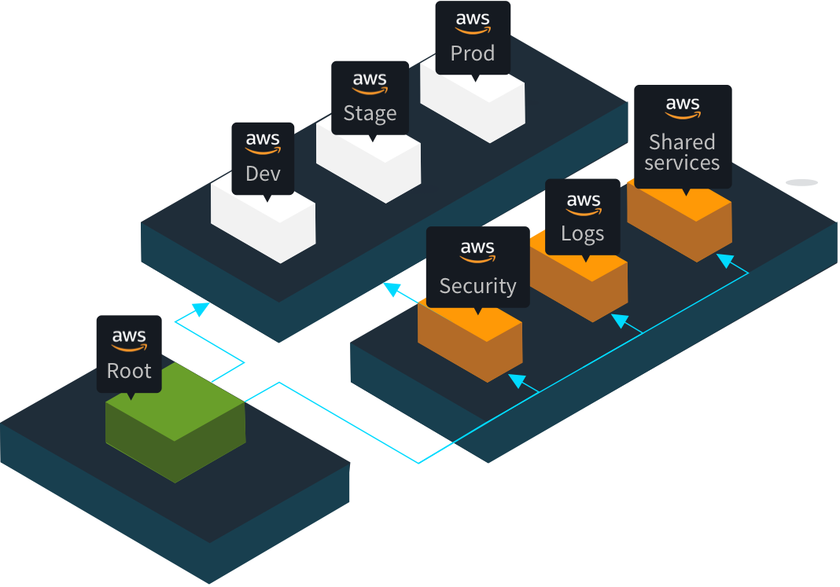
Landing Zone and Initial Build
A landing zone is a well-architected, multi-account AWS environment that is scalable and secure. This is a starting point from which your organization can quickly launch and deploy workloads and applications with confidence in your security and infrastructure environment. Building a landing zone involves technical and business decisions to be made across account structure, networking, security, and access management in accordance with your organization’s growth and business goals for the future.
*Image for illustration only
LANDING ZONE OVERVIEW
Notes:
Your landing zone and supporting resources get built out in the Mobilise phase, which is the 2nd phase of the migration.

Slide 29
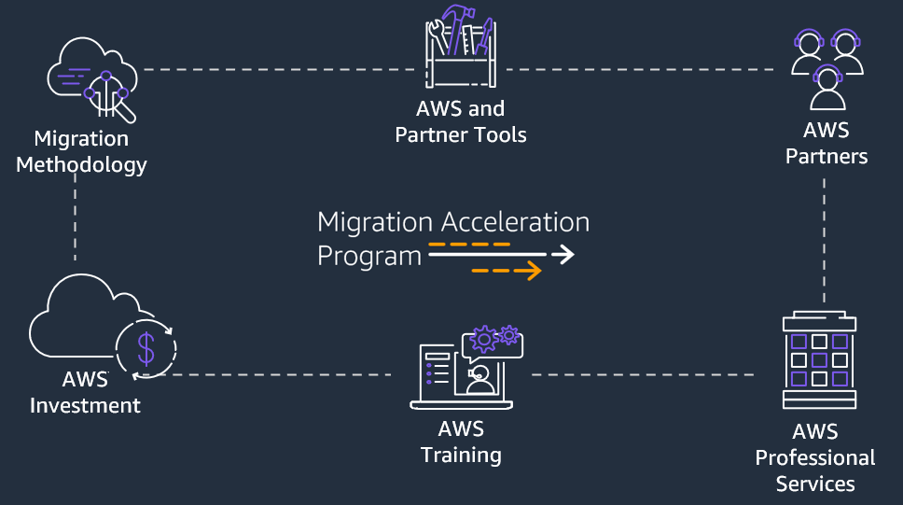
Migration Acceleration Program
For customers with incremental AWS adoption exceeding $500K annually, the Migration Acceleration Program provides a comprehensive and proven methodology, based on experience migrating hundreds of enterprise customers, making cloud adoption easier and allowing customers to gain cloud benefits sooner. MAP consists of an agile-based migration approach, a global network of vetted partners, automation tools, a training path to up-skill staff, professional services, and financial investment to help manage transition costs.
1
Identify and engage your executive champion and sponsor.
Work with your account team to engage the Migration Acceleration Program to accelerate your cloud journey.
Schedule a discovery and migration readiness assessment
2
3
MAP OVERVIEW
Notes:
Funding!
Specialist to talk about this?

Slide 30
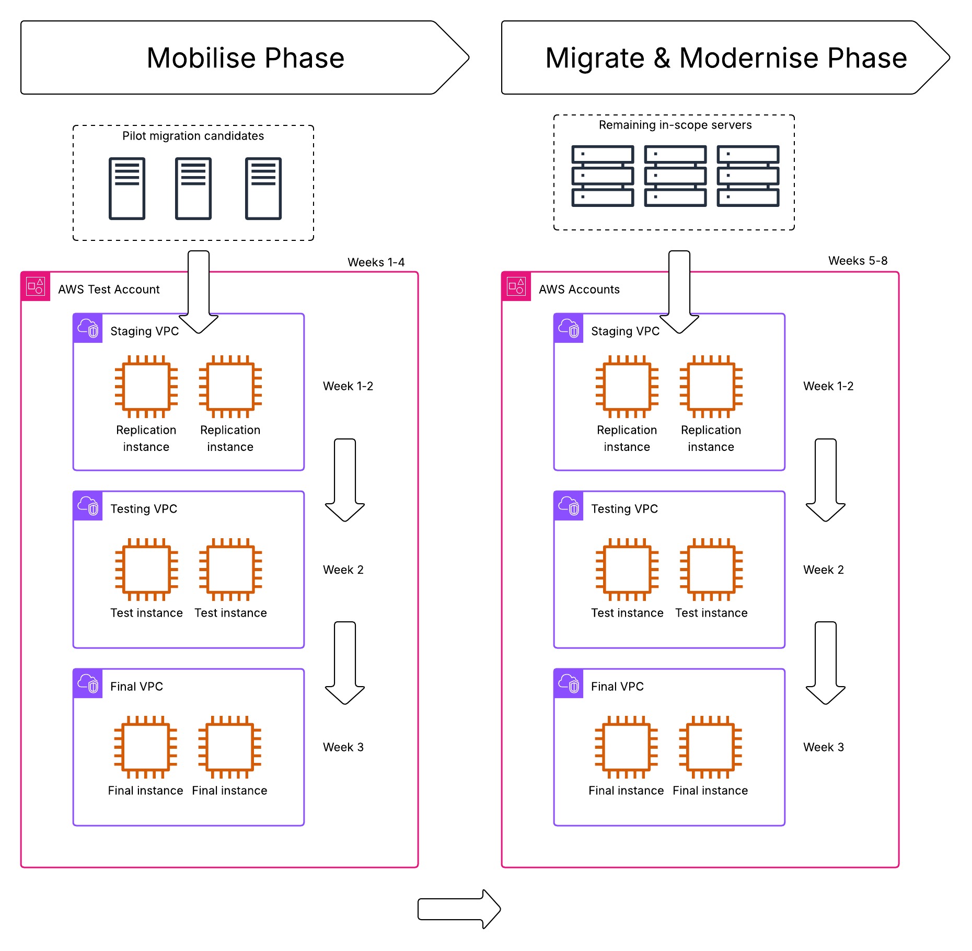
Standard migration process
Mobilise Phase
Pilot candidates are replicated to AWS Staging Area
Once replication is in sync, launch test instances
Customer checks and validates test instances
Launch templates edited
Migrated servers are cutover
Migrate & Modernise Phase
Repeat above workflow for remaining servers
Pilot candidates must be identified ahead of any works
Replication can take multiple days/weeks for resources with high rates of change
Remaining servers begin their replication after pilot is complete, potentially delaying completion
Notes:
Standard migration process, splits all migration tasks between the second and third phases.
This means majority of servers wouldn’t start replicating until a few weeks into the project which may cause unacceptable delays given the exit dates.

Slide 31
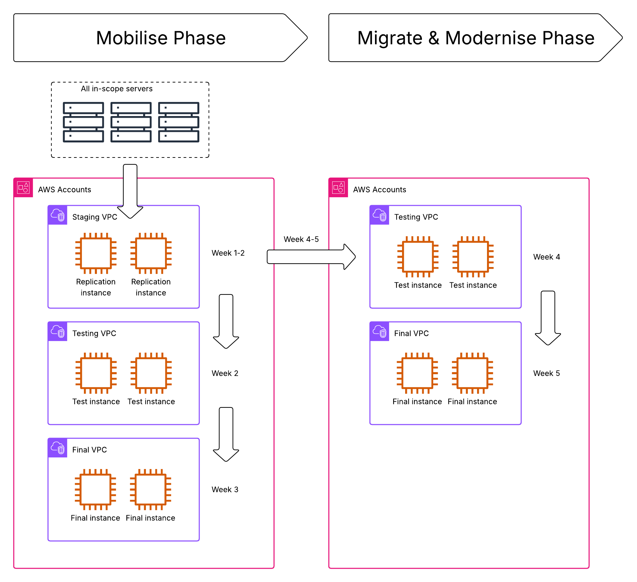
Standard migration process
Mobilise Phase
All servers are replicated to AWS Staging Areas
Identify first non-prod servers to be in sync – these are your pilot candidates
Launch test instances
Customer checks and validates test instances
Launch templates edited
Migrated servers are cutover
Migrate & Modernise Phase
Repeat above workflow for remaining servers
Pilot candidates are identified by speed of replication and being in sync
Process follows the same guidelines as standard, except all servers are replicating from Day 1
Potential to knock 2 weeks off the timeline.
Notes:
Adjusted for this project, all replication happens as early as possible in the Mobilise phase.
Pilot candidates are identified by non-prod servers to sync up first (agreed by customer at the time)
All servers should already be in sync by the time phase 3 starts, potentially removing a couple of weeks from the timeline.

Slide 32
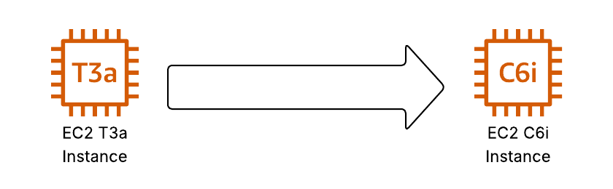
Replication Servers
Why avoid T instances for replication?
Sustained Compute Power: MGN replication agents require consistent CPU performance to handle continuous data replication — T family may throttle under load.
Faster Disk & Network Throughput: C family supports higher IOPS and bandwidth, reducing replication lag and speeding up cutover readiness.
No CPU Credit Limitations: Avoids performance degradation during peak replication periods.
Better for Parallel Replication: Handles multiple volumes and concurrent replication threads more efficiently.
Baseline + Burstable CPU: Uses CPU credits to burst above baseline performance when needed.
Cost-Effective: Lower hourly pricing, suitable for workloads with occasional spikes.
General Purpose: Good for dev/test environments, small databases, and microservices.
Limited Network & Disk Throughput: Not optimised for high I/O or sustained compute.
Credit Exhaustion Risk: Performance drops if CPU credits are depleted during sustained load.
High vCPU-to-Memory Ratio: Ideal for compute-intensive tasks like batch processing or analytics.
Consistent Performance: No CPU credit system — full performance is always available.
Enhanced Networking: Higher bandwidth and packet per second (PPS) capabilities.
Latest Generation Support: Includes Graviton (Arm) and Intel-based options.
Optimised for Scalability: Better suited for parallel processing and large-scale workloads.
Notes:
Further considerations to speed up the migration process.
Remember we talked about T instances for production? Same issue with replication servers.
C6i is recommended over other instance types because it has higher network bandwidth, higher EBS throughput and consistent performance.
C6a would improve cost/performance ratio but has lower throughput values.

Slide 33
About us

Slide 34
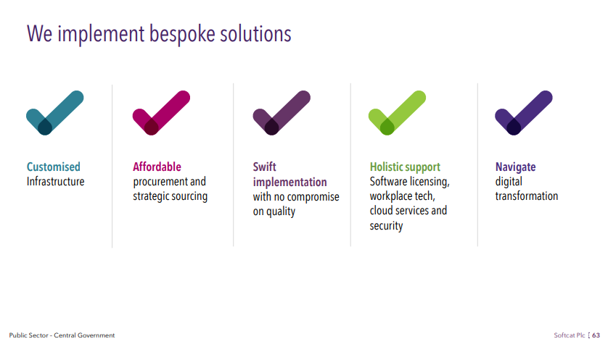

This slide is locked by your administrator. Do not edit.
Why Softcat?
Some of the reasons organisations choose to partner with Softcat in their workspace efforts include:
Industry Expertise
Customer Experience
Partner Ecosystem
Independent vendor advice
With decades of combined experience, we understand customer needs and partner objectives at a highly detailed level.
Understanding your business goals is our top priority. As a trusted partner, we align products and solutions to enhance productivity, user experience, and customer satisfaction.
We have an ecosystem of trusted partners, harnessing their specialised expertise across diverse technology areas to help you succeed.
We believe in the importance of impartial guidance with a truly independent approach. Our recommendations are focused only on identifying the vendor best suited to achieve your desired outcome.

Slide 35



What we do
We support commercial and public sector organisations to design, procure, implement and manage their digital infrastructure. Our continued success puts us in the privileged position to invest in new capabilities in exciting and emerging areas of technology, organised around five key customer priorities.
Workspace
We design and implement solutions, products and services to deliver an agile workspace environment that enables productivity, creativity and collaboration.
Hybrid platforms
We offer advice, design, managed and support capabilities to modernise, optimise and protect on- premises, edge and public cloud infrastructure.
Cyber security
Our comprehensive approach secures a digital future, providing expert guidance through the assessment, design, implementation, and ongoing management of best practice cyber security solutions.
Networking
& connectivity
From on-premises to cloud and anywhere in between, our solutions connect anything to everything in the customer’s digital ecosystem with assessment, design, implementation and managed services.
Data, AI & Automation
Helping organisations to harness vast amounts of data, streamline complex processes, and leverage intelligent insights for strategic decision-making.
Softcat overview

Slide 36




We are passionate about working in partnership with our customers to deliver the latest technology solutions and services that enable the right business outcomes now and into the future.
For more information, take a look at the Softcat FY2024 Annual Report.
Get in touch 01628 403 403
Find out more www.softcat.com

