Slide 1

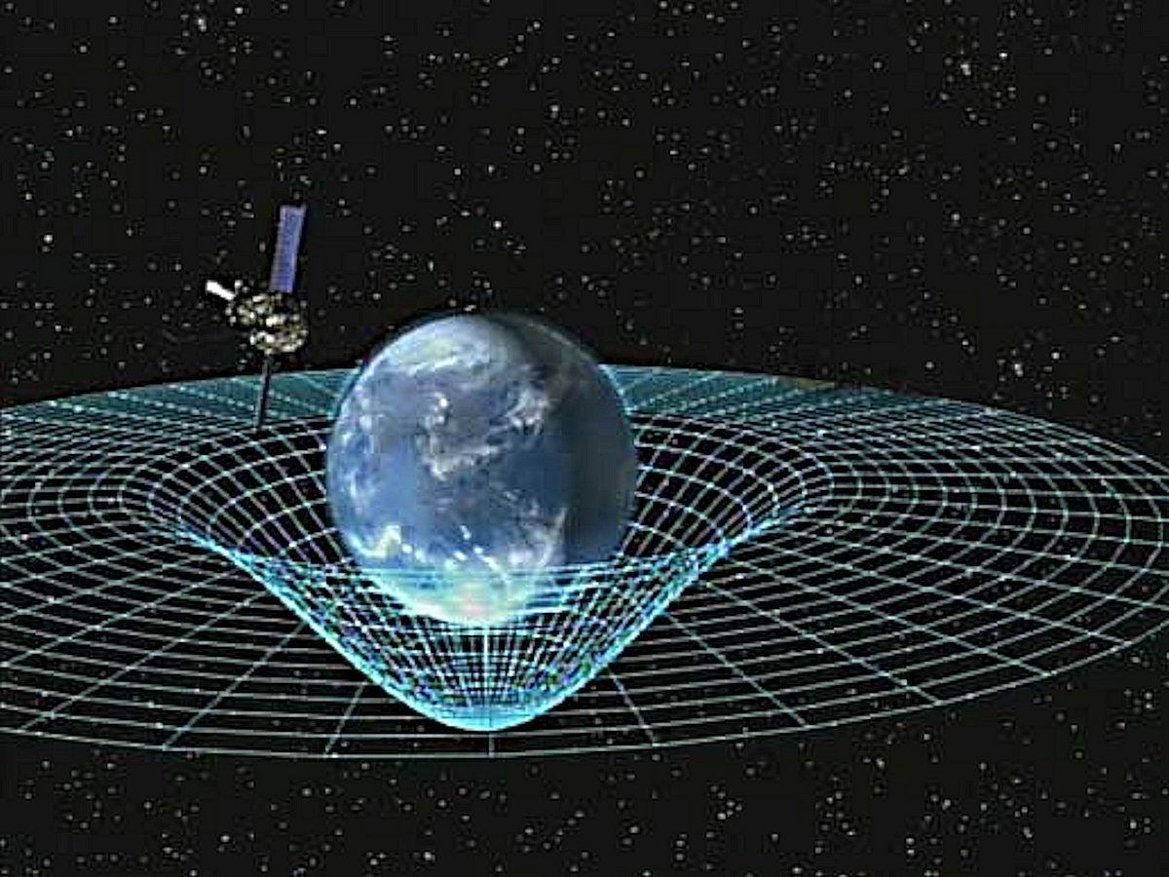
A brief introduction to the magic of spatiotemporal LCA
Ex-ante LCA meeting, 09.05.2023
Stewart McDowall and Amelie Mueller

Slide 2
Agenda
Revision Matrix of LCA
Matrix-based regional LCA
Temporal LCA
Demonstration of spatiotemporal LCA using bw25

Slide 3
Why are regionalized and temporal LCAs useful?
And for which impact categories are they particularly useful?

Slide 4
Why regional and temporal LCA are useful and for which impact categories
Regional:
Production is always occurring at a certain location
Many impacts are site-dependent, but not all
Impact categories: Land use, water use, eutrophication, PM… (any local impact/pollution)
Temporal:
Life cycle stages occur in reality over time
Temporal dimension fully neglected in conventional LCA, implicitly assumed to happen “all at once” and assessed over a certain Time Horizon for some impact categories
Impact categories: Climate change, ecotoxicity, …
To give better policy support:
Understand the system better
Identify relevant hotspots

Slide 5
Quick summary of conventional LCA Maths
h = C * B * A⁻¹ * f
1
# elem. flows
# activities
# activities
1
# impact cat.
# impact cat.
# elem. flows
# products
# products
h:
C:
B:
A:
f:
# activities
1
A
1
f
# products
# products
A * s = f -> s = A⁻¹ * f
s
# activities
=
*
B * s = g -> g = B * A⁻¹ * f
# elem. flows
B
# elem. flows
g
LCI
Scaling vector

Slide 6
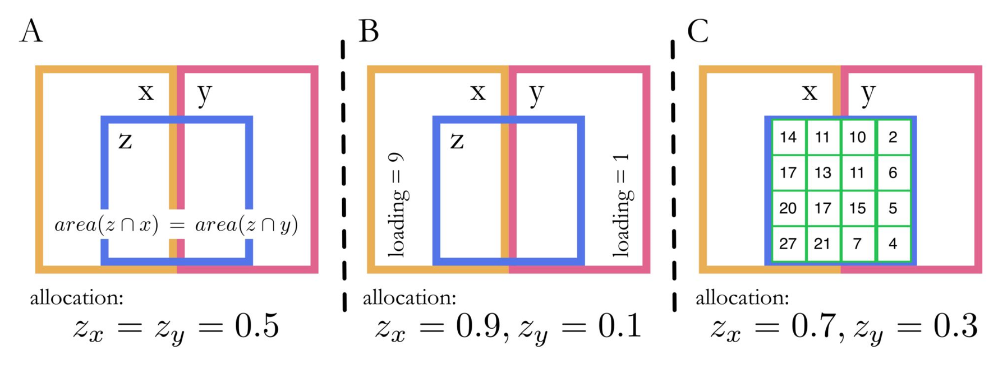
Regional LCA: 4 different types with different spatial scales
Spatial scale of the inventory,
e.g. rice production, Catalonia
Spatial scale of the impact assessment,
e.g. Water scarcity, Catalonian Basin
z
x
y
Site-generic (no spatial scale)
Shared spatial scale: mapping needed
Different spatial scale of LCI and LCIA: mapping AND allocation needed
0
1
2
3
4
x
y
-> Conventional
LCA
Mapping to shared spatial scales
Mapping to spatial scales + area-based allocation
Mapping to spatial scales + Allocation based on background loading of LCIA
Mapping to spatial scales
+ Allocation based on addi- tional data (extension tables)

Slide 7
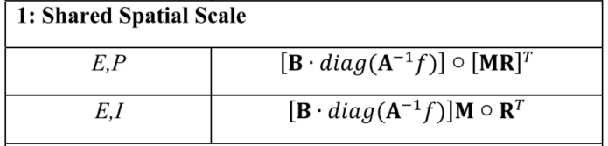
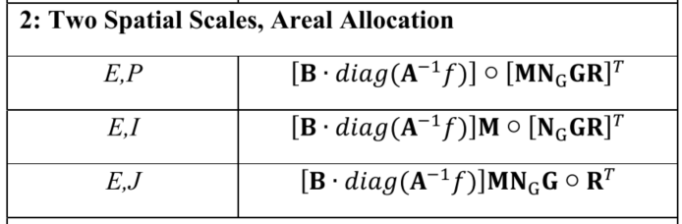
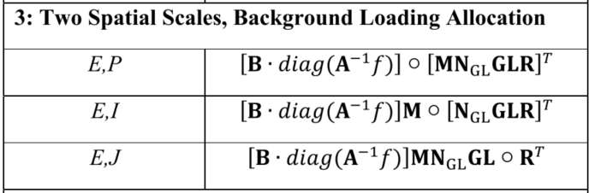
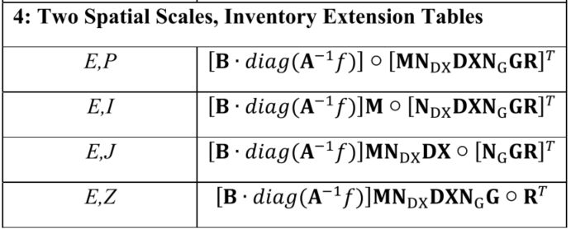
Regional LCA Maths
dimensions
formula
E = # elem. Flows
P = # Inventory datasets
I = # Inventory spatial units
J = # LCIA spatial units
Z = extension table spatial units
M = Mapping matrix between spatial scales of LCIA and LCI
R= regional characterization matrix on spatial scale of LCIA
N…=Normalization matrixes
G= geographic transformation matrix between diff. spatial scales of LCIA and LCI
L = background loadings
D = distribution matrix between diff. spatial scales of LCI and extension tables
X = density values of extension tables
Quickly gets complicated…
Site-generic: h = C * B * A⁻¹ * f
Regional:
Charaterized LCI
Mapping Matrixes
Alloc. Matrixes
Reg. CFs
*
*
More information in paper

Slide 8
Regional LCA in Brightway
bw2regional
Documentation available online
Core concepts:
Geocollections:
containers for a set of locations (links to a map and field)
LCI and LCIA have geocollections
Intersections:
areal intersections between the spatial units of two geocollections.
Need to be stored as new geocollections
Extension_tables:
additional information on loadings on a third spatial scale, e.g. irrigation of crop by municipality
Is actually also a geocollection
Calculate LCA:
(Site generic: bc.LCA(*args))
bwr.OneSpatialScaleLCA(*args)
bwr.TwoSpatialScalesLCA(*args)
bwr.ExtensionTablesLCA(*args)

Slide 9
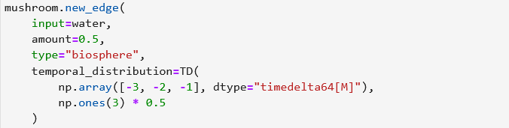
Temporal LCA in Brightway
bw_temporalis
Source code on Github, still under active development and scarce documentation
Each flow (edge) and each activity (node) can get temporal information: TemporalDistribution (TD)
2 numpy arrays: Time (DateTime or TimeDelta) and Amount
TD use relative time, relative to the process (it can be years, months or days)
Default starting time is “today”, unless otherwise specified at the process of the FU

Slide 10

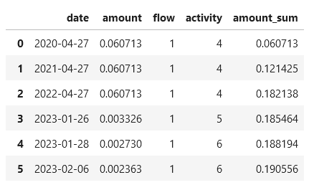
Temporal LCA in Brightway
Bw_temporalis
TDs are added over time (convoluted) and the processes are put on a timeline
Optional: TemporalisLCA can be combined with other lca objects, e.g. a regional LCA object
Bw_temporalis currently contains (basic) temporal LCIA methods

Slide 11

Confused? Enlightened? Ready for a case study?

