Slide 1
Shape from X
Computer vision class
Guided by: Dr. Sabri
Presentor: Heydar Mahmoodi

Slide 2
agenda
Introduction
Shape from Shading
Shape from Motion
Shape from Texture
Shape from Contour
Shape from Focus (SfF)
Shape from Stereopsis
Shape from Reflection
Shape from Infrared (SfIR)
Shape from Sound (SfSd)
Shape from X-ray or CT Scan
Photometric Stereo
Comparison of SfS and PS
Applications of Shape from X
Challenges and Future Directions
Related Works and Notable Researchers
Conclusion

Slide 3
Introduction
Various methods of deriving three-dimensional shape information from two-dimensional images or data.

Slide 4
Why this topic?!
"Existing techniques for extracting 3D information from 2D images are good, but not good enough,"
says Tianfu Wu, co-author of a paper on the work and an associate professor of electrical and computer engineering at North Carolina State

Slide 5
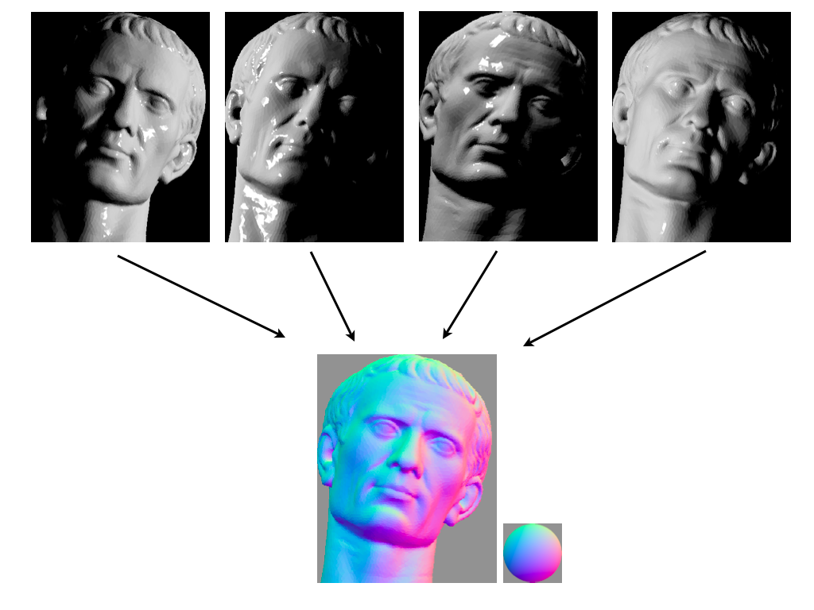
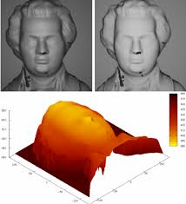
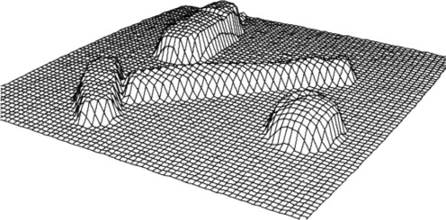
Shape from Shading
Determining the 3D shape of an object by analyzing the variations in brightness and shading in an image.
https://www.researchgate.net/figure/Shape-from-Shading-on-the-Mozart-face-Top-Input-images-Phong-Oren-Nayar-Bottom_fig1_221118830
https://www.sciencedirect.com/topics/computer-science/shape-from-shading
Explanatory diagram of photometric stereo. Multiple images of an object under different lighting are analyzed to produce an estimated normal direction at each pixel. [commons.wikimedia]

Slide 6
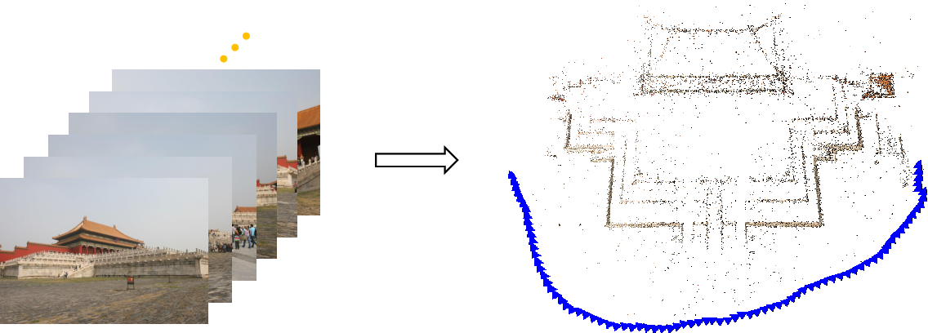
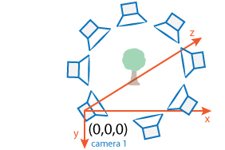
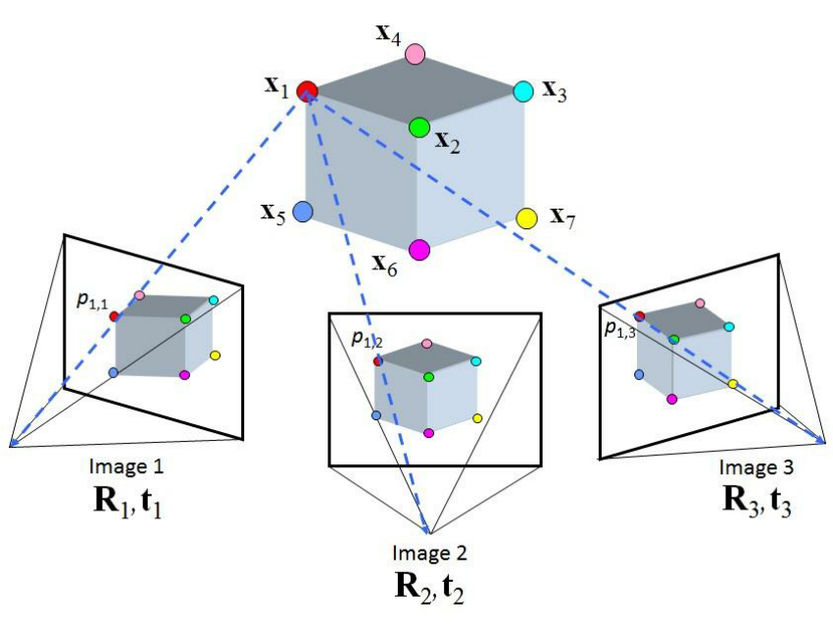
Shape from Motion
Inferring the three-dimensional shape of objects by tracking their movement or motion over time.
https://www.mathworks.com/help/vision/ug/structure-from-motion.html
https://www.semanticscholar.org/paper/Global-Structure-from-Motion-and-Its-Application-Cui/8cf2de5b4dba7feb2997ddec2296a2a876974572
https://www.researchgate.net/figure/Structure-from-Motion-SfM-process-is-illustrated-The-structure-in-the_fig2_269327935

Slide 7
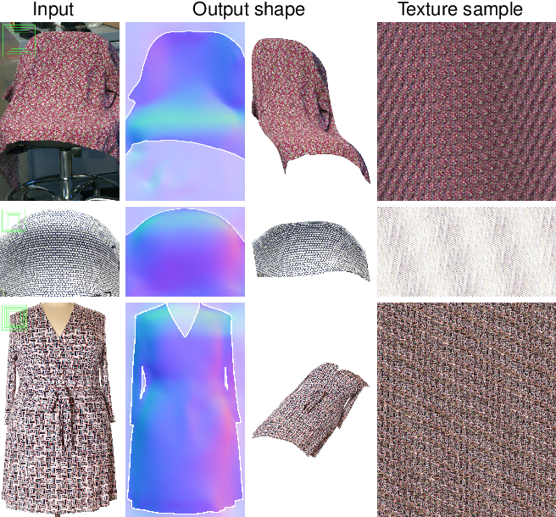
Shape from Texture
Estimating the 3D shape of an object by analyzing the patterns and texture in its surface.
In practice, implementing a complete SfT algorithm involves several complex steps, including camera calibration, dealing with different lighting conditions, and potentially using specialized libraries or custom code for depth integration.
https://www.semanticscholar.org/paper/Toward-a-Universal-Model-for-Shape-From-Texture-Verbin-Zickler/b7c1f89b695070ab23b599a5f31a82ab745408d7

Slide 8
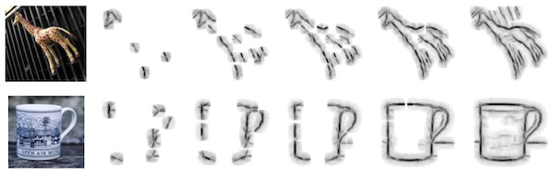
Shape from Contour
Reconstructing the 3D shape of an object by examining the edges and contours in an image.
https://hci.iwr.uni-heidelberg.de/content/contour-based-object-detection

Slide 9
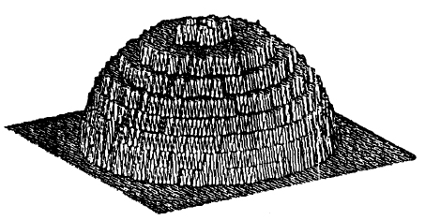
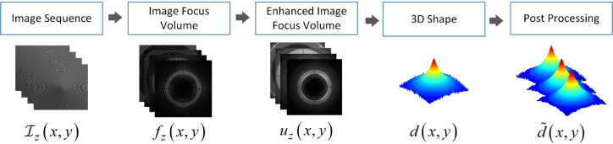
Shape from Focus (SfF)
Obtaining the 3D shape of an object by analyzing the variations in focus or depth of field in images.
Shape from focus or shape from defocus is a method of 3D reconstruction which consists of the use of information about the focus of an optical system to provide a means of measurement for 3D information. One of the simplest forms of this method can be found in most autofocus cameras today.

Slide 10
Shape from Stereopsis
Determining the 3D structure of objects by comparing the disparities or differences in the images seen by both eyes, which is the basis of human stereoscopic vision.

Slide 11
Shape from Reflection
Inferring the shape of an object by examining how it reflects light or other electromagnetic waves.

Slide 12
Shape from Infrared (SfIR)
Deriving the three-dimensional shape of objects using infrared imaging techniques and the properties of infrared light.

Slide 13
Shape from Sound (SfSd)
Estimating 3D shapes through the analysis of sound waves or echoes, often used in applications like sonar and echolocation.

Slide 14
Shape from X-ray or CT Scan
Reconstructing the internal and external 3D structure of objects or organisms by using X-rays or computed tomography (CT) scans to analyze the attenuation of X-ray beams through the object.

Slide 15
Photometric Stereo
A technique that calculates the surface normals and 3D shape of an object by capturing multiple images of the same object under different lighting conditions and analyzing how the object's appearance changes with varying lighting angles.

Slide 16
Comparison of SfS and PS
A comparison between "Shape from Shading" (SfS) and "Photometric Stereo" (PS) techniques, which both aim to recover 3D shape from images, highlighting their differences, advantages, and limitations.

Slide 17
Applications of Shape from X
Refers to the various practical uses of techniques for deriving 3D shape information, where 'X' can represent any of the methods mentioned in your previous question (e.g., Shape from Shading, Shape from Motion, etc.).

Slide 18
Challenges and Future Directions
Discussing the difficulties and potential advancements in the field of deriving 3D shape from 2D data, exploring areas for improvement and future research directions.

