Slide 1
AIaaS
Artificial Intelligence as a Service
[Empowering Businesses with Artificial Intelligence]

Slide 2
Agenda
Introduction to AIaaS
Examples of AIaaS providers
Types of AIaaS offerings
How AIaaS works
Advantages of using AIaaS
Challenges of using AIaaS
Ethical considerations of AIaaS
Real-world examples of AIaaS
The future of AIaaS
Use cases of AIaaS
Success stories of AIaaS
AIaaS vs. traditional AI development
AIaaS vs. traditional AI development
Risks of not adopting AIaaS
Conclusion

Slide 3
Introduction
Definition of Service
Definition of AIaaS

Slide 4
Examples of AIaaS providers
- Amazon Web Services
- Google Cloud
- Microsoft Azure
- IBM Watson

Slide 5
Types of AIaaS offerings
- Natural language processing (NLP)
- Image recognition
- Predictive analytics
- Speech-to-text , …
- Translation services

Slide 6
How AIaaS works
- APIs and SDKs
- RestFull API
- RPC (e.g: gRPC)
- etc

Slide 7
Advantages of using AIaaS
- Scalability
- Flexibility
- Cost-effectiveness
- Faster time-to-market
- Access to advanced AI technologies
- Speed
- High-tech Infrastructure Available
- Usability
- Scalability

Slide 8

Challenges of using AIaaS
- Data privacy and security concerns
- Integration with existing systems
- Compatibility issues with legacy software
- Dependence on third-party providers
Wait

Slide 9
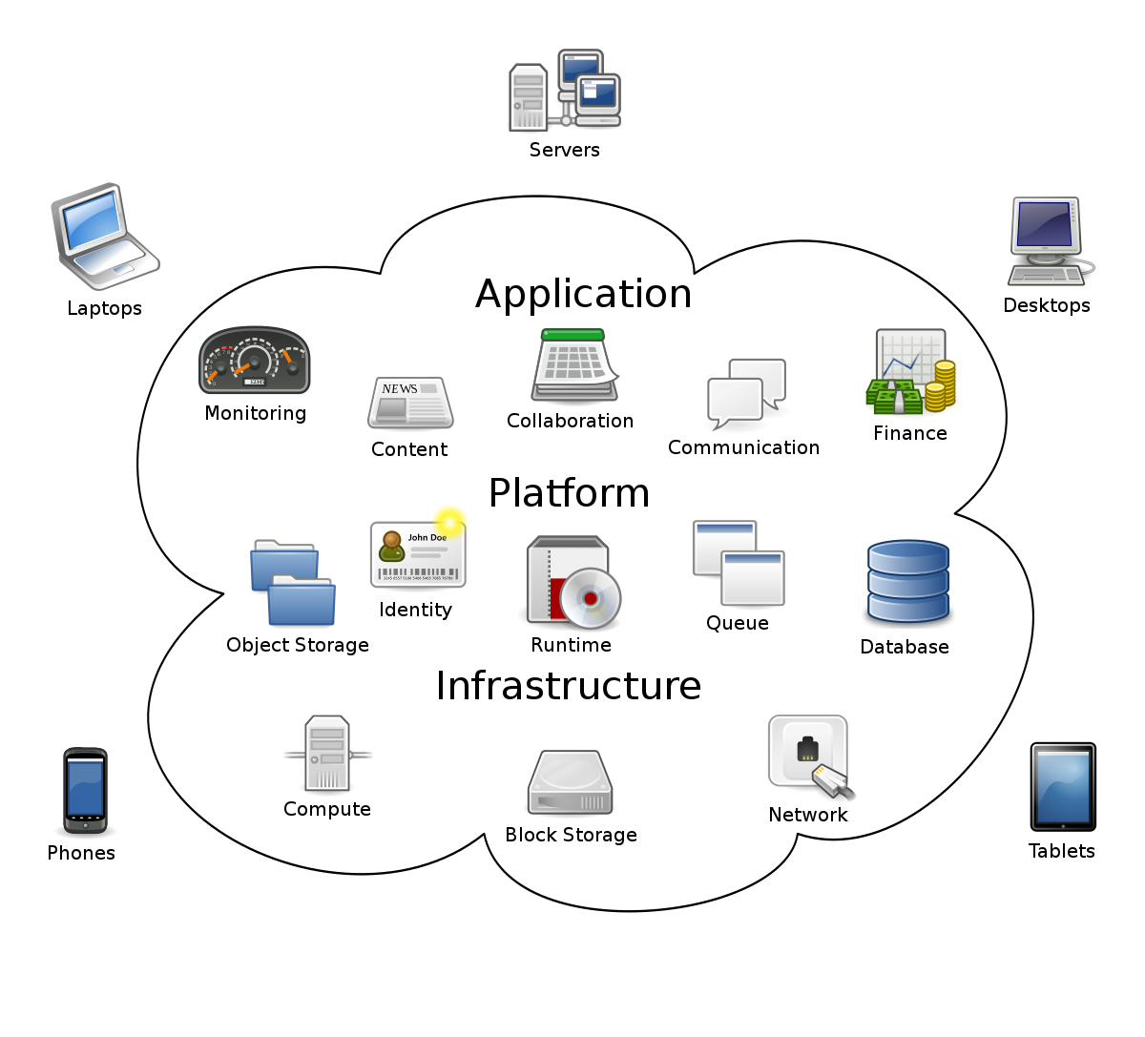
Ref: https://en.wikipedia.org/wiki/Cloud_computing

Slide 10
Ethical considerations of AIaaS
- Algorithmic bias
- Responsibility of AI developers
- Transparency and interpretability of AI models

Slide 11
Real-world examples of AIaaS
Bots
Logistics
Language Translation
Assistance
Agents
Converters
Image improvers
etc

Slide 12
The future of AIaaS
- Increasing adoption in different industries
- Emergence of new AI technologies
- Advancements in natural language processing and computer vision

Slide 13
Use cases of AIaaS
- Healthcare
- Retail
- Manufacturing
- Finance
- Transportation
- etc

Slide 14
Success stories of AIaaS
- Netflix recommendation engine
- Uber's self-driving cars
- PayPal fraud detection system
- Coca-Cola personalized marketing campaigns

Slide 15
AIaaS vs. traditional AI development
- Time and cost implications
- Access to AI talent and expertise
- Flexibility and scalability
- Integration with existing systems

Slide 16
Demystifying AIaaS
- Common misconceptions about AIaaS
- Importance of choosing the right AIaaS provider
- Benefits for businesses of all sizes

Slide 17
Risks of not adopting AIaaS
- Falling behind in the competition
- Losing market share to AI-driven companies
- Inability to keep up with customer expectations

Slide 18
Conclusion
- Recap of the key points
- Encouragement to consider AIaaS for business operations
- Contact information for further inquiries: - Heydar.mahmoodi75@gmail.com
- also you can download slides from presentation dir:
- https://github.com/SC-One/Simple_AIaaS

Slide 19
Talk is cheap , Show me the Service
- The project: https://github.com/SC-One/Simple_AIaaS
- gRPC is used for exposing APIs
- Server is using:
- darknet that based on C language
- Qt
- C++ (whole of application)
- pretrained Yolo3 weights that detecting object
- docker file is also provided to run the server (in git repo)
- also Docker image is build for Linux/AMD64 in dockerhub is available:
https://hub.docker.com/r/societycleaner/simple_ai_as_a_service/tags
- Talking about challenges(in this project).

