Slide 1
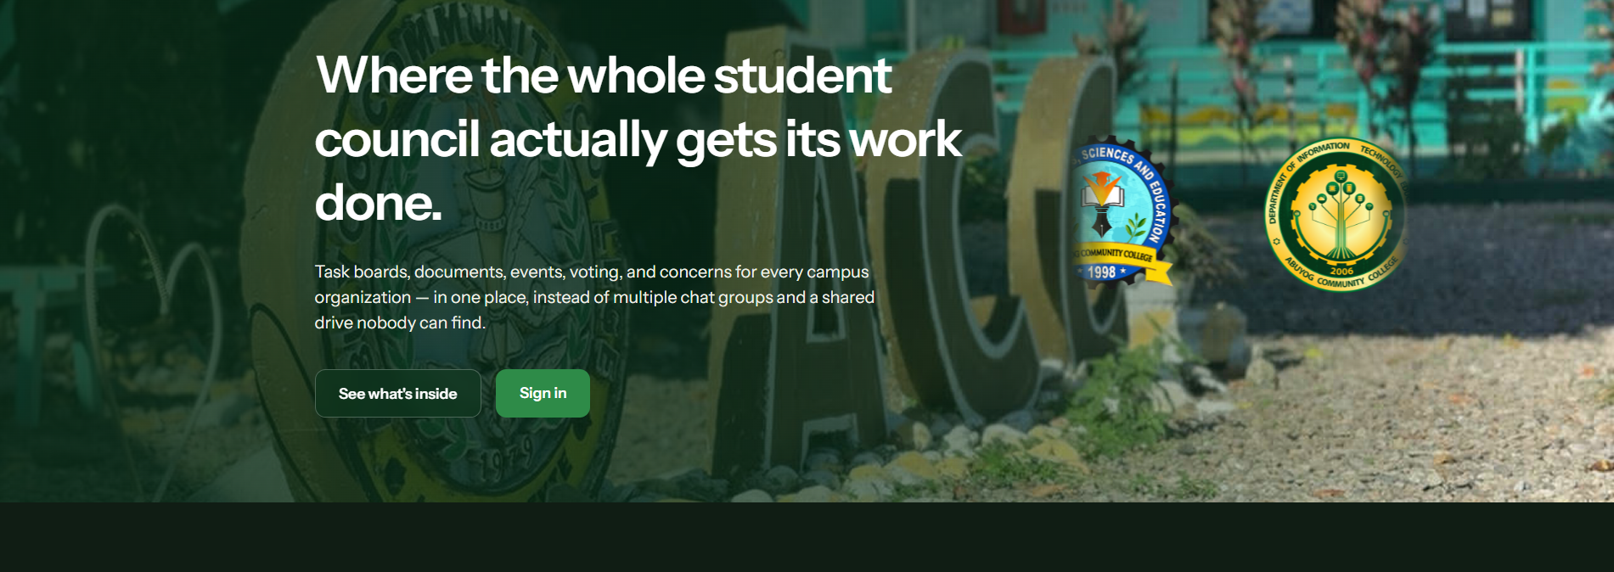
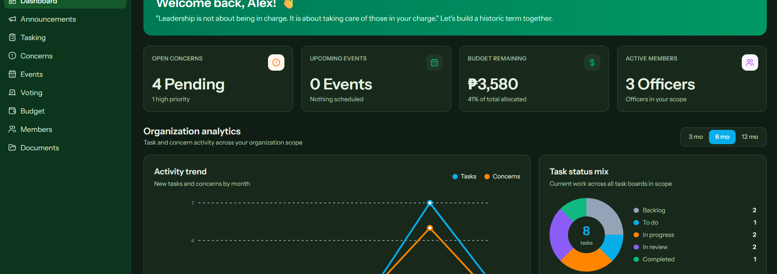
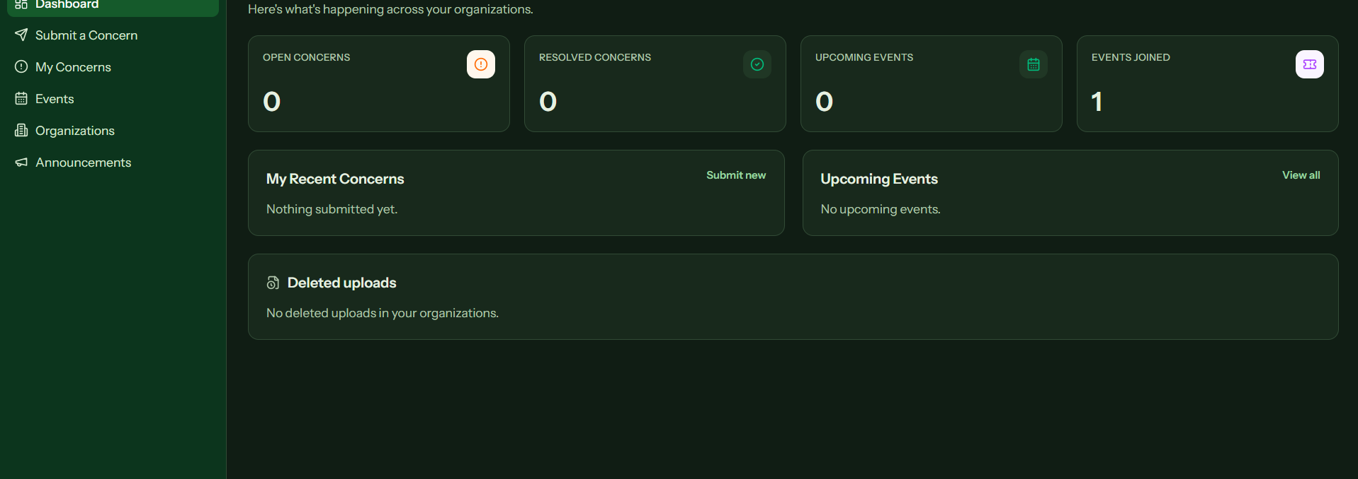
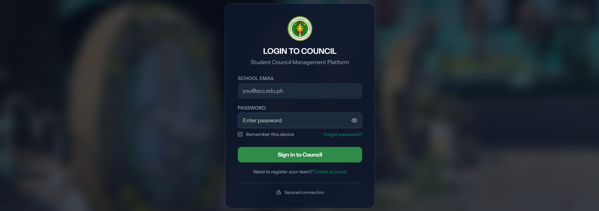
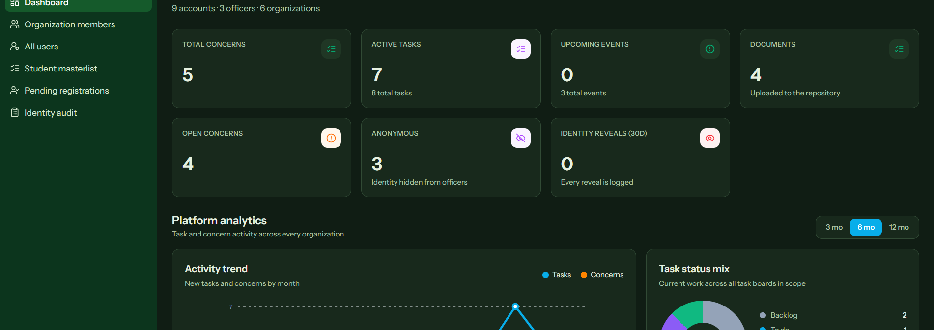
ACC
ABUYOG COMMUNITY COLLEGE
Education for a Brighter Future
SC
MG
STUDENT COUNCIL
MANAGEMENT SYSTEM
CouncilForge Academic Project Poster
Group Members: Sophia Corsiga, Princess Lhea Cominador, Evanlloyd Bandolin
Adviser: Richie A. Cabangon, MSc IT
●
Students
✓
Officers
◆
Administrator
♛
Role Based
Events, announcements, concerns
Tasks, budgets, events, documents
Accounts, users, audit records
Access follows user role
SUSTAINABLE DEVELOPMENT GOALS AND SYSTEM AGENDA
Sustainable Development Goals
System Agenda
Relevant SDGs for the project
✓
Digital information
Initiative access
Efficient governance
Data security and privacy
Sustainable partnerships
SDG 4
SDG 9
SDG 16
Quality
Education
Innovation &
Infrastructure
Peace, Justice &
Institutions
CORE SYSTEM FUNCTIONS
▤
Task Boards
◷
Event Planning
◆
Voting and Polling
Organize committee work and follow task progress.
Keep budgets, schedules, and attendees together.
Manage elections and publish results.
!
Concerns Routing
▥
Documents
⚑
Announcements
Receive, review, and resolve student concerns.
Store files in shared folders with access control.
Share information with the intended audience.
SYSTEM ARCHITECTURE AND SECURITY FLOW
System Architecture
RBAC and Security Flow
Users
Students, officers, OSA/Admin
1
›
2
›
3
›
4
↓
Role-aware modules and dashboards
Sign in
Verify identity
Check role
Allow action
Web Platform
↓
Authentication, workflows, notifications
Permissions limit each user to their authorized scope. Administrator access, account verification, anonymous concerns, and identity reveals have controlled and auditable handling.
Services
↓
Accounts, organizations, audit records
Data Layer
DEVELOPMENT METHODOLOGY AND USER ROLES
1
›
2
›
3
›
4
›
5
Discover
Design
Build
Test
Refine
Map council workflows
Define modules and roles
Develop core services
Validate access and usability
Improve from feedback
User Roles
●
Student
Submit concerns, join events, and view announcements.
●
Officer
Manage tasks, members, budgets, and activities.
●
President
Coordinate organization-wide council operations.
●
Administrator
Verify accounts, oversee records, and audit access.
SYSTEM SCREENSHOTS
CouncilForge connects student participation with transparent and accountable council work.
ACC
ABUYOG COMMUNITY COLLEGE
Developed by
Sophia Corsiga
Princess Lhea Cominador
Evanlloyd Bandolin
Student Council Management System
Adviser: Richie A. Cabangon, MSc IT

