Slide 1
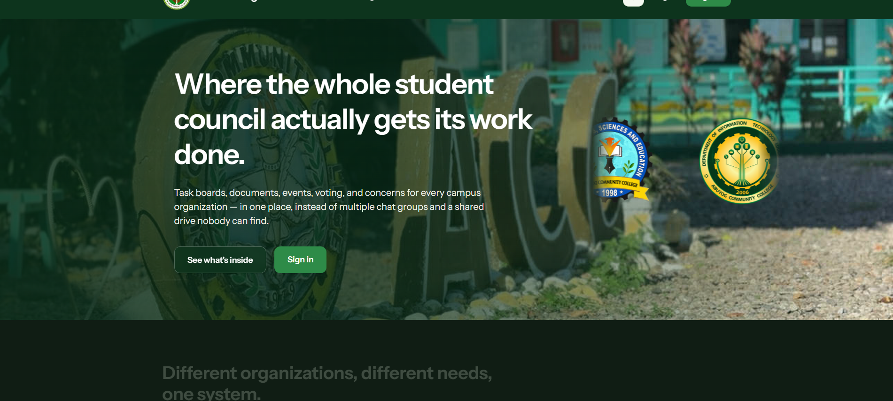
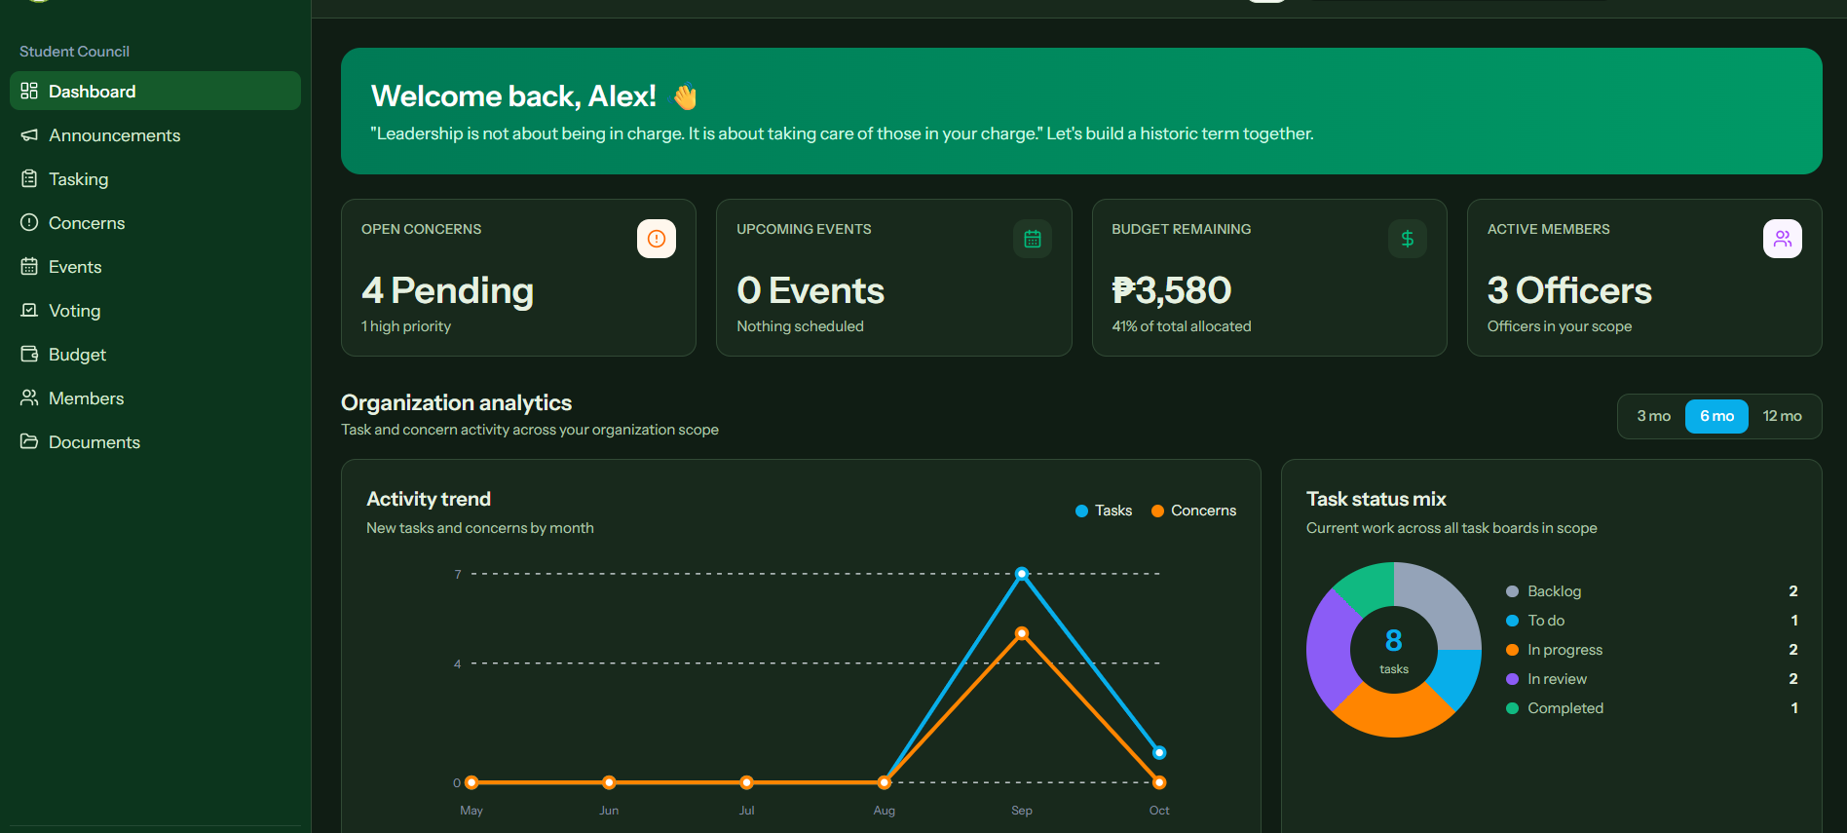
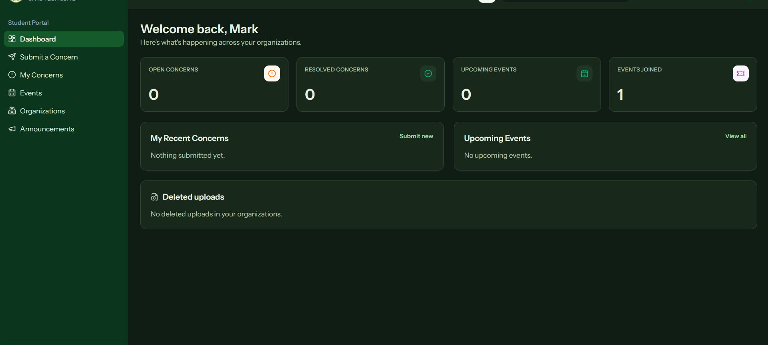
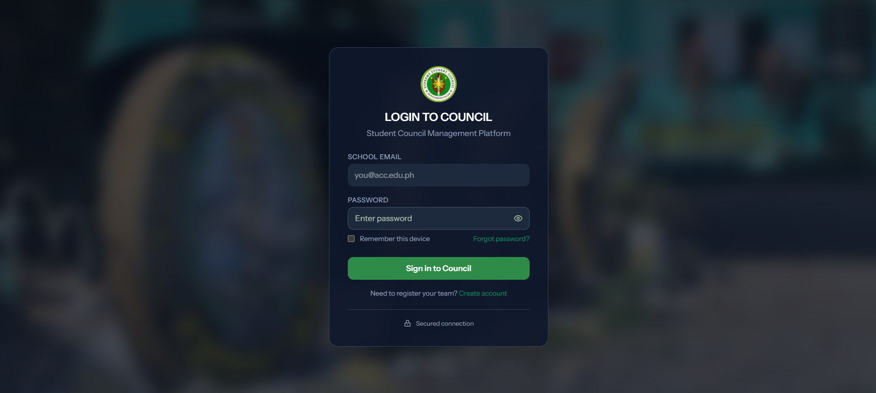
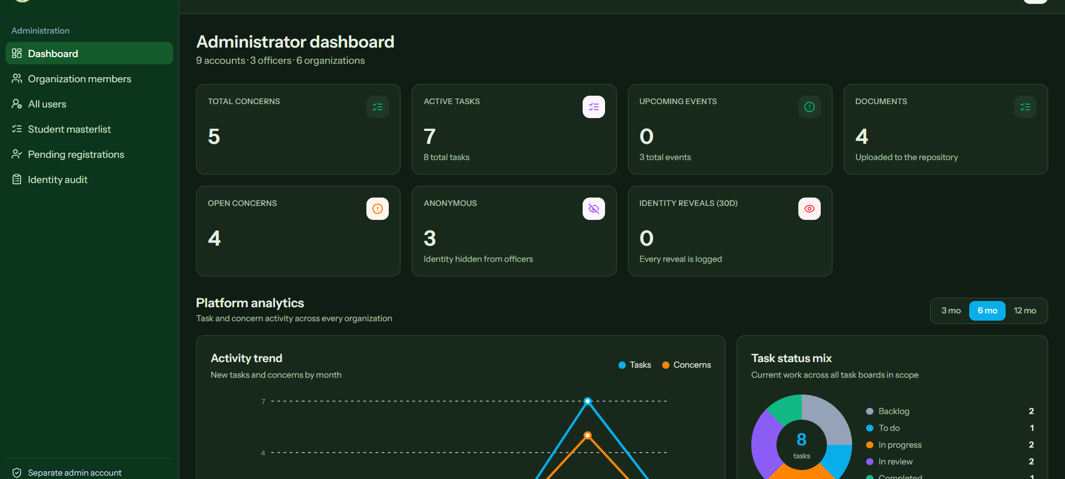
CouncilForge
One campus platform for accountable student leadership
CIVIC TECH SUITE
STUDENT COUNCIL MANAGEMENT SYSTEM
Academic Project Poster | Print size: 8 ft × 3 ft (landscape)
Abuyog Community College
01
Why CouncilForge?
02
Project objectives
03
Sustainable Development Goals
Student councils often work through scattered chat groups, files, and paper records. This makes tasks hard to track, limits transparency, and slows responses to student concerns.
•
Organize council work, events, budgets, documents, and voting in one system.
SDG
SDG
SDG
•
Provide students with visible updates and a protected concern-submission channel.
4
Quality Education
9
Industry, Innovation
& Infrastructure
16
Peace, Justice &
Strong Institutions
Agenda
centralize operations, strengthen accountability, and give students a clear channel to participate.
•
Give administrators oversight without removing organization-level autonomy.
04
Key features
05
System architecture
06
RBAC & security flow
▣
Task boards
◷
Events
Users
Students • Officers • OSA/Admin
Sign in
→
Verify identity
→
Check role
→
Allow action
Assign, monitor, and review work.
Publish events and track joins.
↓
!
Concerns
◉
Voting
Web platform
Role-aware modules and dashboards
•
Role-based permissions limit each account to its allowed scope.
Receive and resolve student issues.
Run organized student decisions.
↓
Authentication • Workflows • Notifications
•
Separate administrator access, account verification, and logged identity reveals protect sensitive actions.
₱
Budget
▤
Documents
Services
Track allocations and balances.
Keep council files accessible.
↓
Accounts • Organizations • Audit records
•
Anonymous concerns stay hidden from officers until authorized handling requires disclosure.
Data layer
07
Development methodology
08
User roles
09
System screenshots
1
›
2
›
3
›
4
›
5
●
Student
Submit concerns, join events, view announcements.
●
Officer
Manage tasks, members, budgets, and activities.
Discover
Design
Build
Test
Refine
●
President
Coordinate organization-wide council operations.
Map council workflows and user needs
Define roles, modules, and interface flows
Develop and integrate core services
Validate functions, access, and usability
Improve from feedback and observed issues
●
Administrator
Verify accounts, oversee records, and audit access.
10
System agenda
CouncilForge connects participation with accountable council operations.
CouncilForge supports a student-governance cycle that keeps decisions, responsibilities, and feedback visible to the people they serve.
Students • Councils • Administration
◉
Transparent operations
◷
Timely student response
▣
Responsible governance
Clear task, budget, document, and activity records.
A structured channel for concerns, updates, and events.
Role-aware access and audit visibility for sensitive actions.
CouncilForge | Student Council Management System | Built for campus participation, coordination, and transparent governance

