Slide 1
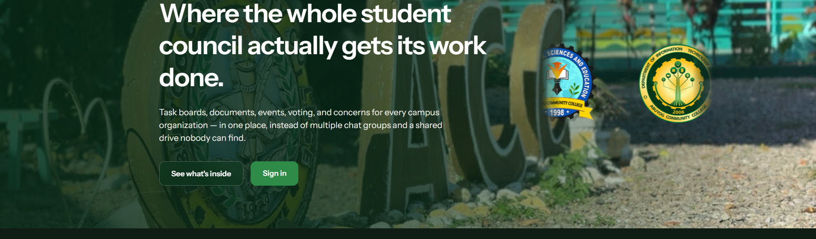
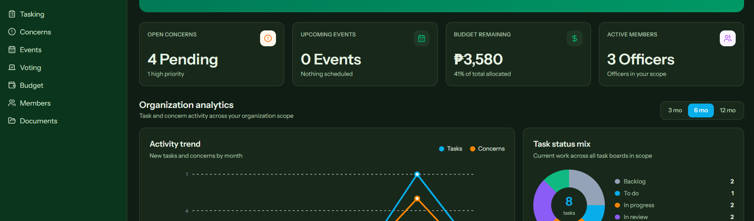
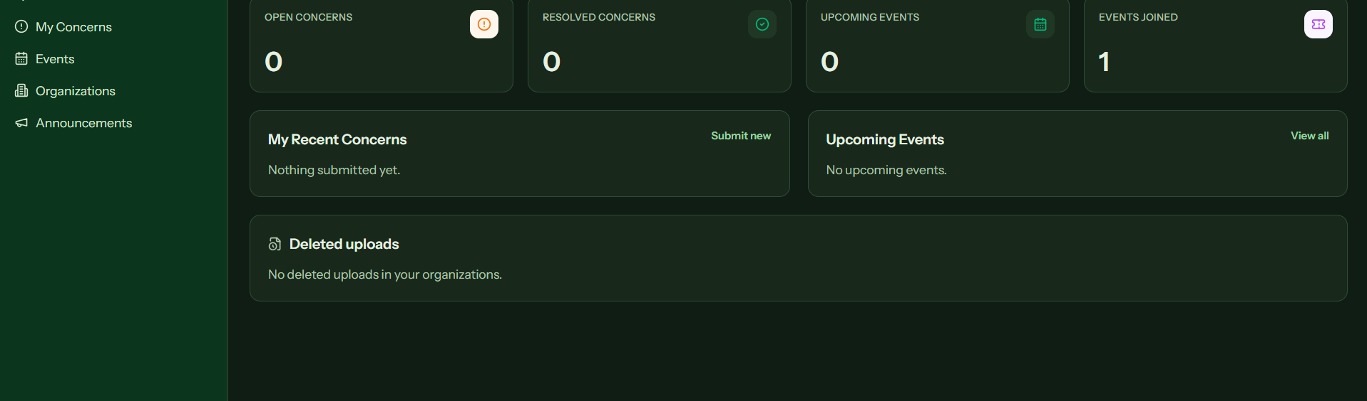
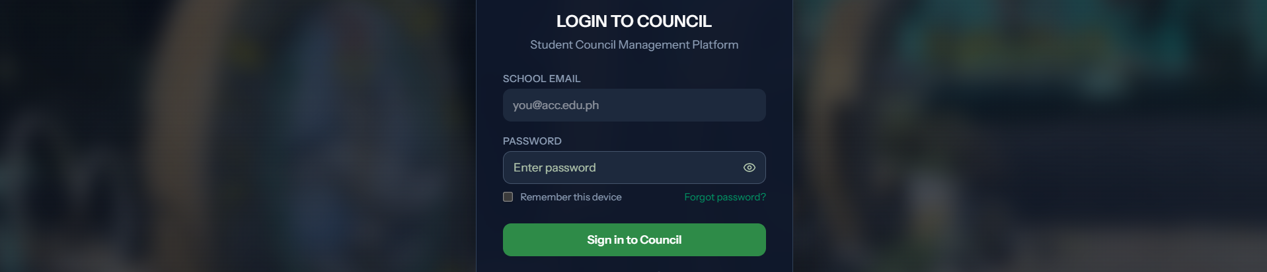
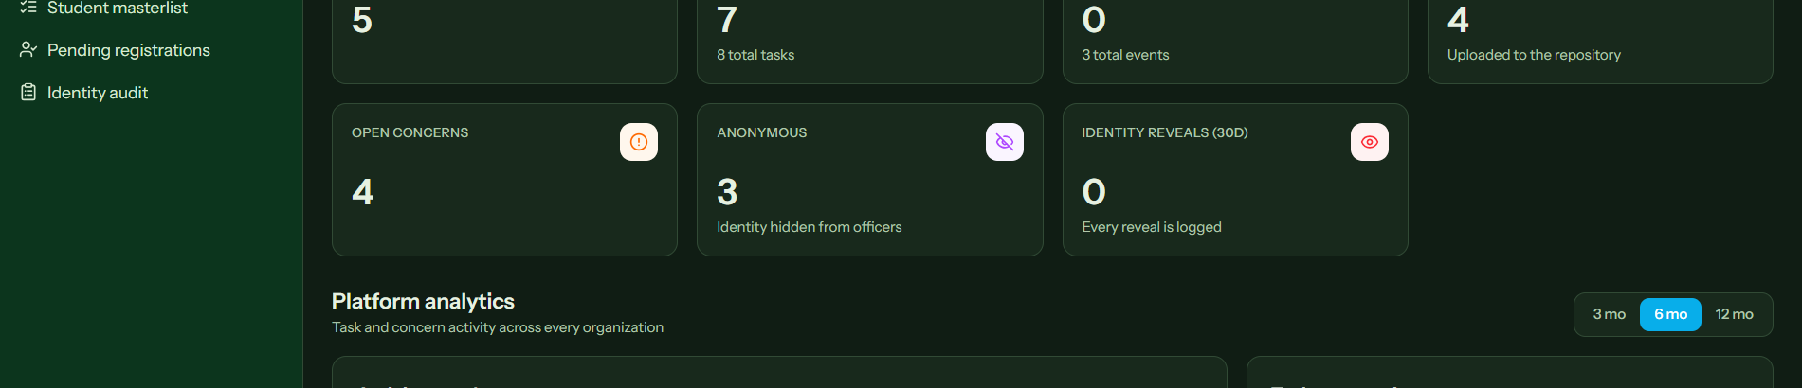
CouncilForge
CIVIC TECH SUITE
STUDENT COUNCIL MANAGEMENT SYSTEM
Abuyog Community College
One campus platform for
accountable student leadership
ACADEMIC PROJECT POSTER | PRINT SIZE: 3 FT × 8 FT | PORTRAIT
01
Why CouncilForge?
Student councils often work through scattered chat groups, files, and paper records. This makes tasks hard to track, limits transparency, and slows responses to student concerns.
System agenda
Centralize operations, strengthen accountability, and give students a clear channel to participate.
02
Project objectives
•
Organize council work, events, budgets, documents, and voting in one system.
•
Give students visible updates and a protected concern-submission channel.
•
Give administrators oversight without removing organization-level autonomy.
03
Sustainable Development Goals
SDG 4
Quality Education
SDG 9
Industry, Innovation
& Infrastructure
SDG 16
Peace, Justice &
Strong Institutions
4
9
16
04
Key features
▣
Task boards
◷
Events
Assign, monitor, and review work.
Publish events and track joins.
!
Concerns
◉
Voting
Receive and resolve student issues.
Run organized student decisions.
₱
Budget
▤
Documents
Track allocations and balances.
Keep council files accessible.
05
System architecture
06
RBAC & security flow
Users
Students, Officers, OSA/Admin
Sign in
→
Verify identity
→
Check role
→
Allow
↓
Role-aware modules and dashboards
•
Role-based permissions limit each account to its allowed scope.
Web platform
↓
Authentication, workflows, notifications
•
Separate administrator access and account verification protect sensitive actions.
Services
↓
Accounts, organizations, audit records
•
Audit records log authorized identity reveals and system activity.
Data layer
07
Development methodology
1
›
2
›
3
›
4
›
5
Discover
Design
Build
Test
Refine
Map workflows
Define modules
Integrate services
Validate access
Improve from feedback
08
User roles
●
Student
Submit concerns, join events, view announcements.
●
Officer
Manage tasks, members, budgets, and activities.
●
President
Coordinate organization-wide council operations.
●
Administrator
Verify accounts, oversee records, and audit access.
09
System screenshots
CouncilForge connects participation with accountable council operations.
Students • Councils • Administration
CouncilForge | Student Council Management System | Built for campus participation, coordination, and transparent governance

