Slide 1
MCU
ST_EN
EN Isolator
NMOS
Line Driver
U1_TX
TX Isolator
Signal and Power Conditioning
U1_RX
RX Isolator

Slide 2
SMPS Domain
DIGITAL Domain
CAN Domain
LEGACY IO Domain
MDD400 Isolated Domains

Slide 3
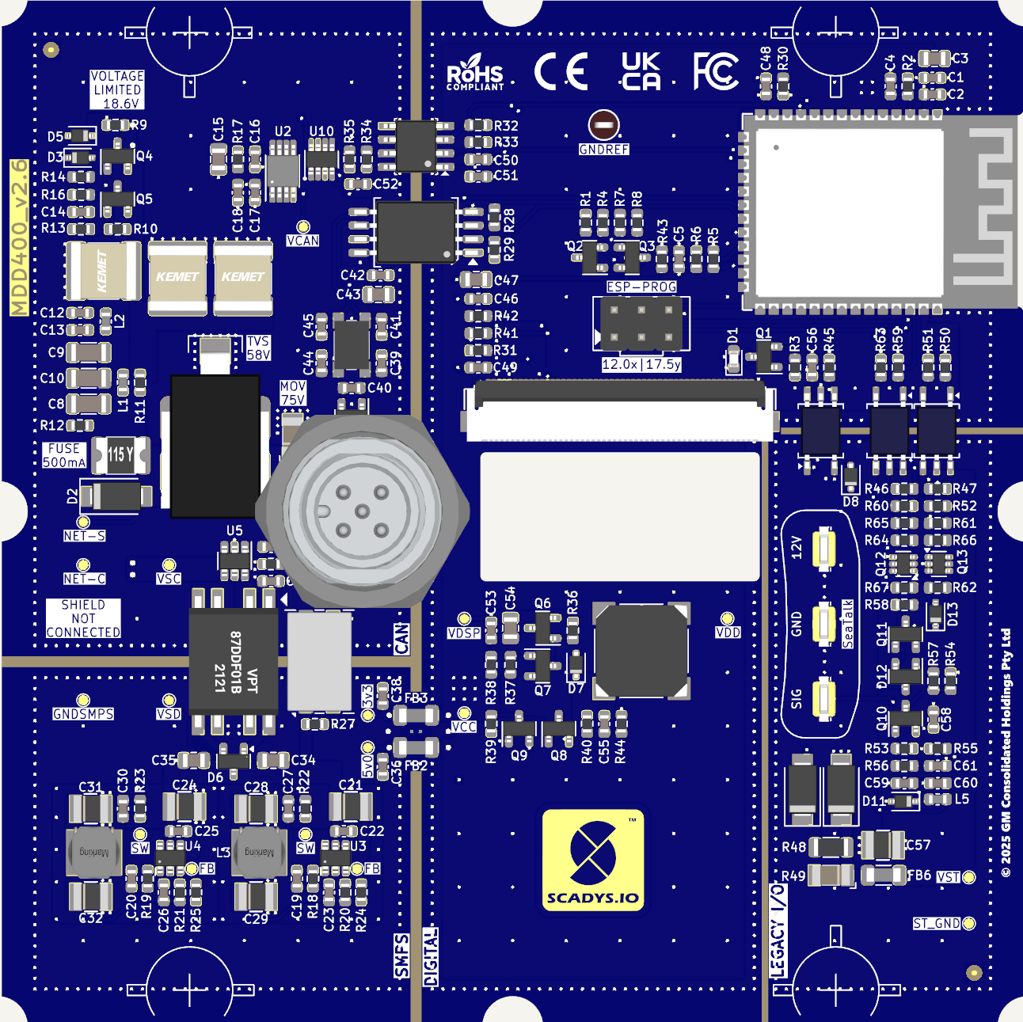
CAN
Domain
DIGITAL
Domain (3.3V)
LEGACY IO Domain
SMPS
Domain
DIGITAL Domain (5V)
MDD400 Functional Domains

Slide 4
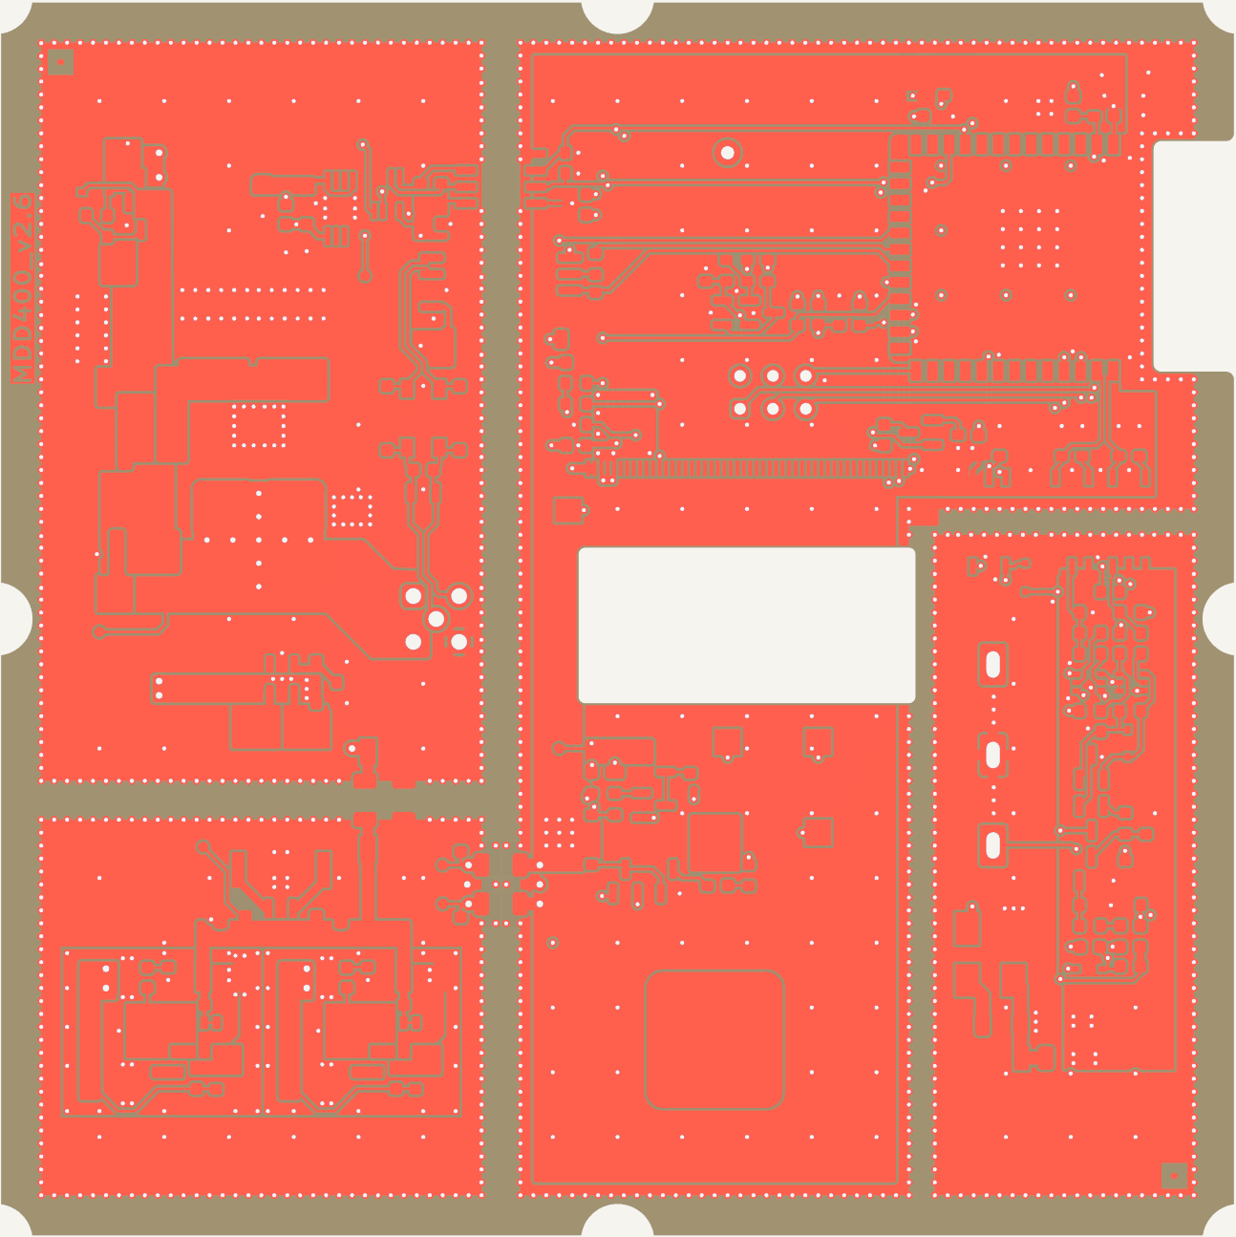
MDD400 Isolation Domains
CAN
Domain
DIGITAL
Domain (3.3V)
Opto-isolators
LEGACY IO Domain
12V Transformer
Ferrites
DIGITAL Domain (5V)
SMPS
Domain

Slide 5
MDD400 Functional Block Diagram
5v5 SMPS (VPP)
DC-DC Converter
Power Isolation (VPP : VSS)
5 V DC Isolation Transformer
3v3 SMPS (VPP)
DC-DC Converter
CAN bus
Isolated CAN Transceiver
3.3 V Domain (VCC)
MCU and sensors
NET-S
Transient and ESD
5 V Domain (VSS)
Display and Buzzer
SeaTalk / NMEA 0183
Isolated Serial Interface

Slide 6
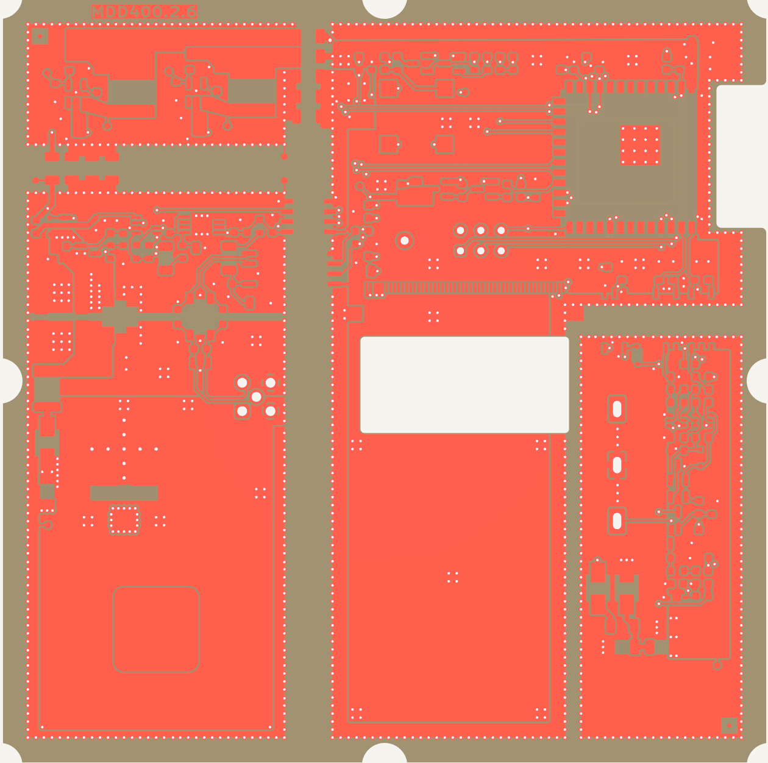
MDD400 Ground Planes
GNDSMPS
DC-DC converter ground refrerence
GNDREF
Digital domain signal ground reference
Ferrites
Ferrites
GNDC
Filtered CAN ground reference
CM Choke
(12V)
CM Choke
(CAN)
Opto-isolators
NET-C
NMEA 2000 Ground
GNDST
SeaTalk / NMEA 0183 Ground
Display FFC Cutout

Slide 7
Thermal Management
3.3V SMPS
ESP-32
5.5V SMPS
TEMPERATURE SENSOR
SM8S36CA TVS
(6.6kW)

Slide 8
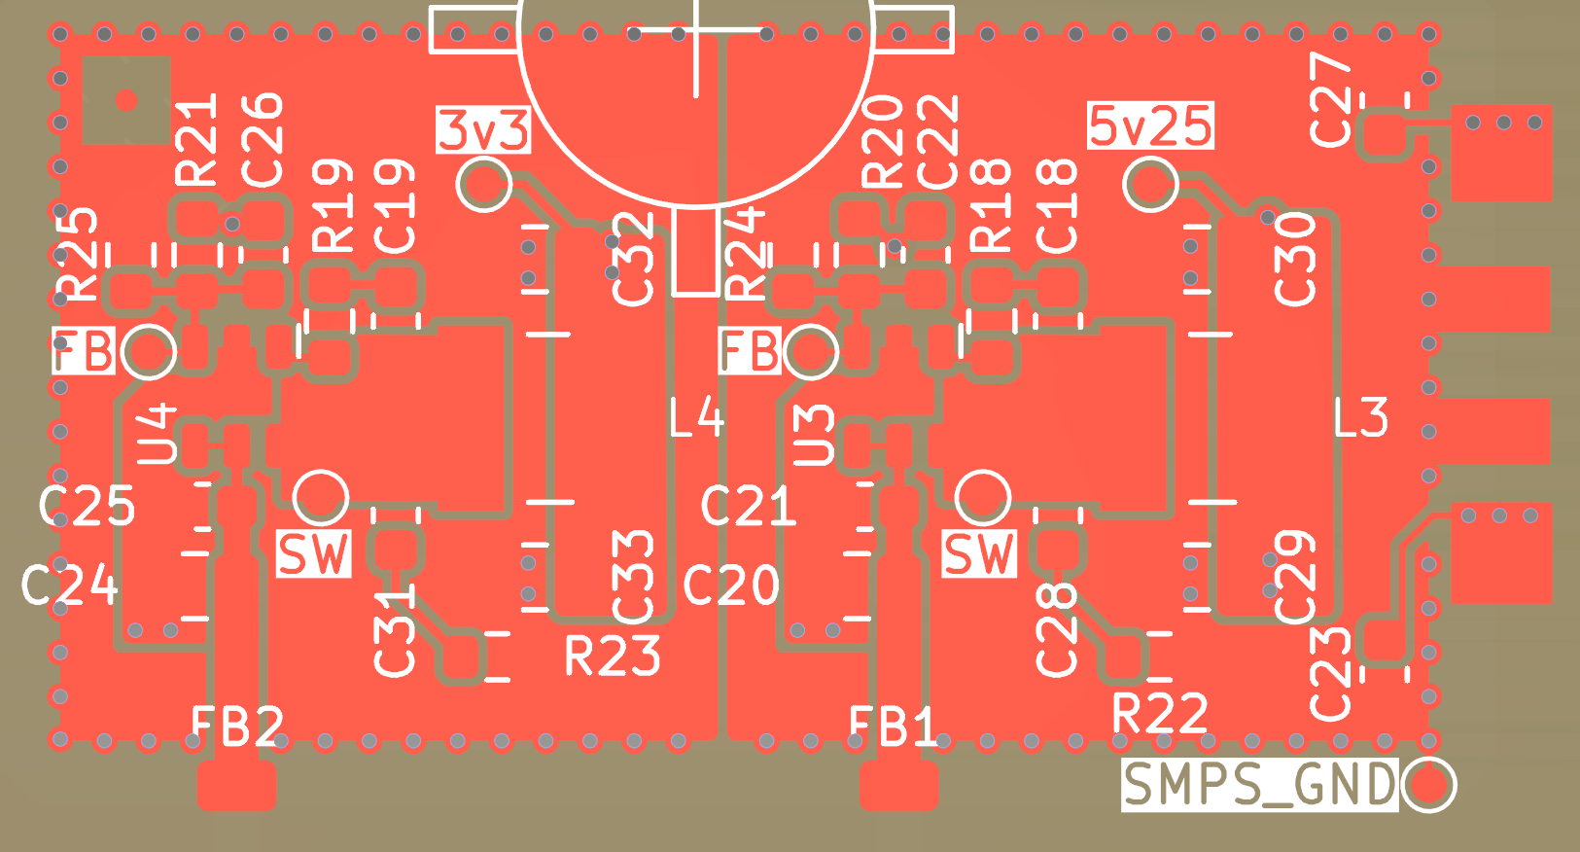
SMPS Ground Plane and Layout
Ferrites

Slide 9
Shaped Waveform at 2kHz
Ferrites

