Slide 2


Slide 4
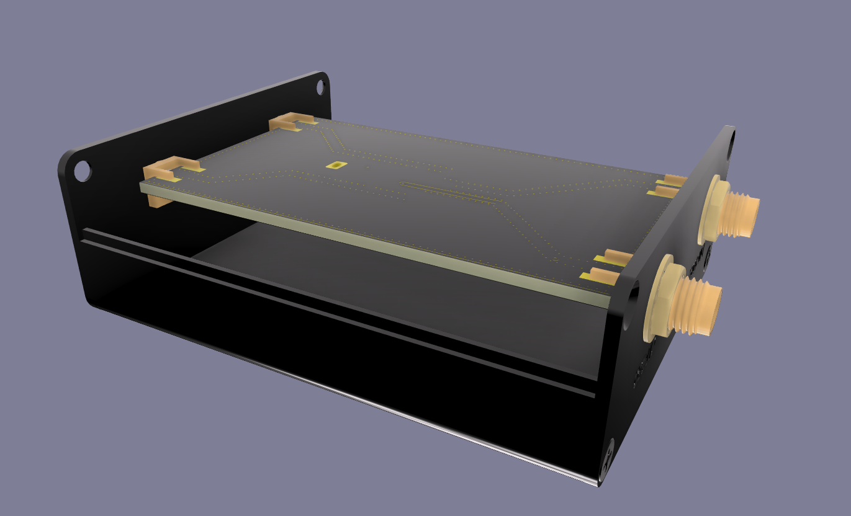
Solder SMA
Connectors

Slide 5
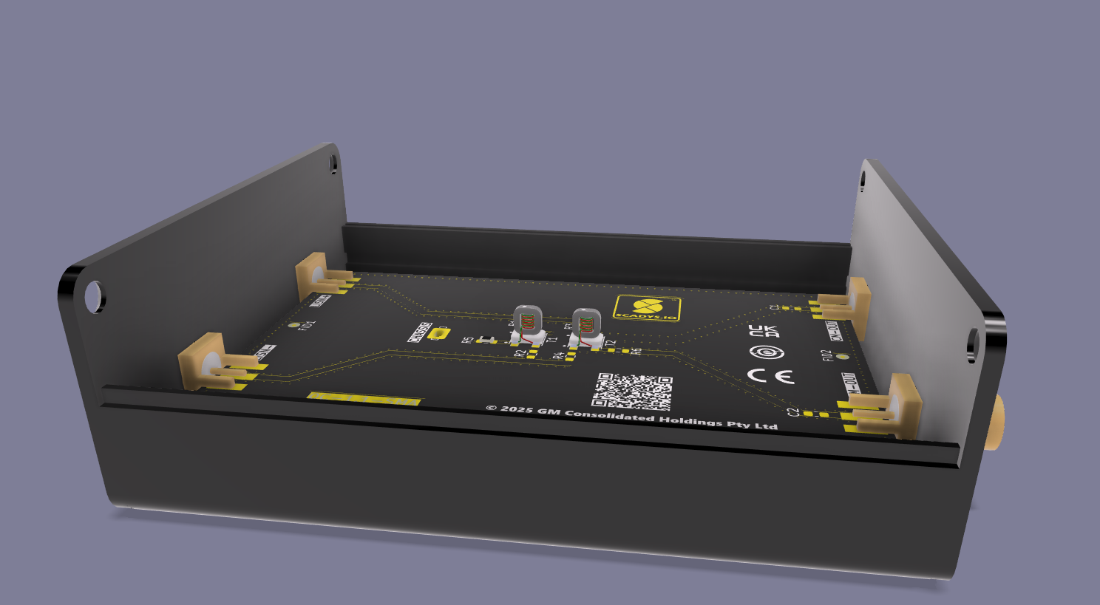
Solder SMA
Connectors

