Slide 1
Experiment
2026년 07월 22일
Sunghyun Lee
Department of Computer Engineering

Slide 2
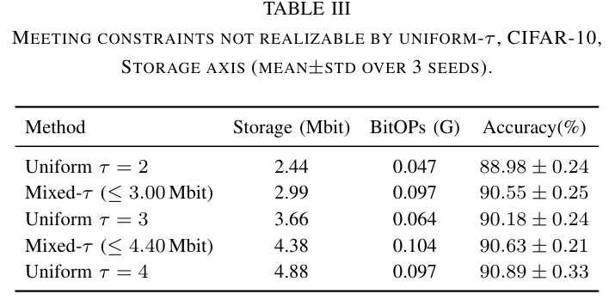
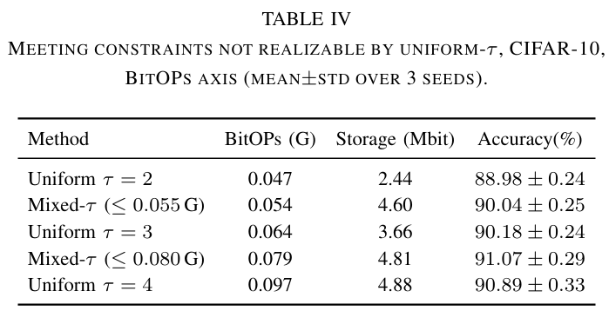
Meeting constraints not realizable by uniform-$τ$

