Slide 1
Figure Overview
2026년 07월 29일
Sunghyun Lee
Department of Computer Engineering

Slide 2
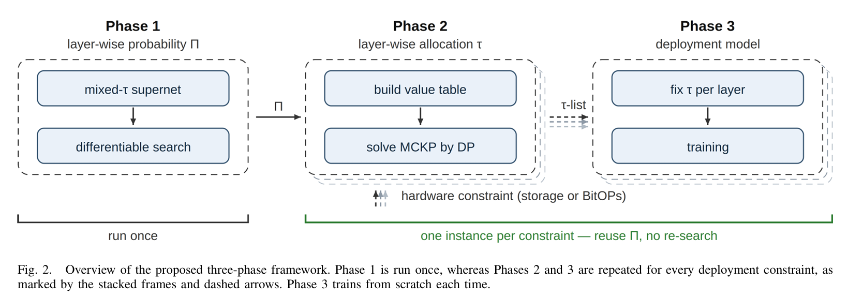
Figure overview

Slide 3
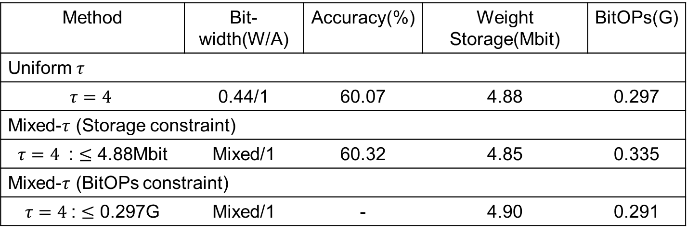
ImageNet
Method | Bit-width(W/A) | Accuracy(%) | Weight Storage(Mbit) | BitOPs(G)
Uniform $τ$
$τ=4$ | 0.44/1 | 60.07 | 4.88 | 0.297
Mixed-$τ$ (Storage constraint)
$τ=4$ : $≤$ 4.88Mbit | Mixed/1 | 60.32 | 4.85 | 0.335
Mixed-$τ$ (BitOPs constraint)
$τ=4$: $≤$ 0.297G | Mixed/1 | - | 4.90 | 0.291

