Slide 1
Table 6
2026년 08월 12일
Sunghyun Lee
Department of Computer Engineering

Slide 2
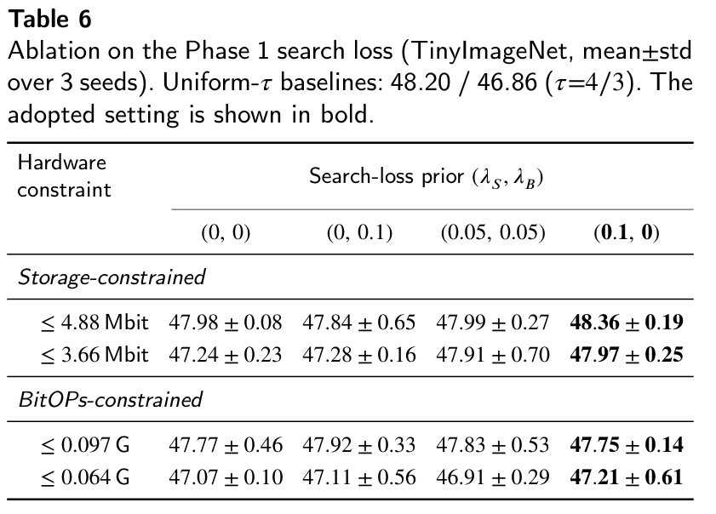
Table 6

Slide 3
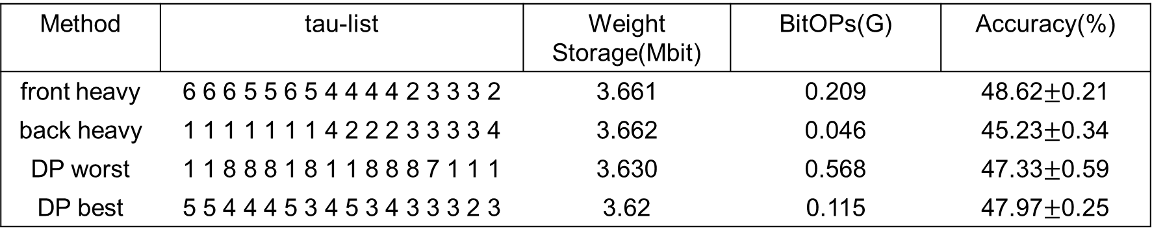

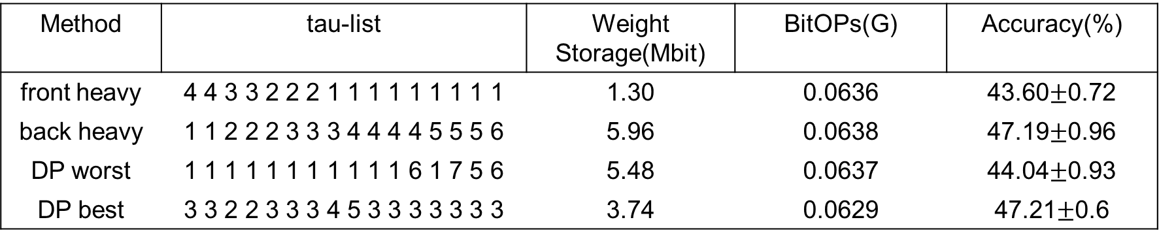
Why allocation must be searched, not guessed
기준 : uniform tau=3 ( Storage=3.66Mbit, BitOPs=0.064G) 46.86$±$0.32%
storage constraint
Method | tau-list | Weight Storage(Mbit) | BitOPs(G) | Accuracy(%)
front heavy | 6 6 6 5 5 6 5 4 4 4 4 2 3 3 3 2 | 3.661 | 0.209 | 48.62$±$0.21
back heavy | 1 1 1 1 1 1 1 4 2 2 2 3 3 3 3 4 | 3.662 | 0.046 | 45.23$±$0.34
DP worst | 1 1 8 8 8 1 8 1 1 8 8 8 7 1 1 1 | 3.630 | 0.568 | 47.33$±$0.59
DP best | 5 5 4 4 4 5 3 4 5 3 4 3 3 3 2 3 | 3.62 | 0.115 | 47.97$±$0.25
bitops constraint
Method | tau-list | Weight Storage(Mbit) | BitOPs(G) | Accuracy(%)
front heavy | 4 4 3 3 2 2 2 1 1 1 1 1 1 1 1 1 | 1.30 | 0.0636 | 43.60$±$0.72
back heavy | 1 1 2 2 2 3 3 3 4 4 4 4 5 5 5 6 | 5.96 | 0.0638 | 47.19$±$0.96
DP worst | 1 1 1 1 1 1 1 1 1 1 1 6 1 7 5 6 | 5.48 | 0.0637 | 44.04$±$0.93
DP best | 3 3 2 2 3 3 3 4 5 3 3 3 3 3 3 3 | 3.74 | 0.0629 | 47.21$±$0.6

