Slide 1
Experimnet 4
2026년 08월 19일
Sunghyun Lee
Department of Computer Engineering

Slide 2
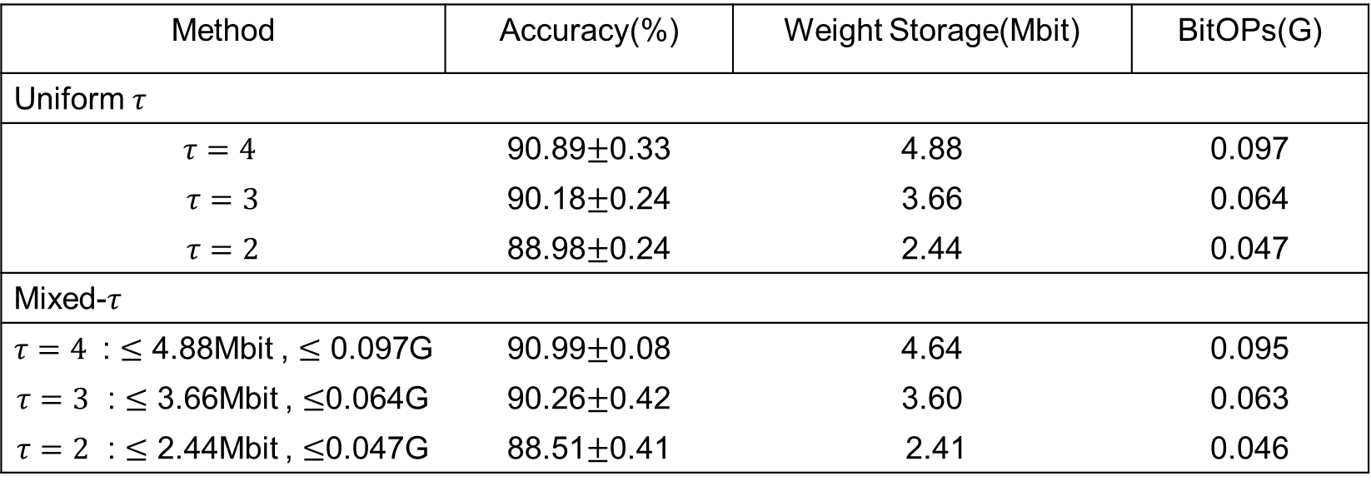
Experiment 4
CIFAR-10
Method | Accuracy(%) | Weight Storage(Mbit) | BitOPs(G)
Uniform $τ$
$τ=4$ | 90.89$±$0.33 | 4.88 | 0.097
$τ=3$ | 90.18$±$0.24 | 3.66 | 0.064
$τ=2$ | 88.98$±$0.24 | 2.44 | 0.047
Mixed-$τ$
$τ=4$ : $≤$ 4.88Mbit , $≤$ 0.097G | 90.99$±$0.08 | 4.64 | 0.095
$τ=3$ : $≤$ 3.66Mbit , $≤$0.064G | 90.26$±$0.42 | 3.60 | 0.063
$τ=2$ : $≤$ 2.44Mbit , $≤$0.047G | 88.51$±$0.41 | 2.41 | 0.046

Slide 3
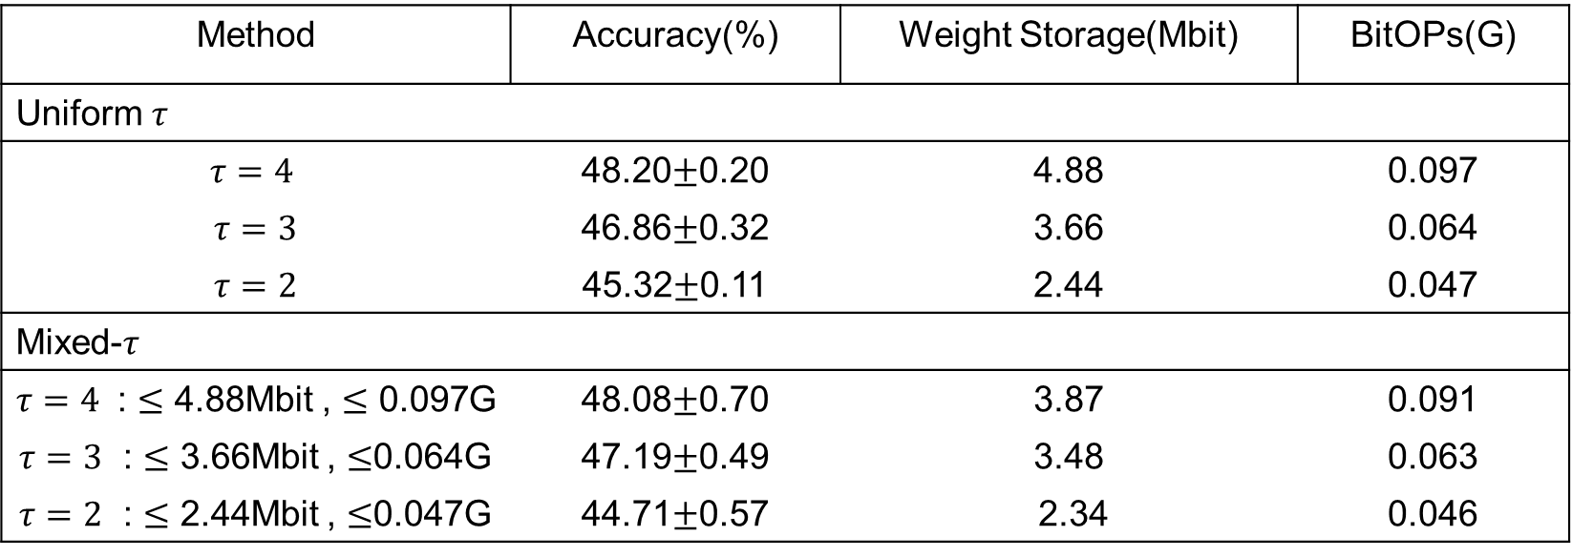
Experiment 4
TinyImagenet
Method | Accuracy(%) | Weight Storage(Mbit) | BitOPs(G)
Uniform $τ$
$τ=4$ | 48.20$±$0.20 | 4.88 | 0.097
$τ=3$ | 46.86$±$0.32 | 3.66 | 0.064
$τ=2$ | 45.32$±$0.11 | 2.44 | 0.047
Mixed-$τ$
$τ=4$ : $≤$ 4.88Mbit , $≤$ 0.097G | 48.08$±$0.70 | 3.87 | 0.091
$τ=3$ : $≤$ 3.66Mbit , $≤$0.064G | 47.19$±$0.49 | 3.48 | 0.063
$τ=2$ : $≤$ 2.44Mbit , $≤$0.047G | 44.71$±$0.57 | 2.34 | 0.046

