Slide 1
ACEv2
2026년 10월 2일
Sunghyun Lee
Department of Computer Engineering

Slide 2

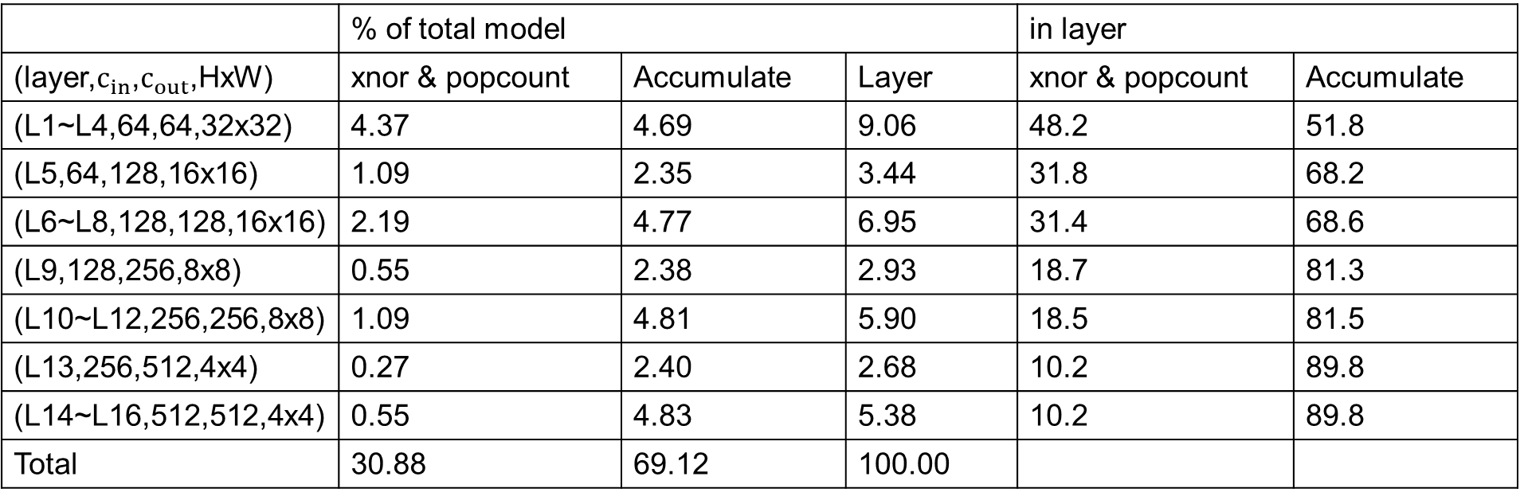
ResNet18 ACEv2
CIFAR10 & Tinyimagenet
$$τ=5$$
 | % of total model |  |  | in layer
(layer,$c_{in}$,$c_{out}$,HxW) | xnor & popcount | Accumulate | Layer | xnor & popcount | Accumulate
(L1~L4,64,64,32x32) | 4.37 | 4.69 | 9.06 | 48.2 | 51.8
(L5,64,128,16x16) | 1.09 | 2.35 | 3.44 | 31.8 | 68.2
(L6~L8,128,128,16x16) | 2.19 | 4.77 | 6.95 | 31.4 | 68.6
(L9,128,256,8x8) | 0.55 | 2.38 | 2.93 | 18.7 | 81.3
(L10~L12,256,256,8x8) | 1.09 | 4.81 | 5.90 | 18.5 | 81.5
(L13,256,512,4x4) | 0.27 | 2.40 | 2.68 | 10.2 | 89.8
(L14~L16,512,512,4x4) | 0.55 | 4.83 | 5.38 | 10.2 | 89.8
Total | 30.88 | 69.12 | 100.00

Slide 3

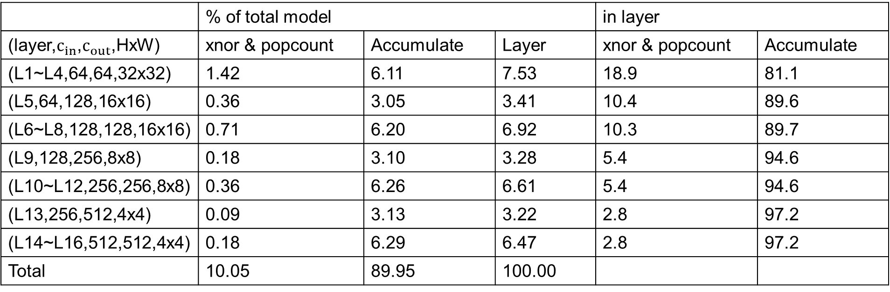
ResNet18 ACEv2
CIFAR10 & Tinyimagenet
$$τ=3$$
 | % of total model |  |  | in layer
(layer,$c_{in}$,$c_{out}$,HxW) | xnor & popcount | Accumulate | Layer | xnor & popcount | Accumulate
(L1~L4,64,64,32x32) | 1.42 | 6.11 | 7.53 | 18.9 | 81.1
(L5,64,128,16x16) | 0.36 | 3.05 | 3.41 | 10.4 | 89.6
(L6~L8,128,128,16x16) | 0.71 | 6.20 | 6.92 | 10.3 | 89.7
(L9,128,256,8x8) | 0.18 | 3.10 | 3.28 | 5.4 | 94.6
(L10~L12,256,256,8x8) | 0.36 | 6.26 | 6.61 | 5.4 | 94.6
(L13,256,512,4x4) | 0.09 | 3.13 | 3.22 | 2.8 | 97.2
(L14~L16,512,512,4x4) | 0.18 | 6.29 | 6.47 | 2.8 | 97.2
Total | 10.05 | 89.95 | 100.00

Slide 4
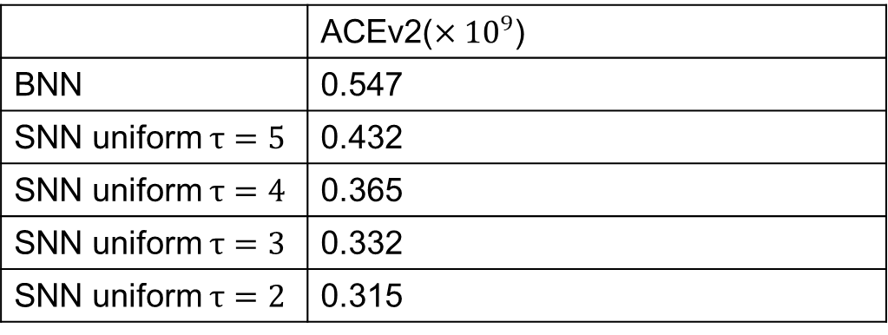
BNN vs SNN in ACEv2
 | ACEv2($×{10}^{9}$)
BNN | 0.547
SNN uniform $τ=5$ | 0.432
SNN uniform $τ=4$ | 0.365
SNN uniform $τ=3$ | 0.332
SNN uniform $τ=2$ | 0.315

