Slide 1
Weekly Review
2024년 9월 25일
Hyungdong Park
Inguk Yeo
Department of Computer Engineering

Slide 2

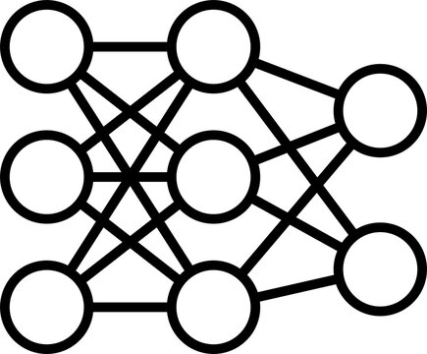
E-Hammer on DNN
DRAM
DRAM
DRAM
DRAM
Electro- Magnetic
E-Hammer
Bit-Flip Attack

Slide 3
E-Hammer on DNN
DNN Model
Ex) VGG8
Train Model
torch.save()
Test Model
Weight data type change
Write weights on DRAM
Host PC → ZCU104
torch.load()
E-Hammer on DRAM
Read weights from DRAM
ZCU104 →Host PC
Weight data type change

Slide 4
E-Hammer on DNN
DNN Model
Ex) VGG8
Train Model
torch.save()
Test Model
Weight data type change
Write weights on DRAM
Host PC → ZCU104
torch.load()
E-Hammer on DRAM
Read weights from DRAM
ZCU104 →Host PC
Weight data type change

Slide 5
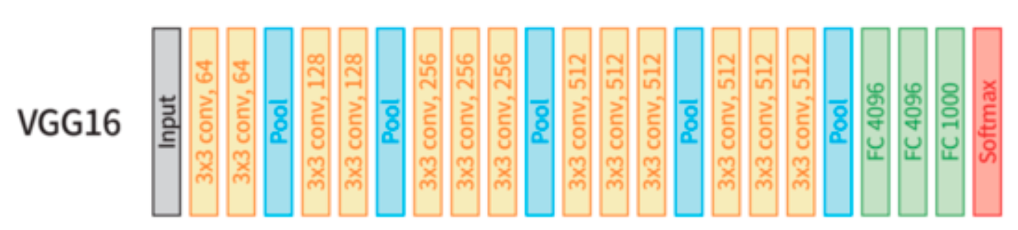
Majority Voter
VGG 16
8096
Test bed

Slide 6
Majority Voter
8096
Test bed
Test bed with Depthwise separable conv
8096
3x3 Depthwise Conv
3x3 Depthwise Conv
3x3 Depthwise Conv
3x3 Depthwise Conv

Slide 7
Majority Voter
8096
Test bed
Test bed with Depthwise separable conv
8096
3x3 Conv binarized
3x3 Conv binarized
3x3 Conv binarized
3x3 Conv binarized

Slide 8
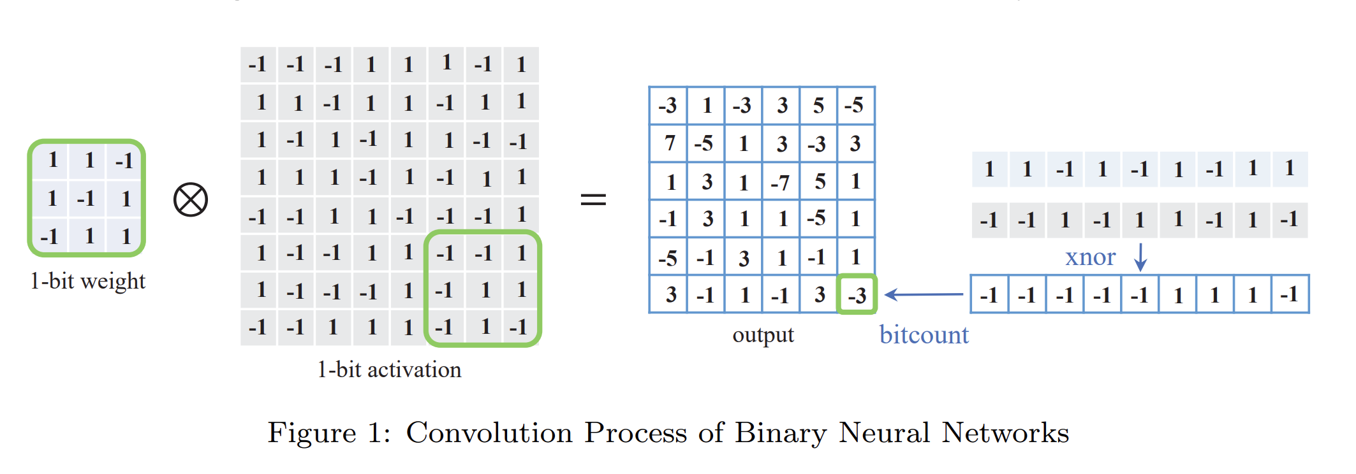
Majority Voter
Majority Voter

